Slide 1
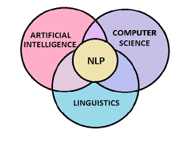
Text Classification
Named Entity Recognition (NER) is a subtask of information extraction that aims to identify and classify named entities mentioned in unstructured text into predefined categories, such as persons, organizations, and locations.

Slide 2
Machine Translation

Slide 3
Tokenization Techniques
Machine Translation is the task of automatically translating text from one language to another using computational methods. It has applications in cross-language information retrieval, multilingual communication, and localization.
Tokenization is the process of breaking down text into smaller units, such as words or phrases, for analysis. It is a fundamental step in many NLP tasks, including named entity recognition and language modeling.

Slide 4
Named Entity Recognition

Slide 5
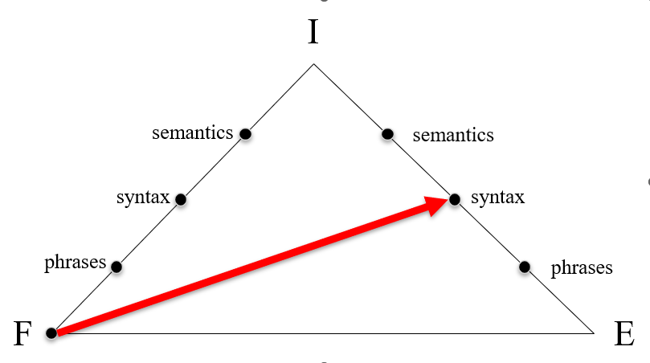
Word Embeddings
Word Embeddings are dense vector representations of words in a continuous vector space. They capture semantic relationships between words and are used in various NLP tasks, such as word similarity, document clustering, and sentiment analysis.

Slide 6
Sentiment Analysis
Text Generation is the task of generating human-like text based on patterns learned from a dataset. It has applications in chatbots, virtual assistants, and content creation.

Slide 7
Sentiment Analysis
• Text Analysis
• Tokenization
• Natural Language Understanding
• Text Mining

