Slide 1

ANDY’S ROOM: NO ESCAPE
La Banda de Patio - 2025/2026

Slide 2
1. THE TEAM
José Doñate Maset -
Cristian Rivero Llacer -
Nerea Herrero Jímenez -
Xiaowei Hu -

Slide 3
2. GAME CONCEPT
GAMEPLAY EXPERIENCE
The game is an FPS based on the film Toy Story and features a cartoony style. You take control of Woody the cowboy to retake control of Andy's room from the evil Buzz Lightyear and his troops. You must use your weapons to fight and defeat Buzz Lightyear’s forces.
OBJECTIVES
The objective of the game is to defeat waves of enemies. With the coins you earn, you can either buy standard upgrades right away or save up for the bigger ones. You can play as many rounds as you want; the main goal is to score as many points as possible and survive for as long as you can.

Slide 4
3. STORYLINE & PROGRESS
SYNOPSIS
The narrative of the game is that, in this universe, Buzz Lightyear is evil and wants to take over Andy’s room for his father, Emperor Zurg. Against all odds, our favorite cowboy, Woody, with his hat and all his bravery, tries to defeat Buzz’s army. In the end, Woody cannot defeat Buzz because his army is so vast that a lone cowboy cannot compete against it.
STRUCTURE AND PROGRESSION
When you kill an enemy, it drops a coin. At the end of each round, there’s a shop where you can buy upgrades for your character. To survive later rounds, you need to choose the upgrades that best suit your playstyle in order to progress through the game and unlock the best weapons.

Slide 5
4. TARGET AUDIENCE
GENERAL TARGET
The game’s main target audience is teenagers and young adults, around the ages of 16–20. It’s a casual experience without complex mechanics. It is aimed at people who enjoy shooters and grew up with Toy Story, and who would like to see a twist on the film.
BARTLE TAXONOMY
The two types of players who would enjoy our game are Killers and Achievers. Killers are the primary audience, as the core mechanic revolves around defeating enemies and achieving high scores in each run. Achievers would also enjoy the game, as they are driven by progression through the shop, advancing through rounds, and setting new personal records.

Slide 6
5. REFERENCES
In terms of mechanical references, the game is wave-based, so the two main inspirations that came to mind were Call of Duty: Zombies and the 2D game Vampire Survivors, as both feature core mechanics centered around waves and upgrades. Call of Duty: Zombies is also a reference because it is an FPS.
In terms of thematic references, the main and only one is, as is obvious, the Pixar film Toy Story, which is also reflected in the game.

Slide 7
6. PLAYER CHARACTER
NARRATIVE AND CONCEPT
Our protagonist, as previously mentioned, is the cowboy Woody. He is a toy with bright colors, wearing a hat, boots, and a full classic cowboy outfit. His motivation is to defend the other toys, and his goal is to defeat Buzz Lightyear. As seen in the movie, Woody is a toy that was given to Andy and now lives in his room with the other toys.
The main appeal of the character is that he comes from a movie and has a lot of personality. He is appealing to most people, but especially to those who grew up with the film.
ABILITIES AND MECHANICS
The only playable character is Woody, who can move and jump, abilities that can be upgraded in the shop throughout the game loop. He also has access to a variety of weapons, he starts with a simple handgun, but the rest can be unlocked in the shop. These weapons allow you to interact with the environment and NPCs.

Slide 8
7. GAME FEEL
The game feels a bit unusual because it’s based on a cartoon, and the overall setting and atmosphere follow a cartoon style. However, the gun mechanics and the enemies don’t fully match the theme, and that’s exactly what makes the game so unique. Players can experience a wide range of emotions while playing, such as nostalgia or curiosity about the game and its theme, and how well these elements connect. The scenery and the characters reflect the cartoon style, but they also tie in with the main mechanics.

Slide 9
8. GAME MECHANICS
The movement uses the classic WASD controls along with jumping, allowing the character to navigate the map and avoid enemies, which can be defeated using the weapons in your inventory. The mechanics may be simple, but as the rounds progress, you need to make the most of them to survive and handle both movement and combat at the same time to defeat tougher enemies. There are no additional mechanics, so the game is easy to understand and not too complicated for most players.

Slide 10
9. GAME ENTITIES
The player has three types of interactions: positive interactions when collecting coins dropped by defeated enemies, negative interactions with enemies (when they detect you, they shoot at you), and neutral interactions, such as the shop at the end of each round where you can buy upgrades or heal yourself.

Slide 11
10. GAME FLOW
CORE GAME LOOP The core gameplay loop is based on rounds. The player must survive each round, then buy upgrades before the next one begins. Each new round becomes more difficult, but the player also becomes stronger, continuing this cycle until they die and the loop restarts.
FLOW PILLARS When you survive a round, there is a clear indicator showing that the round has ended, along with a timer for the next one. Conversely, when you receive damage, there are visual and sound effects to provide feedback. When you die, the game transitions to a loss screen. Upon respawning, the game shows all enemies at the bottom of the screen along with a message prompting you to defeat them. The game becomes progressively more difficult as each round passes, creating a challenge for the player to survive longer or experiment with new strategies to beat the game.

Slide 12
11. UI / UX CONCEPT & HUD
MAIN MENU OF THE GAME: it has the buttons and a background with woody and the name of the game. The buttons are: play, exit and above at the right the settings (where you can adjust the volume or mute it completely, sensibility and toggle full screen).
The store: it has multiple options for upgrading

Slide 13
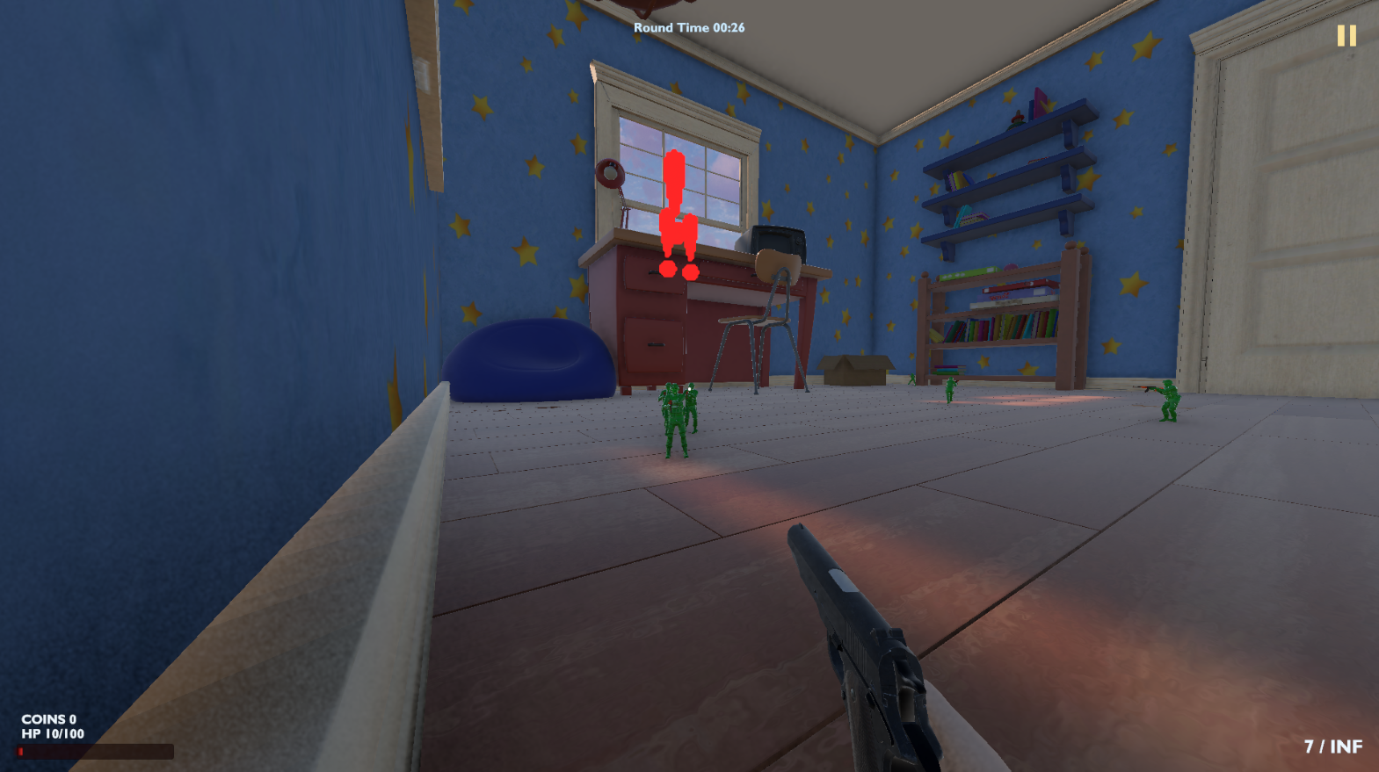
The amount of ammo
The enemies
The bar of health
Gun: there multiple ones in the game and each is shown here

Slide 14
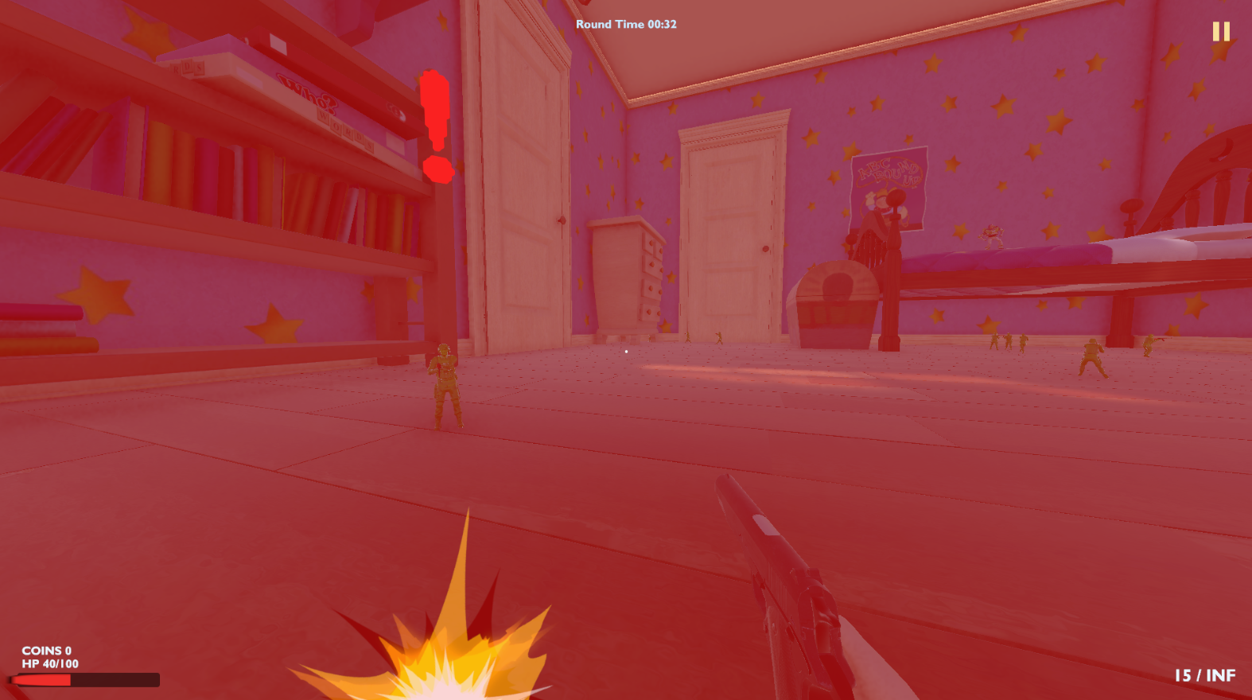
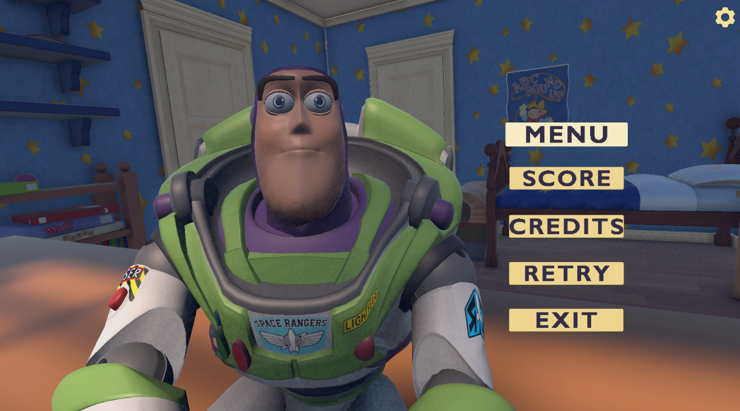
The amount of ammo
The enemies
The bar of health
Gun: there multiple ones in the game and each is shown here

Slide 15
Logo Toy Story – StickPNG
Iconos – Flaticon – Iconos8
Modelos Woody, Buzz y habitación – AgoraComunity
Animaciones y rigs- Mixamo
Canciones personalizadas – SunoAI

