Slide 1
Web Application Development Project for Educational Management
FIRST CHANGE
Nerina Peña Olivero

Slide 2
Proposed changes
Due to Mexican Government regulations, a monthly report on the following data is requested
Misconduct cases of students
Students with alcohol and drugs abuse
Indices of courses failed by students
Student dropouts
These are addition type changes

Slide 3
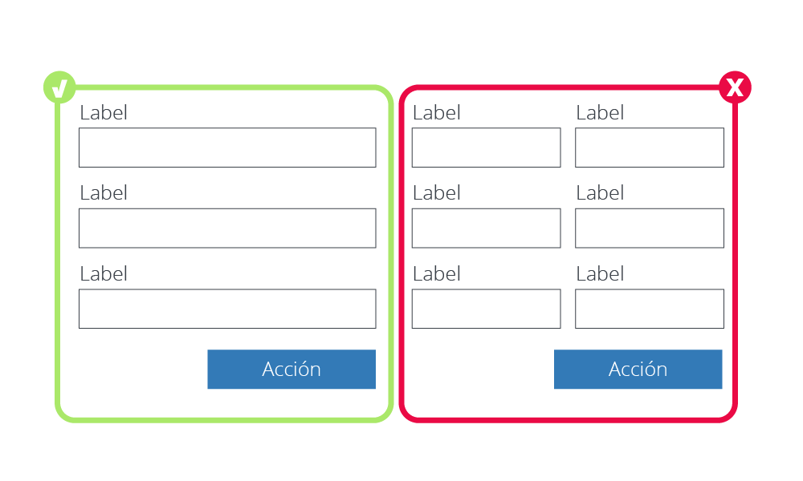
What do these changes affect?
1. Teacher Module
Teachers, being those who are in most direct contact with students, must be in charge of collecting and recording the information requested from the system
Visual interface will have to be modified
Create a form to register new data

Slide 4
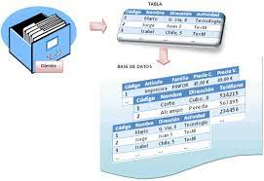
What do these changes affect?
2. Design of the database
The recorded data must be saved, so it is necessary to create a new table in the database
Add a new table
Establish relationships with existing tables

Slide 5
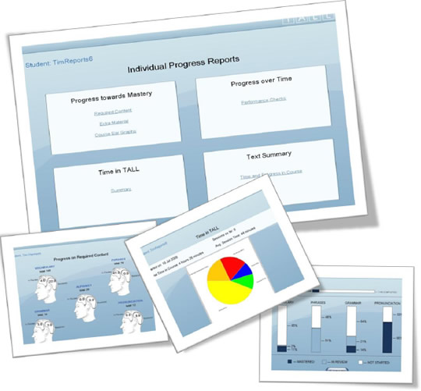
What do these changes affect?
3. Administration Module
Once the information has been collected, it is necessary to generate and distribute the report according to the policies established in the educational institution
Visual interface will have to be modified
The report must be generated
View the report, print or send by e-mail

Slide 6
Risk assessment
taking into account where the changes take effect
Assuming that only one person works on the project

Slide 7
Effort
Taking into account that the changes imply adding 3 new functional requirements, I am measuring the effort in terms of
CODE
Adding additional functionality will require writing additional code to implement the forms, database modifications, and report generation. Coding effort will increase based on the complexity of these new features and the need to integrate them with existing code
DESIGN
The design will also require additional effort, as you will have to plan how the new forms will be integrated and how reports will be presented. This involves fine-tuning the user interface, designing the layout of elements on forms, and creating a structure for reports
DOCUMENTATION
Updating documentation is key to ensuring understanding and proper maintenance of new functionality and reflecting changes. Changes made to the code, modifications to the database, analysis and design diagrams, and how reports are generated should be documented

Slide 8
Effort
The effort in coding, design and documentation will increase in proportion to the complexity of the three new functionalities. Effort in software development and engineering is measured in several ways, I took the following into account:
Work Hours (Person-Day or Person-Month): This is a basic measure in which the effort required is estimated in terms of man-hours or man-days that will be needed to complete a task.
User Story or Use Case Points: This is an agile metric where each user story or use case is scored based on its complexity and perceived effort. The sum of the points in an iteration gives an estimate of the effort required.

Slide 9
 | COLLET AND SAVE DATA | GENERATE REPORT | DISTRIBUTE REPORT | TOTAL
Work Hours | 5h | 8h | 2h | 15
Use Case Points | 3 | 3 | 2 | 8
Work Hours | 4h | 4h | 1h | 9
Use Case Points | 2 | 3 | 2 | 7
Work Hours | 6h | 2h | 2h | 10
Use Case Points | 1 | 1 | 1 | 3
Code
Design
Documentation
Use Case Points 1- minimal complexity 2-little complexity 3- medium complexity 4-maximum complexity

Slide 10
Time
Time
The total estimated time for the original project is 6 months (1440 hours)
Based on the previous effort calculation, the time to make the changes in terms of coding, design and documentation is:
34 hours
2.36%
4 days and 2 hours
Estimated time in hours including changes:
1440 + 34 = 1474 hours

Slide 11
Budget
The initial budget for the project is 113 528 MXN
Taking into account the cost of one month of scholarship, the additional budget required to make the changes was calculated.
14191 MXN
473 MXN
2010 MXN
1 MONTH
FOR 4.25 ADDITIONAL DAYS
1.77% OF THE INITIAL BUDGET
1 DAY
Total budget including changes: 115 538 mxn
Based on calculated effort and time

Slide 12

Human resources
Since the project is intended to be developed by one person, additional human resources cannot be available, and if it were possible then an additional person to occupy the role of programmer is sufficient.
2

Slide 13
Web Application Development Project for Educational Management
FIRST CHANGE
Nerina Peña Olivero

