Slide 1

Go Get Them
Gilad Weiss & Neria Tzidkani

Slide 2
What are we GOing to talk about?
Why use go?
Function declaration in C and Go
Unused imports and variables
Concurrency
Defer, Panic and Recover
; Semicolon
++/-- operator
Compilation
Function & method calls
Goto statements
Types
OOP
Inheritance
Interface
Duck typing
Pointers
Memory allocation
New vs make
Garbage collector
Tidbits

Slide 3
Why use GO?
Fast
Simple
i.e. while , foreach and for loops are spelled ‘for’.
for loops have between 0 and 2 counters. no counters is a while, one counter is a for, two counters is a simultaneous for and foreach.
Basically, a better C

Slide 4
Function declaration in C
returnType funcName (paramType paramName, … ){…}
i.e.
int foo (int* x){…}

Slide 5
Function declaration in Go
func fN (pN1 [pN2…] pT , … ) (returnType no.1 …){…}
Multiple return values!
i.e.
func sumAtois(s t string) (bool , int){ /** CODE **/ return true, someInt }
P.S. c++14 recommended function declaration syntax is similar to GO’s. Coincidence? auto sunAtois(string s, string t) -> decltype({bool , int}) {…}

Slide 6
Let’s get complex!
What is the meaning in C++ ?
void (*(*f[])())()

Slide 7
Let’s get complex!
What is the meaning in C++ ?
void (*(*f[])())()
Defines f as an array of unspecified size of pointers to functions that return pointers to functions that return void

Slide 8
Let’s get complex!
The equivalent in GO is
f := [][]func() (func() ){}
Implicit
definition and assignment
2d array
function without arguments that returns
The next token
function without arguments that returns
void
allocation

Slide 9
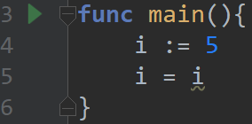
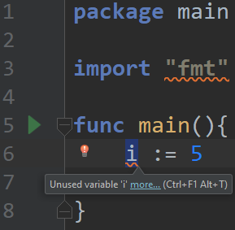
Unused import & variables
GO won’t compile your code if there is an unused import or variable
This restriction accelerates build time
A way around this restriction is to assign a variable to itself

Slide 10
Concurrency
Its always good for a programming language to have support for concurrency.
In GO, running a function in parallel is as easy as adding the word ‘go’ before a function call. These functions are called routines, and are managed by GO’s scheduler.
GO also supports communication between routines using routes called channels.

Slide 11
Defer, Panic and Recover
Defer is a function call that will occur when the program is about to exit.
If there are multiple defer calls, they will be executed in LIFO order.
The main use of defer function is to catch exceptions and release the resources that were being used when the exception occurred.

Slide 12
; Semicolon
“semicolons are for parsers, not for developers”
There are no terminating semicolons (;) in GO (in some rare cases there are, but mostly not).
In reality, semicolons are injected during the build phase to every line that can be the end of a statement.
This forces the use of Java-style code formatting, but makes the code look more pleasant overall.

Slide 13
++/-- operator
GO avoids the confusion caused by the ++ and -- operators by treating them like statements.
In C, they were treated as expressions and so things like “a = a++ + ++a” were possible.
In GO, ++ and -- are always postfix and don't return a value, so they have to appear on their own.
This is much better than Python’s approach, which is to abolish the ++ operator entirely.

Slide 14
Compilation
Thanks to its simple syntax, it’s easy to build a compiler and an intelliSense (code-completion aid) for GO.
GCC standardization.
Optimization on assembly.

Slide 15
Function & Method calls
No default arguments.
No function/operator overloading.
Ambiguous function calls can’t happen because functions can have only one signature. Overloading isn’t an option.
Why? Because the developers hate confusing code.
No nested function declaration
Anonymous functions are allowed
Positional arguments.
Variadic support (unlimited passed arguments)
Watch me: https://stackoverflow.com/a/35092570
There can be multiple arguments in both function calls and function returns.

Slide 16
Function & Method calls
Go implements stack-dynamic activation record instances, and its stack frame is built as follows:
source: src/runtime/stack.go
Stack frame layout in x86 architecture
+------------------+
| args from caller |
+------------------+ <- frame->argp
| return address |
+------------------+
| caller's BP (*) | (*) if fp_enabled && varp < sp
+------------------+ <- frame->varp
| locals |
+------------------+
| args to callee |
+------------------+ <- frame->sp

Slide 17
Goto
Goto statements are allowed, but only in the same scope

Slide 18
Types
Static & Strong.
To avoid confusion and potentially disastrous mistakes, GO does not allow implied casting. all casting must be done explicitly.

Slide 19
OOP
GO is not object oriented.
This makes the objects "feel" lighter, and also allows for more abstract code due to GO's interesting implementation of interfaces.

Slide 20
Inheritance
GO provides two features to replace class inheritance:
Embedding, which can be viewed as an automated form of composition or delegation.
Interfaces, which provide runtime polymorphism.

Slide 21
Interface
If a function returns an interface type, but that type was not instantiated, it will not be nil.
The type will always have some kind of instance, even if it contains nothing. the only way to return nil from a function is to explicitly return nil.

Slide 22
Duck Typing
Go doesn’t fully support duck typing
Interfaces in GO take the form of "duck typing".
If the object implements the functions of an interface, it can be referred to as that interface.
This means that every data-type implements the blank interface: interface{}

Slide 23
Pointers
Pointers in GO are very similar to their C counterparts, but very different in several ways:
There is no pointer arithmetic. You can’t change the address a pointer points to, except to assign a new address to it.
In C, pointers and arrays are essentially the same thing. In GO, arrays are values, and the lack of pointer arithmetic makes pointers to arrays very limited.
In C, often a null pointer is used to signify that something went wrong in a function. In GO, it is possible to return multiple values, so there is no need for a null pointer to signify errors.

Slide 24
Memory Allocation
Dynamic variables are allocated on the heap.
Static variables are allocated on the stack.
If they aren’t too big.
Big variables are allocated on the heap and are managed by the garbage collector.

Slide 25
new vs make
The new(T) function allocates zeroized storage for a new item of type T and returns its address, a value of type *T.
In GO terminology, it returns a pointer to a newly allocated zero value of type T.
The make() function, on the other hand, is a special built-in function that is used to initialize slices, maps, and channels.
make() can only be used to initialize, and that, unlike the new() function, does not return a pointer.

Slide 26
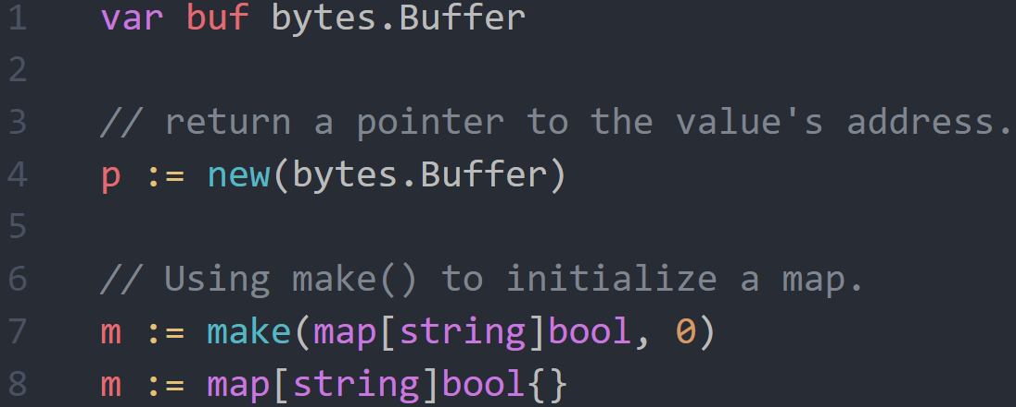
new vs make

Slide 27

Garbage Collector
GO's garbage collector uses Dijkstra’s tri-color mark & sweep algorithm.
The collector starts at the roots (globals) and works its way toward the leaves (last in the reference chain).
A write barrier runs in parallel, and watches for new allocations that connect to pointers on the heap, in case they occur during the mark phase.
Although this process is concurrent, there is a very short "Stop The World" phase to cover pointers on the stack.
usually under $μ$100 seconds, often around $μ$10 seconds.

Slide 28
Tidbits
Today, GO’s compiler is written in GO.
The very first GO compiler was written in C.
The developers hate functional-programming.
even “(cond)? s1 : s2”
Support for imports directly from GitHub repositories
Mostly, if-else-if... is translated to switch-case during compilation

Slide 29

Questions?

