Slide 1

Go Get Them
Gilad Weiss & Neria Tzidkani

Slide 2
What are we GOing to talk about?
Why Go?
Why Go is better than C
Unused imports and variables
Concurrency
Defer, Panic and Recover
; Semicolon
++/-- operator
Compilation
Function & method calls
Goto statements
Types
OOP
Inheritance
Interface
Duck typing
Pointers
Memory allocation
New vs make
Garbage collector
Tidbits

Slide 3
Why Go?
Fast
Revolutionary build time
Extensive concurrency support
Safe
Strong-type and memory managed
Simple
i.e. while , foreach and for loops are spelled ‘for’
for loops have between 0 and 2 counters. no counters is a while, one counter is a for, two counters is a simultaneous for and foreach
In short, a better C

Slide 4
Why better than C? – Here’s an example
What is the meaning in C ?
void (*(*f[])())()

Slide 5
Why better than C? – Here’s an example
What is the meaning in C ?
void (*(*f[])())()
Defines f as an array of unspecified size of pointers to functions that return pointers to functions that return void

Slide 6
Why better than C? – Here’s an example
The equivalent in Go is
f := [][]func() (func() ){}
Implicit
definition and assignment
2d array
function without arguments that returns
The next token
function without arguments that returns
void
allocation
P.S. c++14 recommended function declaration syntax is similar to Go’s. Coincidence? auto sunAtois(string s, string t) -> decltype({bool , int}) {…}

Slide 7
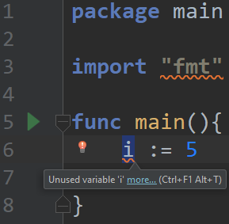
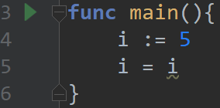
Unused import & variables
Go won’t compile your code if there is an unused import or variable
This restriction accelerates build time
A way around this restriction is to assign a variable to itself

Slide 8
Concurrency
Its always good for a programming language to have support for concurrency
In Go, running a function in parallel is as easy as adding the word ‘go’ before a function call. These functions are called routines, and are managed by Go’s scheduler
Go also supports communication between routines using routes called channels
This support means that Go is associated with the concurrent programming paradigm

Slide 9
Defer, Panic and Recover
Defer is a function call that will occur when the program is about to exit
If there are multiple defer calls, they will be executed in LIFO order
The main use of defer function is to catch exceptions and release the resources that were being used when the exception occurred

Slide 10
Defer, Panic and Recover
Panic is the equivalent of throw in C
Recover is completely different from catch in C
It can appear only in a deferred function
All the deferred functions will run in LIFO order until a recover command is reached. The recovery section will execute and the program will resume from where the panic occurred

Slide 11
; Semicolon
“ semicolons are for parsers, not for developers ”
There are no terminating semicolons (;) in Go (in some rare cases there are, but mostly not)
In reality, semicolons are injected during the build phase to every line that can be the end of a statement
This forces the use of Java-style code formatting, but makes the code look more pleasant overall

Slide 12
++/-- operator
Go avoids the confusion caused by the ++ and -- operators by treating them like statements
In C, they were treated as expressions and so things like “a = a++ + ++a” were possible
In Go, ++ and -- are always postfix and don't return a value, so they have to appear on their own
This is much better than Python’s approach, which is to abolish the ++ operator entirely

Slide 13
Compilation
Thanks to its simple syntax, it’s easy to build a compiler and an intelliSense (code-completion aid) for Go
GCC standardization
Optimization on assembly

Slide 14
Function & Method calls
No default arguments or overloading
Ambiguous function calls can’t happen because functions can have only one signature. Overloading isn’t an option
Why? Because the developers hate confusing code
No nested function declaration
Anonymous functions are allowed
Positional arguments
Variadic support (unlimited passed arguments)
Watch me: https://stackoverflow.com/a/35092570
Functions can return multiple values
Notes:
אפשר להחזיר גם פונקציה

Slide 15
Function & Method calls
Go implements stack-dynamic activation record instances, and its stack frame is built as follows:
source: src/runtime/stack.go
Stack frame layout in x86 architecture
+------------------+
| args from caller |
+------------------+ <- frame->argp
| return address |
+------------------+
| caller's BP (*) | (*) if fp_enabled && varp < sp
+------------------+ <- frame->varp
| locals |
+------------------+
| args to callee |
+------------------+ <- frame->sp

Slide 16
Goto
Goto statements are allowed, but only in the same scope
Hence, Go’s association with the structured programming paradigm

Slide 17
Types
Static & Strong
To avoid confusion and potentially disastrous mistakes, Go does not allow implied casting. all casting must be done explicitly

Slide 18
OOP
Go is not object oriented
This makes the objects "feel" lighter, and also allows for more abstract code due to Go's interesting implementation of interfaces

Slide 19
Inheritance
Go provides two features to replace class inheritance:
Embedding, which can be viewed as an automated form of composition or delegation
Interfaces, which provide runtime polymorphism

Slide 20
Interface
If a function returns an interface type, but that type was not instantiated, it will not be nil
The type will always have some kind of instance, even if it contains nothing. the only way to return nil from a function is to explicitly return nil

Slide 21
Duck Typing
Go doesn’t support duck typing
Interfaces in Go take the form of "duck typing"
If the object implements the functions of an interface, it can be referred to as that interface
This means that every data-type implements the blank interface: interface{}

Slide 22
Pointers
Pointers in Go are very similar to their C counterparts, but very different in several ways:
There is no pointer arithmetic. You can’t change the address a pointer points to, except to assign a new address to it.
In C, pointers and arrays are essentially the same thing. In Go, arrays are values, and the lack of pointer arithmetic makes pointers to arrays very limited.
In C, often a null pointer is used to signify that something went wrong in a function. In Go, it is possible to return multiple values, so there is no need for a null pointer to signify errors.

Slide 23
Memory Allocation
Dynamic variables are allocated on the heap
Static variables are allocated on the stack
If they aren’t too big
Big variables are allocated on the heap and are managed by the garbage collector

Slide 24
new vs make
The new(T) function allocates zeroized storage for a new item of type T and returns its address, a value of type *T
In Go terminology, it returns a pointer to a newly allocated zero value of type T
The make() function, on the other hand, is a special built-in function that is used to initialize slices, maps, and channels
make() can only be used to initialize, and that, unlike the new() function, does not return a pointer

Slide 25
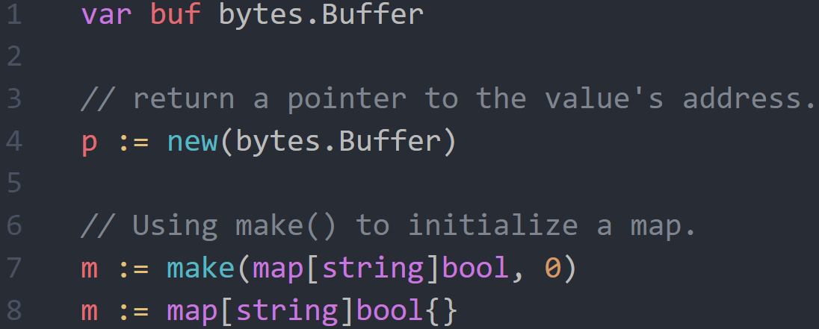
new vs make

Slide 26

Garbage Collector
Go's garbage collector uses Dijkstra’s tri-color mark & sweep algorithm
The collector starts at the roots (globals) and works its way toward the leaves (last in the reference chain)
A write barrier runs in parallel, and watches for new allocations that connect to pointers on the heap, in case they occur during the mark phase
Although this process is concurrent, there is a very short "Stop The World" phase to cover pointers on the stack.
usually under $μ$100 seconds, often around $μ$10 seconds

Slide 27
Tidbits
Today, Go’s compiler is written in Go
The very first Go compiler was written in C
The developers hate functional-programming.
even “ (cond)? s1 : s2 ”
Support for imports directly from GitHub repositories
Mostly, if-else-if... is translated to switch-case during compilation

Slide 28

Questions?

