Slide 1


PHS Rshiny Dashboard Project
Emily Noone
Neringa Siugzdinyte
Tom Wightman
Mujtaba Khider
D12-Codeclan
@P_H_S_Official

Slide 2
Public Health Scotland
Scotland’s lead national agency for improving and protecting the health and wellbeing of all of Scotland’s people.
the vision of a Scotland where everybody thrives.
there focus is on increasing healthy life expectancy and reducing premature mortality.
Bringing together Information Services Division, Health Protection Scotland and NHS Health Scotland

Slide 3
Objective:
our target in this project look at different aspects ;
Temporal: How has this issue changed over time
Geographic: How does this issue different between areas in Scotland
Demographic: Who is most affected by this issue

Slide 4
Tools were used for the project:
Zoom
Trello
Git/GitHub
R Studios

Slide 5
Our Dashbord, data and the theme
Dashbord:
Brief description of dashboard :
Our dashboard focusses on the impact that past winters have had on NHS Scotland with regards to demographics, medical centre capacity and volume of admissions.
data:
is openly sourced and can be found on the Public Health Scotland (PHS) website. The data specifically looks at acute admissions within secondary care within NHS Scotland. This consists of data from 14 health boards and over 250 individual medical centres.
theme:
for the project is to look at the trends of admissions over 5 years, with a deeper investigation on the winter of 2020 moving into 2021.

Slide 6
Result

Slide 8
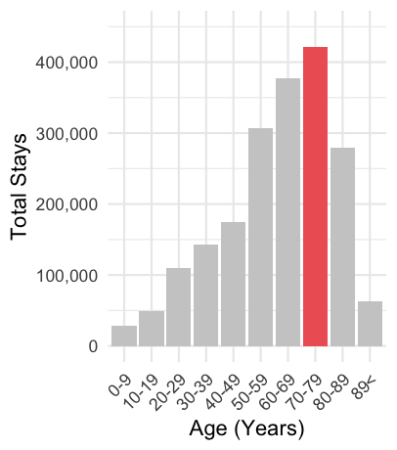
The group how lead the population age between (males -70-79)
Who is most affected by this issue:
( women)
Reasons?

