Slide 1
Crime Analysis for Neighborhoods in Vancouver

Slide 2
Why Vancouver?
Why a lot of people choose to live in Vancouver?
Beside the prices of house, what other characters should you consider?
Well, the safety!
- This Presentation will help you to find out how safety Vancouver’s Neighborhoods are.

Slide 3
Data
The crime.csv
-includes all crimes(from 2003 to 2019) reported in Vancouver.
-It also shows the detail of each crime such as: crime type, date, and Neighborhood. -This data is directly download from Kaggle
The Location.xlsx data
-combined with a list of Neighborhoods and their GPS location.
-The table is manually created by gathering data from Wikipedia.
-This data is helpful for combining crime data with the Foursquare location data.
Some useless rows and columns in crime.csv are deleted.
Neighborhoods cannot be Null in both tables.

Slide 4
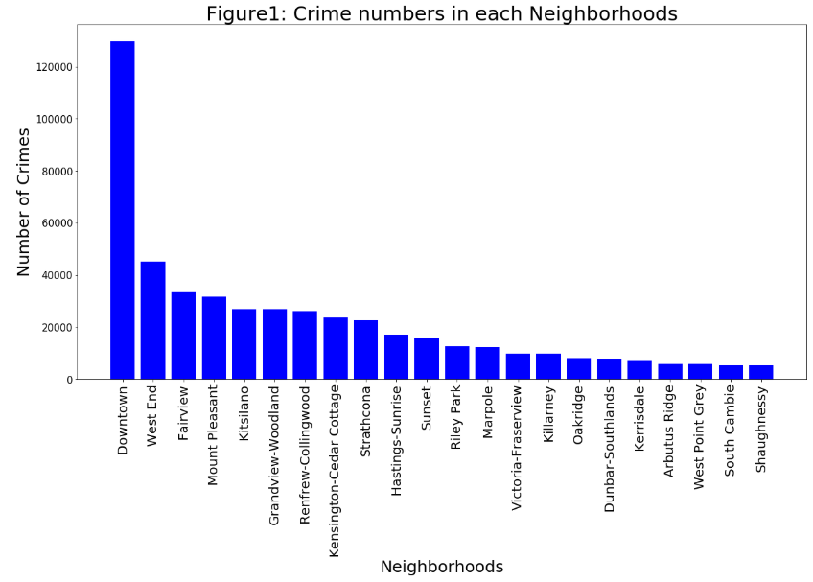
-Most of crimes are in ‘Downtown’ and ‘West End’.
-’Downtown’ has almost 5 times more crimes than other Neighborhoods.

Slide 5
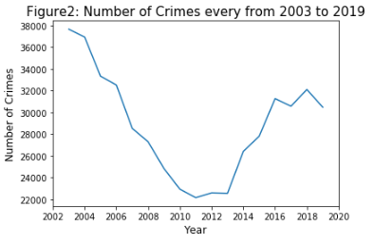

Slide 6
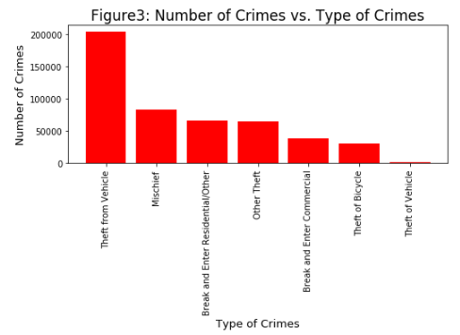

Slide 7
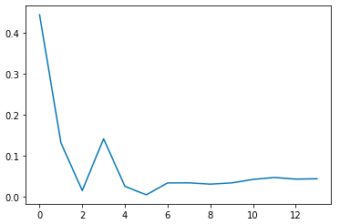
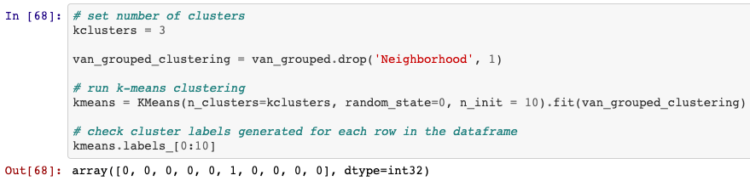
How to Cluster the Neighborhoods?
By using 'The Silhouette Method', find the optimal cluster number is 3.
Then, run Kmeans Clustering to Cluster Neighborhoods into 3 groups.

Slide 8
One Neighborhood is very different based on it’s venues categories.
-There are 85 unique venues categories in Vancouver.

Slide 9
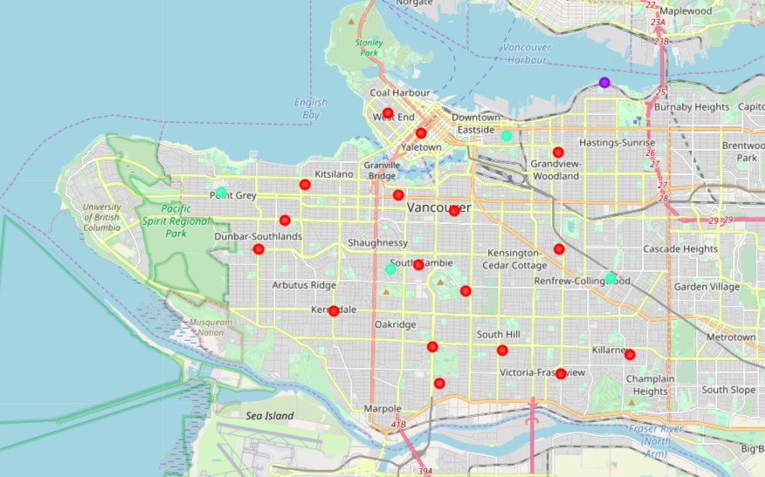
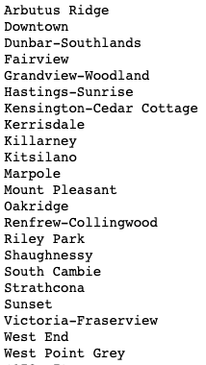
Map of Vancouver’s Neighborhoods (into 3 clusters)

Slide 10
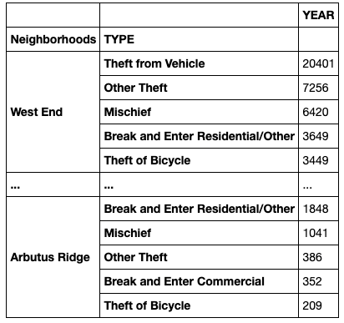

Slide 11
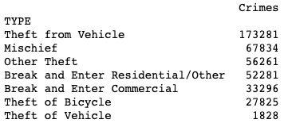
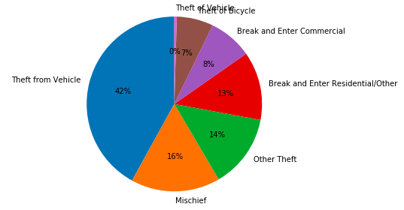
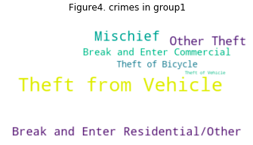
The First Group

Slide 12
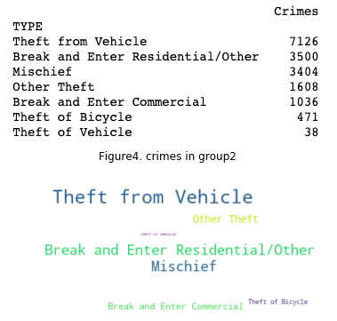
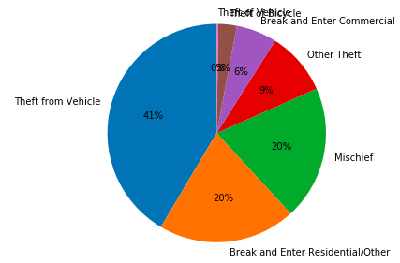
The second group

Slide 13
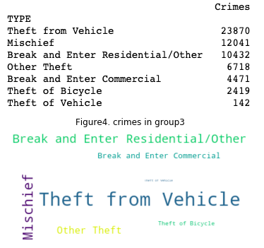
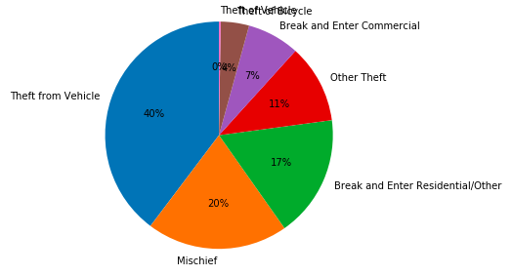
The third group

Slide 14
Resources
https://www.kaggle.com/agilesifaka/vancouver-crime-report

