Slide 1
Hemming net and competition-base networks
Harel Weinberg, Neriya Filber

Slide 2
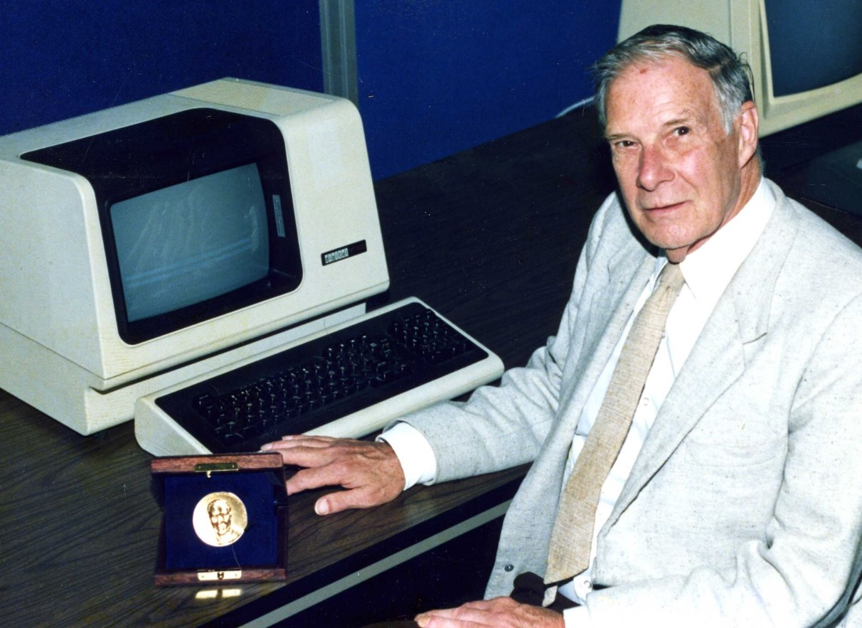
RICHARD W. HAMMING
Richard W. Hamming was born and lived from 1915 to 1998 in the United States.
He was a mathematician and engineer during his life.
He invented the Hamming Net in 1988.

Slide 3
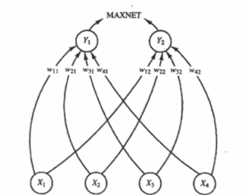
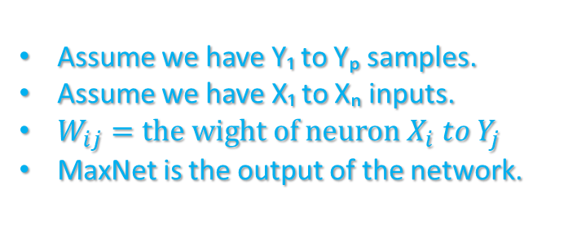
Hemming net architecture
Assume we have Y₁ to Yₚ samples.
Assume we have X₁ to Xₙ inputs.
$W_{ij}=the wight of neuron X_{i} to Y_{j}$
MaxNet is the output of the network.

Slide 4
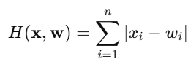


Hemming net architecture
Formula to calculate the hemming distance (mismatch) between two vectors x and w.
Formula to calculate match score between two vectors x and w (that’s the wight in the previous slide).
Formula to calculate output of the net.
K is represents the indices for all the templets

Slide 5
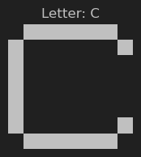
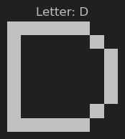
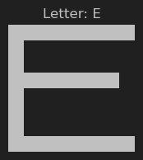
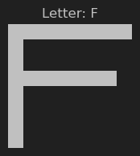


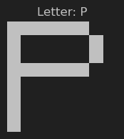
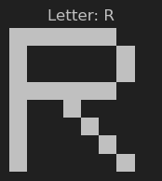
Similar letters and our data

Slide 6
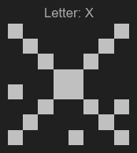
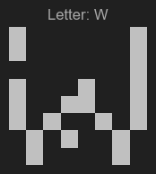
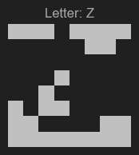
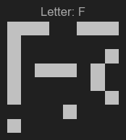
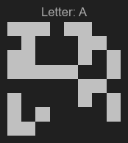
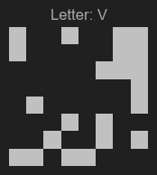
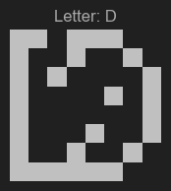
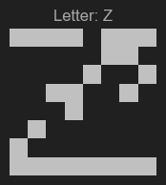
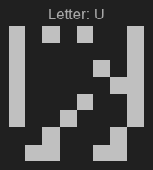
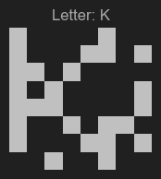
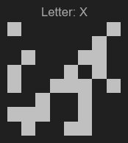
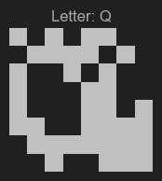
Our data with random noise:
5% noise (3 bits)
15% noise (9 bits)
25% noise (16 bits)
10% noise (6 bits)
20% noise (12 bits)
30% noise (19 bits)

Slide 7
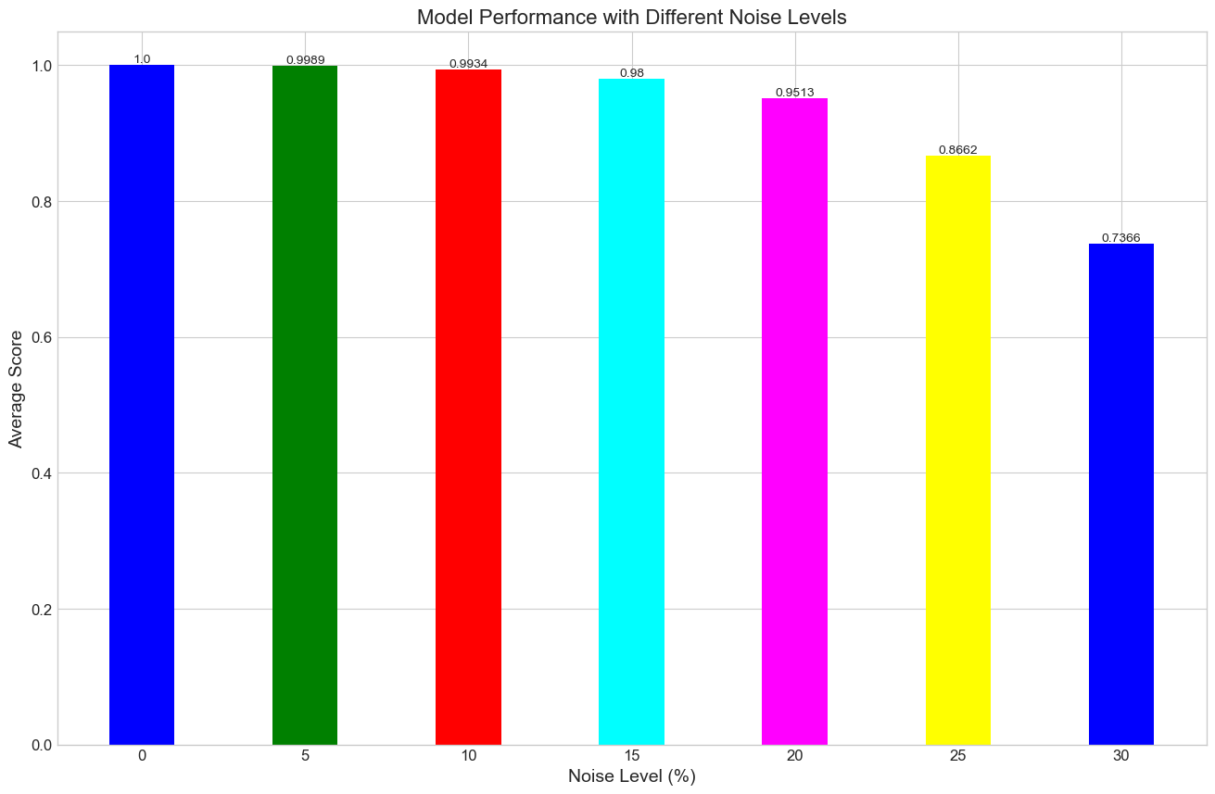
Model results over 10,000,000 samples:

Slide 8
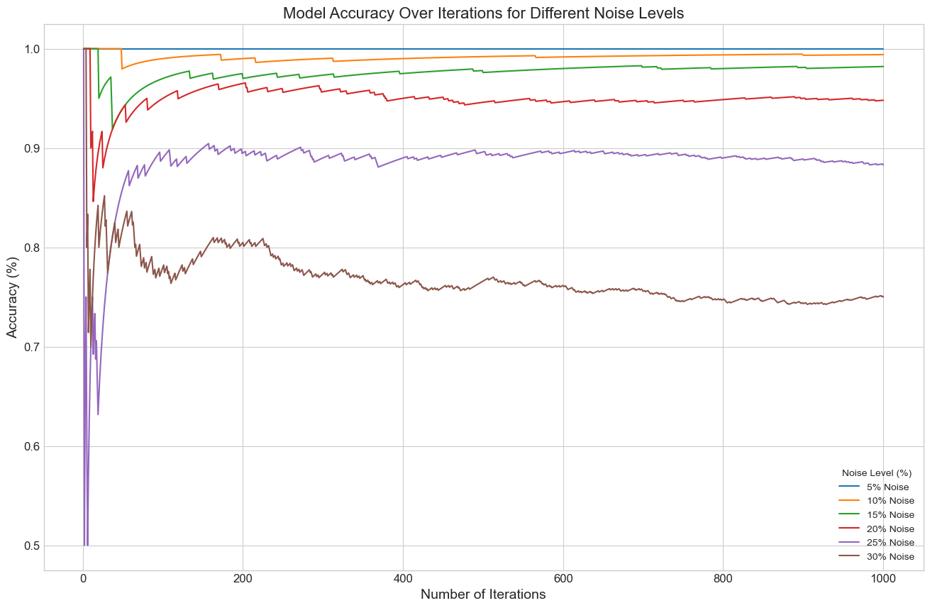
The results with small amount of samples

Slide 9
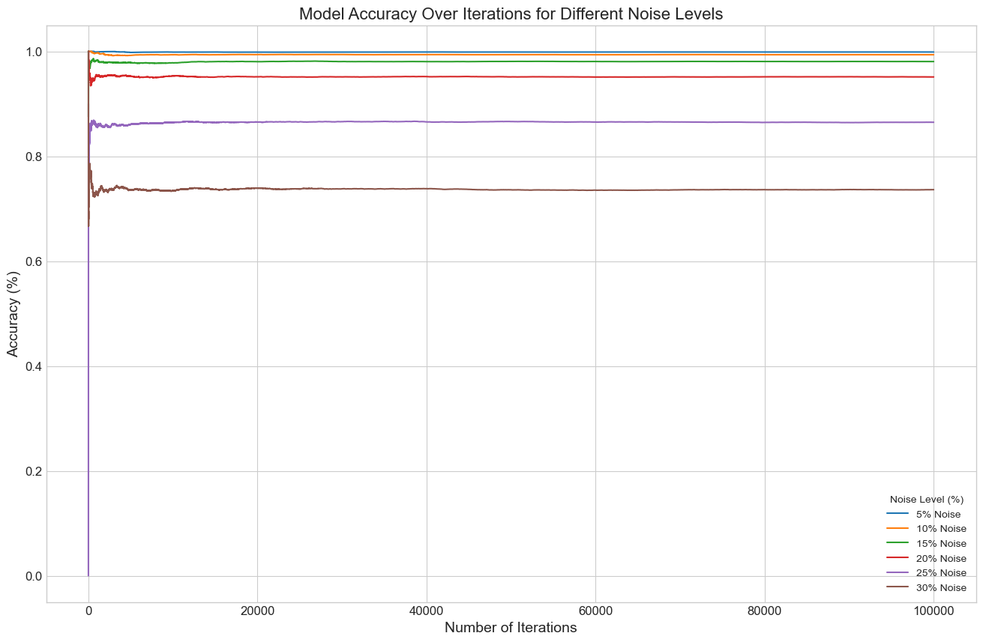
The results with large amount of samples

Slide 10

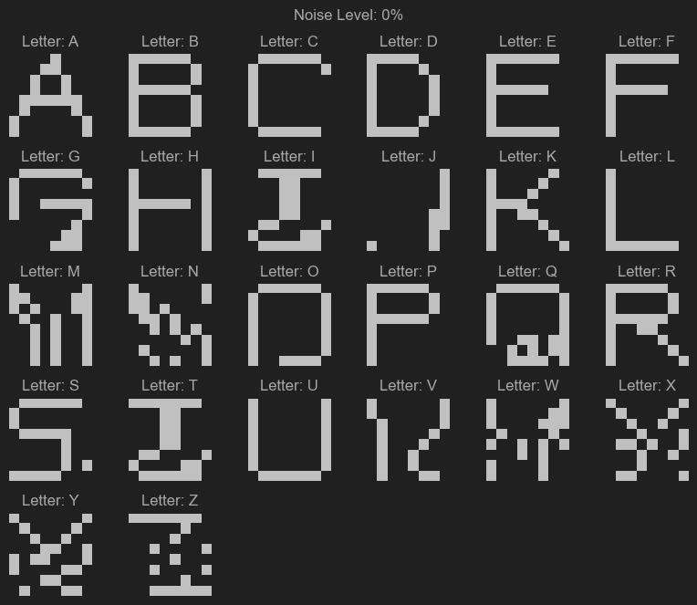
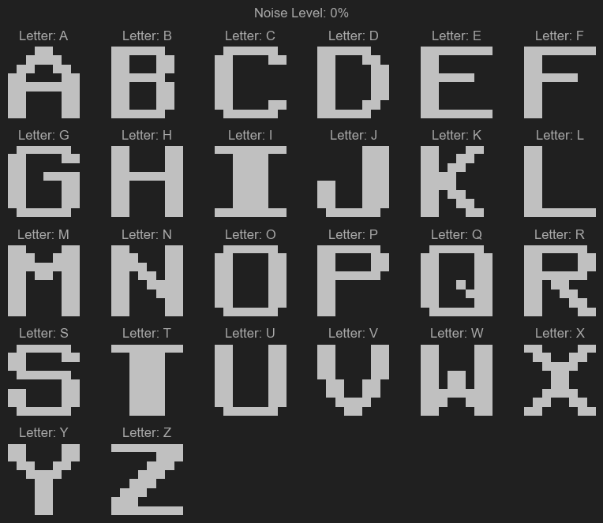
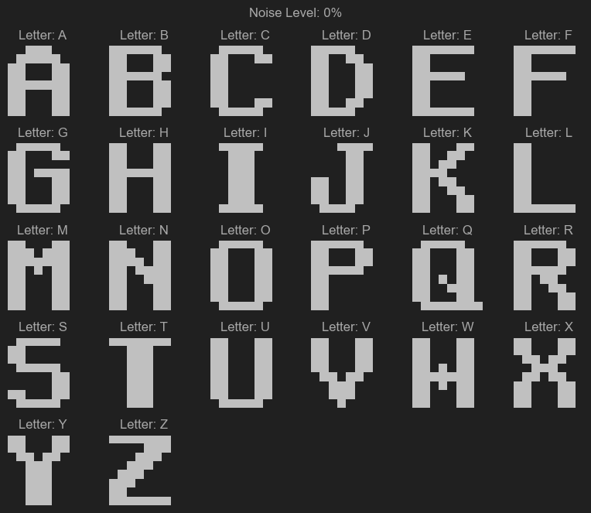
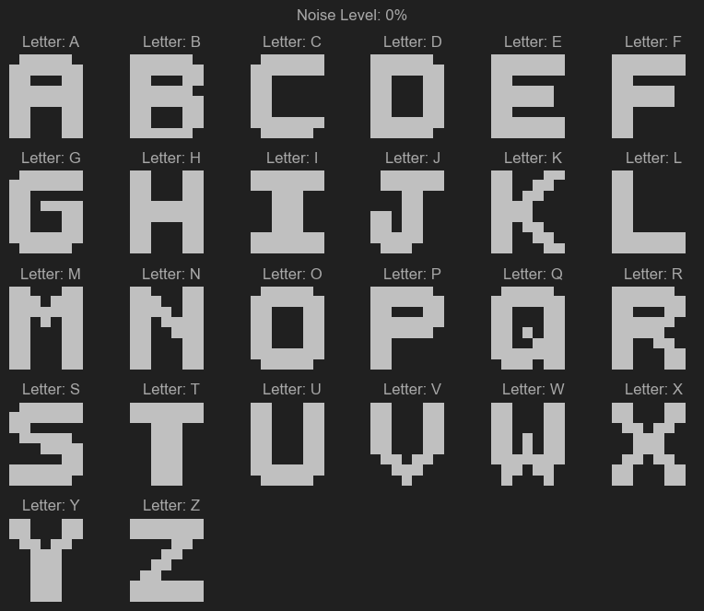
Different fonts
Font 1
Font 2
Font 3
Font 4
Original font

Slide 11
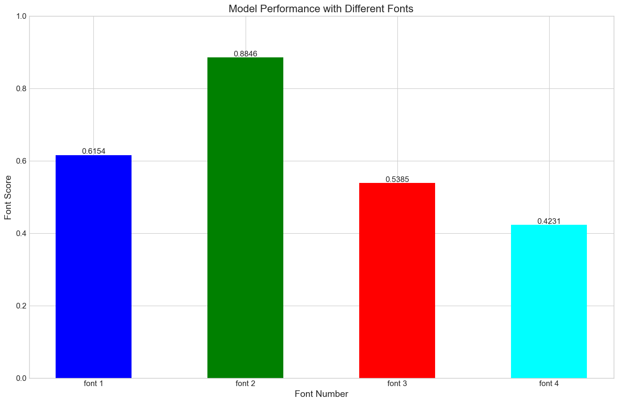
Results with different fonts:

Slide 12
Pros and cons of Hamming net
Pros
Cons
Can predict nonbinary answers
Very reliable in small percentage of noise.
Simple model implementation
Deterministic output
unsensitive to data with noise.
Can’t learn in process only in initial net.
Useless on data with a lot of noise.
Overfitting to the data he got.
Limited to binary data.

Slide 13

Questions?

