Slide 1







Manufacturing Productivity
Analyzing factory efficiency.

Slide 2







Our Team
Nermine Elsayed
Hanan Abdulrazeq
Eman Maher
Sara Farouk

Slide 3

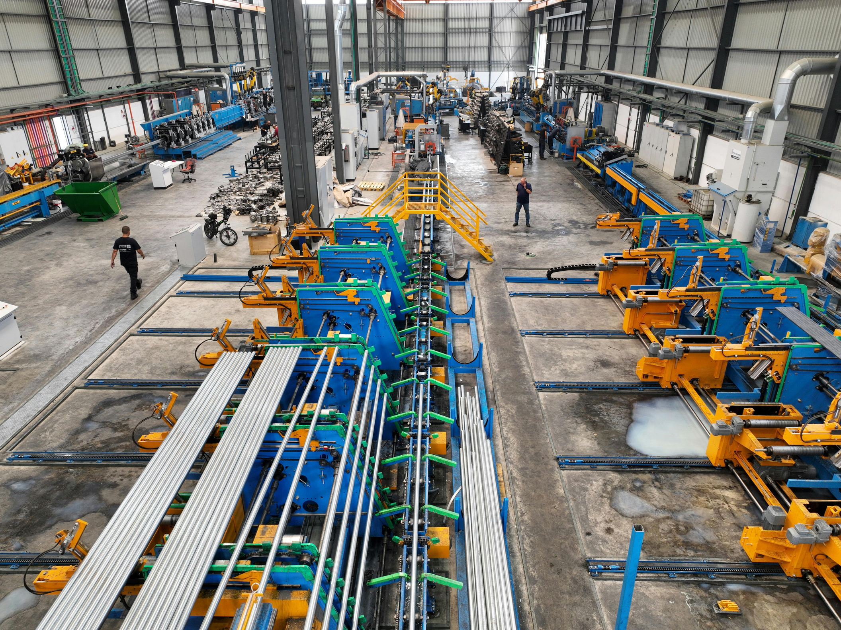

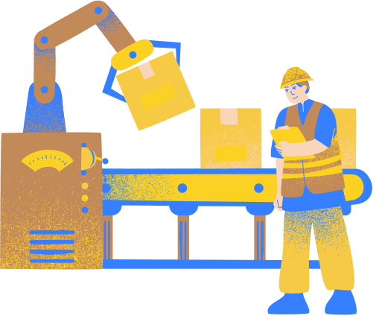
Executive Summary
Manufacturing Downtime Analysis
Insights - Forecasting - Productivity

Slide 4

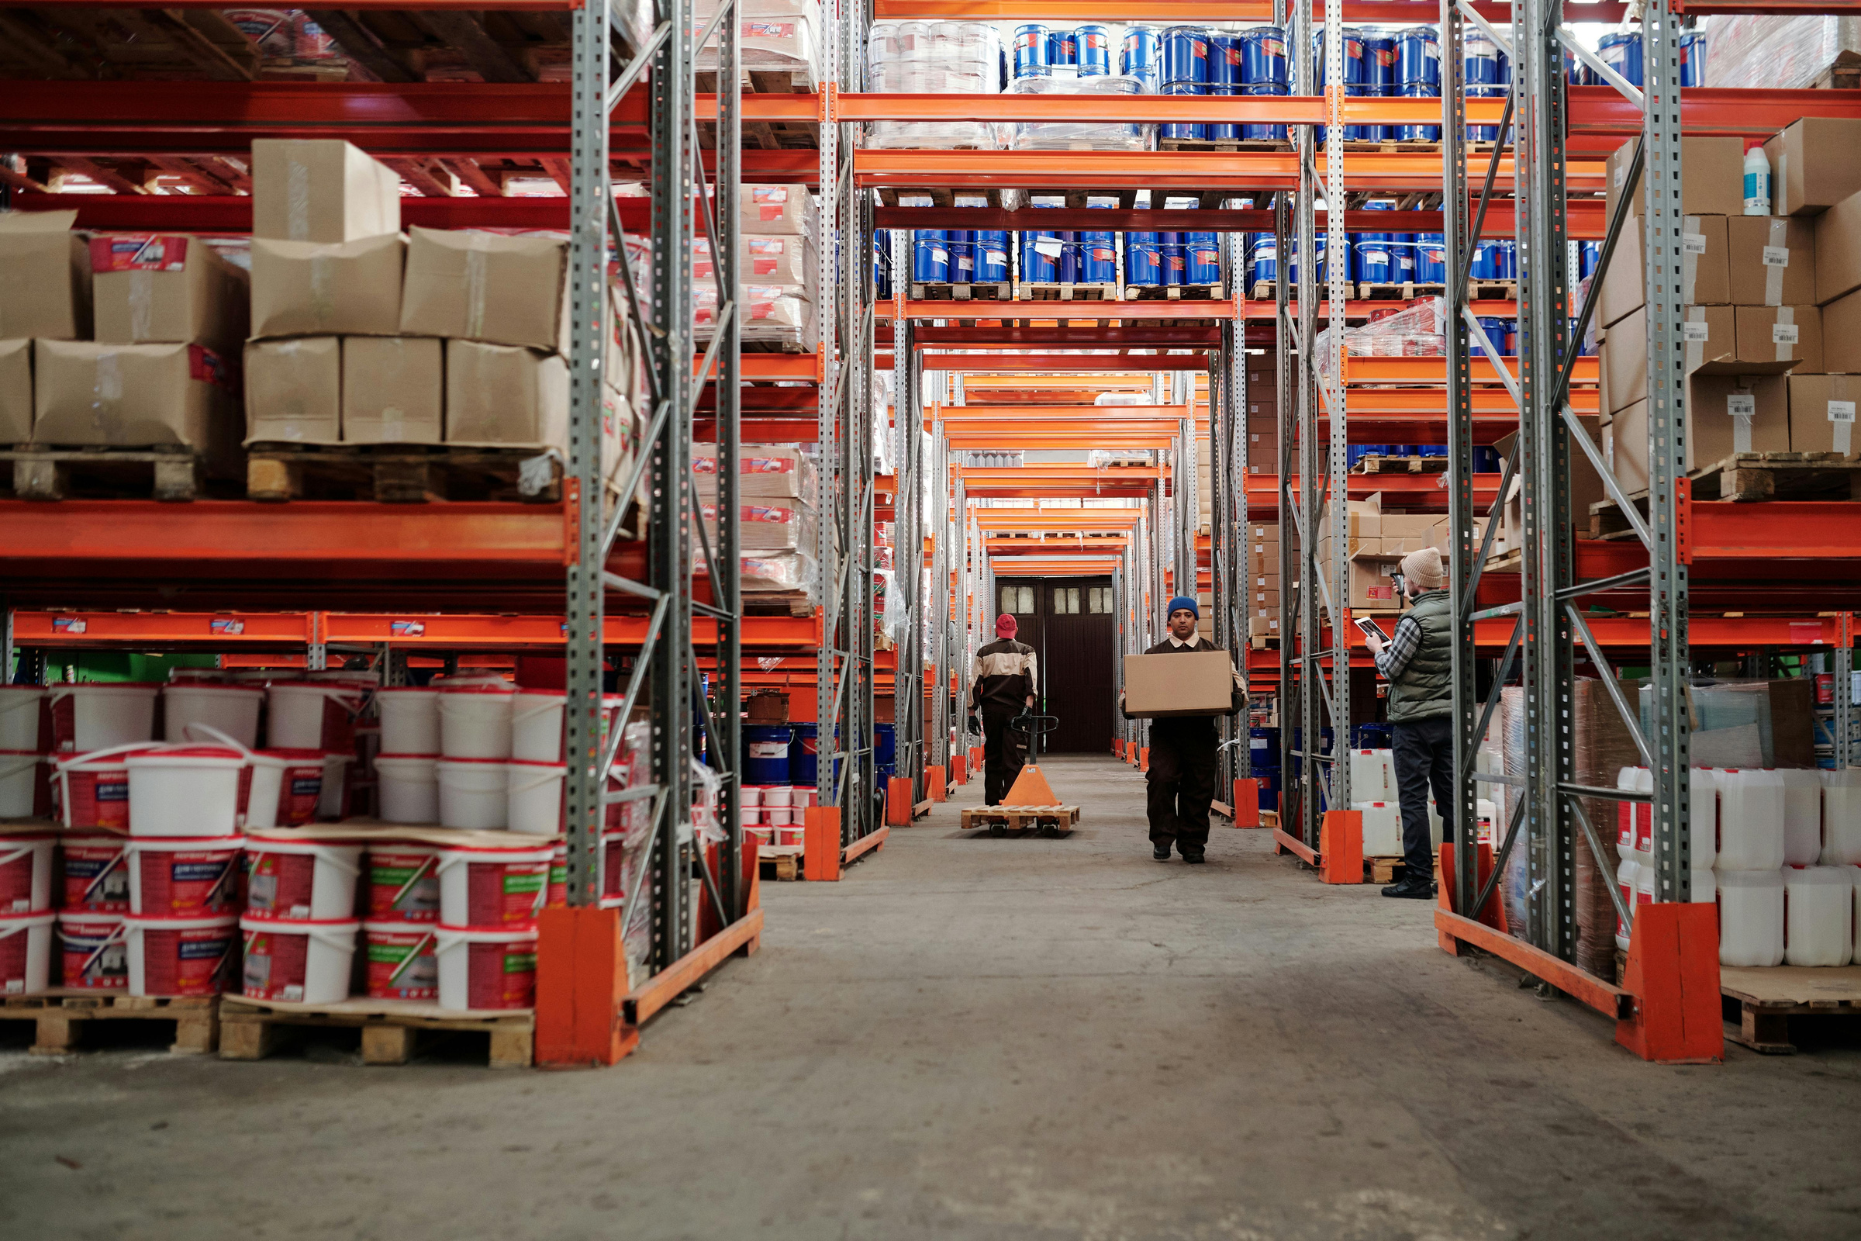

Introduction
Manufacturing downtime disrupts production and lowers efficiency. By analyzing downtime events and daily output, we can identify the main causes and improve performance.

Slide 5


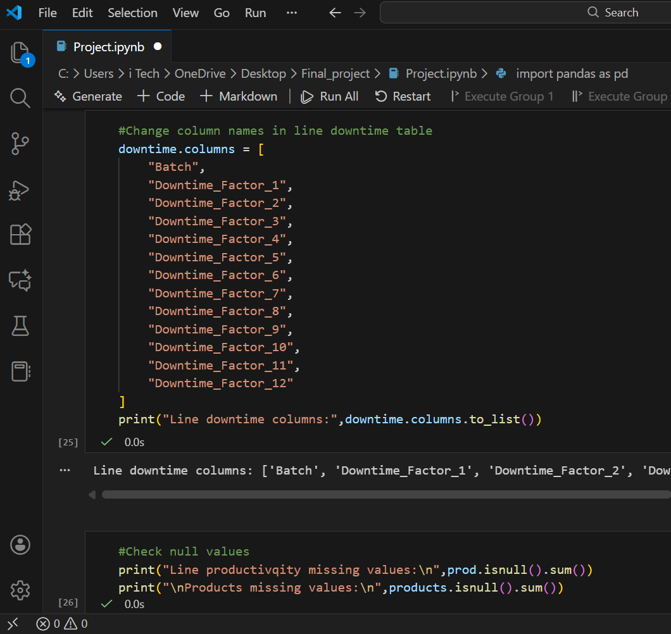

Methodology
1
We cleaned the data using Python by fixing missing values, correcting errors, and preparing it for analysis.

Slide 6
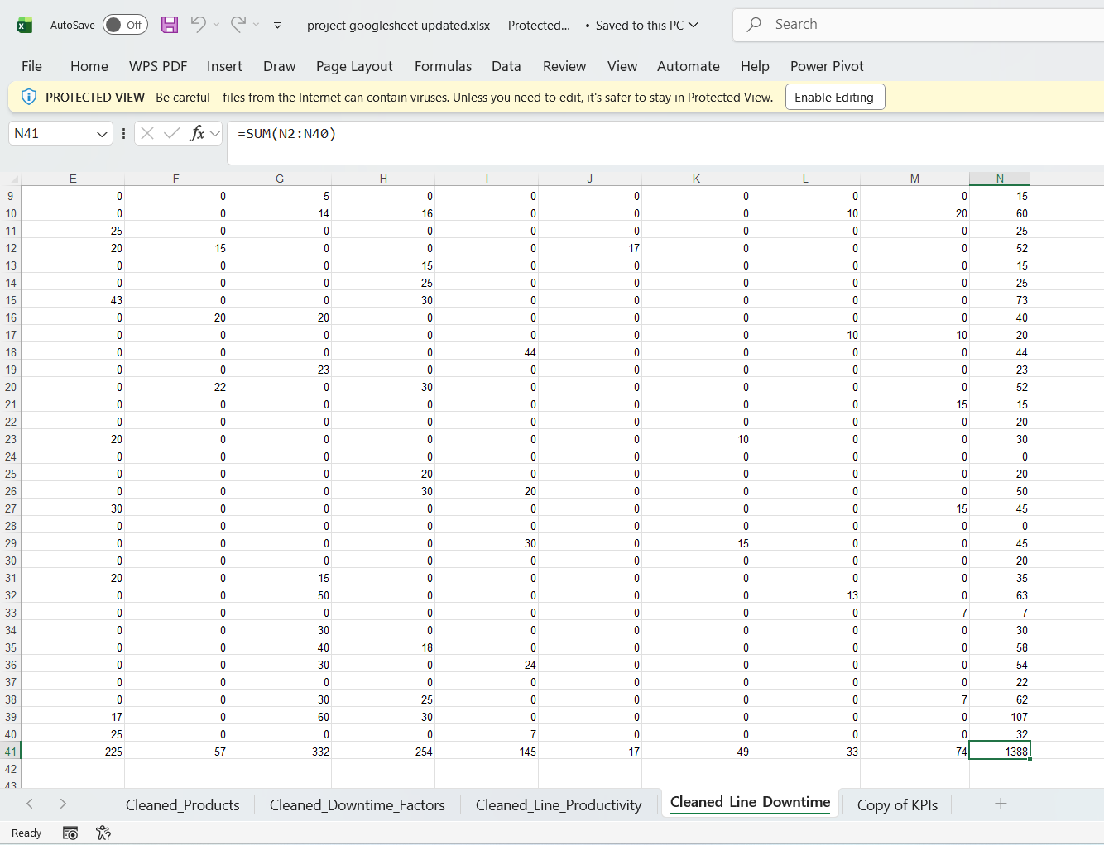
2
We calculated the main KPIs and performance metrics using Excel to understand production behavior and downtime impact.

Slide 7
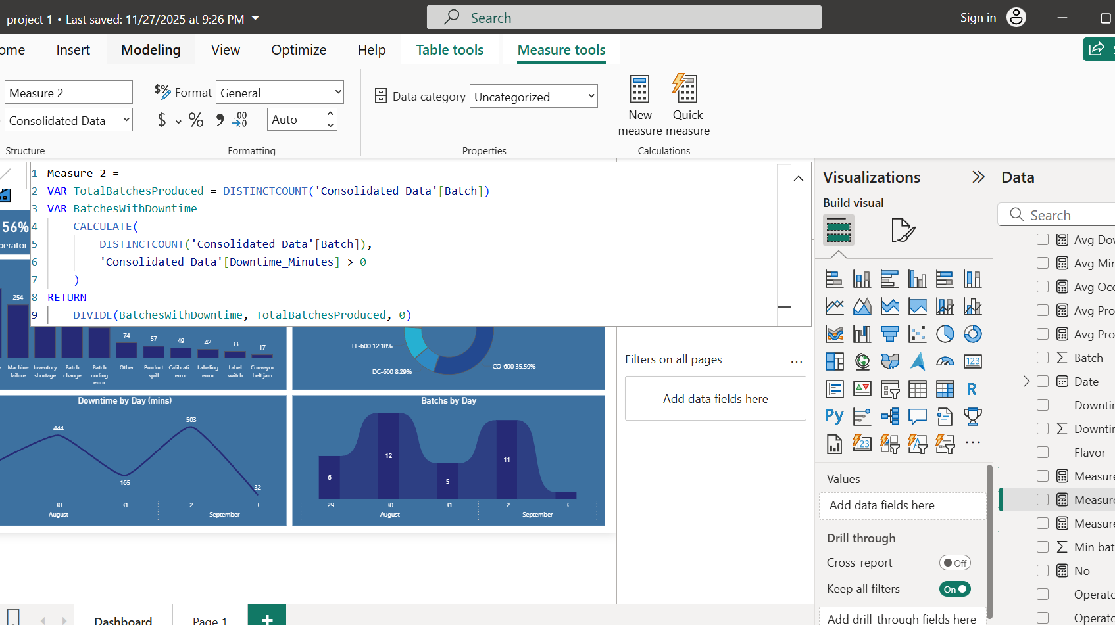
3
We created an interactive dashboard using Power BI to visualize downtime patterns, operator performance, and daily batch output.

Slide 8

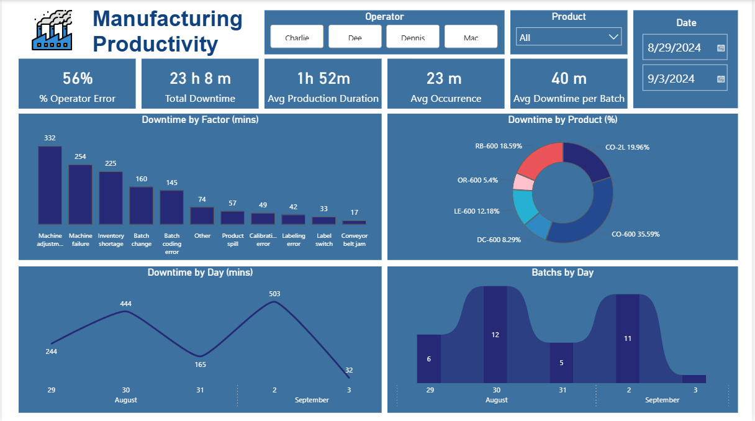
Results

Slide 9
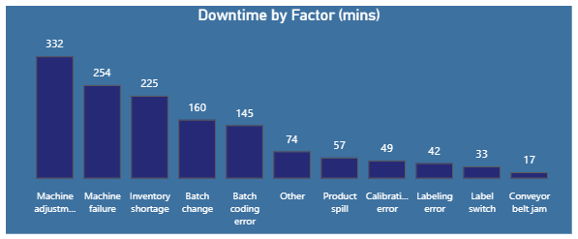

Total Downtime by Factor
The chart shows that machine adjustment and machine failure are the main causes of downtime, while other factors have a smaller impact.

Slide 10
Results

Slide 11
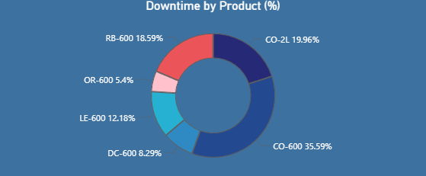
Downtime by Product
The chart shows that CO-600 has the highest downtime, while products like OR-600 and DC-600 have the lowest.

Slide 12
Results

Slide 13
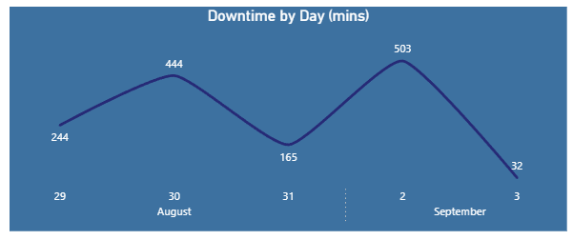
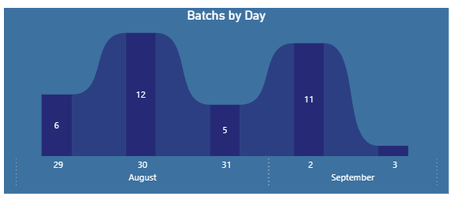
Downtime & Batches Produced by Day
Higher downtime days match higher production activity, while very low downtime (like September 3) shows minimal batches produced.

Slide 14

Conclusion
Operator errors are the main source of downtime, indicating process instability.
Total downtime (23h) reflects significant productivity loss.
Frequent interruptions show a system-wide performance issue.
Machine failures remain a key technical bottleneck.
CO-600 is the most affected product, creating concentrated inefficiency.
Large daily fluctuations reduce consistency and predictability.

Slide 15

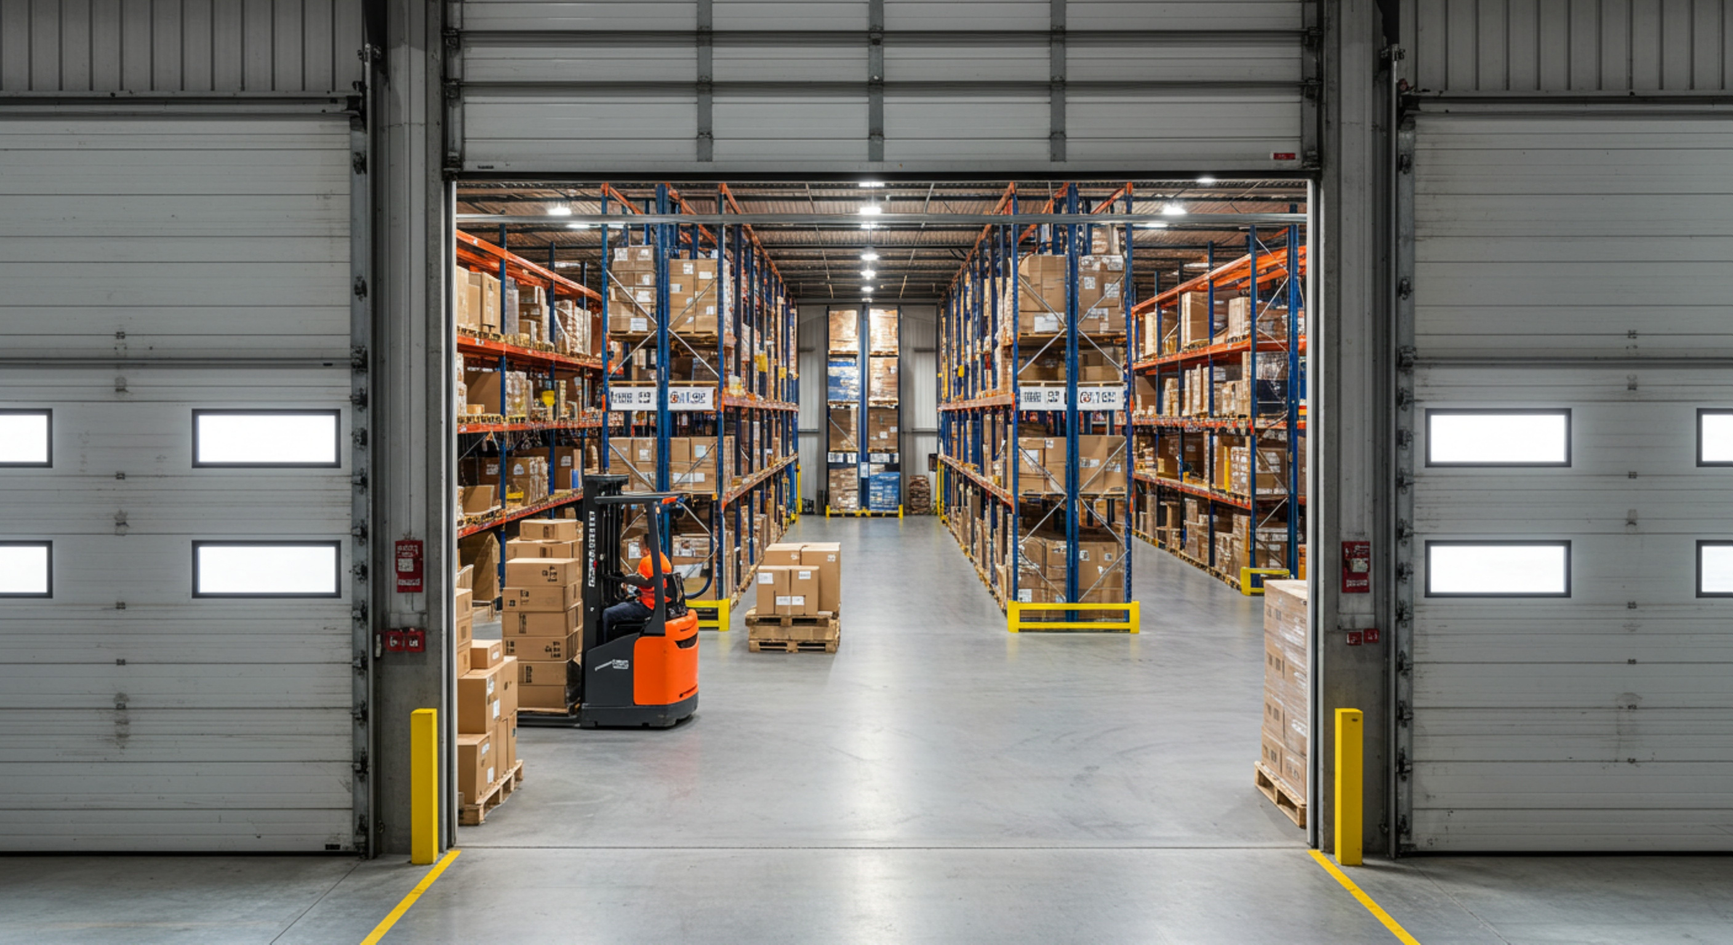
Recommendations
Eliminate operator-related errors by enforcing strict training, clear SOPs, and continuous performance monitoring.
Adopt a preventive maintenance strategy to reduce machine failures and ensure consistent line availability.
Stabilize the production workflow through standardized processes, better scheduling, and tighter control over daily operations.
Prioritize optimization of the CO-600 line, as it creates the largest productivity loss, requiring focused root-cause analysis and corrective action.

Slide 16
Thank You
for Listening.

