Slide 1
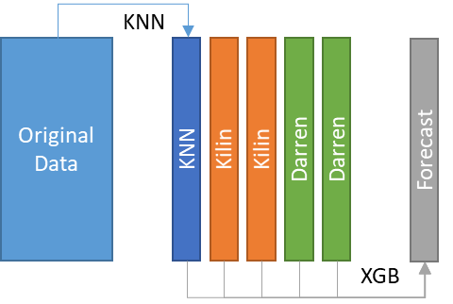
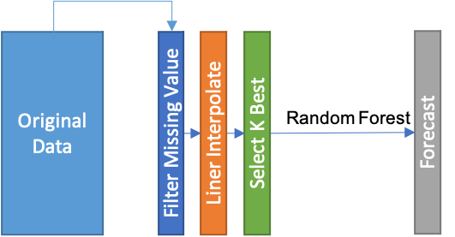
KNN
Original
Data
KNN
Kilin
Kilin
Darren
Darren
Forecast
XGB
Original
Data
Filter Missing Value
Liner Interpolate
Select K Best
Random Forest
Forecast

