Slide 1
CSC3050 – Computer Architecture
Quiz 1 (group competition)

Slide 2
Example 1
Who are the authors of our textbook?
John Hennessy
RISC-V foundation
David Peterson
David Patterson
Answer: 1,4

Slide 3
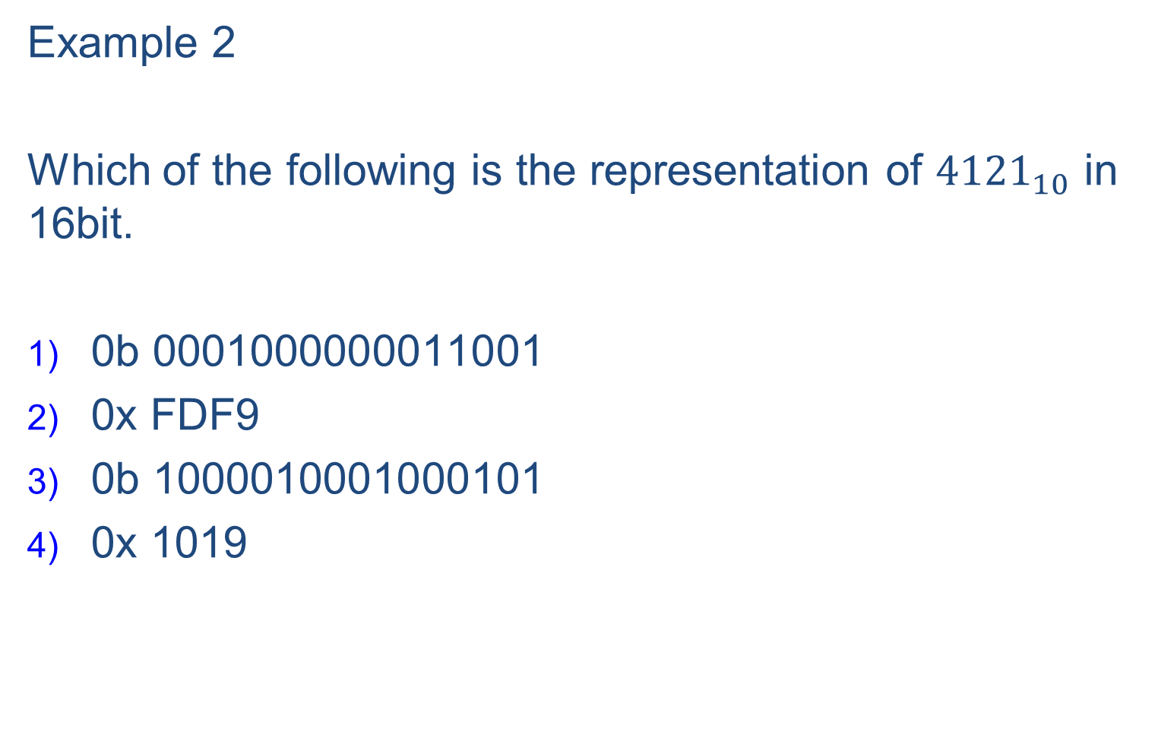
Example 2
Which of the following is the representation of ${4121}_{10}$ in 16bit.
0b 0001000000011001
0x FDF9
0b 1000010001000101
0x 1019
Answer: 1,4

Slide 4
Are you ready ?

Slide 5
1) What is Computer Architecture?
It is all about the hardware organization of a computer
It is all about writing assembly code.
Simply put, it is the interface between hardware and software
It includes ISA (Instruction Set Architecture) and its microarchitectures.
Answer: 3,4

Slide 6
2) What are the general RISC hardware design principles?
Simplicity favors regularity
Smaller is faster
KISS (Keep It Simple, Stupid)
Good design demands good compromises
Make common cases fast
Answer: 1,2,4,5

Slide 7
3) Which of the following RV32I instructions can clear the register X1?
XOR X1, X1,X1
ADD X1, X0,X0
ADD X1, X0,X1
AND X1, X0,X1
Answer: 1,2,4

Slide 8
4) What localities are exhibited in the following C loop?
for (i=0; i<100; i++)
a[i] += b[i];
Structural locality
Temporal locality
Spatial locality
Special locality
Answer: 2,3

Slide 9
5) What does the 32 mean in RV32I?
The general purpose register is 32-bit wide
There are 32 general-purpose registers
The instructions are 32-bit long
The addressability is 32-bit
The core ISA has 32 instructions
Answer: 1,4

Slide 10
6) Which of the following instructions belong to RV64I instead of RV32I?
LD X1, 0(X2)
LWU X1, 0(X2)
SLLI X5, X6, 48
SLL X5, X6, X7
Answer: 1,2,3

Slide 11
7) Which of the following are considered Micro-architecture instead of Architecture?
Out-of-order instruction execution
RISC-V ISA
Fast integer multiplier
Intel x86 family
Microprocessors with L1/L2/L3 on-chip caches
Answer: 1,3,5

Slide 12
8) Which instructions can be inferred as procedure return instructions?
JAL X1, 1020
JALR X0, 0(X1)
JALR X3, 0(X3)
JALR X1, 1024(X1)
Answer: 2

Slide 13
9) Which instructions can be inferred as a procedure call instruction?
JAL X1, 1020
JALR X0, 0(X1)
JAL X0, 1020
JALR X1, 4(X1)
Answer: 1

Slide 14
10) RV32I ISA is
One operand instruction format
Two operand instruction format
Three operand instruction format
Four operand instruction format
Answer: 3

Slide 15
11) Which of the following instructions are I-type instructions?
JAL X1, 1020
JALR X0, 0(X2)
LW X1, 0(X2)
SW X1, 0(X2)
SLLI X1, X1, 4
Answer: 2,3,5

Slide 16
12) What is the range a branch (e.g. beq) instruction in RV32I can reach from the current PC (program counter)?
±512KB
±1KB
±2KB
±4KB
Answer: 4

Slide 17
13) What is the range a Jump (JAL) instruction in RV32I can reach from the current PC (program counter)?
±512KB
±1MB
±2MB
±4MB
Answer: 2

Slide 18
14) What range can an Indirect Jump (JALR) instruction in RV32I reach?
4KB
1MB
4MB
4GB
Answer: 4

Slide 19
15) In the following C statements
{ int x,y;
unsigned int c,d;
x = y >> 8;
c = d >> 4; …}
What RV32I instruction should be generated by the compiler?
1) SRLI for d >> 4
2) SRA for y >> 8
3) SRAI for y >> 8
4) SLLI for d >> 4
Answer: 1, 3

Slide 20
16) Which of the following are pseudo instructions in RV32I ? (Pseudo instructions are not actual hardware instructions but are provided by assemblers to make programming easier)
Li X1, 0x01ABCDEF
Addi, X2, X3, 100
MV X2,X3
J loop_end
Call funct
Answer: 1,3,4,5

Slide 21
17) In the following C function, which of the following store instructions should be used to access A[10]?
int f (int idx, b)
{
int A[100];
…….
A[10] = b; };
SW a1, 40(fp)
SW a1, -360(fp)
SW a0, -360(fp)
SB a1, -360(fp)
SW a1, -40(fp)
Answer: 2

Slide 22
18) One word (32b) in the memory has the following bits
0x 00000033
Which is
0b 0000 0000 0000 0000 0000 0000 0011 0011
What could it be?
If it is an RV32I instruction, it is Add X0,X0,X0 (i.e. NOP)
If it is a signed integer, it is 51
If it is a string of ASCII characters, it is “3”
If it is an unsigned integer, it is 51
Answer: 1,2,3,4

Slide 23
19) Which of the following instructions in RV32I uses 12-bit immediates?
Load instructions
Store instructions
Branch instructions
JALR instructions
AUIPC instructions
Answer: 1,2,3,4

Slide 24
20) Which of the following RV instructions do not have a destination operand (rd)?
Branch instructions
Unconditional jump instructions
Store instructions
Privileged Instructions (accessing CSR)
Answer: 1,3

Slide 25
21) Which of the following statements about RISC vs CISC are true?
RISC is optimized for processor speed
CISC is optimized for compact code size
RISC is optimized for assembly programmers
CISC is optimized for compiler designers
Answer: 1,2

Slide 26
22) Some programming languages (e.g. Java, Rust, Python, …) enforce bounds checking on array indexing.
So, for int A[100], we need to check if idx in A[idx] is positive and less than 100. Which of the following RV32I instructions can do the job, assuming idx is allocated to register X5 and 100 is in X6?
BGT X0, X5, out_of_bound
BLE X6, X5, out_of_bound
BLT X5,X0, out_of_bound
BGE X5, X6, out_of_bound
3) BGEU X5, X6, out_of_bound
4) BLEU X6,X5, out_of_bound
Answer: 2,3

Slide 27
23) In RV32I, what registers a leaf routine should try to utilize based on the calling convention?
Register a0-a7
Register t0-t6
Register s0-s11
Register X28-X31
Register X18-X27
Answer: 1,2,4

Slide 28
24) What are the disadvantages if the RV architecture includes 1024 general-purpose registers?
Register access time may take longer, thus increasing the clock cycle time
Procedure call overhead will increase since too many registers to save and restore
Context switching cost will increase
Instruction length will increase, 32 bit is no longer sufficient
Compiler is more difficult to manage so many registers
Answer: 1,2,3,4

Slide 29
25) Which data types are unlikely to be allocated to registers?
Unsigned integers
Multi-dimensional arrays
Strings
Structures
Floating point number variables
Answer: 2,3,4

