Slide 1
CSC3060 – Computer Systems
Quiz 3

Slide 2
Section I
(Single Answer)

Slide 3
1) Three common hazards can often reduce the efficiency of a pipelined datapath. Which of the following is not one of the three hazards?
^{1) Structure hazards}
^{2) Forward hazards}
^{3) Data hazards}
^{4) Control hazards}
Answer: 2

Slide 4
2) Which extension, if absent, would make RISC-V a fixed-length ISA?
A extension
B extension
C extension
D extension
E extension
Answer: 3

Slide 5
3) Which of the following microarchitectures could have a CPI lower than 1?
Single-cycle data path implementation
Multi-cycle data path implementation
Pipelined implementation
Superscalar implementation
Answer: 4

Slide 6
4) When comparing the performance of single-cycle, multi-cycle, and pipelined data paths, which statements is correct?
1) Single-cycle > Multi-cycle > Pipelined
2) Pipelined > Multi-cycle > Single-cycle
3) Pipelined > Single-cycle > Multi-cycle
4) Multi-cycle > Pipelined > Single-cycle
Answer: 2

Slide 7
5) Frequent pipeline stalls are likely to occur when traversing a long linked list due to
Delay hazards
Date hazards
Data hazards
Control hazards
Answer: 3

Slide 8
6) Branch prediction should be carried out during which stages of the pipeline?
1) IF
2) ID
3) EXE
4) MEM
5) WB
Answer: 1

Slide 9
7) Which of the following functional units is the most difficult to pipeline?
Integer multiply
Floating point add
Floating point multiply
Integer divide
Fused multiply-and-accumulate (FMAC)
Answer: 4

Slide 10
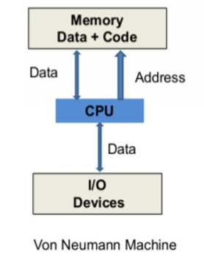
8) A Von Neumann machine is depicted on the right. What is the so-called “Von Neumann bottleneck” in a pipelined data path?
1) It is like a structural hazard
2) It is like a data hazard
3) It is like a control hazard
4) It is like a memory hazard
Answer: 1

Slide 11
9) Which of the following microarchitectures is unlikely to be used by Apple’s M4 processor (i.e., the latest one)?
Dynamic branch prediction
Pipelined data path
Static branch prediction
BTB-based prediction
Answer: 3

Slide 12
10) Which RV32I instruction has the greatest impact on the clock rate of the single-cycle data path?
JALR X0, 0(X2)
LW X1,4(X2)
SLL X1,X2,X3
LUI X5, 0x12345
Answer: 2

Slide 13
Section II
(multiple answers)

Slide 14
11) MIPS (Microprocessor without Interlocked Pipeline Stages) reduces hardware cost by using software to avoid hazards, making the processor cheaper and faster. What was the primary reason for its lack of success?
1) Compatibility and Scalability
2) Non-competitive performance
3) Incompatible with x86
4) John Hennessy was too occupied.
Answer: 1

Slide 15
12) In which cases should callee-saved registers be considered for allocation?
Leaf routines
A temporary value used heavily across multiple calls
Temporaries in expression evaluation
C Strings
Local variables
Answer: 2,5

Slide 16
13) Which of the following is a common hardware technique to reduce the penalty of data hazards?
^{1) Data forwarding}
^{2) A deeper pipeline}
^{3) Data Bypassing}
^{4) Compiler code scheduling}
Answer: 1,3

Slide 17
14) Most modern microprocessors have split I/D caches. Why?
1) To avoid structural hazards in the pipeline
2) To get a higher cache hit rate
^{3) To increase reliability}
4) To increase the cache access bandwidth
Answer: 1,4

Slide 18
15) Compared to a pipelined data path, a single-cycle data path typically has:
1) Higher throughput
2) Faster clock rate
3) Simple control logic
4) A longer instruction latency
5) A lower CPI
Answer: 3,5

Slide 19
16) Function A calls function B. In function A, three registers live across the call to B: $s1, $t0, and $a1. What registers must be saved/restored across the call?
1) $s1
2) $t0
3) $a1
4) None of them
Answer: 2,3

Slide 20
17) What are the essential principles of designing a pipelined datapath?
1) Multi-stage partitioning
2) Overlapped execution
3) Increased throughput
4) Lowered instruction latency
5) Improved resource utilization
Answer: 1,2,3,5

Slide 21
18) Which of the following are techniques used to reduce the penalty caused by control hazards?
1) Pipeline stalls
2) BTB (Branch Target Buffer)
3) BHT (Branch History Table)
4) Data Bypassing
5) Data forwarding
Answer: 2,3

Slide 22
19) What (HW/SW) strategies can reduce pipeline stalls caused by data hazards?
^{1) Deeper pipeline}
^{2) Data forwarding}
3) Out-of-Order instruction execution
4) Compiler instruction scheduling
^{5) Branch prediction}
Answer: 2,3,4

Slide 23
20) Which of the following are considered “Microarchitecture states”?
BHT
BTB
Floating-point registers
PC
Pipelined registers
Answer: 1,2,5

Slide 24
21) In practice, what might occur if we increase the number of pipeline stages from 5 to 20?
1) The clock rate becomes 4X faster
2) The branch misprediction penalty would increase
3) The data hazard penalty would increase
4) The CPI would increase
5) More pipelined registers will be required
Answer: 2,3,4,5

Slide 25
22) What information is used to index a branch prediction table in correlated branch prediction (also known as 2-level adaptive branch prediction)?
Current PC
Branch instruction address
PC+4
Global branch history
Answer: 1,4
Notes:
RISC-V has no opcode as 0000000 (illegal instruction)

Slide 26
23) Which of the following could be effective for static branch predictions?
Predict a backward branch taken
Predict a forward “beq rs1, x0” not taken
Predict the “beq rs1, rs2” not taken
Predict the blt instructions taken
Predict the JALR instruction not taken
Answer: 1,2
Notes:
Loop counter (i==0) or linked list (ptr == NULL)

Slide 27
24) Why is a BHT (Branch History Table) usually untagged?
Simple
Fast access
Consume less energy
Good for high-performance microprocessors
Cost-effective
Answer: 1,2,3,5
Notes:
Quad-precision, FP16, and Bfloat16

Slide 28
25) Which of the following control signals must be propagated through the pipelined registers to the WB stage?
Rd (target register)
WRen (write-enable)
WBsel (Write back selection)
ALUctl (ALU control)
Answer: 1,2,3

Slide 29
26) Which of the following statements about single-cycle data path implementation is true?
CPI is 1, every instruction must finish in one cycle
The clock cycle must accommodate the slowest instruction
The resources in the data path cannot be reused in the same cycle
The result is written back to the register file in the same clock cycle.
Answer: 1,2,3

Slide 30
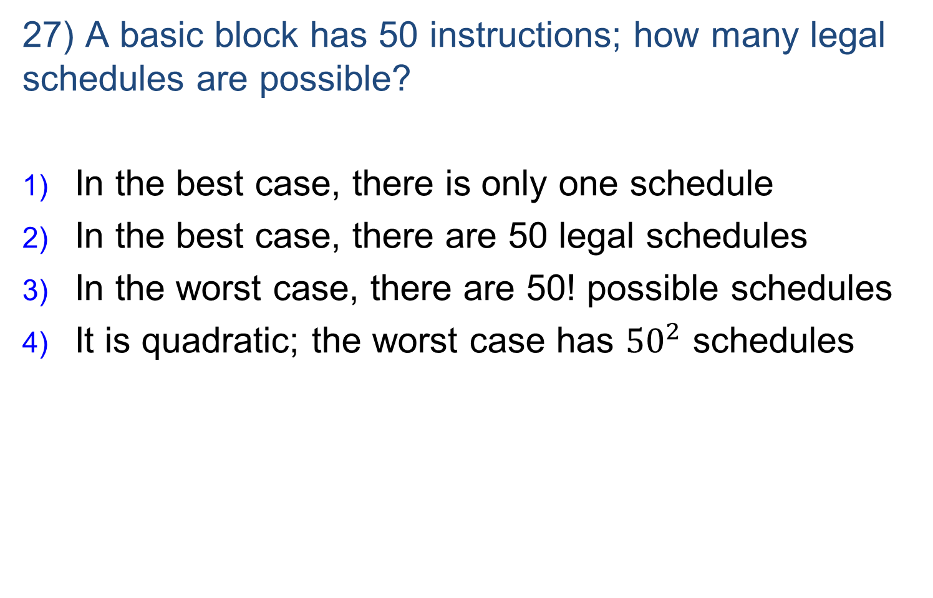
27) A basic block has 50 instructions; how many legal schedules are possible?
In the best case, there is only one schedule
In the best case, there are 50 legal schedules
In the worst case, there are 50! possible schedules
It is quadratic; the worst case has ${50}^{2}$ schedules
Answer: 1,3
Notes:
RISC-V has no opcode as 0000000 (illegal instruction)

Slide 31
28) A compiler can reorder instructions to avoid data hazards. However, what limitations does it often encounter?
1) Code scheduling is error-prone
2) Memory dependencies may not be known due to possible memory aliasing
3) Structural hazards are hard to deal with
4) Memory operation latencies are unknown and non-deterministic
Answer: 2,4

Slide 32
29) In our RV32I pipelined data path, which stage requires two adders?
1) IF
2) ID
3) EXE
4) MEM
5) WB
Answer: 3

Slide 33
30) When running a binary tree search on a pipelined data path, what hazards are likely to occur?
1) Dependence hazards
2) Structure hazards
3) Data hazards
4) Control hazards
5) Branch hazards
Answer: 3,4

Slide 34
31) Why do some RV pipelined data path designs utilize a comparison unit to execute the compare-and-branch instructions instead of using the standard ALU?
To avoid structural hazards
Avoid setting the wrong ‘taken/not-taken’ due to integer subtraction overflows.
The ALU at the EXE stage is needed for R-type instructions and Load/Store instructions
Comparison operation does not trap
Answer: 2

Slide 35
32) Intel Pentium 4 has 31 pipeline stages. A branch instruction is resolved pretty late, near the 31st stage. If the branch misprediction rate is 2%, what would be the performance impact? (Assuming 20% of instructions are branches, and the average CPI is 1).
2%
6%
20%
12%
60%
Answer: 4

Slide 36
33) What information is stored in the pipelined registers?
Control signals
Data (ALU results, Register values, Immediates)
Addresses (PC, PC+4, memory address)
Register designators
Answer: 1,2,3,4

Slide 37
34) Which RV32I branch/jump instructions are most difficult to predict?
Conditional branches such as BLT/BEQ/BNE
Unconditional jumps such as JAL, X0, target
Function calls such as JAL X1, function_name
Indirect branch for switches, such as JALR, 4(X1)
Return branch, such as JALR, X0, 0($ra)
Answer: 4

Slide 38
35) Intel Itanium has a post-increment load instruction:
LW rd, imm(rs1)
Its register transfer behavior is as follows
rd ← mem[rs1 + imm]
rs1 ← rs1 + imm
Why does RISC-V not adopt this instruction?
This instruction is rarely used by the compiler
This instruction requires two register write ports
This instruction breaks the regularity: rs1 is both a source and a destination.
This instruction is NIH (Not-Invented-Here)
Answer: 2,3

