Slide 1
Neural Operators A seminar presentation
Alexander Luce
Based on
Neural Operator: Learning Maps Between Function Spaces with Applications to PDEs [0]
Notes:
Neural Operators are the concept for all neural networks which satisfy some criteria for mappings between infinite dimensional functionspace
First disect what Neural operators do
Next layout the structure of Neural Operators
Finally show some examples

Slide 2
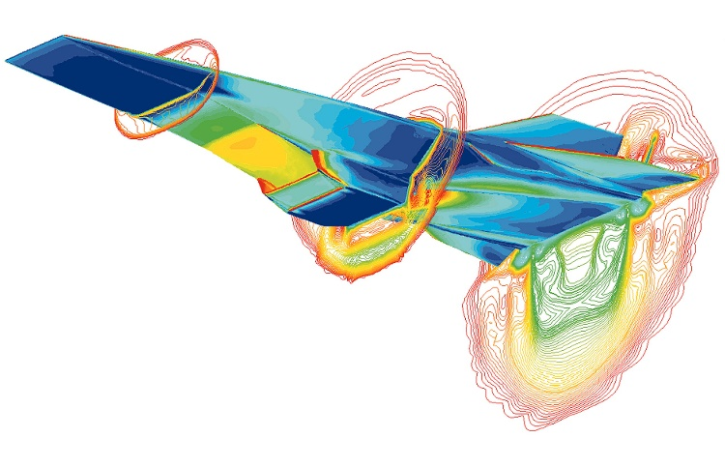
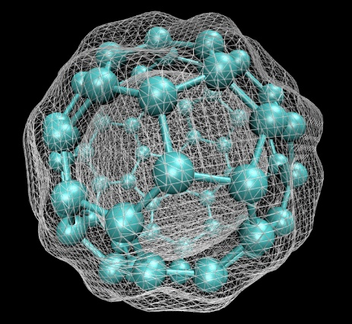
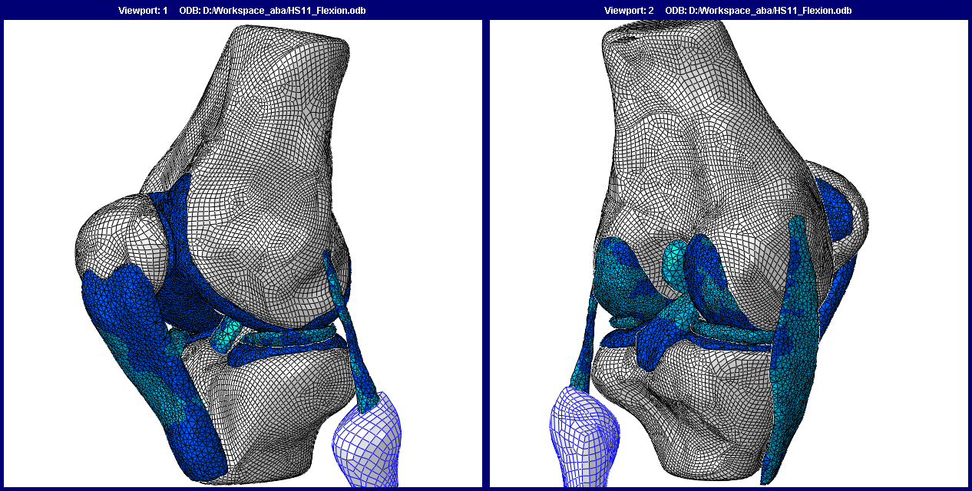
The goal of neural operators
Solving complex physics problems
The physics reduces to solving PDEs
slow and expensive
Want to find the solution Operator
Cheaply map input parametrization to the solution
[2]
[1]
[3]

Slide 3
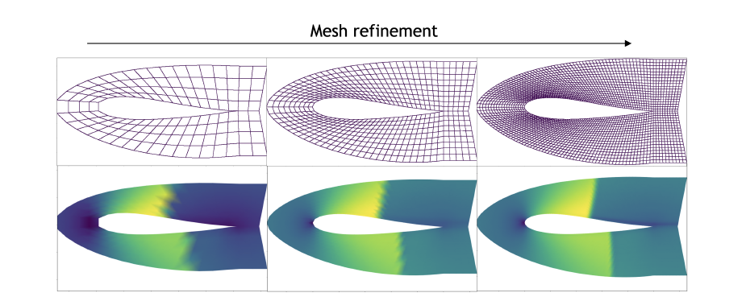
What's the problem?
Generalization to the diversity of parametrizations
Zero-shot performance
Severe limitation –> NNs are not scale and discretization invariant
If the scale of the inference problem changes, it becomes useless
Bad generalization from large scale to fine scale –> different effects
Another problem –> NNs do not return a function and can’t be queried everywhere
Training on variable meshes difficult
[0]

Slide 4
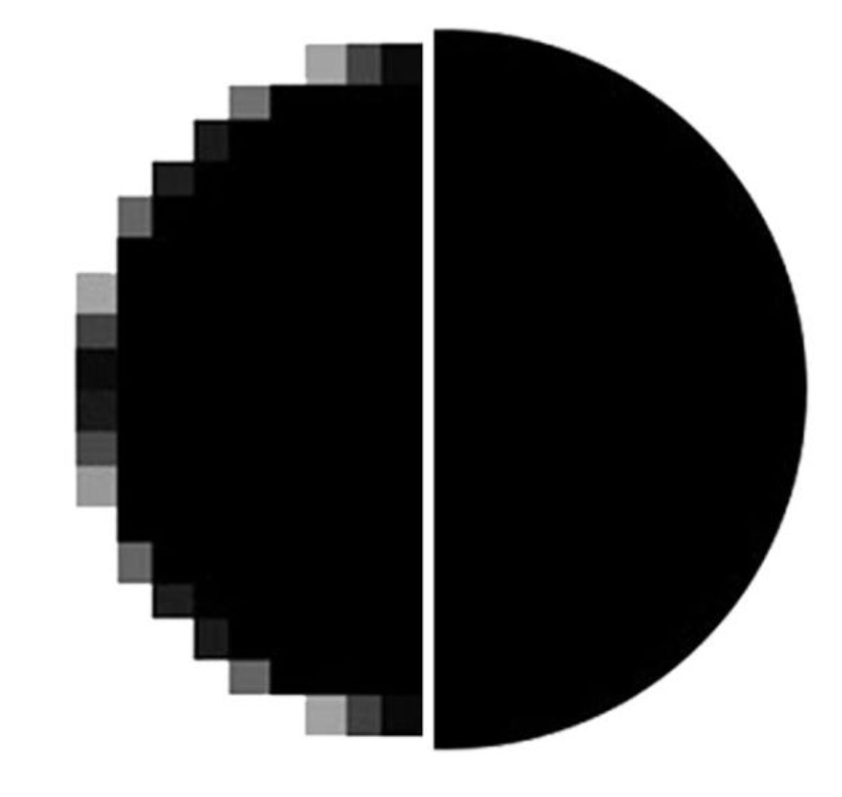
Operator learning vs Neural Networks
Neural Networks
Vector <–> Vector
Neural Operators
Function <–> Function
Discrete
Continuous
[4]
Notes:
Neural Networks assume that a problem can be vectorized in such a way that the data captures the entire problem
Example CNN trained on data from a specific camera and then change the camera

Slide 5


What is an Operator
Physicists describe the shape of the world with functions and the dynamics of the world via operators
An operator acts on a function
Example
$\frac{d}{dt}$ is the Differential Operator
Function
$\frac{d}{dt}x(t)$ $=\dot{x}(t)$
Operator

Slide 6
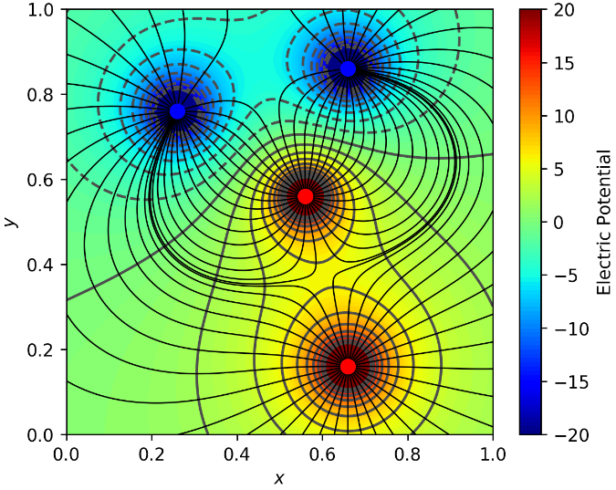
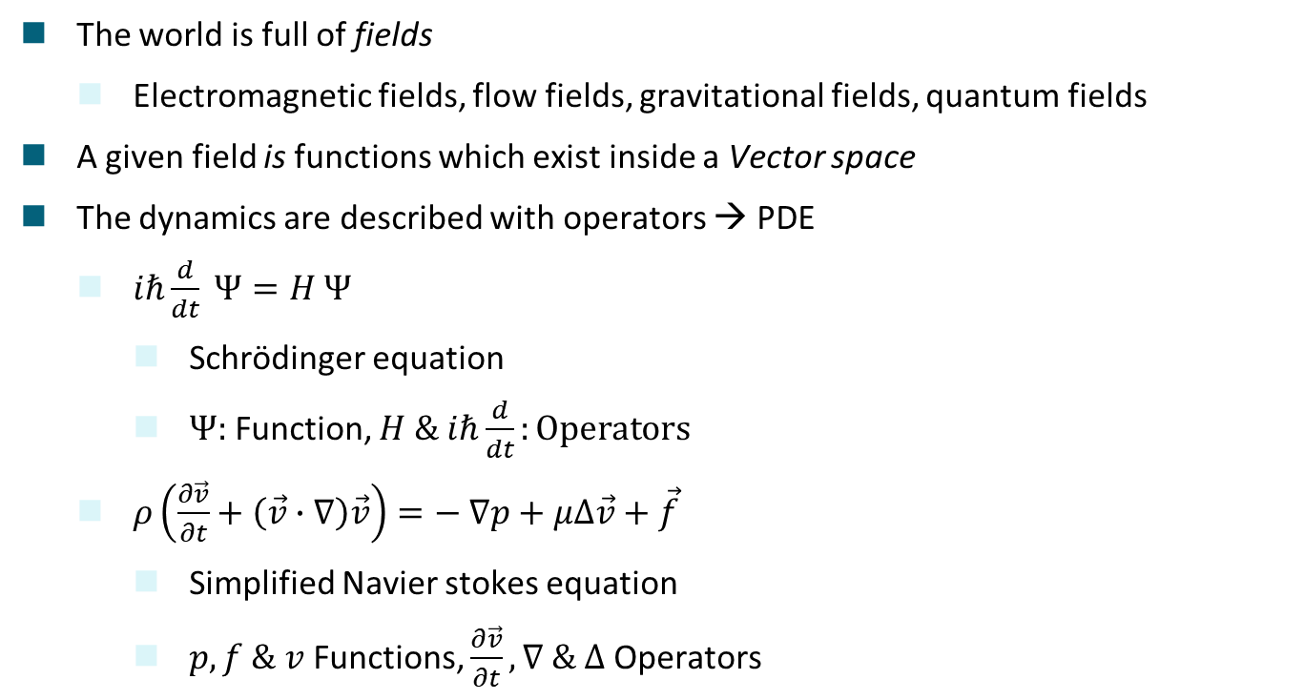
That can‘t be all
The world is full of fields
Electromagnetic fields, flow fields, gravitational fields, quantum fields
A given field is functions which exist inside a Vector space
The dynamics are described with operators → PDE
$iℏ\frac{d}{dt} Ψ=H Ψ$
Schrödinger equation
$Ψ:$ Function, $H \& iℏ\frac{d}{dt}:Operators$
$ρ\left(\frac{∂\vec{v}}{∂t}+\left(\vec{v}∙∇\right)\vec{v}\right)=− ∇p+μ∆\vec{v}+\vec{f}$
Simplified Navier stokes equation
$p, f \& v$ Functions, $\frac{∂\vec{v}}{∂t}, ∇ \& ∆$ Operators
A scalar field of an electric potential [5]

Slide 7
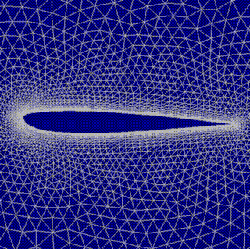
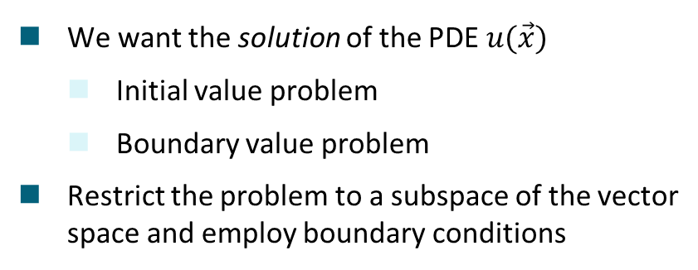


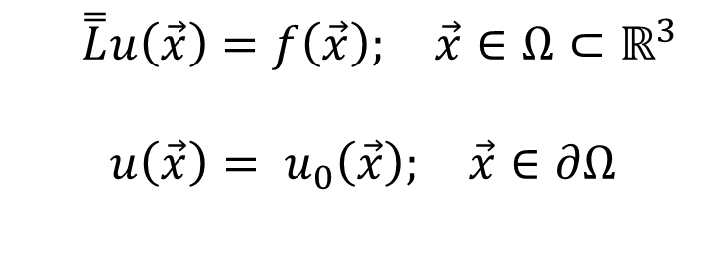
What are we actually interested in?
$$∂Ω$$
Aircraft wing
We want the solution of the PDE $u(\vec{x})$
Initial value problem
Boundary value problem
Restrict the problem to a subspace of the vector space and employ boundary conditions
Airflow
$$Ω$$
[6]
The solution
Source terms
The operator
$\overset{̿}{L}u\left(\vec{x}\right)=f\left(\vec{x}\right); \vec{x}∈Ω⊂ℝ^{3}$
$${ u\left(\vec{x}\right)= u}_{0}\left(\vec{x}\right); \vec{x}∈∂Ω$$
Boundary condition

Slide 8
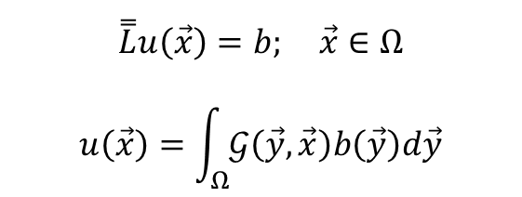
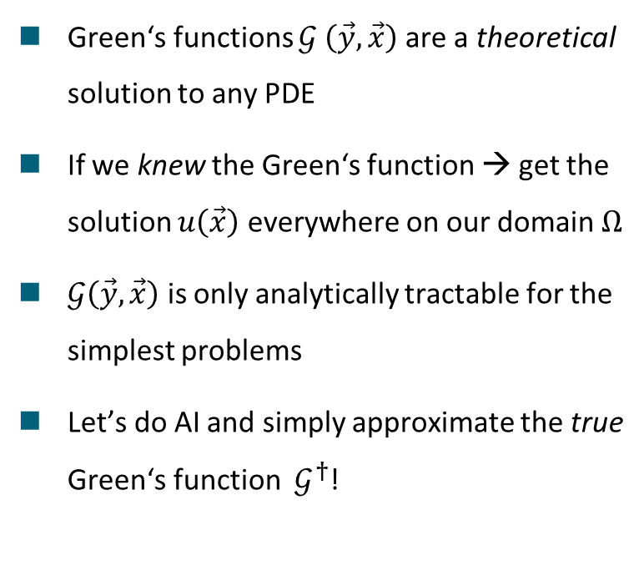
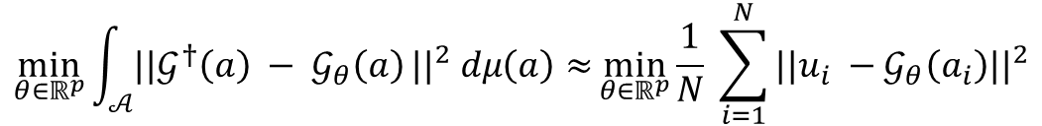
Introducing neural operators
Green‘s functions $𝒢 \left(\vec{y}, \vec{x}\right)$ are a theoretical solution to any PDE
If we knew the Green‘s function → get the solution $u\left(\vec{x}\right)$ everywhere on our domain $Ω$
$𝒢\left(\vec{y}, \vec{x}\right)$ is only analytically tractable for the simplest problems
Let’s do AI and simply approximate the true Green‘s function $𝒢^{†}$!
$$\overset{̿}{L}u\left(\vec{x}\right)=b; \vec{x}∈Ω$$
$$u\left(\vec{x}\right)=\int_{Ω}^{ }{𝒢\left(\vec{y}, \vec{x}\right)b\left(\vec{y}\right)d\vec{y}}$$
$$\min_{θ∈ℝ^{p}}{\int_{𝒜}^{ }{||𝒢^{†}\left(a\right) − 𝒢_{θ}\left(a\right)}||^{2} dμ\left(a\right)≈}\min_{θ∈ℝ^{p}}\frac{1}{N} \sum_{i=1}^{N}{||u_{i} −𝒢_{θ}\left(a_{i}\right){||}^{2}}$$

Slide 9
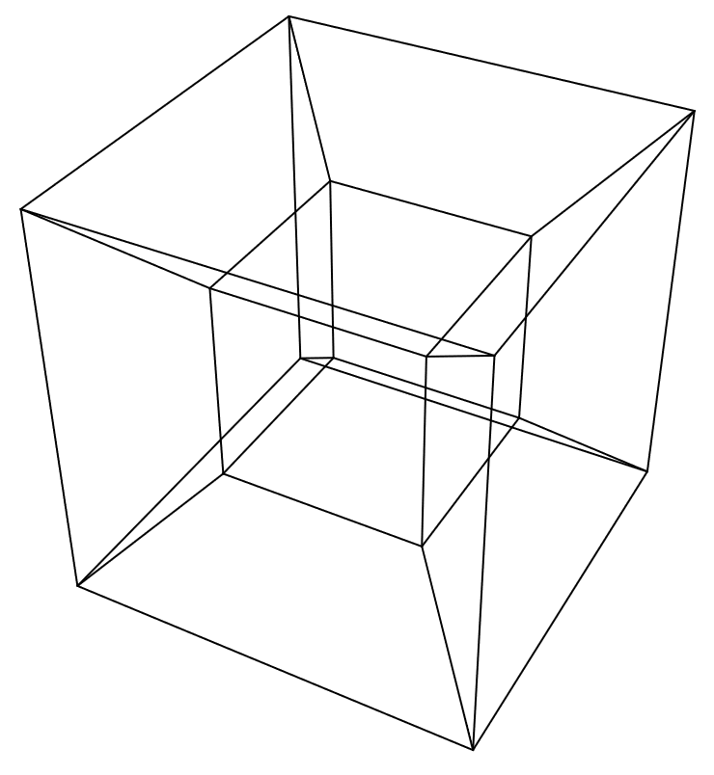
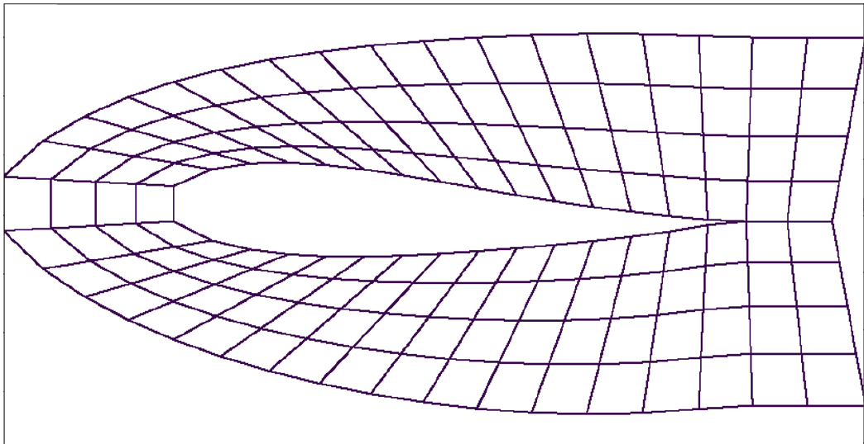
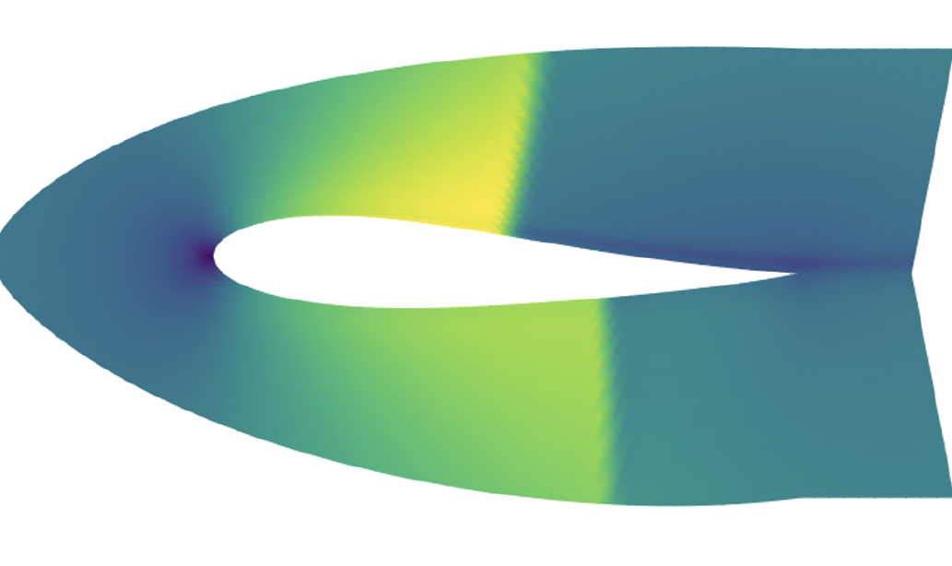
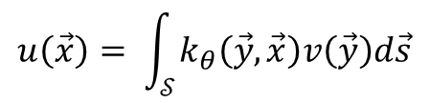
What does $𝓖_{θ}$ look like?
Lifting
Iterative kernel integration
Projection
$$u\left(\vec{x}\right)= \int_{𝒮}^{ }{k_{θ}\left(\vec{y}, \vec{x}\right)v\left(\vec{y}\right)d\vec{s}}$$
[7]

Slide 10
[8]
Notes:
Recap NNs – vector to vector NOs – function to function

Slide 11

Architectures
Neural Operator GitHub
Layers
Fourier Neural Operator (FNO) [0]
Low-rank Neural Operator (LNO) [0]
(Multipole) Graph Neural Operator (GNO) [0]
And advanced architectures
Adaptive Fourier Neural vision transformer [8]
Physics Informed Neural Operator [9]
Message Passing Neural Operator [10]
Universal transformer Neural Operator [11]
Geometry Informed Neural Operator [12]

Slide 12
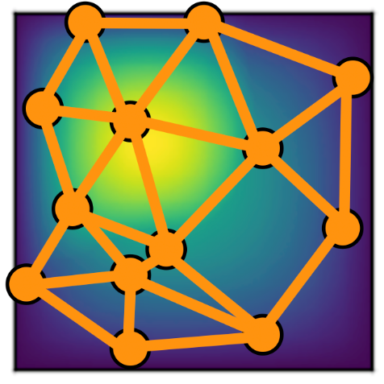
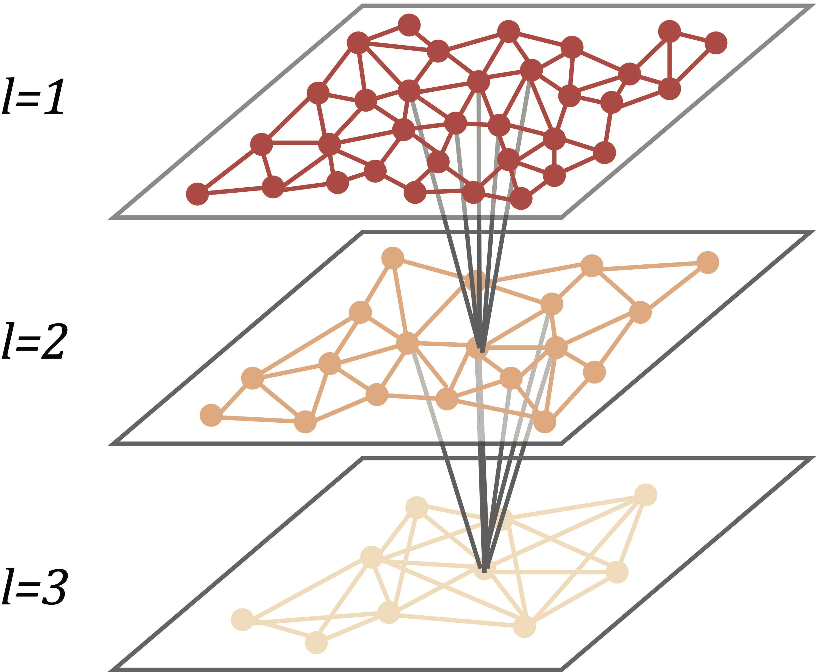
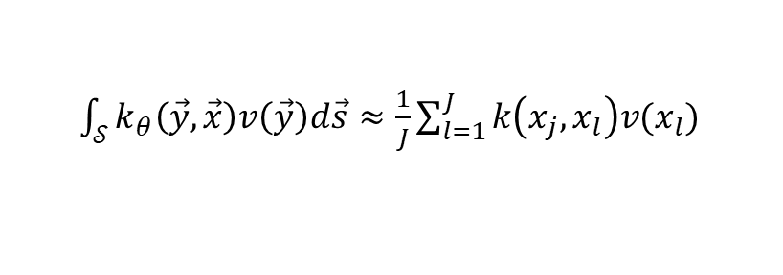



The Graph Neural Operator - GNO
Kernel Integrator approximated by Nyström approximation with domain truncation
Domain truncation: Sample the Domain $𝒮$ on subsets $s⊂ 𝒮$
Naturally leads to a multiscale approach
$\int_{𝒮}^{ }{k_{θ}\left(\vec{y}, \vec{x}\right)v\left(\vec{y}\right)d\vec{s}}≈\frac{1}{J}\sum_{l=1}^{J}{k\left(x_{j}, x_{l}\right)v(x_{l})}$
Complete Domain $𝒮$
Subset $s⊂ 𝒮$
Local scale
Global scale

Slide 13
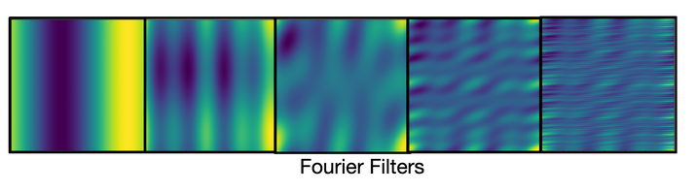
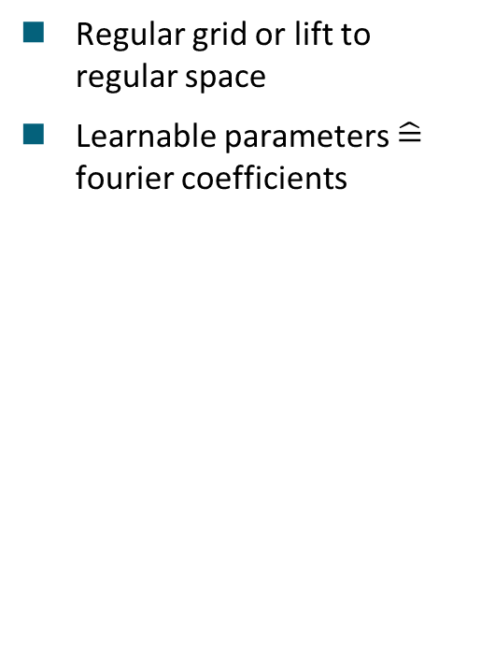

Fourier Neural Operator - FNO
Demo
Regular grid or lift to regular space
Learnable parameters $\hat{=}$ fourier coefficients
$$u\left(\vec{x}\right)= ℱ^{−1}(R_{θ}ℱ\left(\vec{y}\right))(\vec{x})$$
Full Neural Operator
Fourier layer

Slide 14
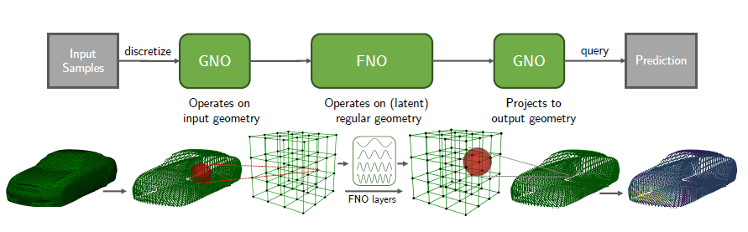
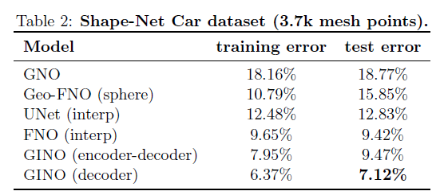
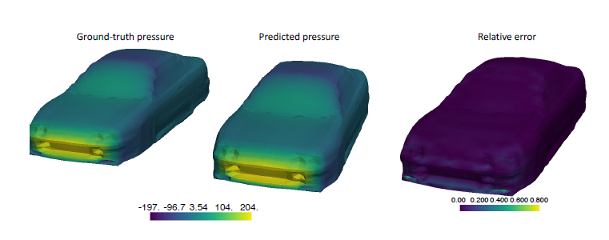
Geometry Informed Neural Operator - GINO
Geometry Encoder
Geometry Decoder
Global Model
Application results
[12]

Slide 15
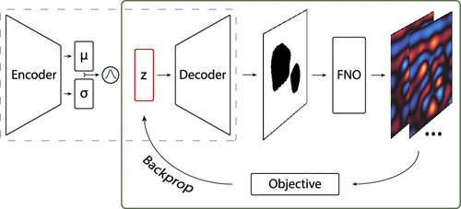
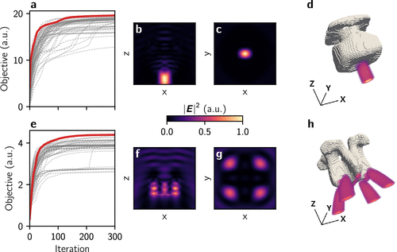
Outlook – inverse design via Neural Operators
Neural Operators are fully differentiable
Inverse design:
Compute loss of output with a target function
Backprop through NO
Update the input vector
Iterate
[13]

Slide 16
Questions?
[13]

Slide 17
References
Fourcastnet: A global data-driven high-resolution weather model using adaptive fourier neural operators
[0] N. B. Kovachki, Z. Li, B. Liu, K. Azizzadenesheli, K. Bhattacharya, A. M. Stuart, A. Anandkumar: Neural Operator: Learning Maps Between Function Spaces. CoRR abs/2108.08481. 2021.
[1] https://en.wikipedia.org/wiki/Computational_chemistry
[2] https://en.wikipedia.org/wiki/Computational_fluid_dynamics
[3] https://en.wikipedia.org/wiki/Finite_element_method
[4] https://iclr.cc/media/iclr-2021/Slides/3281.pdf
[5] Draw electric field lines without Mayavi
[6] Gitter (Geometrie)
[7] Tesseract MathWorld
[8] J. Pathak, S. Subramanian, P. Harrington, S. Raja, A. Chattopadhyay, M. Mardani, T. Kurth, D. Hall, Z. Li, K. Azizzadenesheli, P. Hassanzadeh, K. Kashinath, A. Anandkumar: FourcastNet: A global data-driven high-resolution weather model using adaptive Fourier neural operators. CoRR abs/2202.11214. 2022.

Slide 18
References
[9] Z. Li, H. Zheng, N. Kovachki, D. Jin, H. Chen, B. Liu, K. Azizzadenesheli, A. Anandkumar: Physics-Informed Neural Operator for Learning Partial Differential Equations. ACM / IMS J. Data Sci. 1(3), Article 9. 2024.
[10] J. Brandstetter, D. Worrall, M. Welling: Message Passing Neural PDE Solvers. CoRR abs/2202.03376. 2023.
[11] B. Alkin, A. Fürst, S. Schmid, L. Gruber, M. Holzleitner, J. Brandstetter: Universal Physics Transformers: A Framework For Efficiently Scaling Neural Operators. CoRR abs/2402.12365. 2025.
[12] Z. Li, N. B. Kovachki, C. Choy, B. Li, J. Kossaifi, S. P. Otta, M. A. Nabian, M. Stadler, C. Hundt, K. Azizzadenesheli, A. Anandkumar: Geometry-Informed Neural Operator for Large-Scale 3D PDEs. CoRR abs/2309.00583. 2023.
[13] Y. Augenstein, T. Repän, C. Rockstuhl: Neural Operator-Based Surrogate Solver for Free-Form Electromagnetic Inverse Design. ACS Photonics, 10(5): 1547–1557. 2023. DOI: 10.1021/acsphotonics.3c00156.

