Slide 1
More Stack Applications
Parentheses Matching
Maze Router
Infix to Postfix
Chung-Ang University Spring 2014

Slide 2
Parentheses Matching
(((a+b)*c+d-e)/(f+g)-(h+j)*(k-l))/(m-n)
  Output pairs (u,v) such that the left parenthesis at position u is matched with the right parenthesis at v.
    (2,6) (1,13) (15,19) (21,25) (27,31) (0,32) (34,38)
(a+b))*((c+d)
  (0,4)
  right parenthesis at 5 has no matching left parenthesis
  (8,12)
  left parenthesis at 7 has no matching right parenthesis
Chung-Ang University Spring 2014
Notes:
Matching parenthesis is nearest unmatched parenthesis on left.

Slide 3
Parentheses Matching
scan expression from left to right
when a left parenthesis is encountered, add its position to the stack
when a right parenthesis is encountered, remove matching position from stack
Chung-Ang University Spring 2014

Slide 4
Example
(((a+b)*c+d-e)/(f+g)-(h+j)*(k-l))/(m-n)
2
1
0
Chung-Ang University Spring 2014

Slide 5
Example
(((a+b)*c+d-e)/(f+g)-(h+j)*(k-l))/(m-n)
15
1
0
(2,6)
(1,13)
Chung-Ang University Spring 2014

Slide 6
Example
(((a+b)*c+d-e)/(f+g)-(h+j)*(k-l))/(m-n)
21
1
0
(2,6)
(1,13)
(15,19)
Chung-Ang University Spring 2014

Slide 7
Example
(((a+b)*c+d-e)/(f+g)-(h+j)*(k-l))/(m-n)
27
1
0
(2,6)
(1,13)
(15,19)
(21,25)
Chung-Ang University Spring 2014

Slide 8
Example
(((a+b)*c+d-e)/(f+g)-(h+j)*(k-l))/(m-n)
1
0
(2,6)
(1,13)
(15,19)
(21,25)
(27,31)
(0,32)
and so on
Chung-Ang University Spring 2014

Slide 9
More Stack Applications
Parentheses Matching
Maze Router
Infix to Postfix
Chung-Ang University Spring 2014

Slide 10
Rat In A Maze
Chung-Ang University Spring 2014
Notes:
Could use rat in a maze animation from Web site instead.
First step is for rat to enter the maze.
Orange and green squares are squares the rat can move to; blue squares cannot be moved to.

Slide 11
Rat In A Maze
Move order is: right, down, left, up
Block positions to avoid revisit.
Chung-Ang University Spring 2014
Notes:
Now rat has a choice of direction to move. Arbitrarily select the above order. As the rat moves from one position to the next, a scent is left at the moved from position so the rat doesn’t enter that position again (avoids going in circles).

Slide 12
Rat In A Maze
Move order is: right, down, left, up
Block positions to avoid revisit.
Chung-Ang University Spring 2014
Notes:
Yellow squares are squares on stack.

Slide 13
Rat In A Maze
Move backward until we reach a square from which a forward move is possible.
Chung-Ang University Spring 2014

Slide 14
Rat In A Maze
Move down.
Chung-Ang University Spring 2014
Notes:
Red squares are squares we have been to but are not on stack. Red squares should not be moved to again. Yellow squares may have adjacent squares not yet moved to.

Slide 15
Rat In A Maze
Move left.
Chung-Ang University Spring 2014

Slide 16
Rat In A Maze
Move down.
Chung-Ang University Spring 2014

Slide 17
Rat In A Maze
Move backward until we reach a square from which a forward move is possible.
Chung-Ang University Spring 2014

Slide 18
Rat In A Maze
Move backward until we reach a square from which a forward move is possible.
Chung-Ang University Spring 2014
Move downward.

Slide 19
Rat In A Maze
Move right.
Backtrack.
Chung-Ang University Spring 2014

Slide 20
Rat In A Maze
Move downward.
Chung-Ang University Spring 2014

Slide 21
Rat In A Maze
Move right.
Chung-Ang University Spring 2014

Slide 22
Rat In A Maze
Move one down and then right.
Chung-Ang University Spring 2014

Slide 23
Rat In A Maze
Move one up and then right.
Chung-Ang University Spring 2014

Slide 24
Rat In A Maze
Move down to exit and eat cheese.
Path from maze entry to current position operates as a stack.
Chung-Ang University Spring 2014

Slide 25
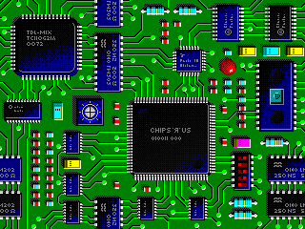
Wire Routing
Chung-Ang University Spring 2014
Notes:
Represent as a grid in which components and already placed wires are denoted by
blocked grid positions.

Slide 26
Lee’s Wire Router
start pin
end pin
Label all reachable squares 1 unit from start.
Chung-Ang University Spring 2014
Notes:
Could use rat in a maze animation from Web site instead.
Blue squares are blocked squares. Orange squares are available to route a wire.
A queue of reachable squares is used. The queue is initially empty, and the start pin square/cell is the examine cell. This cell has a distance value of 0. Unreached unblocked squares adjacent to the examine cell are marked with their distance (this is 1 more than the distance value of the examine cell) and added to the queue. Then a cell is removed from the queue and made the new examine cell. This process is repeated until the end pin is reached or the queue becomes empty. Cells become examine cells in order of their distance from the start pin.

Slide 27
Lee’s Wire Router
start pin
end pin
1
1
Label all reachable unlabeled squares 2 units from start.
Chung-Ang University Spring 2014

Slide 28
Lee’s Wire Router
start pin
end pin
2
2
1
1
2
2
2
Label all reachable unlabeled squares 3 units from start.
Chung-Ang University Spring 2014

Slide 29
Lee’s Wire Router
start pin
3
3
end pin
2
2
1
1
2
2
2
3
3
Label all reachable unlabeled squares 4 units from start.
Chung-Ang University Spring 2014

Slide 30
Lee’s Wire Router
start pin
4
3
3
end pin
2
2
1
1
2
2
2
3
4
3
4
4
4
Label all reachable unlabeled squares 5 units from start.
Chung-Ang University Spring 2014

Slide 31
Lee’s Wire Router
5
start pin
4
5
3
3
end pin
2
2
1
1
2
2
2
3
4
3
4
5
4
4
5
5
5
Label all reachable unlabeled squares 6 units from start.
Chung-Ang University Spring 2014

Slide 32
Lee’s Wire Router
6
5
6
start pin
4
5
3
3
end pin
2
2
1
1
2
2
2
6
3
4
3
4
5
6
4
4
5
6
5
6
5
6
6
End pin reached. Traceback.
Chung-Ang University Spring 2014

Slide 33
Lee’s Wire Router
6
5
6
start pin
4
5
3
3
end pin
2
2
1
1
1
2
2
2
2
6
3
4
3
3
4
4
5
5
6
4
4
5
6
5
6
5
6
6
End pin reached. Traceback.
Chung-Ang University Spring 2014

Slide 34
More Stack Applications
Parentheses Matching
Maze Router
Infix to Postfix
Chung-Ang University Spring 2014

Slide 35
X = a / b - c + d * e - a * c a = 4, b = c = 2, d = e = 3
Interpretation 1:
((4/2)-2)+(3*3)-(4*2)=0 + 8+9=1
Interpretation 2:
(4/(2-2+3))*(3-4)*2=(4/3)*(-1)*2=-2.66666…
How to generate the machine instructions corresponding to a given expression? precedence rule + associative rule
Evaluation of Expressions
Chung-Ang University Spring 2014

Slide 36
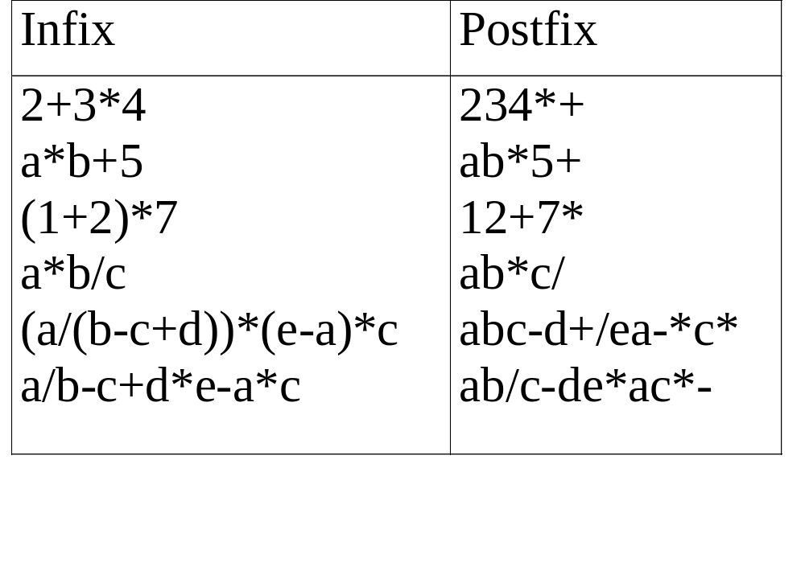
user
compiler
Postfix: no parentheses, no precedence
Chung-Ang University Spring 2014

Slide 37
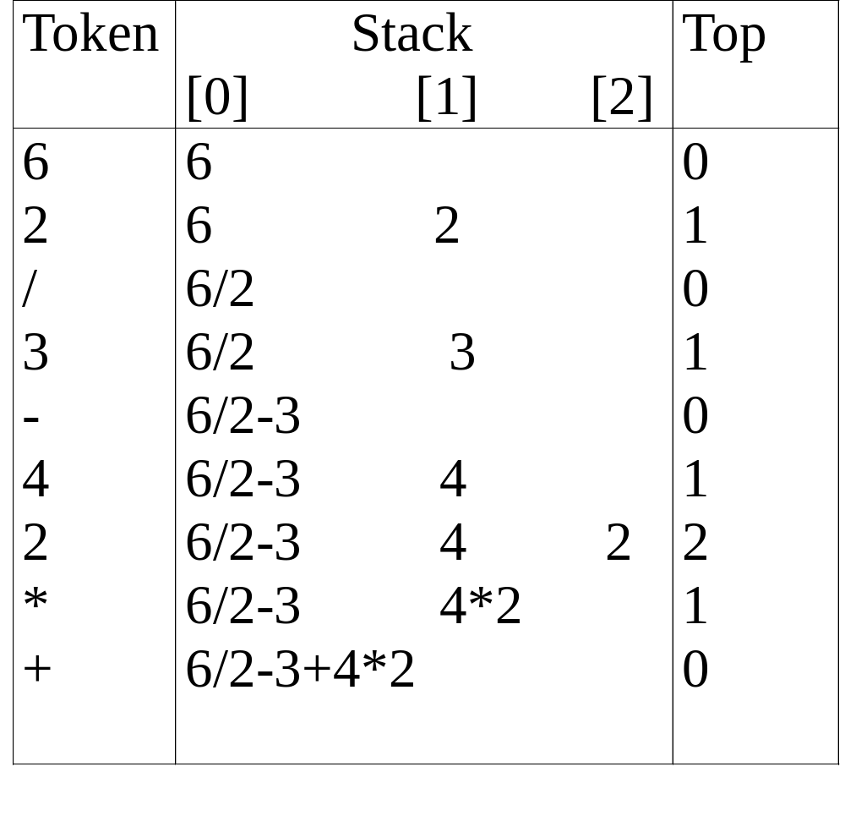
Chung-Ang University Spring 2014

Slide 38
#define MAX_STACK_SIZE 100 /* maximum stack size */
#define MAX_EXPR_SIZE 100 /* max size of expression */ typedef enum{1paran, rparen, plus, minus, times, divide, mod, eos, operand} precedence; int stack[MAX_STACK_SIZE]; /* global stack */ char expr[MAX_EXPR_SIZE]; /* input string */
Infix to Postfix
Assumptions:
operators: +, -, *, /, %
operands: single digit integer
Chung-Ang University Spring 2014

Slide 39
int eval(void)
{
/* evaluate a postfix expression, expr, maintained as a global variable, ‘\0’ is the the end of the expression.
The stack and top of the stack are global variables. get_token is used to return the token type and the character symbol. Operands are assumed to be single character digits */ precedence token; char symbol; int op1, op2; int n = 0; /* counter for the expression string */ int top = -1; token = get_token(&symbol, &n); while (token != eos) { if (token == operand) push(&top, symbol-’0’); /* stack insert */
Evaluation of Postfix Expressions
Chung-Ang University Spring 2014

Slide 40
else { /* remove two operands, perform operation, and return result to the stack */ op2 = pop(&top); /* stack delete */ op1 = pop(&top); switch(token) { case plus: push(&top, op1+op2); break; case minus: push(&top, op1-op2); break; case times: push(&top, op1*op2); break; case divide: push(&top, op1/op2); break; case mod: push(&top, op1%op2);
}
} token = get_token (&symbol, &n);
} return pop(&top); /* return result */
}
Chung-Ang University Spring 2014

Slide 41
precedence get_token(char *symbol, int *n)
{
/* get the next token, symbol is the character representation, which is returned, the token is represented by its enumerated value, which is returned in the function name */
*symbol =expr[(*n)++]; switch (*symbol) { case ‘(‘ : return lparen; case ’)’ : return rparen; case ‘+’: return plus; case ‘-’ : return minus;
Chung-Ang University Spring 2014

Slide 42
case ‘/’ : return divide; case ‘*’ : return times; case ‘%’ : return mod; case ‘\0‘ : return eos; default : return operand;
/* no error checking, default is operand */
}
}
Chung-Ang University Spring 2014

Slide 43
Infix to Postfix Conversion
(Intuitive Algorithm)
(1) Fully parenthesized expression
a / b - c + d * e - a * c -->
((((a / b) - c) + (d * e)) – (a * c))
(2) All operators replace their corresponding right
parentheses.
((((a / b) - c) + (d * e)) – (a * c))
(3) Delete all parentheses.
ab/c-de*+ac*-
two passes
/
-
+
*
*
-
Chung-Ang University Spring 2014

Slide 44
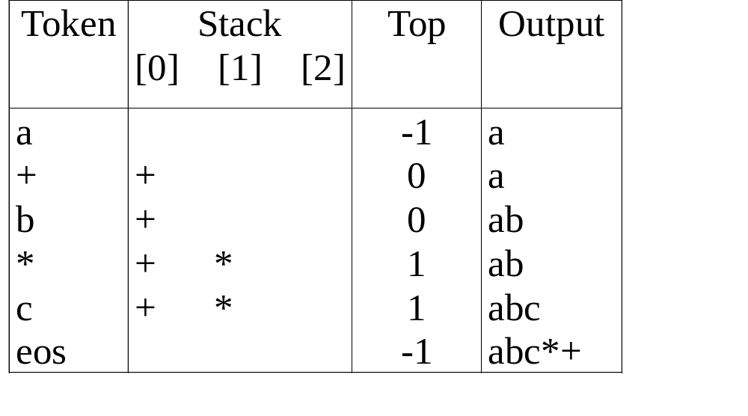
The orders of operands in infix and postfix are the same.
a + b * c, * > +
Chung-Ang University Spring 2014

Slide 45
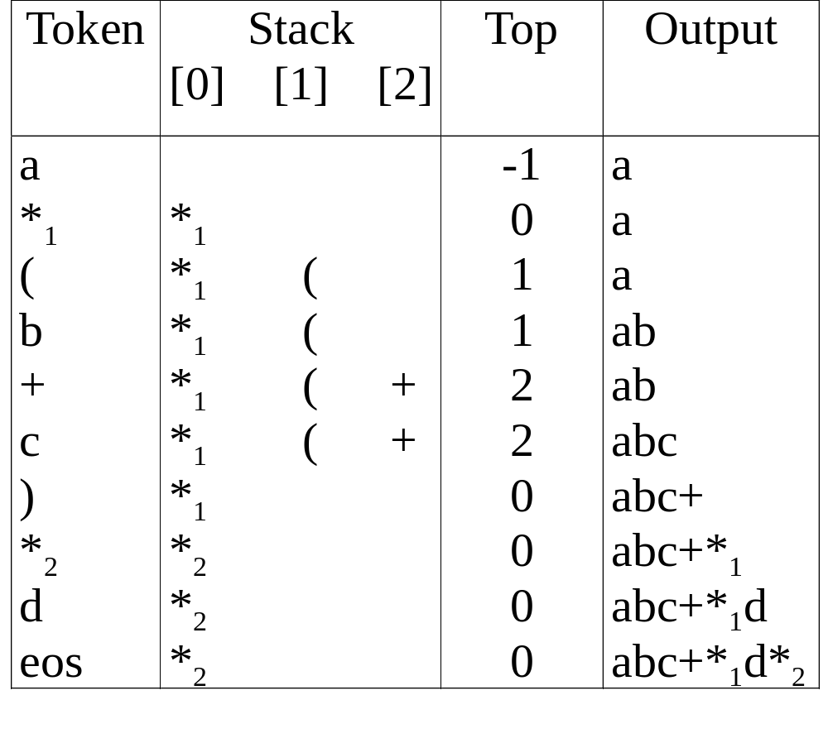
a *₁ (b +c) *₂ d
match )
*₁ = *₂
Chung-Ang University Spring 2014

Slide 46
Rules
Operators are taken out of the stack as long as
their
in-stack precedence is higher than or equal to the
incoming precedence of the new operator.
(2) ( has low in-stack precedence, and high incoming
precedence.
( ) + - * / % eos
isp 0 19 12 12 13 13 13 0
icp 20 19 12 12 13 13 13 0
Chung-Ang University Spring 2014

Slide 47
precedence stack[MAX_STACK_SIZE];
/* isp and icp arrays -- index is value of precedence lparen, rparen, plus, minus, times, divide, mod, eos */ static int isp [ ] = {0, 19, 12, 12, 13, 13, 13, 0}; static int icp [ ] = {20, 19, 12, 12, 13, 13, 13, 0};
isp: in-stack precedence
icp: incoming precedence
Chung-Ang University Spring 2014

Slide 48
void postfix(void)
{
/* output the postfix of the expression. The expression string, the stack, and top are global */ char symbol; precedence token; int n = 0; int top = 0; /* place eos on stack */ stack[0] = eos; for (token = get _token(&symbol, &n); token != eos; token = get_token(&symbol, &n)) { if (token == operand) printf (“%c”, symbol); else if (token == rparen ){
Infix to Postfix
Chung-Ang University Spring 2014

Slide 49
/*unstack tokens until left parenthesis */ while (stack[top] != lparen) print_token(delete(&top)); pop(&top); /*discard the left parenthesis */
} else{
/* remove and print symbols whose isp is greater than or equal to the current token’s icp */ while(isp[stack[top]] >= icp[token] ) print_token(delete(&top)); push(&top, token);
}
} while ((token = pop(&top)) != eos) print_token(token); print(“\n”);
}
Infix to Postfix (cont’d)
Chung-Ang University Spring 2014

