Slide 1


How to Go
Was go besonders macht

Slide 2

Tobias Theel
Software Architekt, Entwickler, Spielkind
https://noobygames.de
tobias.theel@noobygames.de

Slide 3
Gliederung
Allgemeines
Performance
Hello World
Klassen?
Vererbung?
Exceptions?
Concurrency
Interfaces

Slide 4
Allgemeines
Hauptsächlich von Google entwickelt
Intention: "Ein besseres C++"
Open Source
Compiliert zu Maschinen-Code
Sehr performant
Build Times
Batteries Included
Funktionen sind "first class citizens"
Static Typed
Starkes Toolset

Slide 5
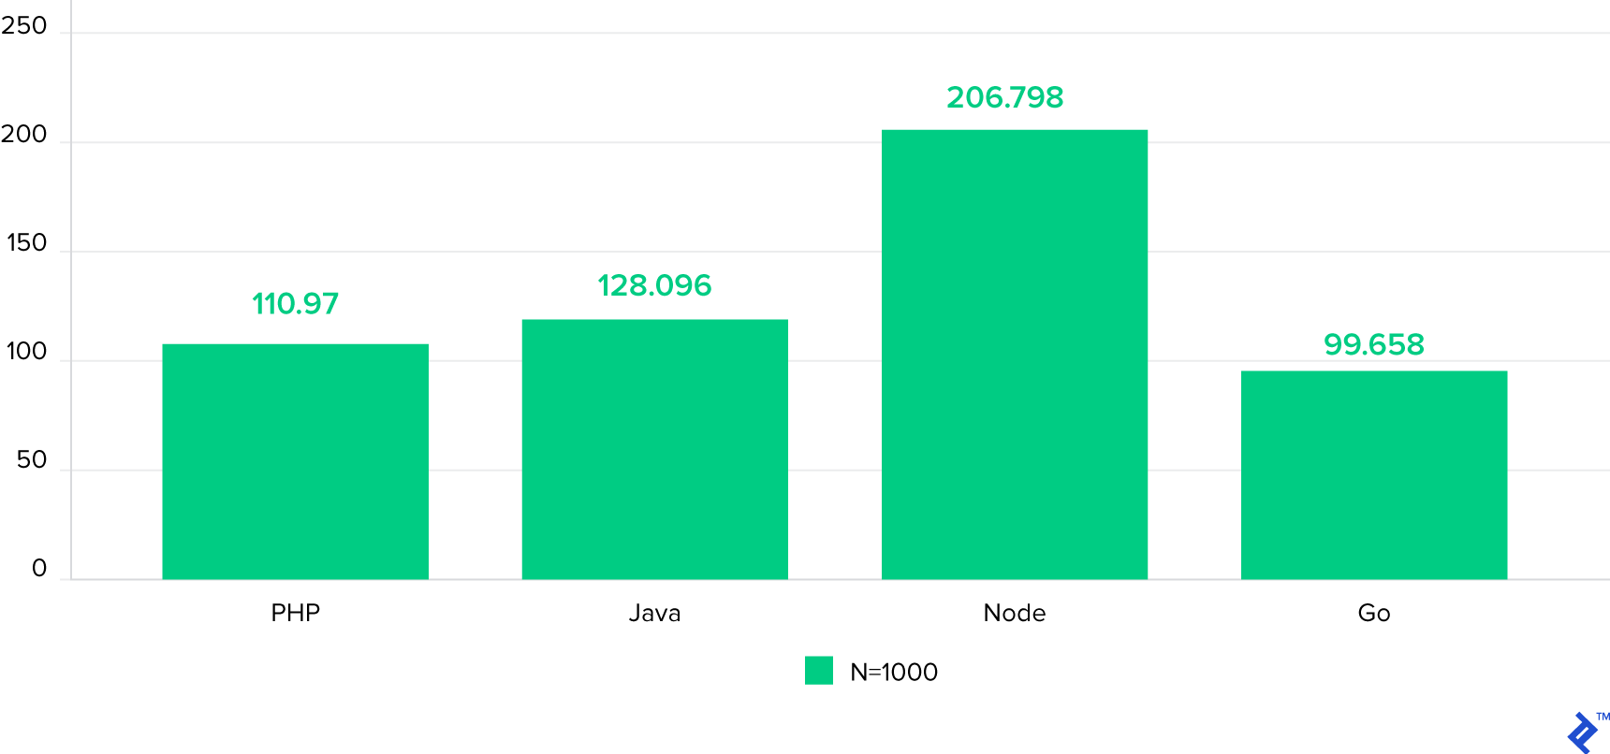
Performance
SHA-256 von 64K Daten
2000 Iterationen
300 Concurrent Requests
1000 Hashes pro Iteration
MilliSekunden Median

Slide 6
Hello World
->VSCode

Slide 7
Klassen?
Es gibt keine Klassen
Structs
Method Receiver
Pointer <3
VSCode

Slide 8
Vererbung
Es gibt keine Vererbung
"Favor composition over inheritance"
VSCode

Slide 9
Exceptions?
Nope
Error Interface

Slide 10
Concurrency
"A goroutine is a lightweight thread managed by the Go runtime. "
"Goroutines run in the same address space, so access to shared memory must be synchronized. The sync package provides useful primitives, although you won't need them much in Go as there are other primitives. (See the next slide.) "
https://tour.golang.org/concurrency/1

Slide 11
Interfaces
VSCode

Slide 12
Weiteres
https://tour.golang.org/welcome/1

Slide 13



