Slide 1
Game Concept
Presentation #1
CSCE-552-001
Due: 15th September 2017
Team “BOTS”
Abbi Reisig
M. Brady O’Leary
A. Danielle Talley

Slide 2
Team “BOTS”
Abbi Reisig
M. Brady O’Leary
A. Danielle Talley

Slide 3
Mission Statement
The goal of this game is to create a networked multiplayer 3D game in Unity that is a blend of PvP and PvE, whose level is procedurally generated, and that empowers the players based on strategic, cooperative gameplay.

Slide 4
Decision Tree
Character Selection
Abilities
Personal Goal
Regions
Components
Resources
Early Game
Team Composition
Pre-Game
Late Game
Enemy Composition
Team Objective

Slide 5
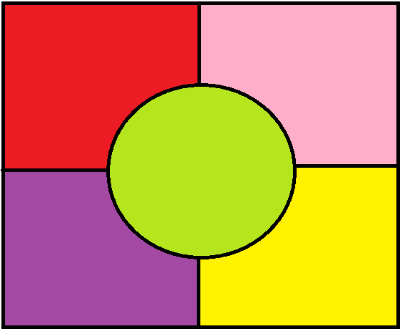
Level Design
Four regions (one for each corner) randomly selected:
Mountains
Forest
Desert
Swamp
Coast
The center is open grassland
“No man’s land”
The configuration of the map and each region will be generated each match
Resources and enemies will be region specific
Excluding generic (common) resources that might appear in multiple regions at varying percentages (wood, rocks, etc.)

Slide 6
Timeline
Phase | Due | Interval | Objective
Phase 1 | 15th September 2017 | 1 week | Preliminary Design
Phase 2 | 22nd September 2017 | 1 week | In-Depth Design
Phase 3 | 20th October 2017 | 4 weeks | Core Functionality
Phase 4 | 10th November 2017 | 2 weeks | Required Modeling
Phase 5 | 24th November 2017 | 2 weeks | User Interfaces
Phase 6 | 8th December 2017 | 2 weeks | Refine

