Slide 1
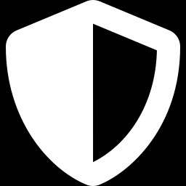
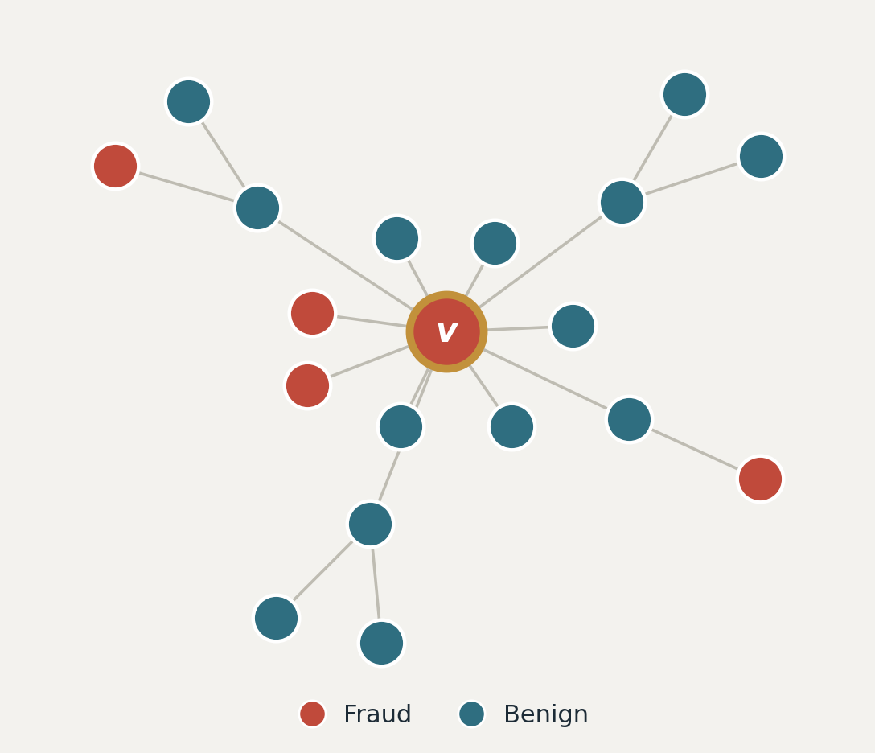
GRAPH-BASED FRAUD DETECTION
Group Aggregation
Against Low Homophily
AUTHORS
Alessandro Nese
COURSE
Neural Network · MSc Computer Science, Sapienza
Target node v is fraudulent, yet most of its neighbors are benign
EXAM DATE
30 June 2026

Slide 2


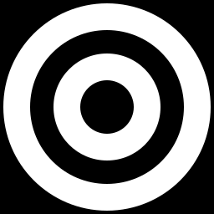
01 · MOTIVATION & AIM
Why fraud detection breaks standard GNNs
Fraudsters camouflage
A fraud node connects mostly to benign nodes, so its neighborhood looks legitimate: the graph is heterophilic (low homophily).
Smoothing hurts here
Message-passing GNNs average neighbors, implicitly assuming they share the target's label. Under heterophily this dilutes the fraud signal into the benign majority
GOAL: Reproduce GAGA and quantify how its group aggregation and learnable encodings each contribute Amazon and YelpChi

Slide 3
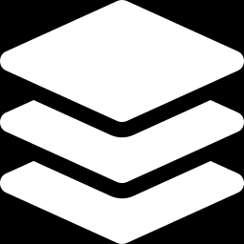
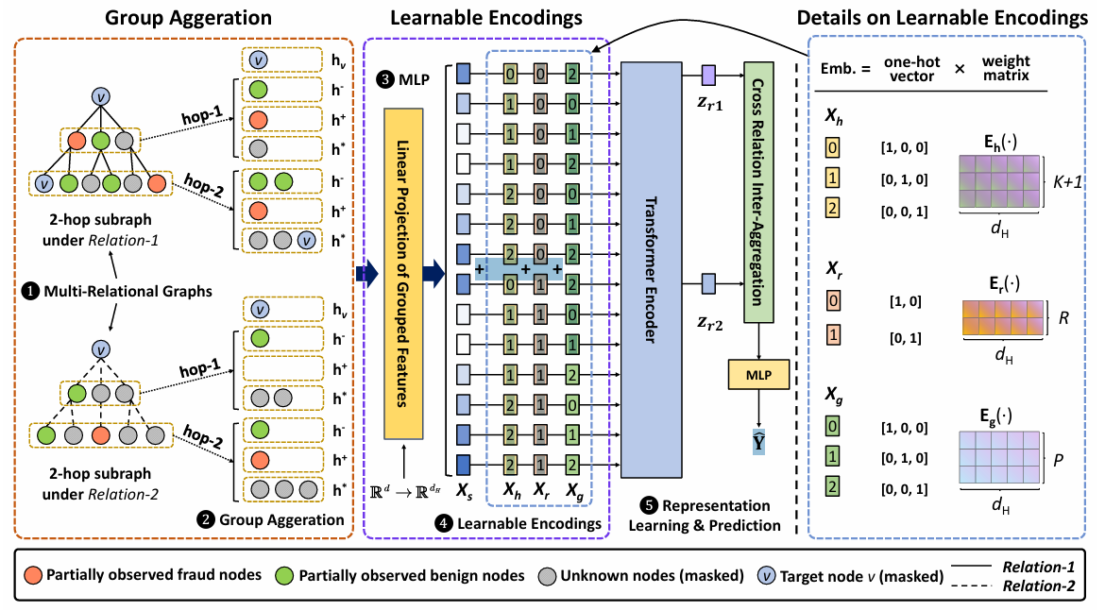
02 · METHOD
GAGA: group aggregation + a Transformer
Key idea Instead of averaging all neighbors into one vector, group them by label (benign / fraud / masked) and let a Transformer re-weight the groups, so the fraud signal is never smoothed away
1
Group Aggregation
Pool neighbors per label group, per hop & relation — weight-free preprocessing.
2
Linear Projection
Lift each group vector to hidden size dH.
3
Learnable Encodings
IMAGE PLACEHOLDER
Add hop, relation & group (label) stamps: Xin = Xs+Xh+Xr+Xg.
4
Transformer Encoder
Multi-head attention re-weights the group vectors.
5
Inter-Agg. + MLP
Fuse relations → sigmoid → fraud probability.

Slide 4

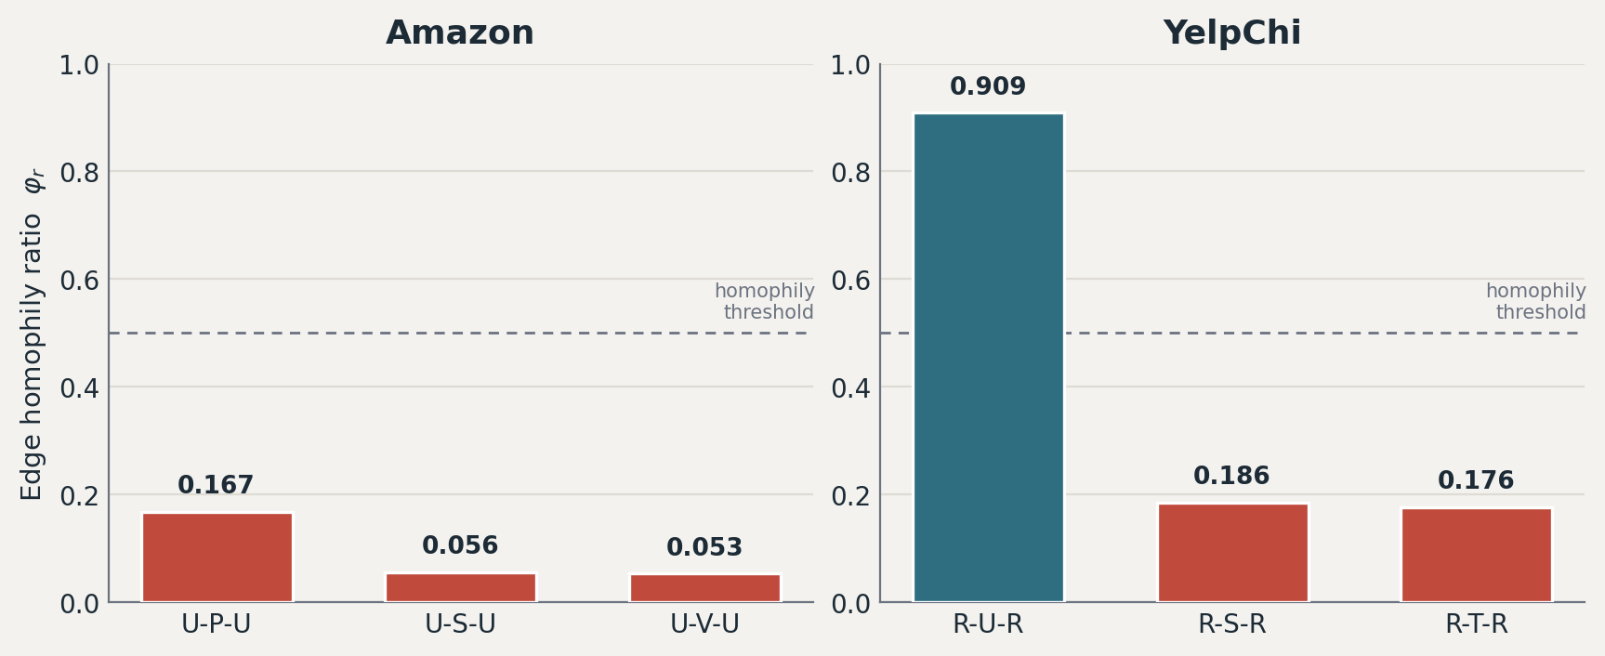

03 · IMPLEMENTATION & EXPERIMENTS
Datasets & what I evaluated
Amazon
YelpChi
11,944 nodes · 3 relations · imbalance 13.5 · homophily φ 0.05–0.17
45,954 nodes · 3 relations · imbalance 5.9 · homophily φ 0.18–0.91
What I evaluated
Component ablation (§5.7.1) GA vs. a plain mean aggregator, plus RNN/LSTM/Transformer backbones.
Encoding ablation (§5.7.2) Isolating the contribution of Xh, Xr and the group encoding Xg.
Parameter analysis (§5.7.3) Sensitivity to training-set % and observed-label %.
Most relations sit far below the 0.5 homophily line — the low-homophily regime GAGA targets.
.

Slide 5
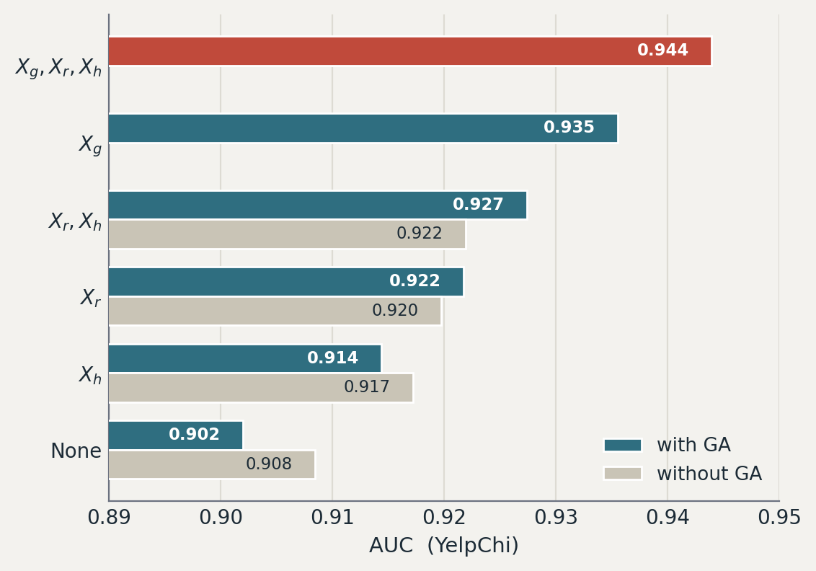
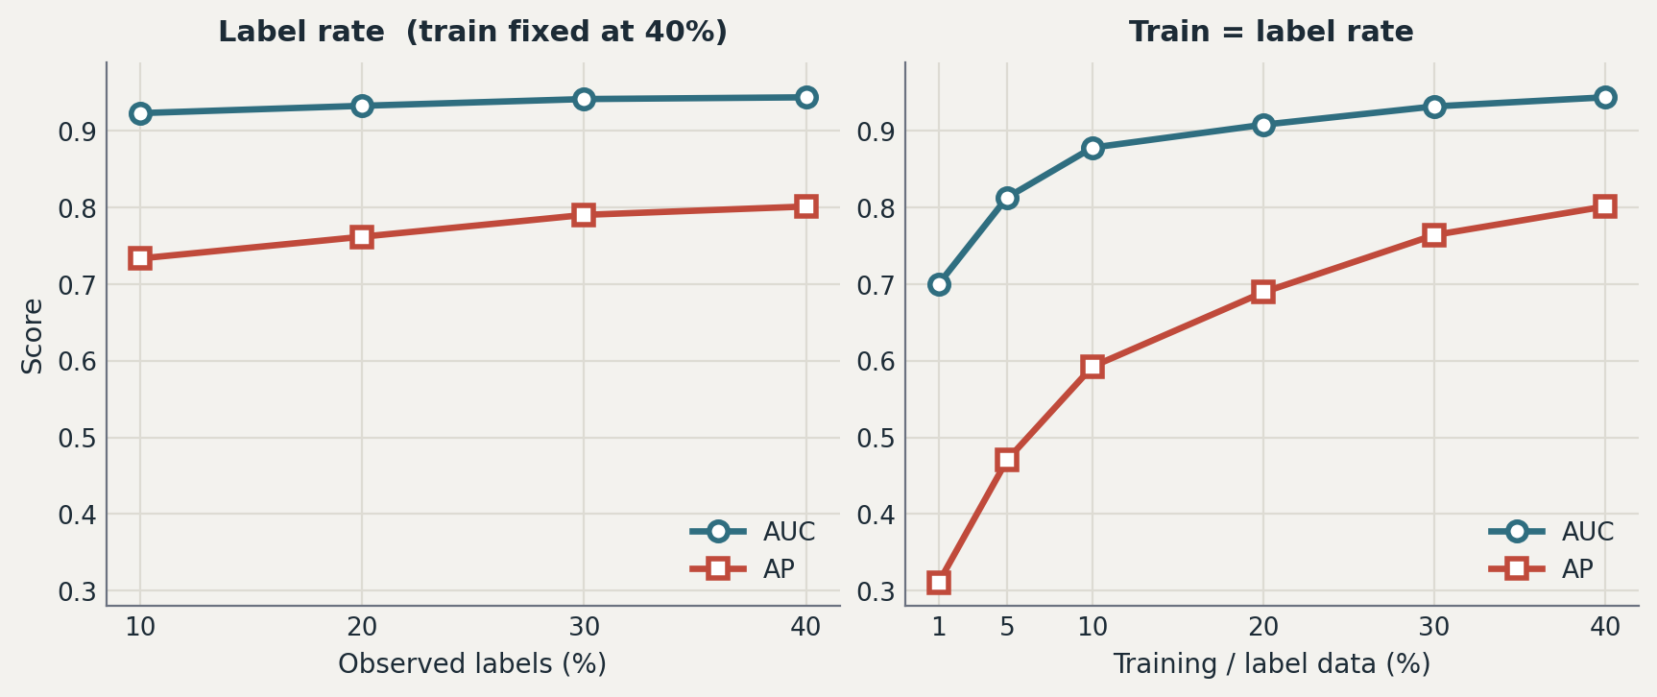
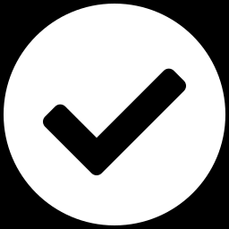
04 · RESULTS
Group aggregation drives the gains
Sensitivity analysis (YelpChi). GAGA stays strong as labels/data shrink.
Full model — best AUC 0.944 on YelpChi.
Encoding ablation (YelpChi AUC). Full model in red; group encoding Xg is the strongest single encoding.
Group encoding Xg alone: +3.4 AUC pts over no encoding.
Robust under scarcity — 0.878 AUC with only 10% labels.

Slide 6
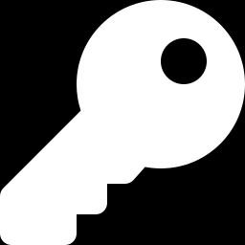
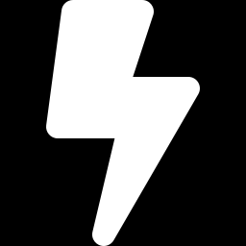
05 · CONCLUSIONS
Goal achievement & key takeaways
Removing group aggregation costs −3.8% AUC and −12.9% AP on YelpChi — the decisive component.
Goal achieved
Labels as features
Practical & efficient
Reproduced GAGA's behavior; group aggregation is what closes the low-homophily gap.
The group (label) encoding gives the single largest encoding boost — labels belong in the feature space.
Accurate even with few labels, and training throughput is independent of graph structure.

Slide 7
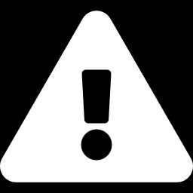
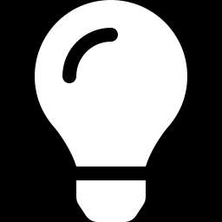
06 · OUTLOOK
Limitations & future work
Limitations
Future work
Binary only (C = 2): groups are benign / fraud / masked.
Generalize group aggregation to multi-class (C > 2).
This study omits baseline comparisons — scope is GAGA's internal components.
Benchmark against CARE-GNN, PC-GNN and H2-FDetector.
Encoder norm placement is under-specified in the paper (pre- vs post-norm).
Extend to dynamic / streaming fraud graphs.

