Slide 1
FINTECH – ML CASE STUDY
Client Segmentation and Recommendation Systems
Simone Colombara, Alessia Cotroneo, Jacopo Figuriello, Cecilia Gallotti

Slide 2
Business Problem
Goal: Tailoring Products to Bank Customers
Client Segmentation
Recommendation Systems
Identify Financial Personas
Associate the right product to the customer need
We want to perform dimensionality reduction in order to summarize key informations and group together people with similar traits.
We want to understand the needs of our clients and offer them tailored products and services in a personalized way.
We will focus on those clients’ traits deemed relevant in producing a product recommendation.
We will focus on two products: income and accumulation funds. What changes is whether the client wants to receive regular investment income or is looking to accumulate capital.

Slide 3
Business Plan
Tailoring Your Products And Services To Your Customers
As often happens, we have datasets with different features.
Dataset 1: Bank Clients with many informations about clients and their financial habits.
Dataset 2: Needs where clients are associated with a particular product’s type: income or accumulation taking into consideration client’s risk propensity.
Steps
Estimate the unknown features of dataset Bank Clients with the features of the dataset Needs thanks to a Supervised Learning approach. In particular, we build:
A Classifier able to infer whether a given client is more likely to pick an income or an accumulation product;
A Regressor able to infer the client’s risk propensity.
Clustering clients using Dataset 1 and apply to such clusters the Classifier and Regressor obtained above in order to deduce risk propensity and product taste.
Take into consideration previous results and financial expertise to reach a final customer recommendation.

Slide 4
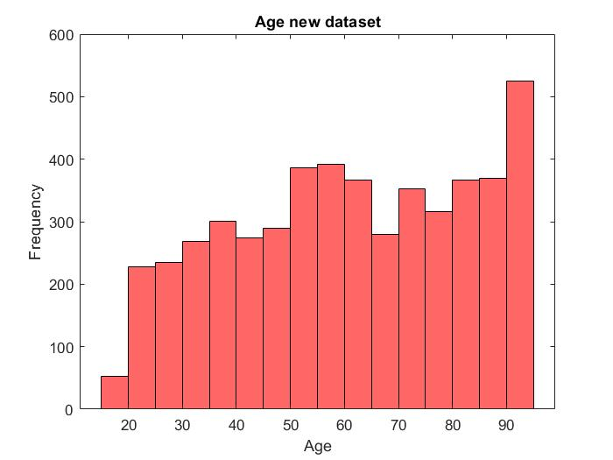
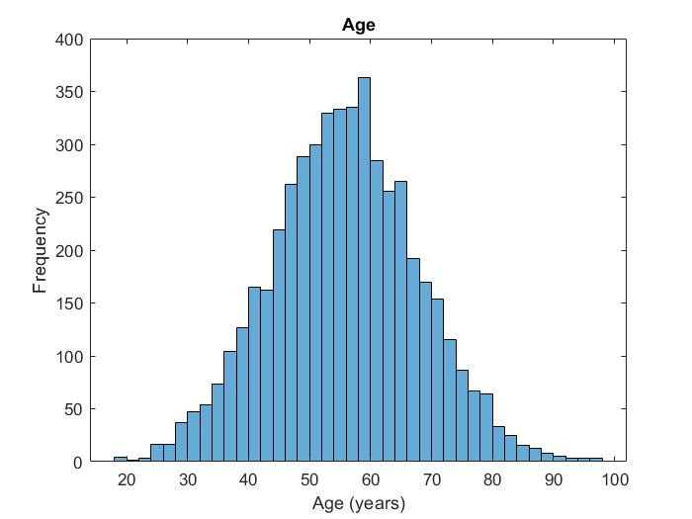
Dataset Exploration and Issues
First of all we do some dataset exploration for both the Datasets. We immediately realized that the distributions of the clients in the two datasets are quite different mainly because of the different proportion of older clients.
Observation: note that the feature age is the only one that we do not rescale during the models training since it’s the only variable whose meaning is exactly the same in the two datasets. For example variables income and wealth in Dataset ‘BankClients’ are already standardized (and we cannot deduce their actual values) while on the Dataset ‘Needs’ income and wealth are not standardized (we have their actual values).

Slide 5
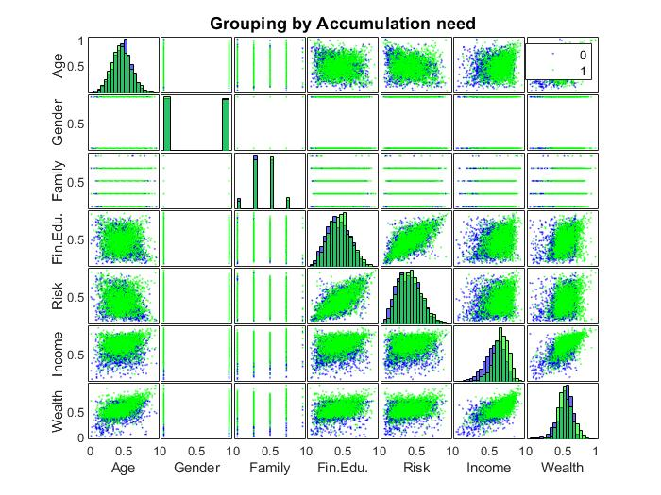
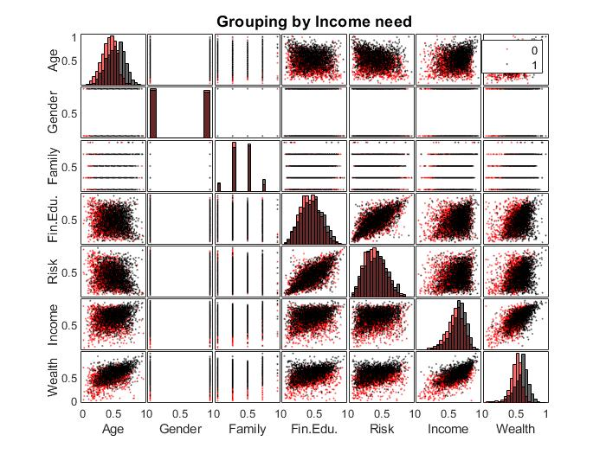
Dataset Exploration and Issues
We also realized that for each of two products it’s not easy for an algorithm to discern whether a person is interested or not.
We can observe that the features that present some kind of differentiation are age, income and wealth. As a matter of fact these are the main features on which we trained our Classifier and Regressor.

Slide 6
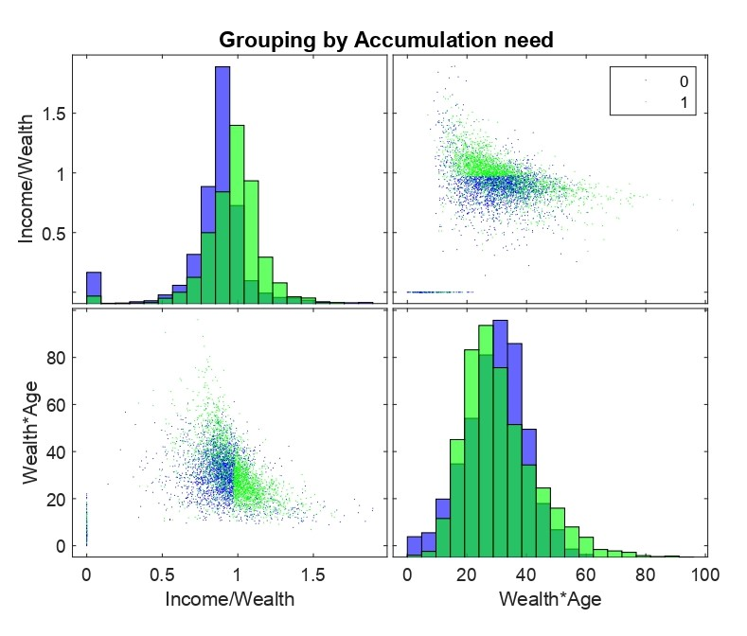
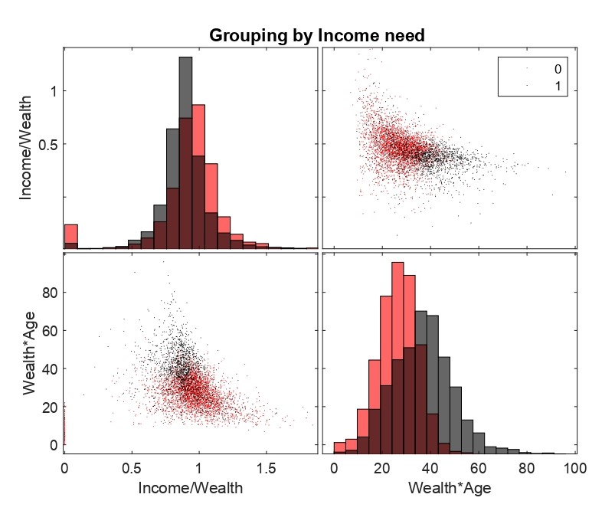
Dataset Exploration and Issues
Moreover, in training the Classifier and Regressor we will also use some additional features: income/wealth and wealth*age since, as you can see from the graphs below, they help in discerning if the client is interested in the product.

Slide 7


Training Classifier and Regressor
We use the Regression Learner to find the best model to retrieve the Risk Propensity of the Dataset Bank Clients from the Dataset Needs.
[trainedRegressor, validationAccuracy] = trainRegressionModel(XsmallTrainTableRegression)
%The results are not so good in terms of R2 (it is 0.5 on training set and 0.48 on test set)
Similarly, we built a Classification Algorithms for both Accumulation and Income estimation. The model we picked is an Optimizable Ensemble.
%Model for Income estimation
[trainedClassifierInc, validationAccuracy] = trainClassifierInc(XsmallTrainTableClassification, yInvIncTrain)
%Model for Accumulation estimation
[trainedClassifierAcc, validationAccuracy] = trainClassifierAcc(XsmallTrainTableClassification, yInvAccTrain)

Slide 8

Client Segmentation
Dataset Exploration
Analysis and scaling of the dataset, Dimensionality Reduction through PCA and Feature Selection.
Cluster Analysis
Embedding Algorithm: tsne
Clustering Algorithm : k-medoids.
Clustering Evaluation
Cluster evaluation based on 3 different techniques: Silhouette, Calinski-Harabasz and Davies-Bouldin methods.
Inspecting Clusters
Focus on the clustering with better performances and inspect them in order to identify Financial Personas. We also used our financial expertise in order to group together similar clusters.
Financial Personas
Creation of semi-fictional representation of ideal customer for each cluster.

Slide 9
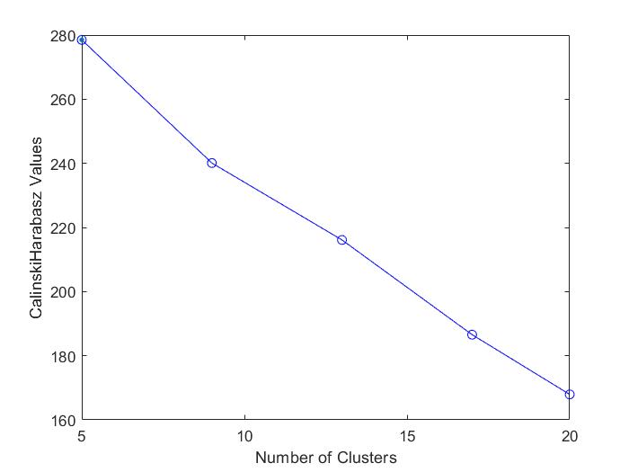
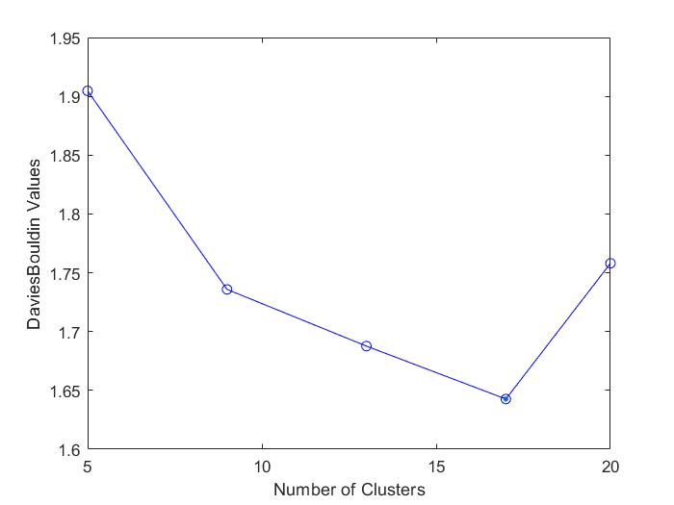
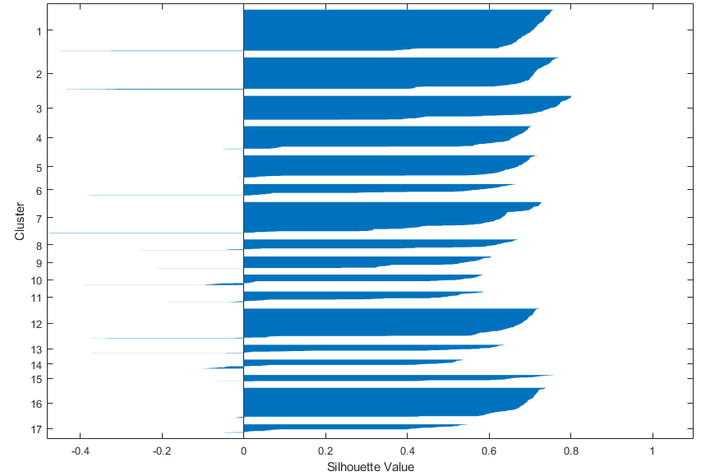
Clustering Evaluation
We used the tsne algorithm to perform dimensionality reduction so that we can plot the many features of the dataset BankClients in a 3 dimensional scale. Then we picked K-medoids as a clustering algorithm. We tried the algorithm with many different choices for the number of clusters. At the end we decided to use an ‘innovative’ approach picking a relatively high number of clusters -17- with very good algorithm performances and then grouping together clusters that we considered similar.
Y = tsne(X,'Algorithm','exact','Distance', @MixDistance,'NumDimensions',3);
%Try 17 cluster k-medoids
[IDX17, C17, SUMD17, D17, MIDX17, INFO17] = kmedoids(X,17,'Distance', @MixDistance,'replicates',20);

Slide 10
Inspecting Clusters
We strongly reduced the number of clusters from 17 to 5, analyzing and grouping together similar clusters. The features we mostly took under consideration are the following:
Age
Income and Wealth
The time horizon is a very important feature when it comes to picking the right financial product and it’s the main driver of the choice between accumulation and income
As general indicators of the financial status. Unfortunately our clusters have all similar values between income and wealth and among them. (Except for the clusters we denoted as Top Jobs.)
Savings approach
Kind of investments
It’s an important parameter to take into consideration when analyzing the likelihood of success of a particular investment product/strategy. For example, a spendthrift could have a hard time with an accumulation product with a long- term time horizon.
It is a key feature to outline a character and its approach towards investing: no investing, lump sums, capital accumulation.
Observation: we also took under consideration other features like lifestyle, luxury, … to design the financial personas.

Slide 11


 | AGE: 55
 | INCOME: 0.75
 | WEALTH: 0.75
 | FINEDU: 0.69
 | SAVINGS:0.62
 | TYPE OF INVESTMENTS: LUMP SUMS/ CAPITAL ACCUMULATION
 | SUGGESTED PRODUCT: ACCUMULATION (EVENTUALLY BOTH)
THE EDUCATED TOP JOBS ELITE
Financial
Personas Presentation
 | AGE: 68
 | INCOME: 0.57
 | WEALTH: 0.57
 | FINEDU:0.50
 | SAVINGS: 0.58
 | TYPE OF INVESTMENTS:CAPITAL ACCUMULATION
 | SUGGESTED PRODUCT: INCOME
THE WAGE/PENSION SLAVER
Observation:
The suggested product is chosen for now according to our common sense. It will be compared later with the output of our classifier.

Slide 12


THE NO INVESTING APPETITE PERSON
 | AGE: 65
 | INCOME: 0.56
 | WEALTH: 0.55
 | FINEDU: 0.49
 | SAVINGS:0.52
 | TYPE OF INVESTMENTS: NO INVESTMENTS
 | SUGGESTED PRODUCT: ACCUMULATION (LOW RISK)
Financial
Personas Presentation
 | AGE: 70
 | INCOME: 0.50
 | WEALTH: 0.56
 | FINEDU: 0.48
 | SAVINGS: 0.50
 | TYPE OF INVESTMENTS: LUMP SUMS
 | SUGGESTED PRODUCT: INCOME
THE RETIRED LUMP SUM INVESTOR

Slide 13

 | AGE: 60
 | INCOME: 0.62
 | WEALTH: 0.63
 | FINEDU: 0.55
 | SAVINGS: 0.58
 | TYPE OF INVESTMENTS: CAPITAL ACCUMULATION
 | SUGGESTED PRODUCT: ACCUMULATION
THE WELL-OFF NEARLY RETIRED PERSON
Financial
Personas Presentation
Observation
‘The educated Top Jobs Elite’ is made up of clusters: 3,7 and accounts for the 17.08% of the total;
‘The Wage/Pension Slaver’ is made up of clusters: 2, 8, 15 and accounts for the 15.33% of the total;
‘The No investing appetite person’ is made up of clusters: 5, 9, 13, 16, 17 and accounts for the 25.18% of the total;
‘The Retired lump sum investor’ is made up of clusters: 4, 10, 12, 14 and accounts for the 22.51% of the total;
‘The well-off nearly retired person’ is made up of clusters: 1, 6, 11 and accounts for the 19.90% of the total.

Slide 14

Recommendation Systems
Performance Evaluations
Check Regression results for Risk Propensity and Classification results for the suggested product. Take into consideration financial expertise.
Results and Conclusions
Idea
Apply the previously trained Classification and Regression models on clusters of already segmented clients.
Create personalized recommendations
Based on the cluster the client belongs to and on personal traits and risk propensity.

Slide 15
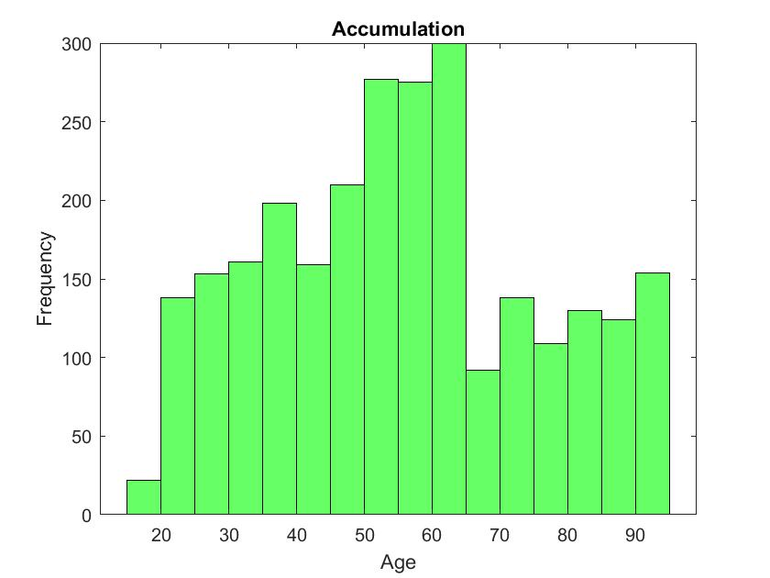
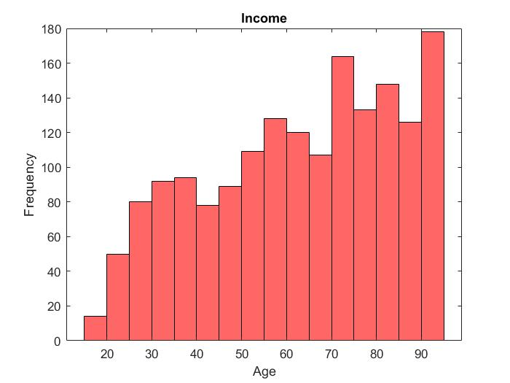
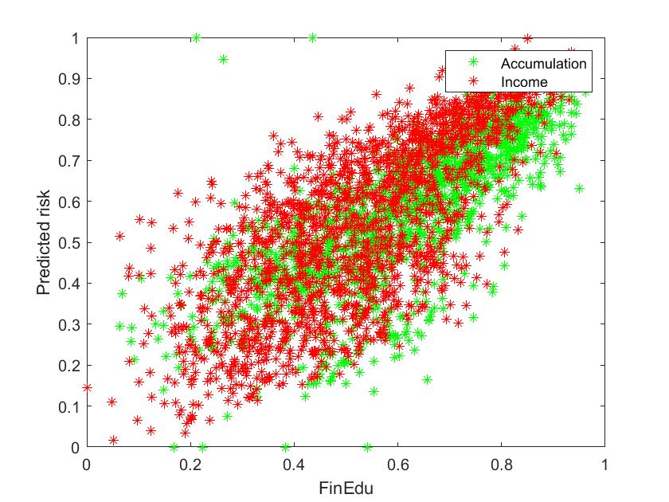
Performance Evaluations
Observe that the frequency of customers that are suggested an accumulation product decrease with respect to age, while the frequency of people that are suggested an income product increase with respect to age. This result is in harmony with what we expected as it is a product not intended for aged and retired people.
Similarly we observe that the predicted risk that a customer is willing to take has a linear dependance with respect to the Financial Education. This is an interesting result as it suggests that well educated people are more likely to take risks. This happens both for accumulation and income product and again reflect what we expected.

Slide 16
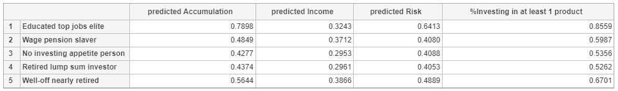
Create personalized recommendations
The results obtained with the classifier are coherent with what we expected especially for some clusters:
Cluster 1: results are identically as expected. We note a high predicted accumulation but as we mentioned before we can also propose these clients an additional income product. Since predicted risk is high we will propose them riskier products;
Cluster 2: results are not easy to interpret but we can observe that the predicted income is one of the highest, at the same time we have a good predicted accumulation. In this case the final recommendation will be done individually;
Cluster 3: results are similar to what expected. We would suggest a (very) low risk accumulation product;
Cluster 4: we thought initially about an income product because of the high average age of the cluster. However the algorithm seems not to agree with us. We would anyway suggest an income product or alternatively consider a personalized suggestion case by case;
Cluster 5: results are similar to what expected. We would suggest an accumulation product with an average risk.
Observation: we match products whose risk is lower or equal than the clients’ predicted risk.

Slide 17
Results and Conclusions
Our work can be helpful as a support base for client segmentation and above all product recommendation. Of couse this work cannot substitute the figure of financial consultants as it’s important to consider each client individually in its peculiarities. In general it isalways suggested to use ML models jointly with financial expertise.
Fixed Income, Income Fund
Aggressive Accumulation (Income) Fund
For those who look at income investments over the low-to-medium term horizon and with low level of risk. The compositon of the portfolio is made up of at least 50% of bonds.
For those who seek a capital growth and are willing to take high levels of risk. The portfolio can have equity instruments up to 100%.
Fixed Income, Accumulation Fund
For those who look at accumulation investments over the low-to-medium term horizon and with low level of risk. The compositon of the portfolio is made up of at least 50% of bonds.
Fixed Income, Income Fund
For those who look at income investments over the low-to-medium term horizon and with low level of risk. The compositon of the portfolio is made up of at least 50% of bonds.
Dynamic Accumulation Fund
For those who look for an accumulation investment product over a low-to-medium time horizon and with a moderate risk propensity. (up to 50% equities)

Slide 18
Thank Y u
Simone Colombara
Alessia Cotroneo
Jacopo Figuriello
Cecilia Gallotti

