Slide 1



22CSP72 – PROJECT WORK II PHASE I II Review Explainable Multi-Objective Concrete Mix Optimization for Strength, Cost, and Sustainability Using Machine Learning
Team Members:
MIDUNA R (23CSR131)
NESHA R K(23CSR147)
ROHITH O R(23CSR180)
MENTOR :
Mr T ARUNKUMAR
Assistant Professor / CSE
Date:12.09.2026

Slide 2
Problem Statement
Concrete compressive strength is a critical factor in ensuring structural safety and durability.
Conventional strength testing requires laboratory experiments and long curing periods, typically up to 28 days.
The testing process is time-consuming and costly.
Delayed test results make it difficult to take quick decisions during construction.
Therefore, there is a need for a faster and reliable approach to estimate concrete strength

Slide 3
Proposed Solution
Develop a Machine Learning-based system to predict concrete compressive strength.
Use concrete mix parameters such as cement, water, aggregates, and
age as input features.
Train ML models using historical concrete strength data.
Identify the most suitable model for accurate strength prediction.
Provide fast and explainable predictions to support construction decision-making.

Slide 4
Objectives
Predict concrete compressive strength.
Compare Machine Learning models.
Explain predictions using SHAP.
Optimize cost and carbon emission.
Recommend the best concrete mix.
Develop a user-friendly dashboard.

Slide 5
Literature Survey
Author & Year | Methodology | Best Model | Performance | Limitations
MDA-Based Concrete Strength Prediction (2024) | Modified Dimensional Analysis (MDA), DT, RF, SVM, ANN | MDA | R² = 0.94 | No explainability, no optimization
Concrete Strength Prediction Using ML Techniques (2024) | LR, RF, DT, XGBoost, LightGBM, AdaBoost, CatBoost | LightGBM | R² = 0.895 | Only prediction, lacks interpretability
Interpretable ML Model for RA-SCC (2025) | XGBoost, RF, SVR, MLP, SHAP, Bayesian Optimization | XGBoost + SHAP | R² = 0.909 | Small dataset, no cost/carbon analysis
Concrete Strength Prediction Using ML (2024) | RF, SVM, Bagging Regressor | Random Forest | R² = 0.87 | No explainable AI, limited optimization

Slide 6
Literature Survey
Author & Year | Methodology | Best Model | Performance | Limitations
Alsaadawi et al. – Hybrid ML with Interactive GUI (2025) | RF, AdaBoost, XGBoost, LightGBM, CatBoost + Bayesian Optimization + SHAP | LightGBM | Accuracy up to 93.5% | Classification only, not mix optimization
Abioye et al. – SHAP Analysis for HPC Strength (2025) | XGBoost, GBR, RF, SVR, ANN, KNN + Grid Search + SHAP | XGBoost | R² = 93.49% | Prediction only, no cost optimization
Shaaban et al. – Forecasting HSC Strength (2025) | XGBoost, RF, ANN, SVR | XGBoost | R² ≈ 0.94 | No explainability or sustainability analysis
Sapkota et al. – Explainable ML for HSC Strength (2025) | XGBoost + Metaheuristic Optimization + SHAP | LS-XGB | R² > 0.96 | Limited to high-strength concrete dataset

Slide 7
Base Paper Selection
Title: Interpretable Machine Learning Model for Compressive Strength Prediction
of Self-Compacting Concrete with Recycled Concrete Aggregates and SCMs
Publication Details:
Journal: Journal of Building Engineering
Publisher: Elsevier
Year: 2025
Best Model: XGBoost + SHAP
Accuracy: R² = 0.909 (90.9%)
Reason:
Recent publication (2025)
Published in a reputed journal
Includes Explainable AI (SHAP)
Provides clear scope for further enhancement
Uses advanced ML techniques (XGBoost)

Slide 8
Research Gap
Existing models lack an integrated framework for strength, cost, and sustainability analysis.
Carbon emission impact of concrete mix designs is rarely considered.
Most research does not provide an optimal concrete mix recommendation system.
Limited consideration of real-world construction requirements such as budget constraints.
Existing studies mainly focus on prediction rather than decision support.

Slide 9
Novelty
Proposed Novel Contributions
Concrete Mix Recommendation
Cost Estimation
Carbon Emission Estimation
Real-time prediction and analysis through a web-based interface
Multi-criteria decision support considering strength, cost, and sustainability simultaneously.

Slide 10
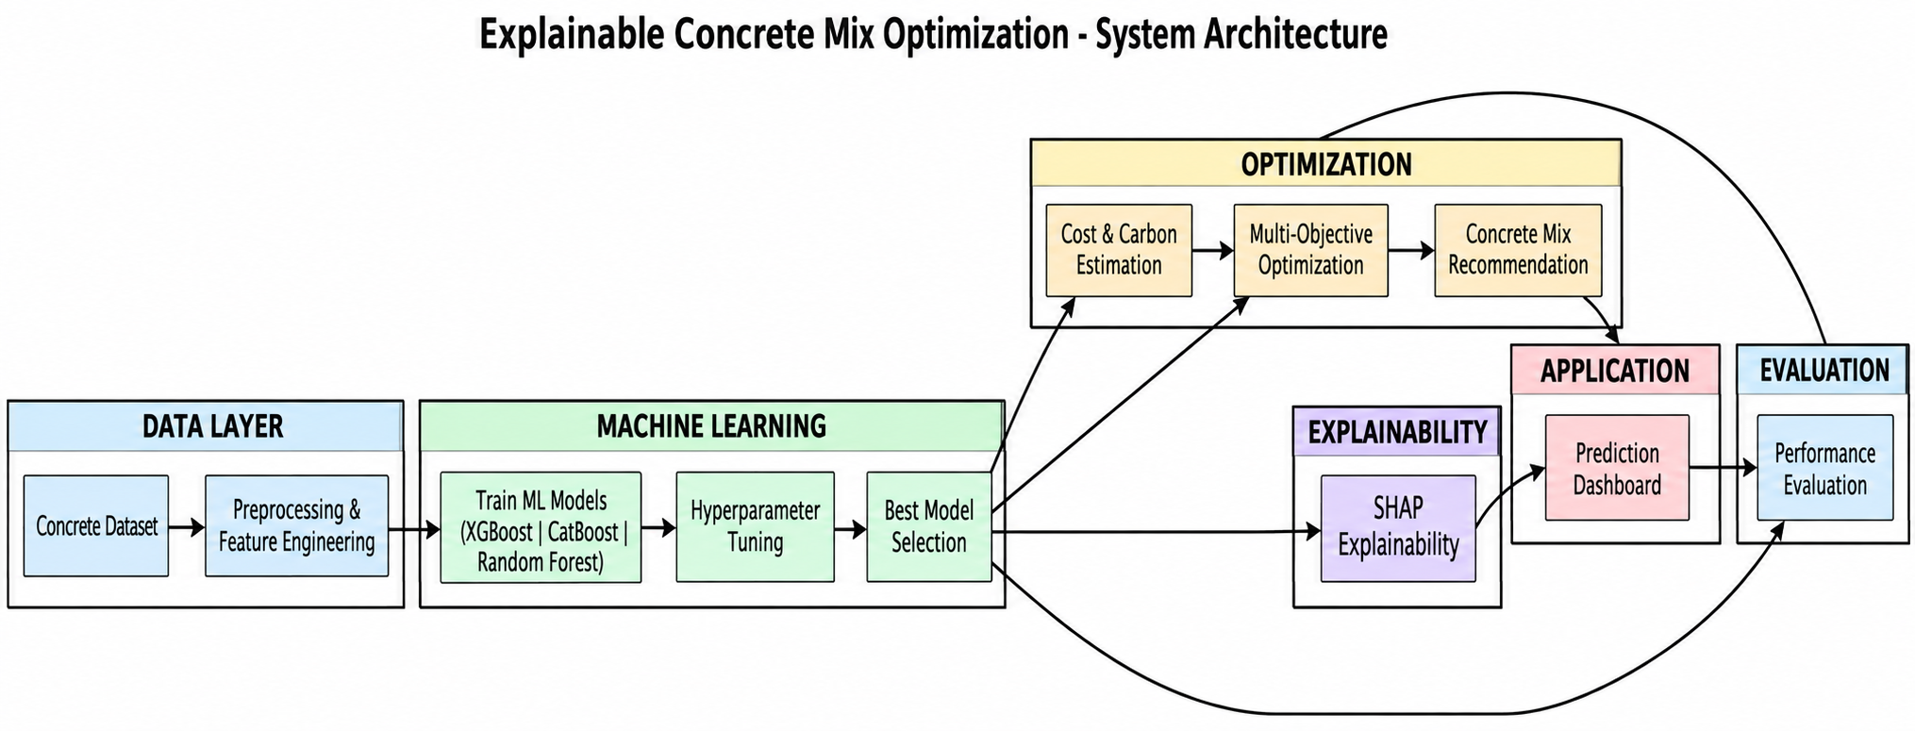
Architecture Diagram

Slide 11
Proposed Work with Planned Innovation
Planned Innovations
Explainable AI using SHAP for transparent strength prediction
Multi-objective optimization balancing strength, cost, and sustainability
Automated material cost estimation for each mix design
Carbon footprint estimation to support sustainable construction
Automatic concrete mix recommendation engine
Interactive prediction dashboard interface
Comparative evaluation of multiple ML models
Hyperparameter tuning for optimal model performance

Slide 12
Modules of the Project
Project Modules
Module 1 – Dataset Collection
Module 2 – Data Preprocessing
Module 3 – Feature Engineering
Module 4 – Machine Learning Model Training
Module 5 – SHAP Explainability
Module 6 – Cost Prediction
Module 7 – Carbon Emission Prediction
Module 8 – Concrete Mix Recommendation
Module 9 – Prediction Dashboard
Module 10 – Performance Evaluation

Slide 13
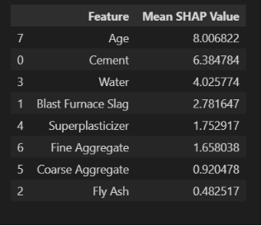
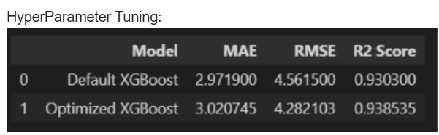
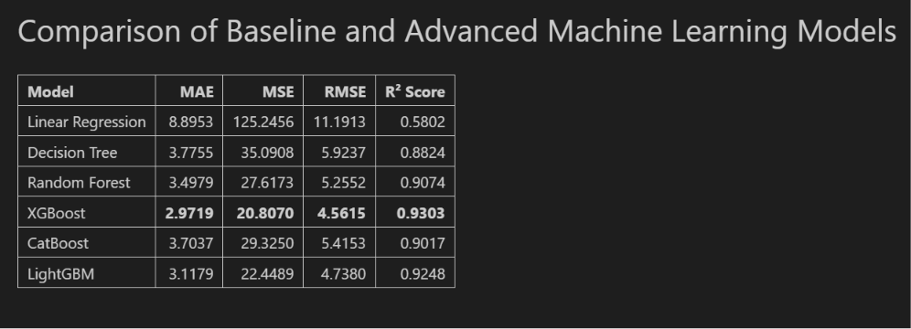
Implementation

Slide 14

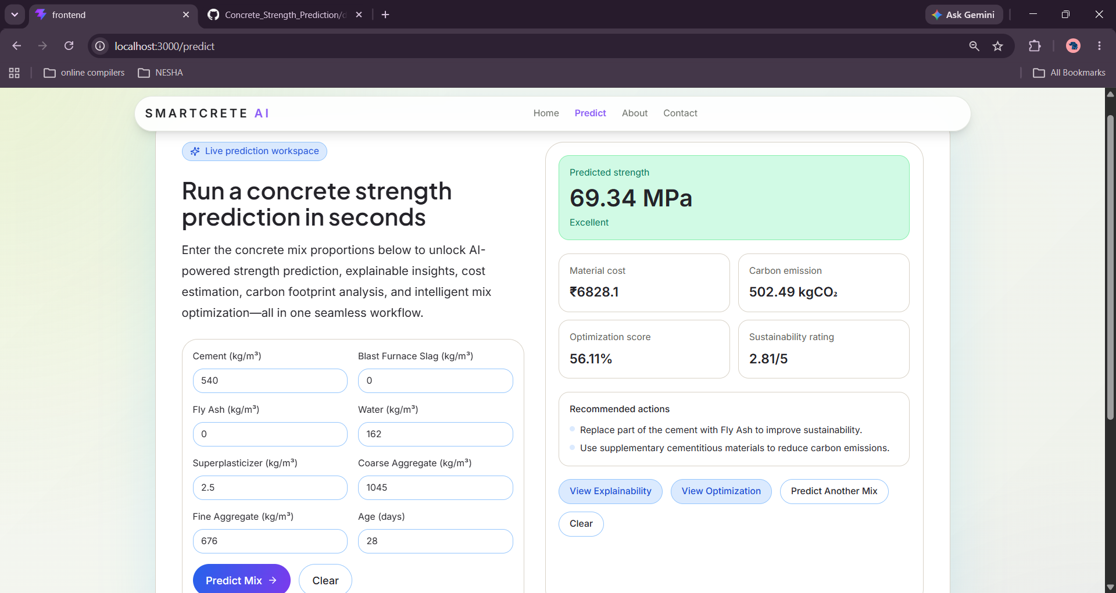
Implementation

Slide 15
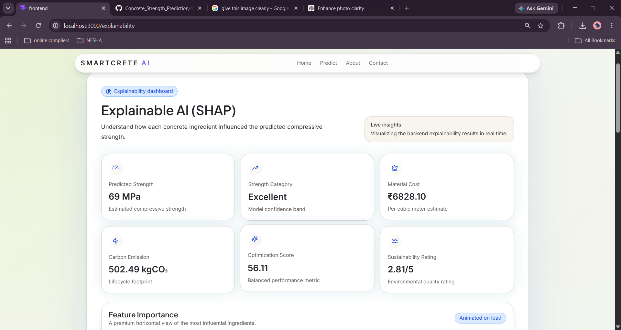
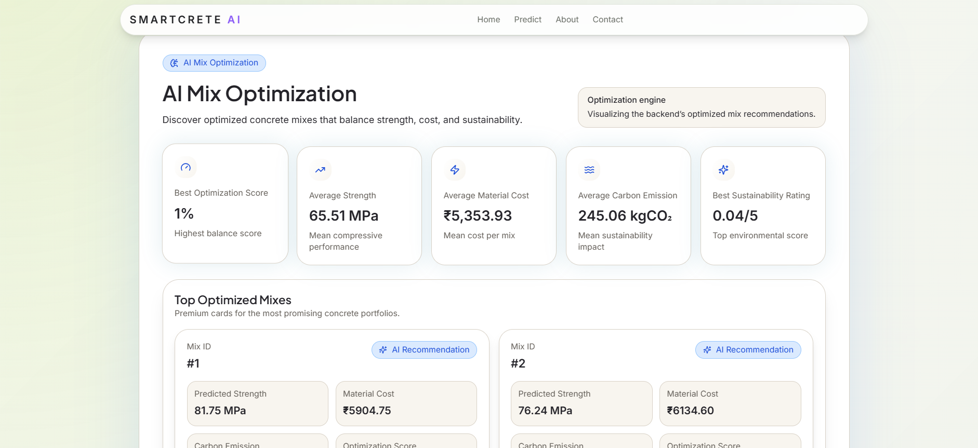
Implementation

Slide 16
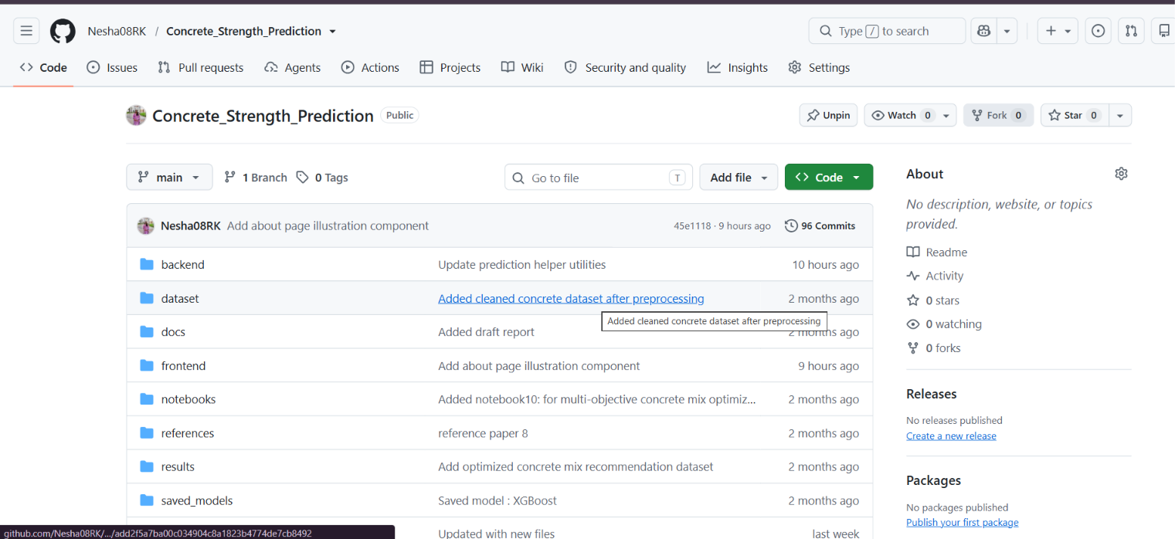
Git Documentation

Slide 17
Expected Outcome
Accurate prediction of concrete compressive strength.
Reduced dependency on laboratory testing.
Faster decision-making during construction planning.
Sustainable and cost-effective concrete mix recommendations.
Reduced construction material wastage.
User-friendly prediction dashboard for engineers and researchers.
Better resource utilization and environmental sustainability.

Slide 18
SDG GOALS
Sustainable Development Goals:
SDG 9 – Industry, Innovation & Infrastructure AI-driven concrete strength prediction and optimization.
SDG 12 – Responsible Consumption & Production Optimizes material usage, cost, and resource efficiency.
SDG 13 – Climate Action Evaluates carbon emissions and promotes lower-impact concrete mixes.

Slide 19
THANK YOU

