Slide 1



22CSP72 – PROJECT WORK II PHASE II First Review Explainable Multi-Objective Concrete Mix Optimization for Strength, Cost, and Sustainability Using Machine Learning
Team Members:
MIDUNA R (23CSR131)
NESHA R K(23CSR147)
ROHITH O R(23CSR180)
MENTOR :
Mr T ARUNKUMAR
Assistant Professor / CSE
Date:20.07.2026

Slide 2
Problem Statement
Existing Problem
Concrete compressive strength is a critical parameter in construction.
Traditional strength testing requires laboratory experiments and curing periods of up to 28 days.
Testing is time-consuming, costly, and unsuitable for rapid decision-making.
Proposed Solution:
Develop a machine learning-based system to predict concrete compressive strength from mix proportions.
Provide accurate and explainable predictions using advanced ML techniques.

Slide 3
Objectives
Predict concrete compressive strength.
Compare Machine Learning models.
Explain predictions using SHAP.
Optimize cost and carbon emission.
Recommend the best concrete mix.
Develop a user-friendly dashboard.

Slide 4
Literature Survey
Author & Year | Methodology | Best Model | Performance | Limitations
MDA-Based Concrete Strength Prediction (2024) | Modified Dimensional Analysis (MDA), DT, RF, SVM, ANN | MDA | R² = 0.94 | No explainability, no optimization
Concrete Strength Prediction Using ML Techniques (2024) | LR, RF, DT, XGBoost, LightGBM, AdaBoost, CatBoost | LightGBM | R² = 0.895 | Only prediction, lacks interpretability
Interpretable ML Model for RA-SCC (2025) | XGBoost, RF, SVR, MLP, SHAP, Bayesian Optimization | XGBoost + SHAP | R² = 0.909 | Small dataset, no cost/carbon analysis
Concrete Strength Prediction Using ML (2024) | RF, SVM, Bagging Regressor | Random Forest | R² = 0.87 | No explainable AI, limited optimization

Slide 5
Literature Survey
Author & Year | Methodology | Best Model | Performance | Limitations
Alsaadawi et al. – Hybrid ML with Interactive GUI (2025) | RF, AdaBoost, XGBoost, LightGBM, CatBoost + Bayesian Optimization + SHAP | LightGBM | Accuracy up to 93.5% | Classification only, not mix optimization
Abioye et al. – SHAP Analysis for HPC Strength (2025) | XGBoost, GBR, RF, SVR, ANN, KNN + Grid Search + SHAP | XGBoost | R² = 93.49% | Prediction only, no cost optimization
Shaaban et al. – Forecasting HSC Strength (2025) | XGBoost, RF, ANN, SVR | XGBoost | R² ≈ 0.94 | No explainability or sustainability analysis
Sapkota et al. – Explainable ML for HSC Strength (2025) | XGBoost + Metaheuristic Optimization + SHAP | LS-XGB | R² > 0.96 | Limited to high-strength concrete dataset

Slide 6
Base Paper Selection
Title: Interpretable Machine Learning Model for Compressive Strength Prediction
of Self-Compacting Concrete with Recycled Concrete Aggregates and SCMs
Publication Details:
Journal: Journal of Building Engineering
Publisher: Elsevier
Year: 2025
Best Model: XGBoost + SHAP
Accuracy: R² = 0.909 (90.9%)
Reason:
Recent publication (2025)
Published in a reputed journal
Includes Explainable AI (SHAP)
Provides clear scope for further enhancement
Uses advanced ML techniques (XGBoost)

Slide 7
Research Gap
Existing models lack an integrated framework for strength, cost, and sustainability analysis.
Carbon emission impact of concrete mix designs is rarely considered.
Most research does not provide an optimal concrete mix recommendation system.
Limited consideration of real-world construction requirements such as budget constraints.
Existing studies mainly focus on prediction rather than decision support.

Slide 8
Novelty
Proposed Novel Contributions
SHAP-based Explainability
Concrete Mix Recommendation
Cost Estimation
Carbon Emission Estimation
Real-time prediction and analysis through a web-based interface
Multi-criteria decision support considering strength, cost, and sustainability simultaneously.

Slide 9
Architecture Diagram
Explainable Concrete Mix Optimization – System Architecture
Concrete Dataset
↓
Preprocessing
↓
Feature Engineering
↓
Train ML Models
↓
(XGBoost, CatBoost, Random Forest)
↓
Hyperparameter Tuning
Best Model Selection
↓
SHAP Explainability
↓
Cost & Carbon Estimation
↓
Multi-Objective Optimization
↓
Concrete Mix Recommendation
↓
Prediction Dashboard
↓
Performance Evaluation

Slide 10
Proposed Work with Planned Innovation
Planned Innovations
Explainable AI using SHAP for transparent strength prediction
Multi-objective optimization balancing strength, cost, and sustainability
Automated material cost estimation for each mix design
Carbon footprint estimation to support sustainable construction
Automatic concrete mix recommendation engine
Interactive prediction dashboard interface
Comparative evaluation of multiple ML models
Hyperparameter tuning for optimal model performance

Slide 11
Modules of the Project
Project Modules
Module 1 – Dataset Collection
Module 2 – Data Preprocessing
Module 3 – Feature Engineering
Module 4 – Machine Learning Model Training
Module 5 – SHAP Explainability
Module 6 – Cost Prediction
Module 7 – Carbon Emission Prediction
Module 8 – Concrete Mix Recommendation
Module 9 – Prediction Dashboard
Module 10 – Performance Evaluation

Slide 12
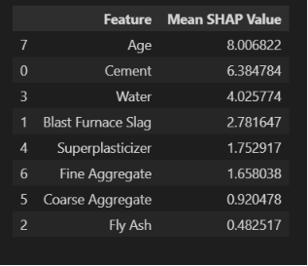
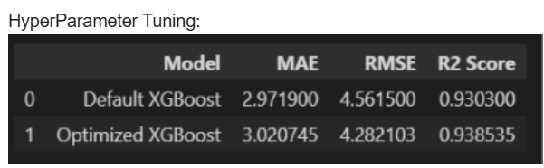
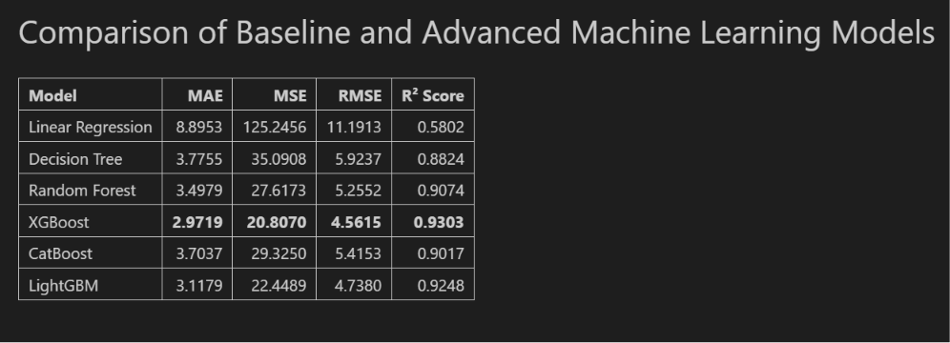
Implementation

Slide 13
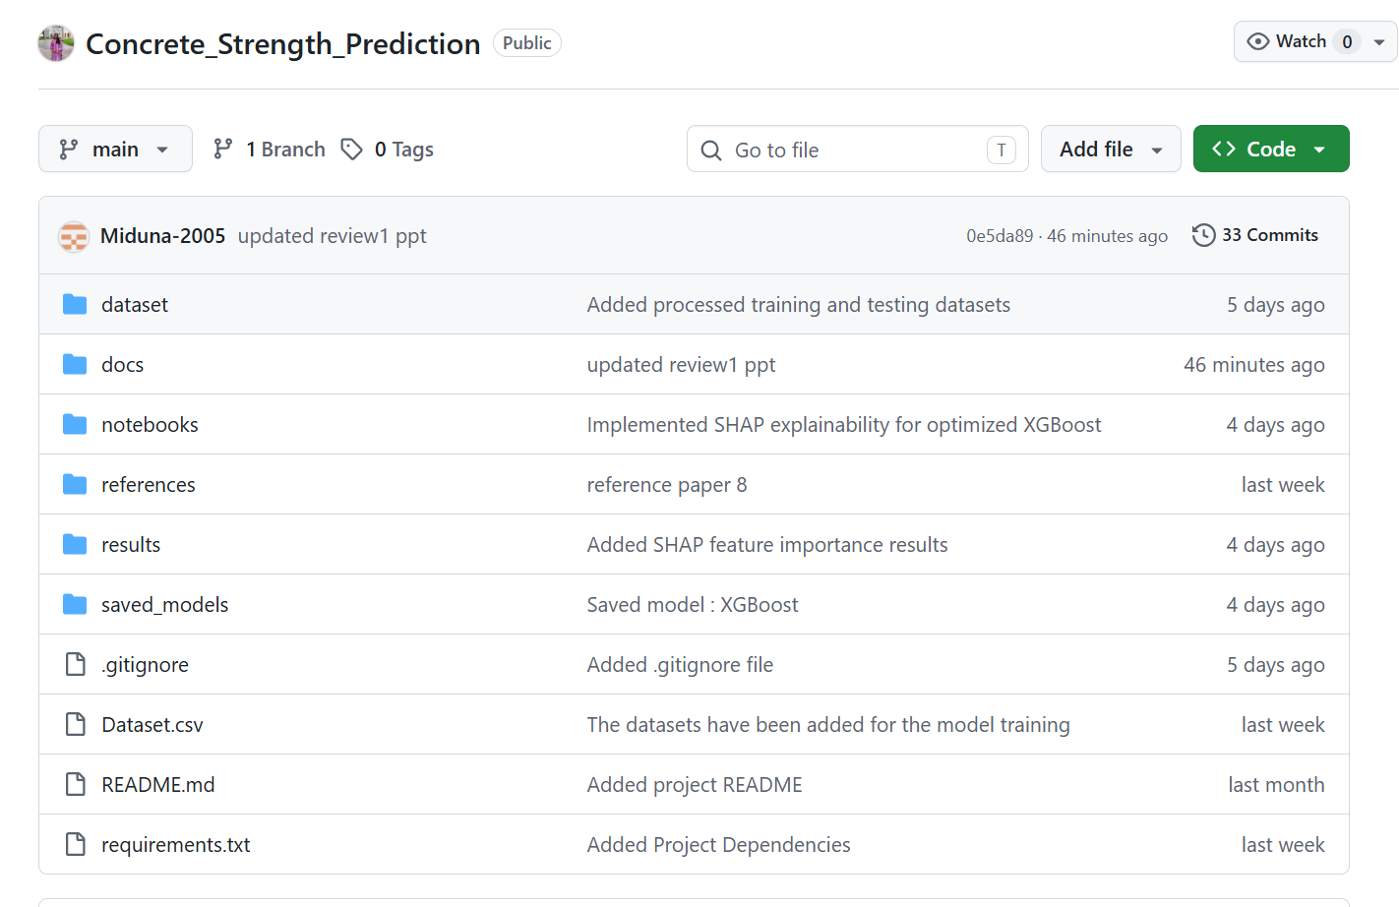
Git Documentation

Slide 14
Expected Outcome
Accurate prediction of concrete compressive strength.
Reduced dependency on laboratory testing.
Faster decision-making during construction planning.
Sustainable and cost-effective concrete mix recommendations.
Reduced construction material wastage.
User-friendly prediction dashboard for engineers and researchers.
Better resource utilization and environmental sustainability.

Slide 15
THANK YOU

