Slide 1
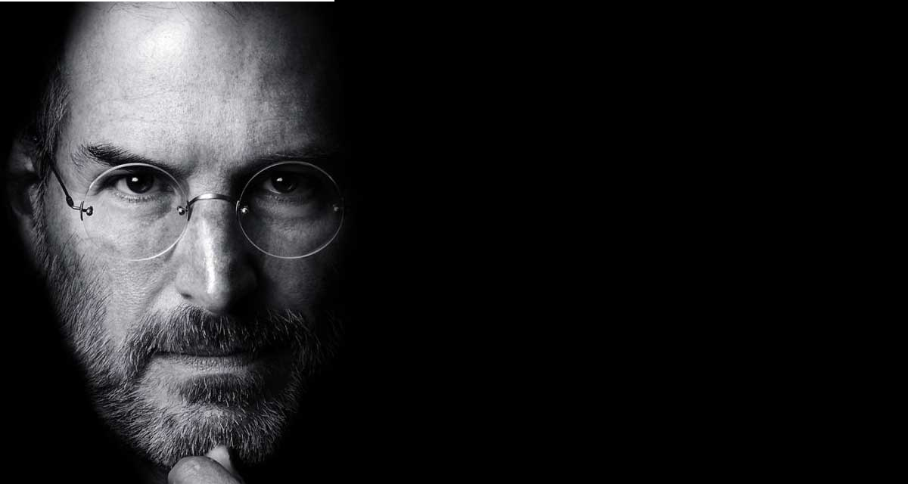
“Data has always been numbers on a screen. But when you give it a voice — when you hear it — it stops being just data. It becomes a story you can feel.”

