Slide 1









Benha University
faculty of computers,Artificial Intelligence.
Inclusive Reading Assistant
User Control and Agency
Mentored By
Mariam Mahmoud

Slide 2




Problem Statement :
People who have difficulty reading or understanding complex content often struggle to access information independently. Long texts, difficult vocabulary, and complicated explanations can make it challenging for them to understand and use information in their daily lives or studies. Our Inclusive Reading Assistant aims to make reading more accessible by allowing users to simplify text, summarize content, explain difficult words and concepts, translate text, or listen to it using text-to-speech. The assistant gives users control over how they want the content to be presented, allowing each person to choose the type of support that best fits their needs
Team Members :
  Nesma Hesham – Frontend Developer
  Menna Haitham – AI & Prompt Engineering
  Malak Ahmed – NLP Engineer
  Jiovany Erwen – Document processing
  Mina Saber – Backend Developer
Github rebo
https://github.com/Nesma-h/HCAI-Project

Slide 3
Inclusive Reading Assistant: Milestone 1 Concept Drafts
Draft 1: ChatGPT
Draft 2: Claude
The user is always in control. The chatbot suggests; the user chooses level, format, and term handling.
The user decides. The chatbot suggests, never assumes. Every setting can be changed at any time.
Principle
  Onboarding: Customize font, size, spacing, and terms, or skip.
  Text Input: Paste/upload text; preview, edit, clear, or cancel.
  Reading Level: Choose Easy, Medium, or Advanced; change anytime and preserve terms.
  Text Display: Original read-only, simplified editable; side-by-side or single-column, with copy/export options.
  Readability Scores: Compare Flesch scores before/after; scores are guides, not ability measures.
  Adjustments: Simpler, Explain/Keep Term, Undo; accept/reject changes and manage explanations.
  Error Handling: Clear empty/long-text messages, explain limits, and always preserve the original.
  Onboarding: Set up or skip; customize font, size, spacing, background, line length, and read-aloud.
  Text Input: Paste/upload PDF, DOCX, or TXT; try a sample, preview, select sections, and check word
  Reading Level: Choose Easy, Medium, or Advanced with previews; control term explanations.
  Text Display: Linked side-by-side text, sentence matching, bold key terms, explanation controls, focus mode, and Undo All.
  Readability Scores: Optional score card showing reading ease, and sentence length before/after.
  Adjustments: Simpler, Not So Simple, Explain/Keep Term, Shorter, Add Example, and Show Changes.
  Error Handling: Handle empty/long text, unsupported files, scanned PDFs, and failures without blaming user
Flow (7 steps)

Slide 4
Inclusive Reading Assistant: Milestone 1 Concept Drafts
Draft 1: ChatGPT
Draft 2: Claude
  Student: Requests large text, wide spacing, and biology text simplification.
  Bot: Confirms preferences and asks about term explanations.
  Student: Chooses hideable explanations and pastes text.
  Bot: Offers Easy, Medium, or Advanced.
  Student: Selects Easy and keeps “photosynthesis” with an explanation.
  Bot: Displays simplified text and a term card with Keep, Hide, Expand options.
  Bot: Set preferences or skip. Student: Chooses a dyslexia-friendly font.
  Bot: Paste your text; nothing changes without permission. Student: Pastes 600 words.
  Bot: Choose a level. Student: Selects Medium and requests explanations on demand.
  Student: Taps “?” on a term. Bot: Shows its meaning with Keep, Hide, or Expand options.
  Student: Keeps the term and requests scores. Bot: Reading ease improves from 28 to 61. [Simpler] [This Is Good] [Download]
Sample conversation
Hybrid approach: Draft 2 (Claude) as the base, with selected parts from Draft 1 (ChatGPT).
Why Draft 2 is the base:
  Lower stress for dyslexic readers: scores are collapsed by default, and onboarding asks one question at a time.
  Stronger user control (our track): students decide level, format, and each term explanation, and every change can be undone.
  More complete: it covers more dyslexia-specific controls (background colors, line length, read-aloud, focus mode) and more error cases (scanned PDFs, unsupported files, failures).
Direction Chosen

Slide 5
Appendix A: Prompt Log and Comparison
You are a UX designer and conversational AI specialist who designs accessible tools for readers with dyslexia.
Draft the core interaction flow for a chatbot called "Inclusive Reading Assistant". It simplifies text, adjusts reading level, and reformats text for readers with dyslexia.
Track: User Control and Agency (the user decides the level and formatting, never the system).
Target users: university students with dyslexia who read long, dense academic texts (textbooks,
lecture notes, papers).
Cover this flow, from opening the chatbot to getting the simplified text:
1. Short onboarding (preferences)
2. Text input (paste or upload)
3. Reading level choice (Easy / Medium / Advanced)
4. Simplified text side by side with the original
5. Readability scores before vs. after (e.g., Flesch Reading Ease)
6. Easy adjustments ("simpler", "explain this term", "keep this term")
7. Error handling (empty input, text too long)
Academic terms must be handled carefully: keep key terms but explain them in simple words, and let the
user choose to keep, hide, or expand each explanation.
For each step, give: user action, chatbot reply, and user controls.
Rules: chatbot messages max 2 sentences, simple words, always offer a choice.
Output: a numbered flow, a sample conversation (6 turns), and 3 strengths + 3 weaknesses.
Exact prompt

Slide 6
Appendix A: Prompt Log and Comparison
Tool 1: ChatGPT
Tool 2: Claude
  7-step flow covering user actions, bot replies, and controls.
  6-turn sample conversation about photosynthesis.
  3 strengths and 3 weaknesses.
  Rule: Never remove or replace academic terms.
  7-step flow with detailed controls (backgrounds, line length, read-aloud, focus mode).
  6-turn sample conversation about cognitive dissonance.
  5-case error table, 3 strengths and 3 weaknesses
  Scorecard collapsed by default.
What it gave
  Simple, clear, and easy to present.
  Original text is read-only; simplified text is editable.
  Strong rule for preserving academic terms.
  More detailed controls and broader error handling (scanned PDFs, unsupported files, failures).
  Hidden scores reduce pressure.
Strengths
  Fewer dyslexia-specific controls (no background colors, line length, or focus mode).
  Limited error handling (empty input and long text).
  Scores cannot be hidden.
  Too many options may cause decision fatigue.
  Longer and harder to present quickly.
  Linked scrolling and highlights are more complex to implement.
Weaknesses
  Added the same UX designer and conversational AI specialist role.
  Focused on university students with dyslexia reading dense academic texts.
  Added a rule to preserve key academic terms, explain them simply, and offer Keep / Hide / Expand.
  Shortened the prompt for focused, comparable outputs.
Prompt changes

Slide 7
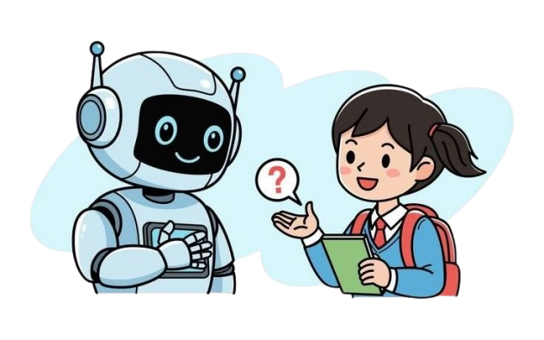


Thank you !
Mentored By
Mariam Mahmoud

