Slide 1
SDM Exercise
Government communication, opinion dynamics and pandemic spread.

Slide 2

Annotated CLD
L
Self-regulation
of polarization
+ L
Virus spread
by dissidents
Polarization
- ?
Communication
Degradation
50
+ L
Amplification by
comm. strength
- L
De-polarization
by comm. quality
Gov.
Communication
Strength/Urgency
Gov.
Communication
Quality
R
+ L
Effect of R on
Urgency of communication
Legend:
Known Link
Known to be absent Link
Unknown link
% Expert agreement
-/+
Link polarity
L
Linear Functional Form
Notes:
Question to expert 1: would you agree with expert 1 that the quality of communication was generally low and especially at the beginning?

Slide 3
Some Questions for you ☺
Self-regulation of polarization:
Is there a range of polarization values for which its self-regulatory effect is particularly high? Or, is it more of a linear relationship (more polarization always means more self-regulation)?
Degradation of comm. quality by polarization (for expert 1):
Would you say that for small values of polarization the effect on quality is negligible, but after a certain value such effect becomes particularly pronounced? If so, what is such value?
Effect of communication quality and strength on polarization:
Would you agree that the amplification effect of communication strength applies to both information of bad AND good quality?
Would you agree that for both comm. strength and quality their individual effects on polarization increases linearly with their value? Or, is it more or less than linear?

Slide 4
Developing an SDM from the aCLD
Labeling
Equations
Software Implementation
Model Estimation
Uncertainty quantification
Uncertainty Propagation
Sensitivity Analysis
Verification & Validation
Answering The Research Questions

Slide 5
Labelling: stock, constant and auxiliary variables
Increasing Dissidents
Decreasing Dissidents
Polarization (P)
+ L
Virus spread
by dissidents
-|?
Communication
degradation
By polarization
L
Self-regulation
of polarization
50
+ L
Amplification by
Comm. strength
- L
De-polarization
by comm. quality
R
Gov. Comm.
Quality (GCQ)
+ L
Effect of R on
urgency of
communication
Degradation
of comm.
quality
Legend:
Gov. Comm.
Strength (GCS)
Auxiliary Var.
Gov.
communication
Response to R
Stock Var.

Slide 6

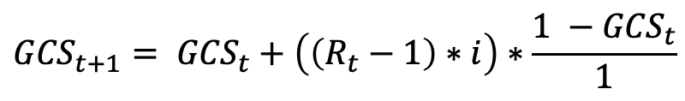
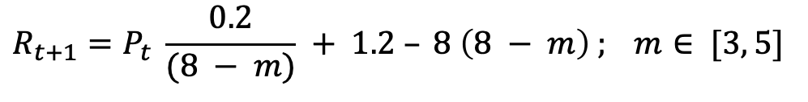
Equations
$$P_{t+1}= P_{t}+(\left(P_{t} −a\right)∗b−{(c∗ GCQ}_{t})∗(e∗ {GCS}_{t}))∗ \frac{12 −P_{t}}{12} ; a∈ [6, 7]$$
Polarization:
R value:
Gov. Com. Strength:
Gov. Com. Quality:
$$R_{t+1}=P_{t} \frac{0.2}{(8 − m)} + 1.2 – 8 \left(8 − m\right) ; m∈ [3, 5]$$
$${GCS}_{t+1}= {GCS}_{t}+\left(\left(R_{t}−1\right)∗i\right)∗\frac{1 −{GCS}_{t}}{1}$$
${GCQ}_{t+1}= {GCQ}_{t} −f\left(P_{t}\right)$ $∗\frac{1 −{|GCQ}_{t}|}{1}$

Slide 7
Model Estimation
“choosing” parameter values and model structures or estimating how likely they are to produce the results we expect.
In this case: output data is missing. Model estimation was carried out by observing the model results qualitatively.
Estimated Parameters
Rate of self-regulation of Polarization b = 0.02
Effect of communication strength on polarization c = 1/6
Effect of communication quality on polarization e = 0.65
Effect of R on communication strength i = 0.1

Slide 8
Uncertainty Quantification
Given we do not have data about the outcomes we cannot use the MCMC techniques to derive a likelihood distribution of our joint space.
In this case the quantification is limited to finding sources of parametric and structural uncertainty and finding parametric and structural interval for each of them.

Slide 9
Uncertainty Quantification: Parametric
Sources of parametric uncertainty
Value of polarization self-regulatory effect changes sign:
a = between 6% and 7%
# polarization value at which R = 1:
m = between 3% and 5%

Slide 10

Uncertainty Quantification: Structural
Sources of structural uncertainty:
Presence of causal Link between polarization and gov. communication quality
Polarity: the polarity is not uncertain (-)
Functional form of link: here assumed to be sigmoidal
n = 0.05
l = “switch”: 1 when the link is considered and 0 when not considered
$f\left(P_{t}\right)$ = l * n * Sig($f\left(P_{t}\right)$ - 6)

Slide 11
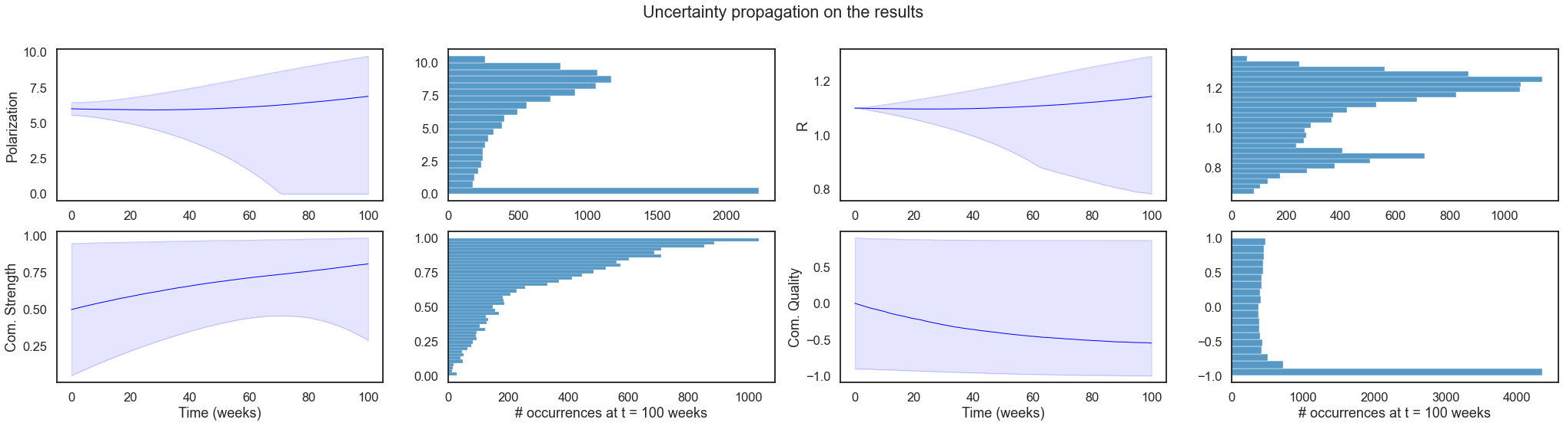
Uncertainty Propagation
the intervals in the joint parameter space are sampled at fixed sub intervals determined in the quantification phase.
Used the Quasi-Monte Carlo method Saltelli (based on Sobol).

Slide 12
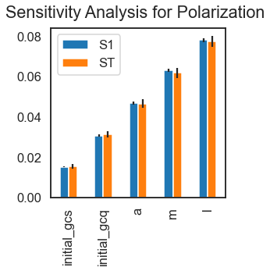
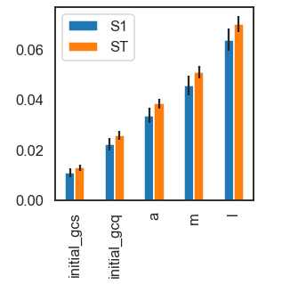
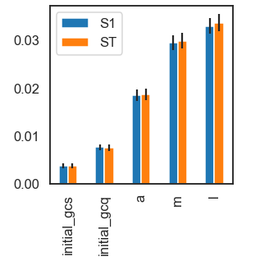
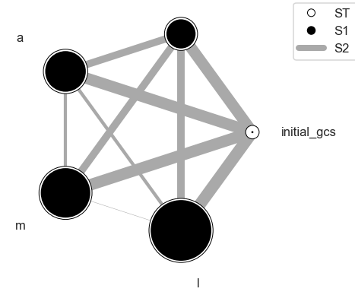
Sensitivity Analysis
Using Sobol: global and variance-based sensitivity analysis
Polarity
Gov. Comm. Strength
Gov. Comm. Quality

Slide 13
From SA + Uncertainty Analysis
Considering a causal link between polarization and government information quality has the highest impact on all the considered variables!
Addressing this structural uncertainty e.g. with further discussion and studies would be beneficial to improve the confidence with the model.

Slide 14
Answering the research questions
What is the effect of the initial communication quality and initial strength of communication on the model output?
I did not have time to complete this but I would proceed as in the following:
Effect of Gov. Comm. Quality: compare simulations with positive and negative initial quality with and without the causal link between polarization and quality
Effect of Gov. Comm. Strength: divide the simulations in different “bins” of initial quality between 0 and 1 and compare them

Slide 15
Expected results
When there is no effect of polarization on communication quality the initial value (and especially its sign) really make a difference.
When the effect of polarization is included, the initial value is not as important as the effect of polarization will make the communication quality negative in a relatively rapid manner.

