Slide 1
End-to-End Analytics Pipeline
NYC Taxi Trip Records (June-July 2025)
Team D:
Ronnie Chan (27206003)
Patrice Gallant (40301020)
Nesrine Larbi (40079009)
COMP 333 | Concordia University | April 2026

Slide 2
End-to-End Analytics Pipeline
Data Acquisition
Data Wrangling
Feature Engineering
Supervised Learning
Unsupervised Learning
Interpretation
NYC Yellow Taxi Trip Records June & July 2025
NYC Hourly Weather (Open-Meteo API)
Dataset: 1.4+ GB
Initial Audit
Check Issues
4 duplicates
Mirrored
NaNs
0-passenger
0-distance
Negative Fares
Outliers
Data Cleaning
pd.pipe()
EDA/DDA
Baseline Model
Filter
Embedded (RF importance)
Wrapper (RFE)
Results: Top 12 features
Random Forest vs XGBoost
PCA
K-Means
Evaluation
Insights
Ethics
Limitations
Future Work
Model selected: XGBoost
Result: 7 clusters

Slide 3
Research Questions
RQ1 — Supervised Learning
"Can we classify a high-tipper passenger based on trip features (distance, time of day, day of week, rate code, passenger count) and weather conditions?"
RQ2 — Unsupervised Learning
"Can we identify distinct natural clusters of NYC taxi trips based on temporal and financial features to study customer behaviour?"

Slide 4

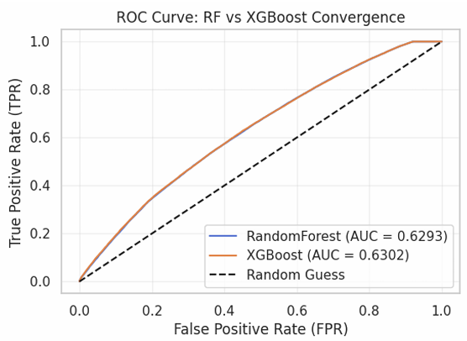
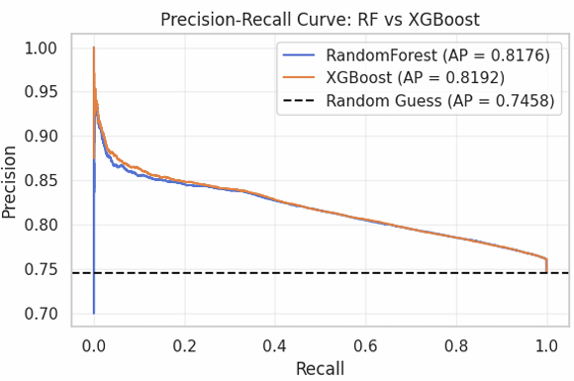
Evaluation
Both models have similar performance metrics on test set.
XGBoost has higher AUC score, higher Average Precision, and faster training speed.
Model Selected: XGBoost
Random Forest vs. XGBoost

Slide 5
Insights
Imbalance Dataset
RQ1 — Tipping Behaviour:
XGBoost classifies high-tippers with 77 % accuracy (AUC 0.63)
Tipping is driven by payment method and fare economics — not weather or time of day
Expect higher tips on credit-card, high-fare, or airport-rate trips.
RQ2 — Trip Archetypes:
K-Means identifies 7 clusters
Clusters based on
short and medium city trips
a strong morning-commute
long-distance/airport trips
a distinct rainy-day cluster
NYC Yellow Taxi Records

Slide 6
Ethics
Data Bias
Handle outliers to keep models stable
Refine target by removing negative fares
Handle imbalance with Stratify K-Fold
Data Fairness
Credit Card users only
Partial View: The dataset is incomplete.
Limited Scope: Findings do not represent all NYC taxi users.
Data Privacy
No Personal Info
Location Anonymity (to protect trip routines)
Trend Focused (and not individual patterns)

Slide 7
Limitations
Future Work
Class Imbalance: 75/25 distribution causes low recall for 'Low Tip’.
Noise: Cash transactions introduce incomplete labels and missing data.
Non-Linearity: Data is not linearly separable, limiting K-Means effectiveness.
Collect more data and unobserved variables (e.g., service quality)
Big Data (Polars or SQL)
Undersample Technique or SMOTE

Slide 8
Thank You!
max growth
Presented by: Team D

