Slide 1

Note: The data and information in this document is reflective of a hypothetical situation and client. This document is to be used for KPMG Virtual Internship purposes only.
Sprocket Central Pty Ltd
Data analytics approach
[Division Name] - [Engagement Manager], [Senior Consultant], [Junior Consultant]

Slide 2
Note: The data and information in this document is reflective of a hypothetical situation and client. This document is to be used for KPMG Virtual Internship purposes only.
Agenda
Introduction
Data Exploration
Model Development
Interpretation

Slide 3
Note: The data and information in this document is reflective of a hypothetical situation and client. This document is to be used for KPMG Virtual Internship purposes only.
Introduction
New Customers Data
These are the insight for new customers:
Age Distribution
Gender Distribution
Country Distribution
Job industry category
State Distribution

Slide 4
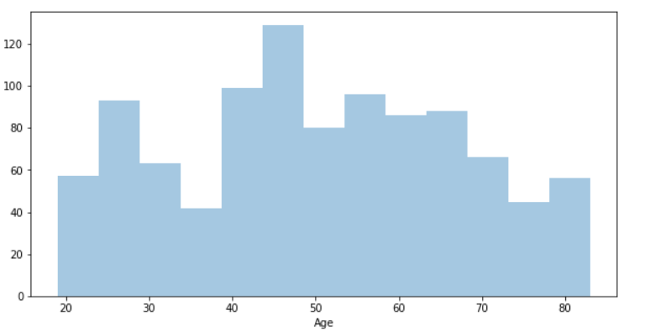
Note: The data and information in this document is reflective of a hypothetical situation and client. This document is to be used for KPMG Virtual Internship purposes only.
Data Exploration
Age Distribution
We can see from the distribution that most of the new customers between the age 40 and 65
From 35 to 40 and from 65 to 75 there’s low number of customers
From 20-35 and 65-70 has average number of customers
Place any supporting images, graphs, data or extra text here.

Slide 5
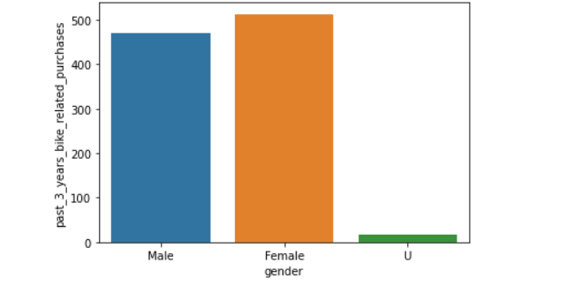
Note: The data and information in this document is reflective of a hypothetical situation and client. This document is to be used for KPMG Virtual Internship purposes only.
Data Exploration
Gender Distribution
Females is the highest in purchasing bikes in the last 3 years but as we can see the difference between male and female is very small
Place any supporting images, graphs, data or extra text here.

Slide 6
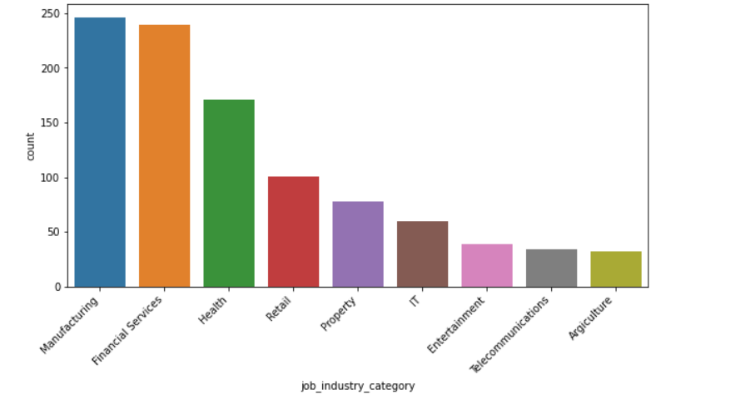
Note: The data and information in this document is reflective of a hypothetical situation and client. This document is to be used for KPMG Virtual Internship purposes only.
Model Development
Job industry category distribution
We can see from this chart that most of
The customers are from Manufacturing
And financial services department
So, if we’re building marketing strategy
We need to focus on those departments
more than others.
Place any supporting images, graphs, data or extra text here.

Slide 7
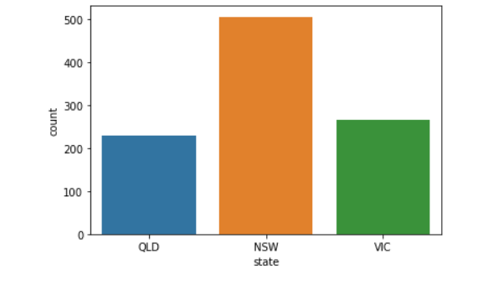
Note: The data and information in this document is reflective of a hypothetical situation and client. This document is to be used for KPMG Virtual Internship purposes only.
Interpretation
State Analysis
We can see from the state distribution that most customers Located in NSW state
Place any supporting images, graphs, data or extra text here.

Slide 8
Note: The data and information in this document is reflective of a hypothetical situation and client. This document is to be used for KPMG Virtual Internship purposes only.
Appendix

Slide 9
Note: The data and information in this document is reflective of a hypothetical situation and client. This document is to be used for KPMG Virtual Internship purposes only.
Appendix
This is an optional slide where you may place any supporting items.

