Slide 1




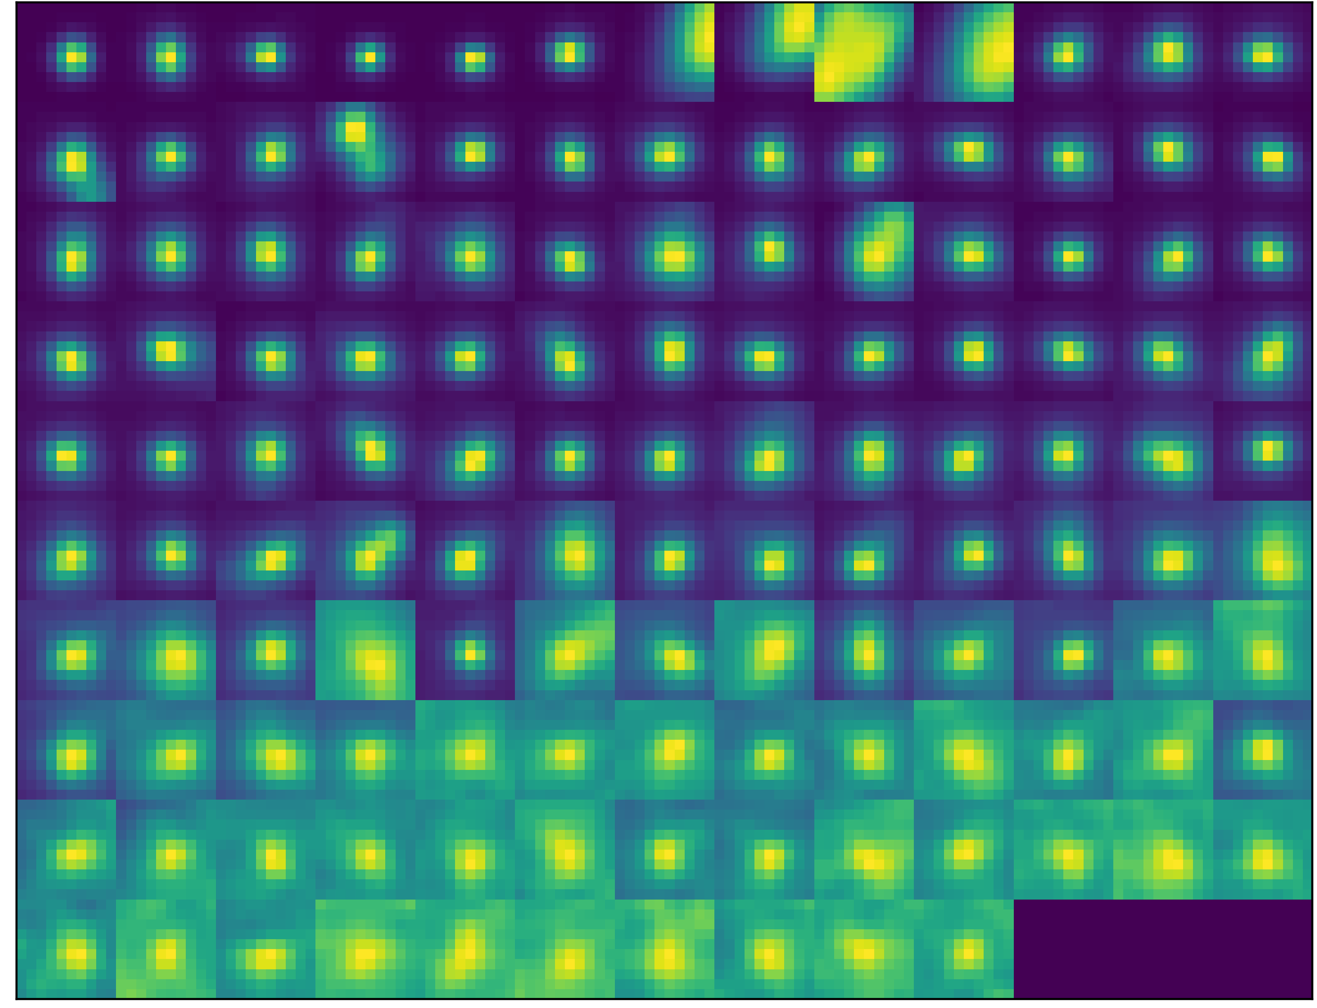
Raw image
Labeled image
Neural Network
Performance evaluation
Corrected ground truth

