Slide 1




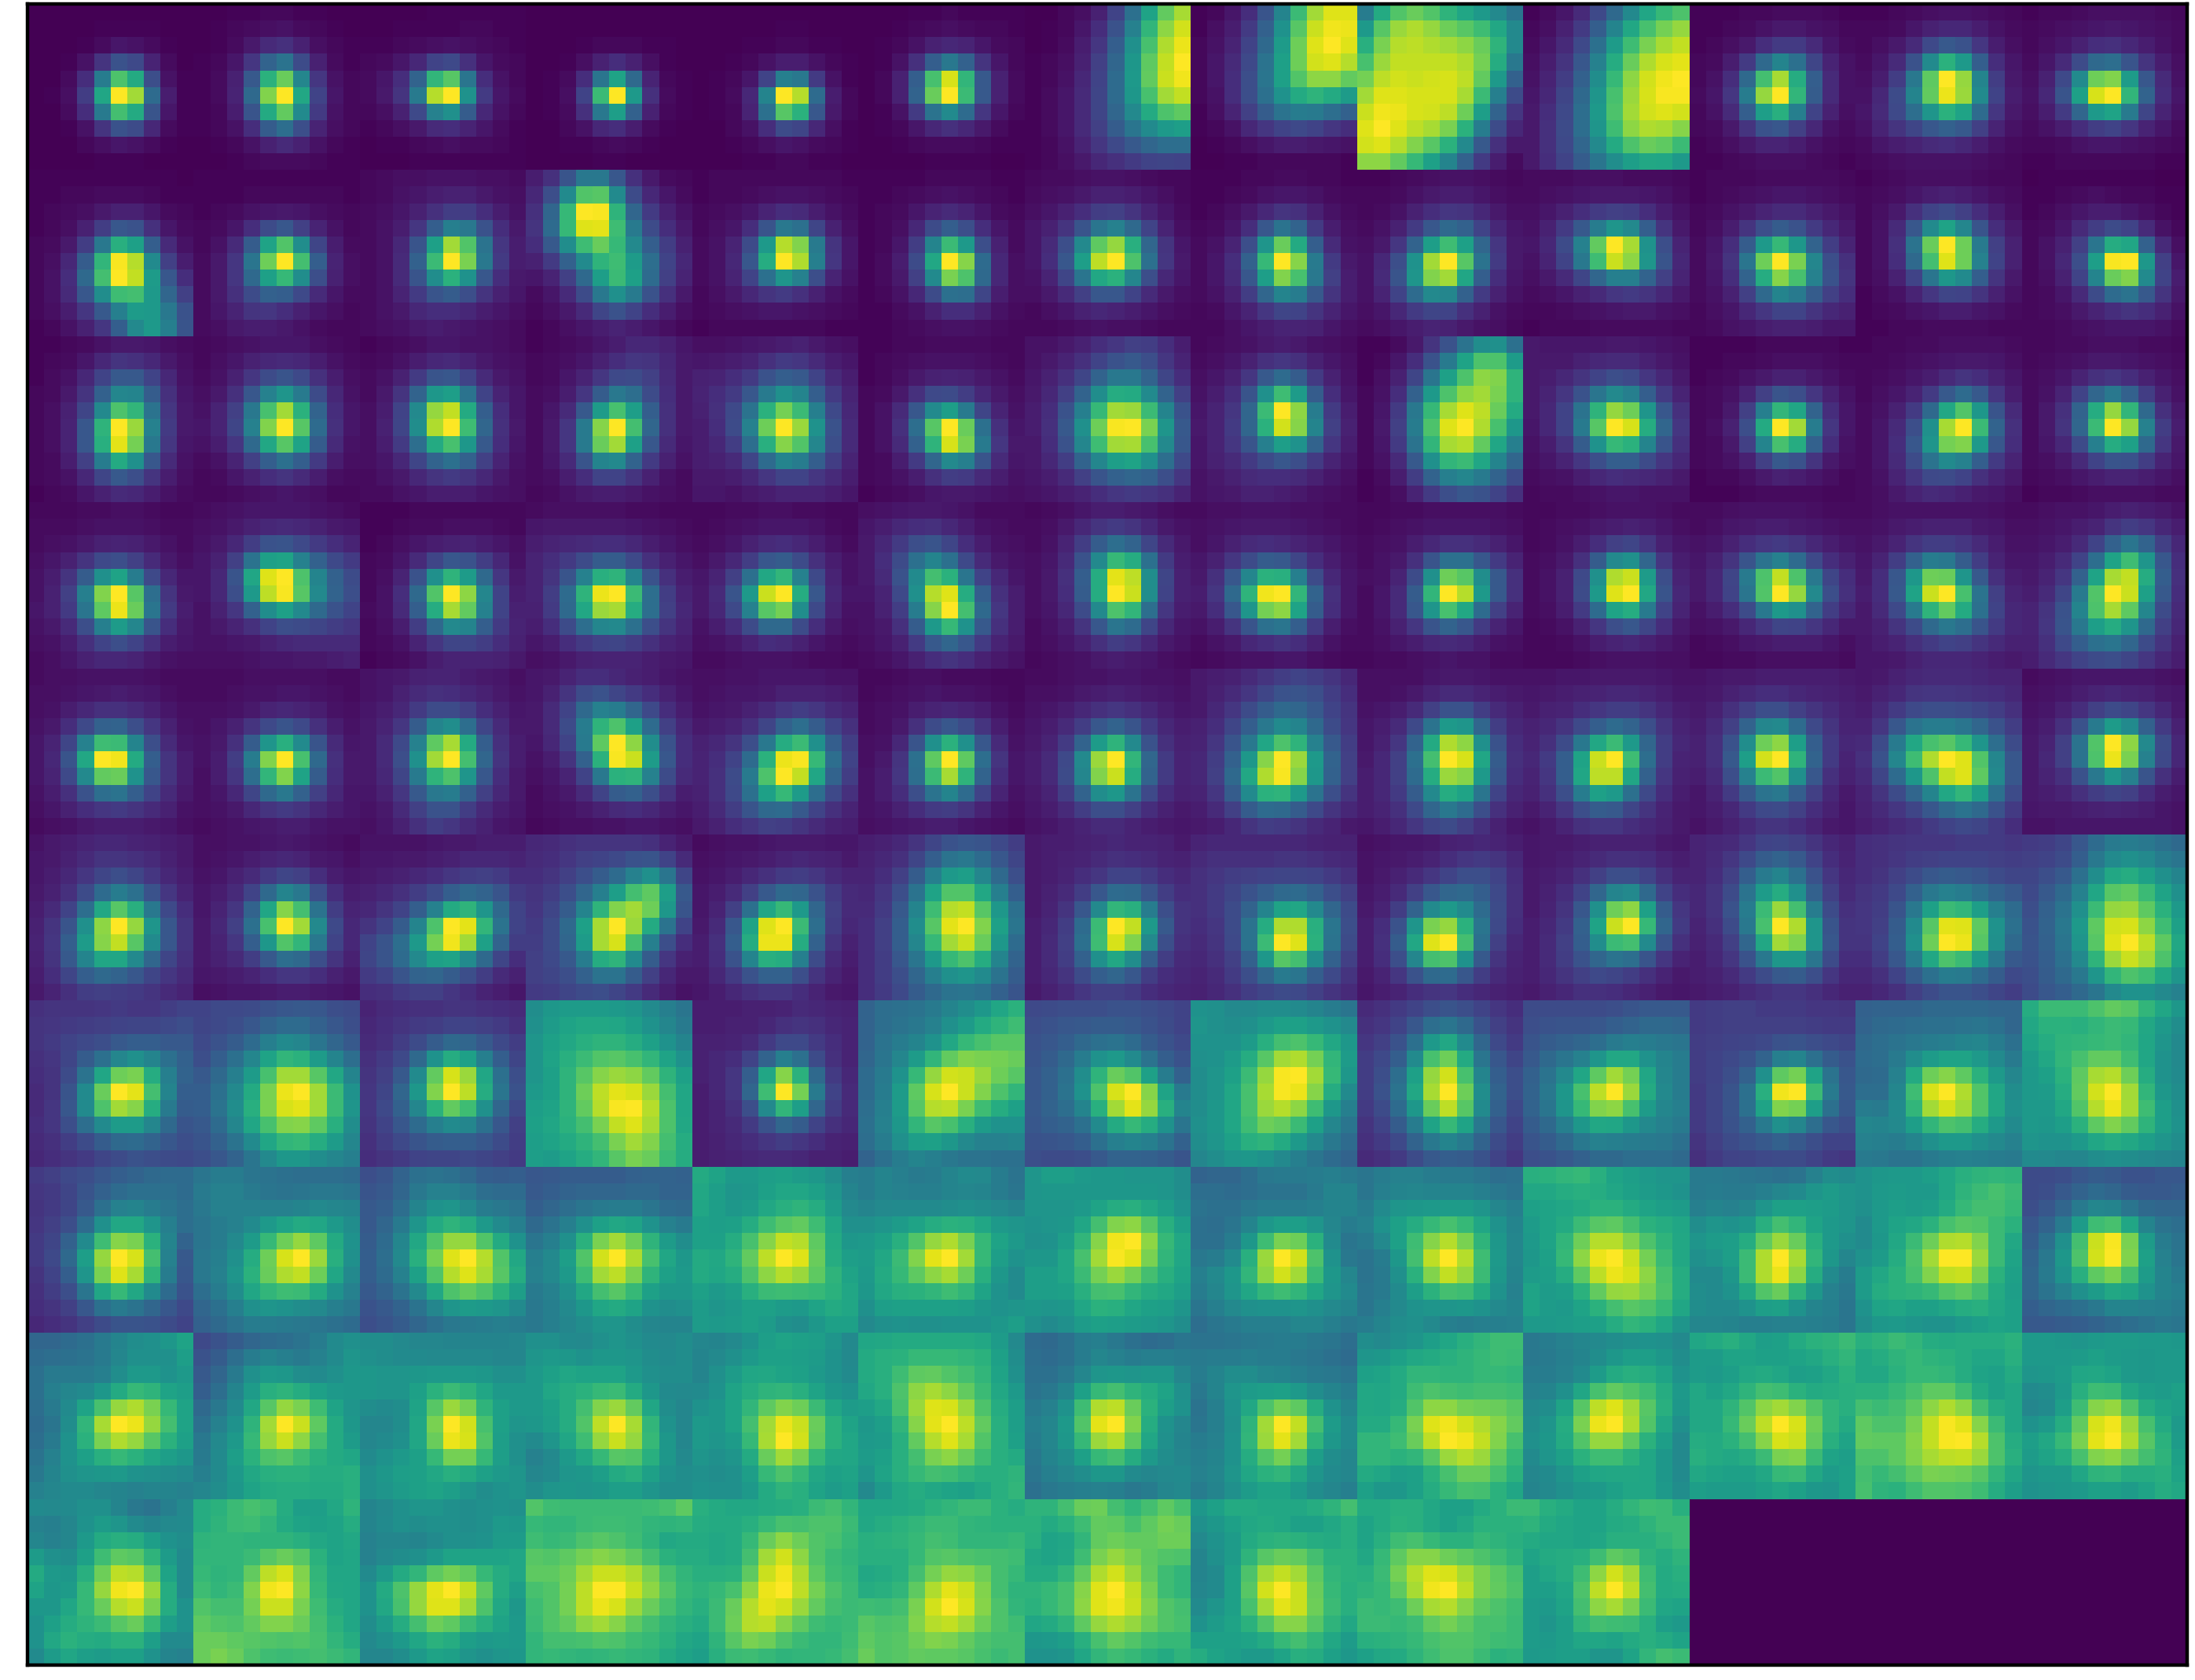
Raw image
Labeled image
Neural Network
Performance evaluation

Slide 2
Raw image
Labeled image
Neural Network

