Slide 1
Smooth 10

Slide 2
Smooth 50

Slide 3
Conca 12uM
Conca 25uM

Slide 4
Monomer
Dimer x2
tetramer
Centroid
Smooth 50
raw

Slide 5
See at low m/z 2 peaks corresponding 2 2 different state (PTM,…)
Loose that definition at high m/z

Slide 6
Collision 100
Collision 70
No collision

Slide 7
LukE
In low range of m/z there is an unfolded lukE bc same weight but at lower m/z -> bc it is unfolded (relaxed) there is more space for protonation so higher charge. However, in the ‘folded’ state of lukE there is more space for Sodium binding hence 2 peaks (+- 200 Da) at lower m/z there is more proton so less sodium (bc competition with proton + more chance to get washed off in unfolded state) . There is also a dimer species (low abundance) in which there is also sodium present.

Slide 8
2 distributions at diff m/z but at the same weight

Slide 9
2 diff weights (probably adducts)

Slide 10
Dimer

Slide 12
In dimer you find the adducts

Slide 13
LukE+pept

Slide 14
Don’t trust weight bc charge state is wrong
2 distributions but only one peptide, just the peptide is bound to sulfate that is dissociated when added + charge. So we see the 1+ state at 1460 and also the 1+ state at 1560 (difference is whether it is hydrolyzed or not -> fragments)

Slide 15
Difference in weight between monomer and monomer +pept = 1500 Da -> peptide weight
Confirm what we saw earlier that at 1500 it is the complete peptide and for 1400 it is the peptide – sulfate group

Slide 16
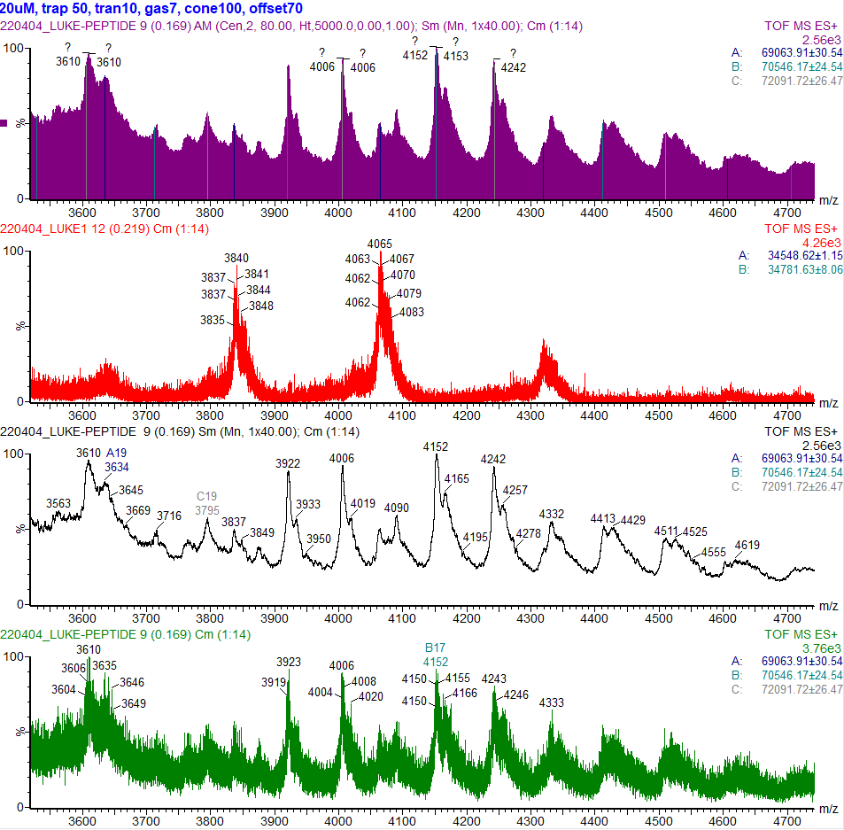
Dimer alone
Dimer + ligand-> dimer + 1500
Dimer + 2 Ligand -> dimer + 3000

