Slide 1
X-ray image validation
By Team Schrödinger

Slide 2
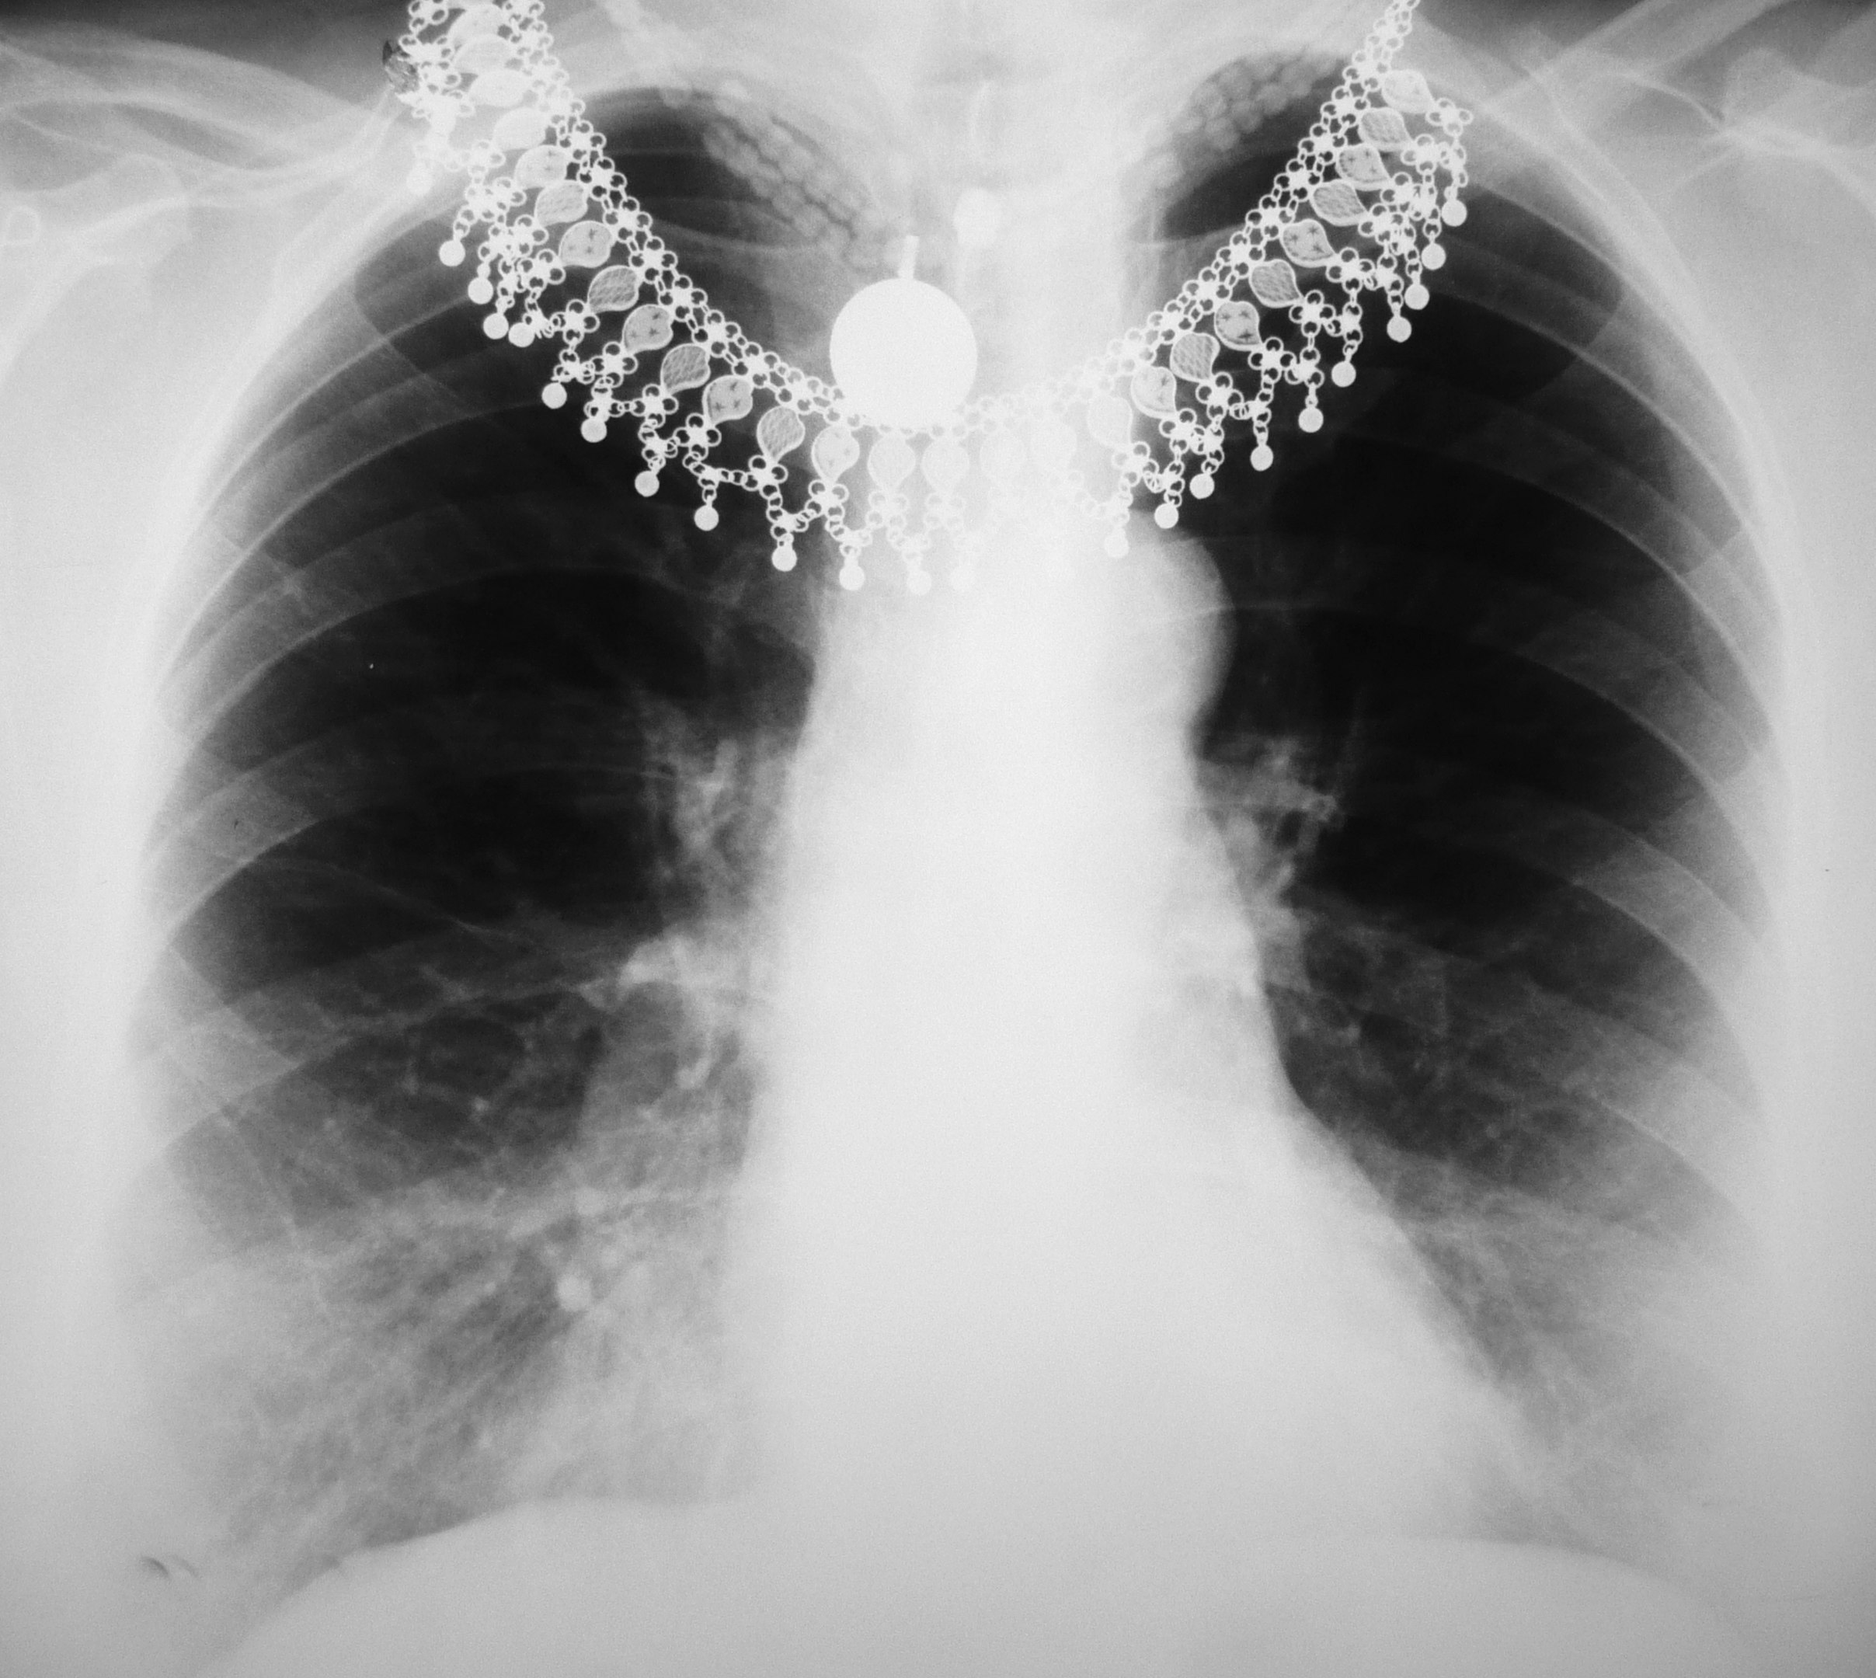
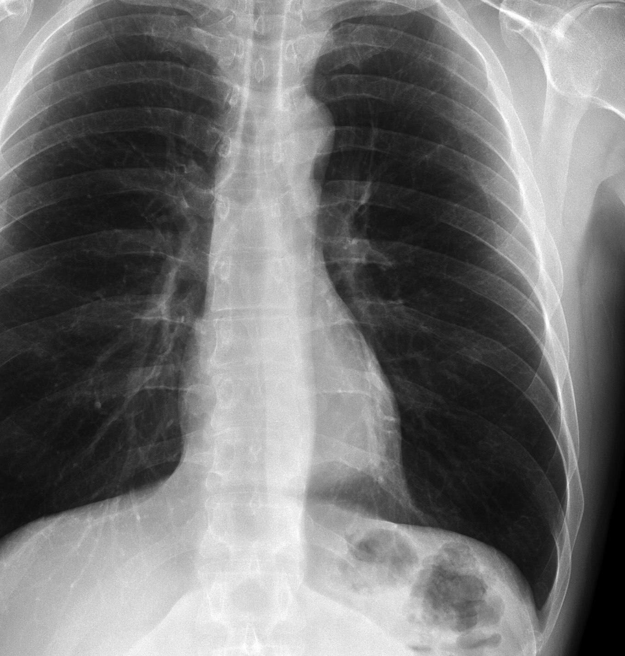
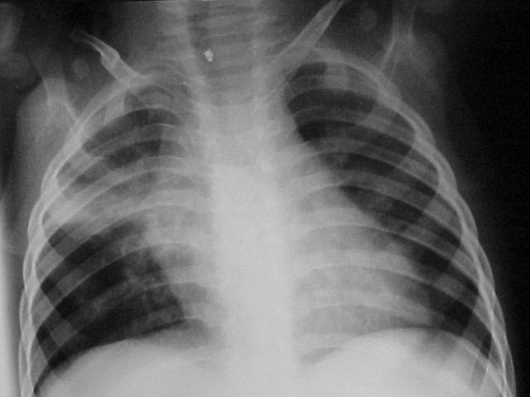
The problem
Lack of experience or attention while working with an x-ray equipment causing doctors to retake the images

Slide 3
The idea
Train the system classifiers with a high-quality and low-quality images
Integrate the system into existing systems used in hospitals or private clinics to send an image and return the response back to the system
Instant notification if the image has problems with exposure, positioning or if an important zone of the image is cropped

Slide 4
Watson logic
2 sequential API calls to figure out the type of the image
1st call – one versus all classification to get which part of body it is
2nd call – one versus all classification to check problematic area of the image

Slide 5
Usage of data
Database images for Watson training
Every appropriate image can be used for training
Using multiple image types (body parts and quality) to achieve the best results

Slide 6
Business feasibility
B2B business model
The company which hosts x-ray images can propose the system to the clients
Clients – Hospitals, medical universities, private clinics which have roentgen’s laboratories
Easy access to an extremely powerful image recognition service

Slide 7
Future of the project
Increased number of classifiers for a better recognition
Integration into the existing systems
Quality assurance tests to analyze the model operation

