Slide 1


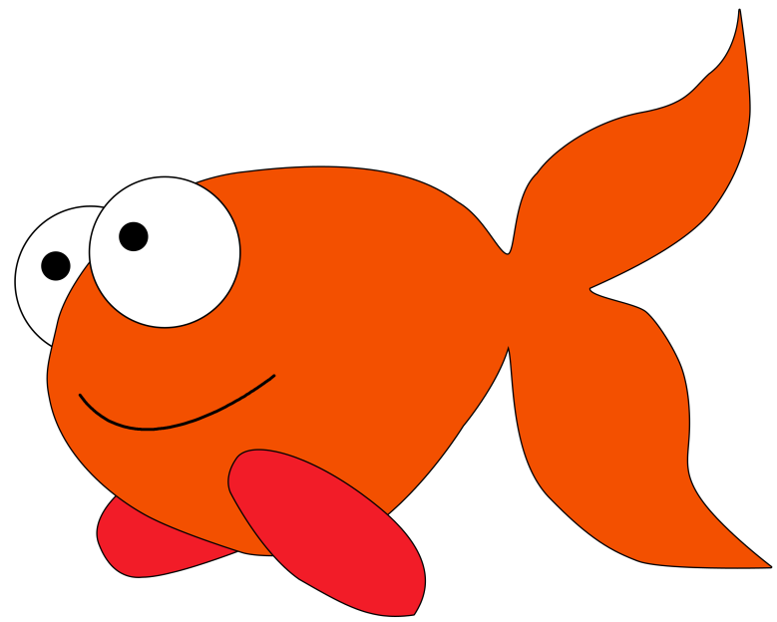
FISH HUNTING

Slide 2
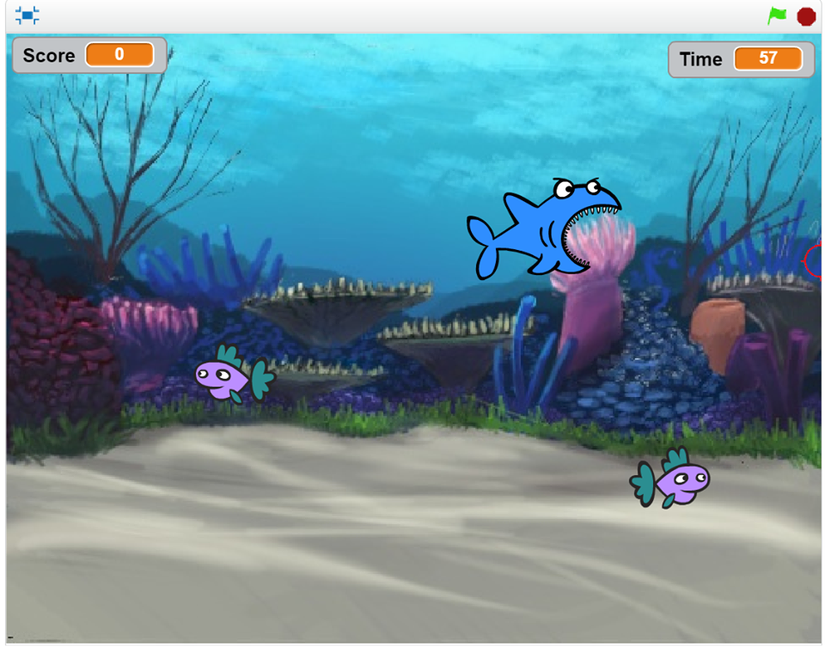
GAME NAME: FISH HUNTING
ENGINE: SCRATCH

Slide 4
RULE!

Slide 5
1.SHOOTING AT
THE YELLOW FISH AND THE PURPLE FISH

Slide 6



150
500

Slide 7
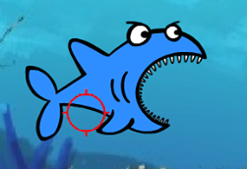
2. DO NOT SHOOTING AT SHARK
GAME OVER !

Slide 8

3. ONE MINUTE PER ROUND

