Slide 1
Client network server model
presentation

Slide 2
To achieve to given task a few steps are to be achieved
1. Create two jupyter note books.
2. Create a server socket object and bind it to a specific port.
3. Listen for incoming connections from clients.
4. To handle client request and send response back to client.
5. client get server address and connect to the server
6. client receive acknowledgement from the server and close connection
7. Track packets from the client to the server.
8. Create firewall to block incoming traffic.
9. Create firewall to allow Outgoing Traffic.

Slide 3
Creating a server socket object and bind it to a specific port
import socket
# Create a socket object
server_socket = socket.socket(socket.AF_INET, socket.SOCK_STREAM)
# Get the local machine name and port
host = socket.gethostname()
port = 12345
# Bind to the port
server_socket.bind((host, port))

Slide 4
Listening for incoming connections from clients
# Listen for incoming connections
server_socket.listen(5)
print('Server listening on {}:{}'.format(host, port))

Slide 5
To handle client request and send response back to client
# Function to handle client requests
def handle_client(client_socket):
message = 'Hello, client! Thank you for connecting.We succesfullly simulated the client server model.\nGroup 12'
client_socket.send(message.encode('utf-8'))
client_socket.close()
while True:
# Establish connection with client
client_socket, addr = server_socket.accept()
print('Got connection from', addr)
# Handle client requests in a new thread or process
handle_client(client_socket)

Slide 6
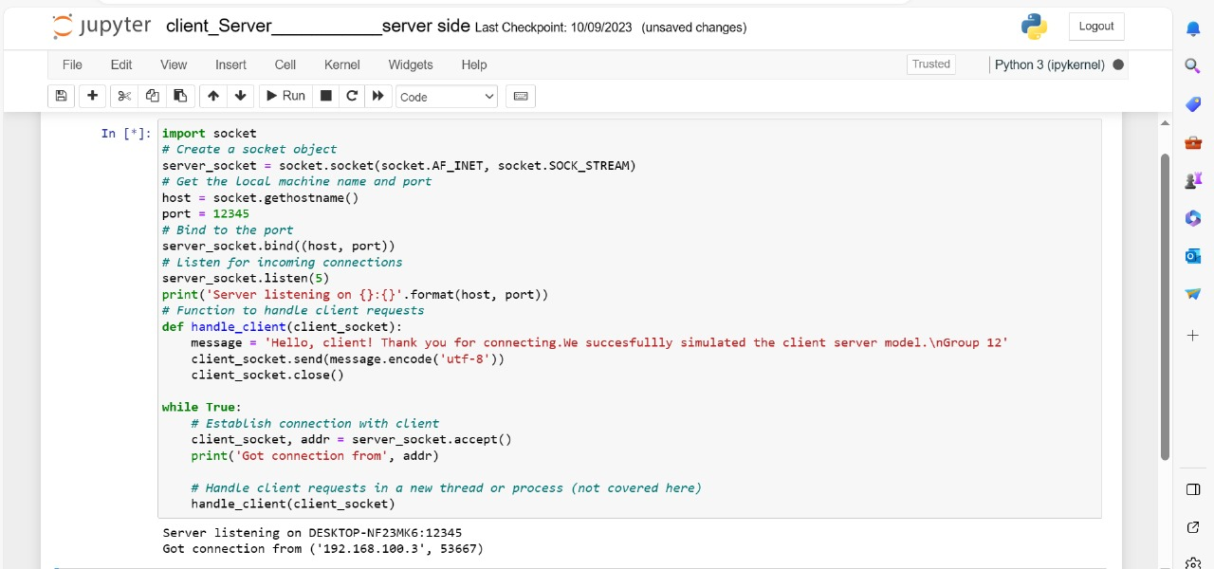
Server side running file

Slide 7

Get server address and connect to the server
import socket
# Create a socket object
client_socket = socket.socket(socket.AF_INET, socket.SOCK_STREAM)
# Get the server machine name and port
host = socket.gethostname()
port = 12345
# Connect to the server
client_socket.connect((host, port))

Slide 8
Get acknowledgement from the server and close connection
# Receive data from the server
message = client_socket.recv(1024)
print('Received from server:', message.decode('utf-8'))
# Close the connection
client_socket.close()

Slide 9
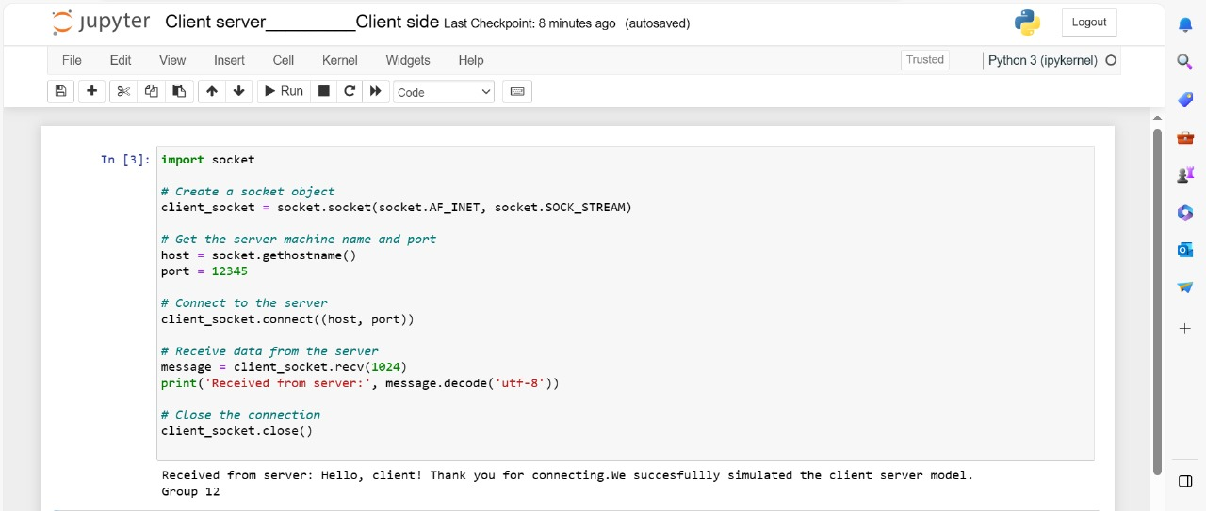
Client side output

Slide 10
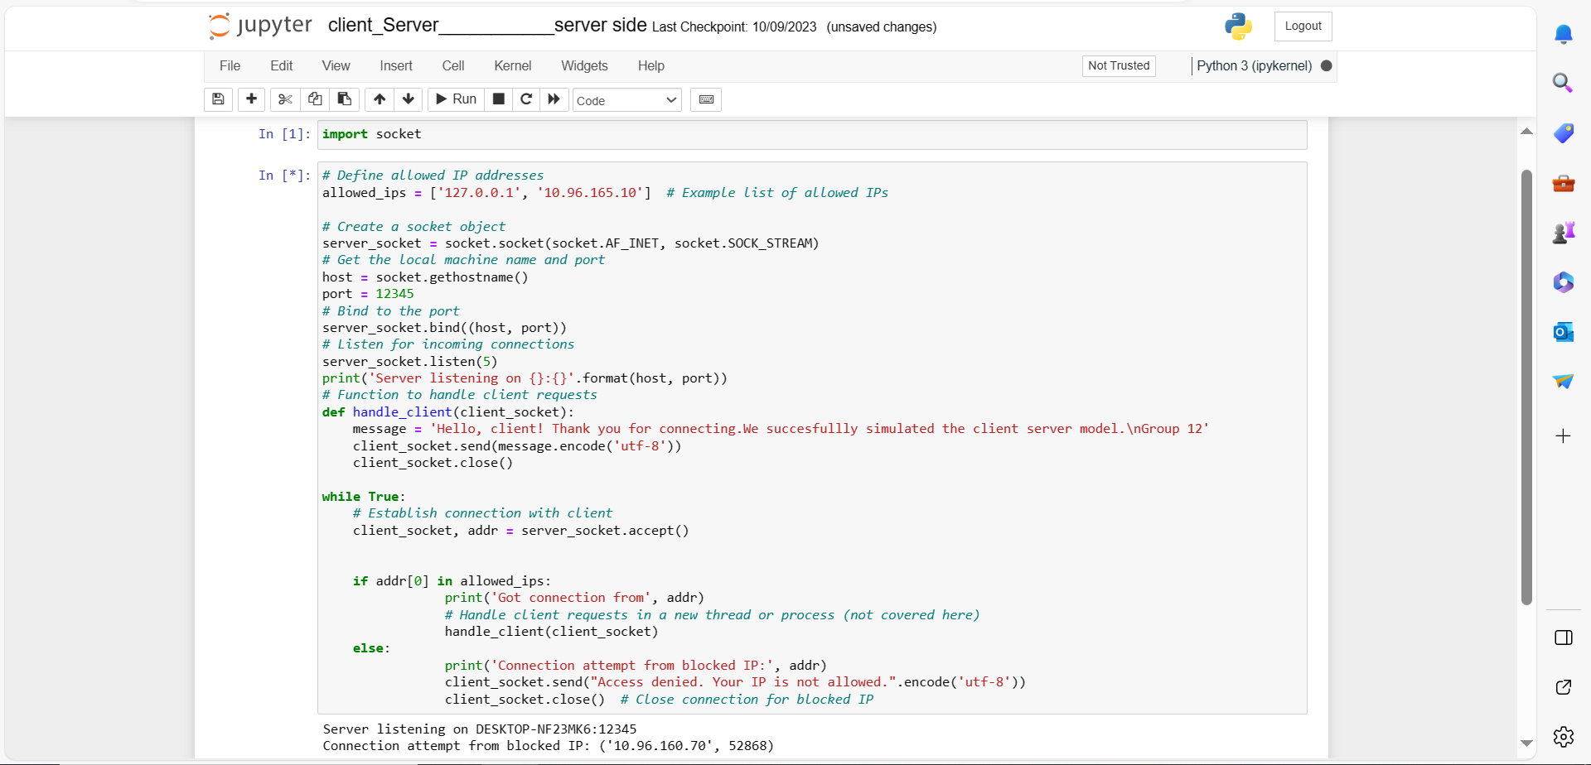
Server blocking access

Slide 11
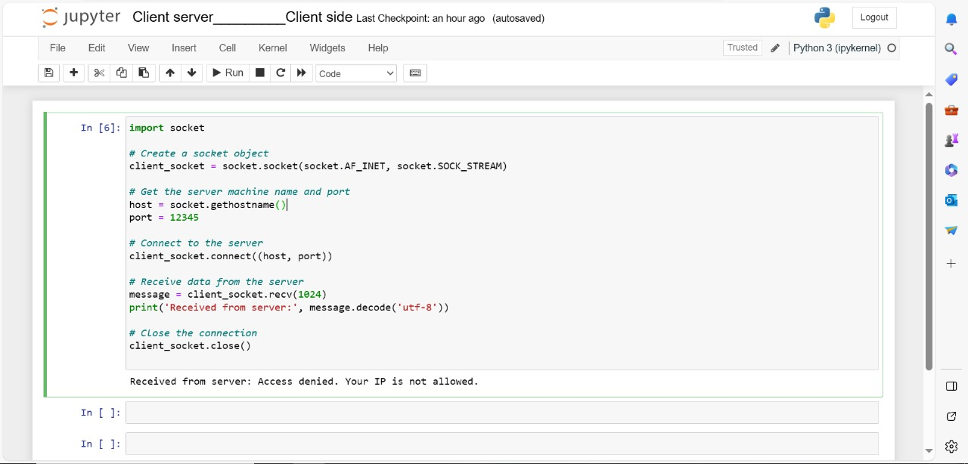
Instance of Denied access

Slide 12
References
Source: Conversation with Bing, 11/27/2023
(1) katmfoo/python-client-server - GitHub. https://github.com/katmfoo/python-client-server.
(2) . https://bing.com/search?q=client+server+network+model+communication+simulation+python+code.
(3) Python Socket Programming - Server, Client Example - DigitalOcean. https://www.digitalocean.com/community/tutorials/python-socket-programming-server-client.
(4) simulating the clients using python - Stack Overflow. https://stackoverflow.com/questions/56493587/simulating-the-clients-using-python.
(5) Client/Server in Python - Stack Overflow. https://stackoverflow.com/questions/64401928/client-server-in-python.
(6) undefined. https://www.techsolveprac.com/client-server-communication-python/.
(7) en.wikipedia.org. https://en.wikipedia.org/wiki/Python_(programming_language).

