Slide 1



Nesvilab
NesviLab
Proteomics and Integrative Bioinformatics

Slide 2
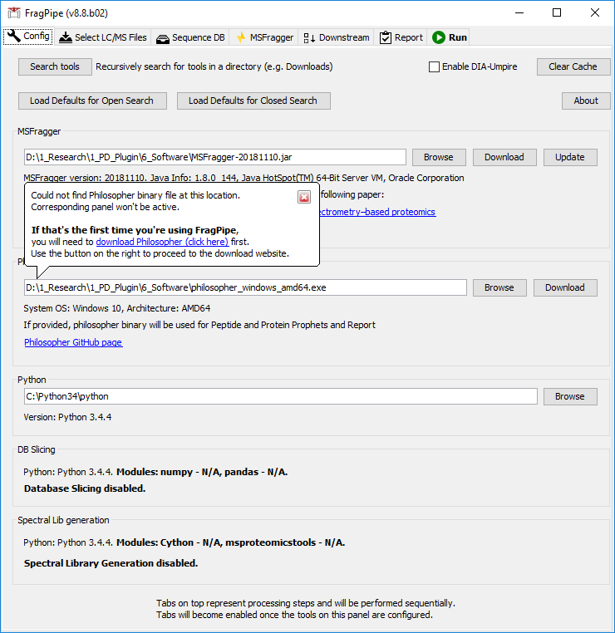

Slide 3
PSMs
Criteria:
Reference channel intensity>0
Precursor ion purity>=50%
Summed MS2 intensity>=5% (2.5% for phospho data)
PSMs not mapping to contaminant proteins
Select the PSM from all PSMs identifying with the same peptide in the same sample/fraction having the maximum intensity summing across all channels.
1. Best PSM Selection
For each selected PSM, the 10 channel intensities are log2 transformed and then subtracted from the reference channel.
For each PSM
2. Log Transform/Normalization I
For a PSM table, the selected PSMs are sorted and divided into 10 groups on the basis of their retention time. Then, we subtract the channel ratios from the median channel ratios of each PSM group.
3. Normalization II
Group the selected PSMs based on a user-defined level (e.g., gene, protein, peptide, and phospho site).
4. Grouping
Interquartile range (IQR) algorithm: The first quantile (Q1), the third quantile (Q3) and the interquartile range (IQR; Q3-Q1) in each PSM group are computed. PSM with ratios outside of the boundaries of Q1-1.5*IQR and Q3+1.5*IQR are removed from the PSM group.
5. Outlier Removal
MD: Calculate the median log2 ratio of the i^{th} sample (m0) and center the ratios in a sample by subtracting m0 from each ratio.
GN: Calculate the median deviation and median absolute deviation of centered values (m1 and m2), and scale all values to derive the final measure using the equation: yij’’ = (yij’/ m2)*m1+m0, where yij is the log2 ratio in the i^{th} group of the j^{th} sample.
6. Normalization III
Output

