Slide 1
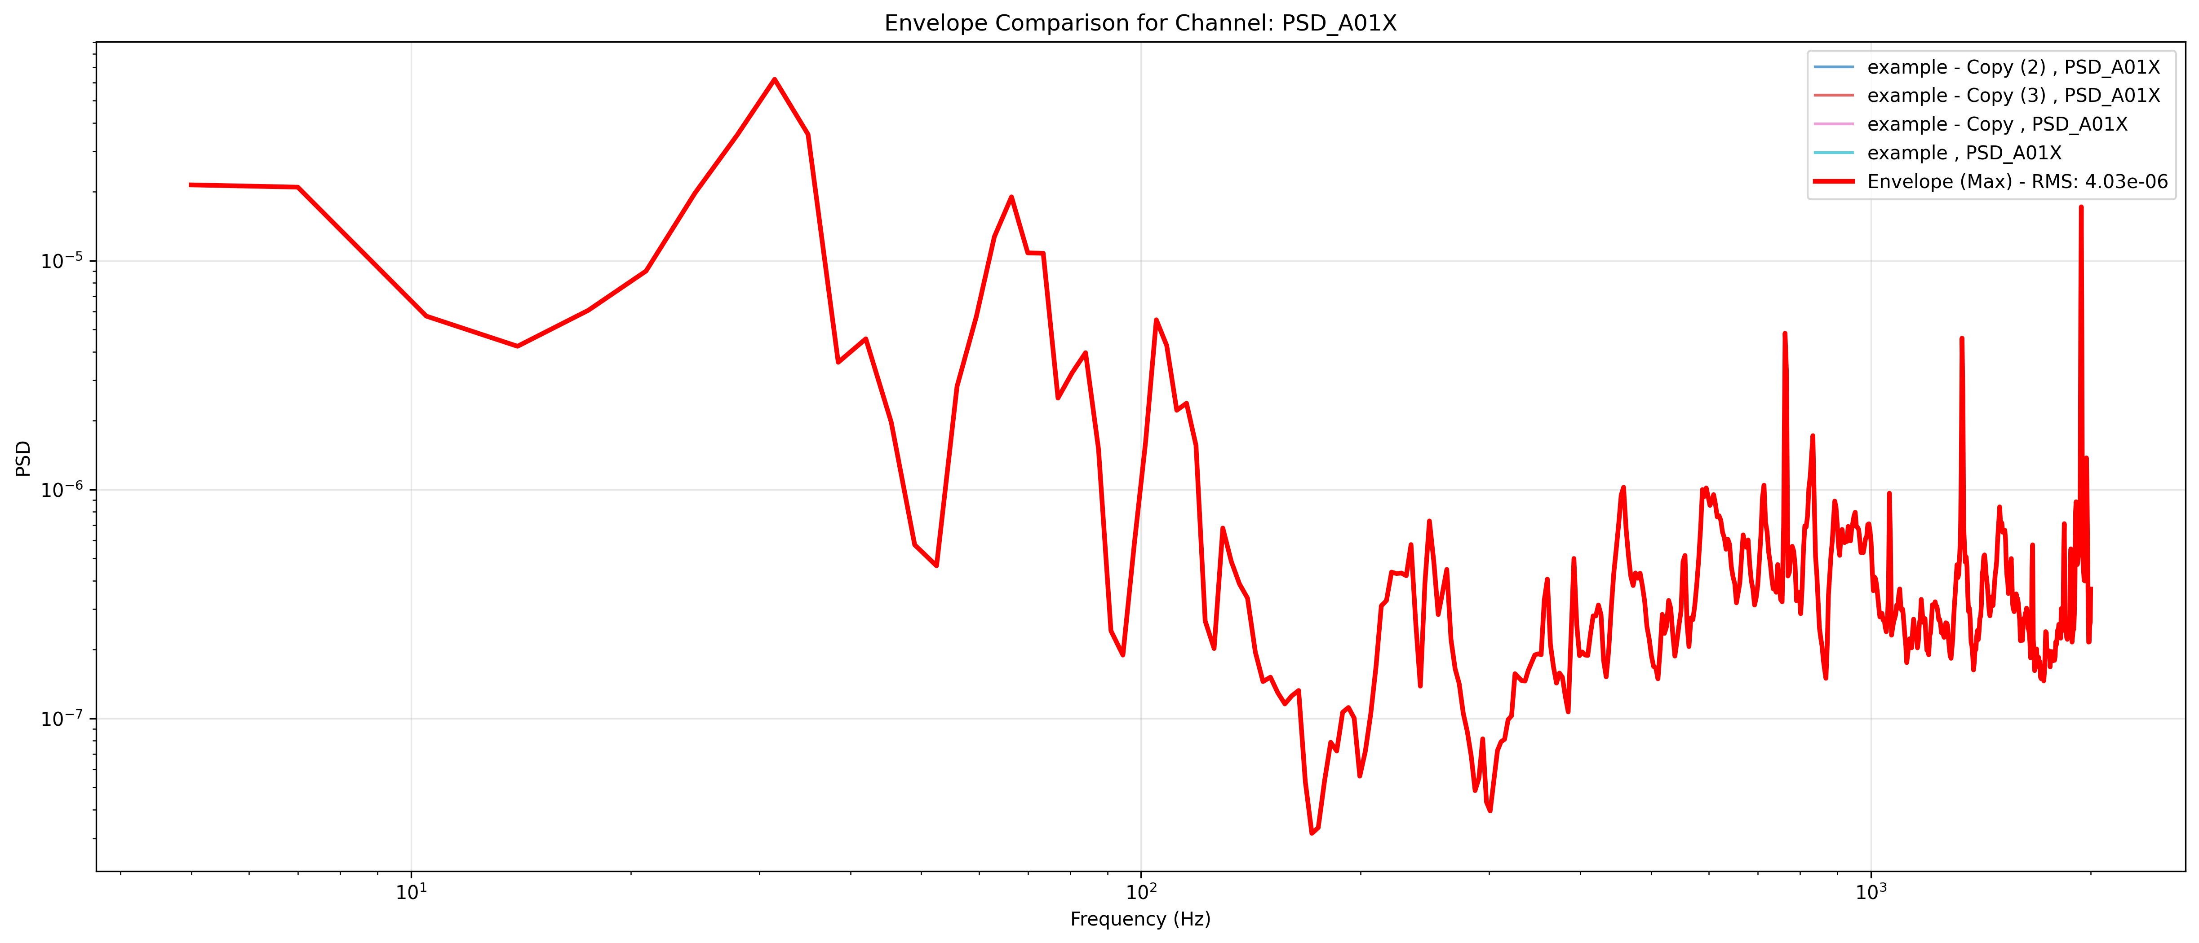
PSD_A01X

Slide 2

PSD_A01Y

Slide 3

PSD_A01Z

