Slide 1

The Case for an Intermediate Representation for
Programmable Data Planes
Muhammad Shahbaz and Nick Feamster
Princeton University

Slide 2

Need for a Programmable Data Plane
Protocol Independence (e.g., GRE, VXLAN, BFD)
VXLAN
ETH
Payload
ETH
Payload
Data Plane
ETH
Payload
P0
LD VXLAN
LD ETH
VXLAN.IP
==
IPx
ETH
==
ETHy
POP VXLAN
SEND P0
To enable this, data plane needs to be able to …
1) Operate on arbitrary packet locations
2) Accept packet processing operations using high-level policies
(or language)
Policy
Notes:
First let’s talk a bit about why we need a programmable data plane
What is it that current (fixed function) switches are not able to provide.
[Click]
“Protocol Independence” – The fixed nature of OpenFlow devices makes it hard to add new protocols or (infact) remove protocols if they are no longer needed.
Recently many new protocols are being developed for serving different applications in datacenter and enterprise networks e.g., GRE, VXLAN, and BFD.
And there is a need to rapidly deploy those protocols in the network without waiting for new OpenFlow specification and chips to spin up (which if not years, tends to take months before they can be actually deployed)
Therefore, it seems reasonable to have some kind of programmability in the network device to quickly deploy these protocols.
[Click]
The data plane device should be able to operate on arbitrary packet locations.
It should provide means for specifying packet operations using high-level network policies.
[Click]
For example, here’s a simple network policy that tells that data plane to read VXLAN and (internal) Ethernet headers from the packet.
Compare the IP in VXLAN with some IPx. If there is a match it removes the VXLAN header from the packet and forwards it through port 0 if internal ETH header matches.
[Click]
Given such programmable devices, the challenge then is how to compile these high-level user policies to such devices.

Slide 3


Compiling Policy
b. generate policy
Switch
Parse
ETH
DC
a. git clone
Parse
ETH
Parse
IP
ACL
HUB
Parse
IP
LB
Router
Parse
TCP
ACL
c. install policy
However, there is an issue here …
- ACL might only be operating on IP src/dst
- In which case, rest of the fields are dead
- A naïve compilation will add these dead fields in the data plane
Data Plane
Notes:
[Click]
We expect that programmers will organize their policies into libraries and modules, possibly, written in different languages (e.g., P4 and POF).
These libraries might be accessible through public repositories like Github.
[Click]
A network programmer can then take these modules and compose them to write more complex policies.
[Click]
And finally install them on to a data plane device.
[Click]
However, installing policies is not straight forward. There are many challenging issues here. For example, ACL might only be operating on IP src/dst.
In which case, rest of the fields are unused and shouldn’t be part of the final policy.
[Click]
But a naïve compilation will add these fields in the data plane
Thus, we need mechanisms to ensure that such redundancies be removed from the final policy and that it’s efficiently compiled to the underlying target.

Slide 4
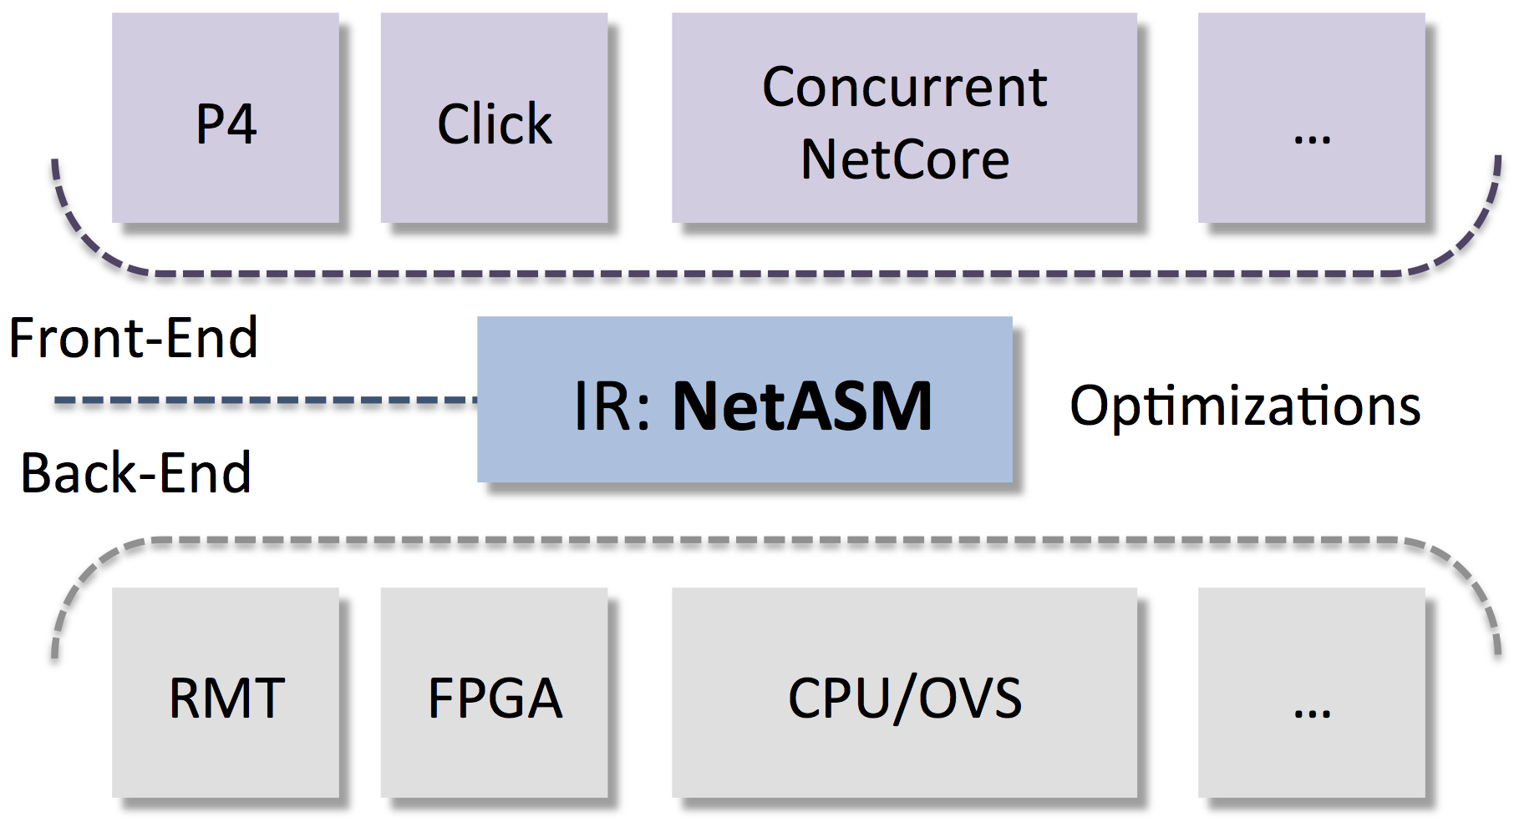
NetASM: An Intermediate Representation
Enables a common platform for writing optimizations for programmable data planes
NetASM Design Features
- Provides an abstract data plane model
- Two kinds of state
a. Per-packet state (e.g., fields)
b. Persistent state (e.g., tables)
- Modes of execution
a. Sequential for invoking pipelined parallelism
b. Concurrent for latency sensitive applications
c. Atomic for stateful operations using shared state
- 23 primitive instructions
Notes:
To tackle this problem, we present NetASM which serves as the “narrow waist” between the languages that are beginning to emerge and rapidly growing set of targets.
[Click]
It enables a common platform for writing optimizations for these programmable devices.
[Click]
Provides an abstract cost model.
[Click]
Persistent state for storing information across packets.
[Click]
In order efficiently map policies to different targets, NetASM provides three modes of execution.
These can be used in conjunction to implement complex execution behaviors of a given device.
[Click]
And has only 23 primitive instructions for implementing these network policies.

Slide 5
Compiling Policy “using NetASM”
Parse
ETH
Parse
IP
ACL
NetASM acts as a common (intermediate) layer
- Improves quality of code using optimizations like
code-motion and dead-code/store elimination
NetASM
Common (Intermediate) Layer
- Performs conventional data and control flow
analyses
- Uses target agnostic and specific cost model
- Improves for metrics like area, latency, and throughput
Data Plane

Slide 6
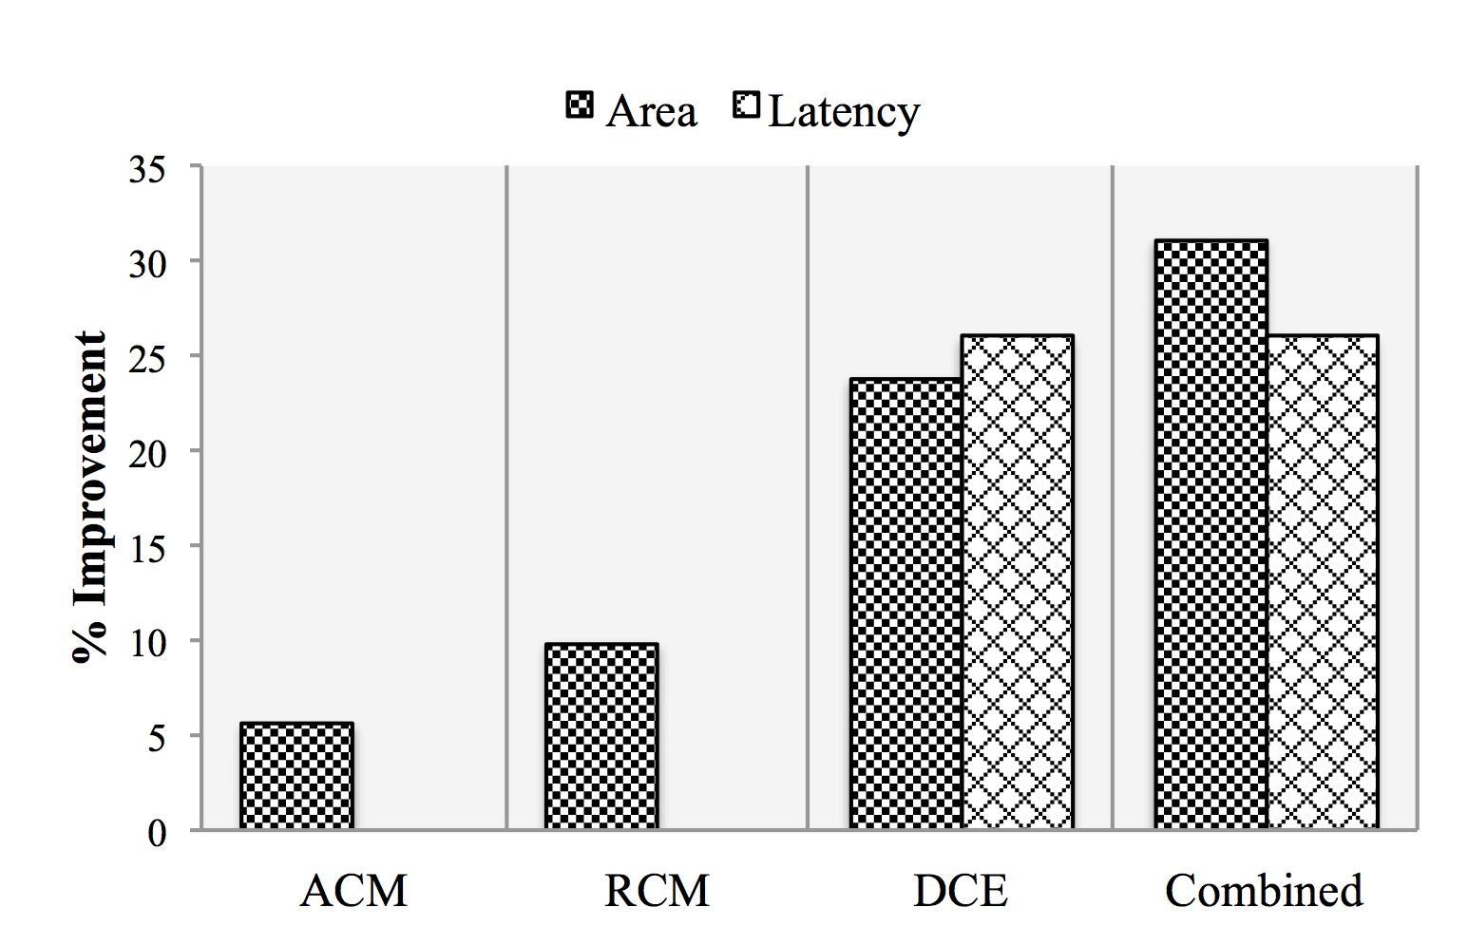
Preliminary Evaluations
- ACL-IPv4 benchmark from ONF Github repository
https://github.com/NetASM/ACL-IPv4-Example
- Results using our abstract cost model (details in the paper)
Notes:
We have done some preliminary evaluations using the ACL-IPv4 benchmark from ONF Github repo.
We translated the original TTP specification into NetASM and wrote a packet parser and deparser for it.
As it’s was not originally specified under TTPs.
We ran these optimizations using an abstract cost model. The details of which are listed in the paper.
We found that by just running few simple code-motion and dead-code elimination optimizations we were able to remove many of the redundancies in the ACL+IPv4 policy.
There was around 32% and 26% increase in the area and latency, which showed the viability of our work.

Slide 7
Future Work
P4
Click
CNC
Complete the language specification for NetASM
Front end
Explore opportunities for optimizations
that can be applied across different classes of target architectures
Compiler
NetASM
Back end
RMT
FPGA
NPU
1
2
3

Slide 8
Summary
NetASM is an intermediate representation for Programmable Data Planes
Enables a common platform for optimizing high-level packet processing programs for a diversity of targets
Leads to better architectural explorations
Notes:
We presented NeASM an intermediate representation for programmable data planes.
NetASM provides a common platform for optimizing packet processing programs for a diverse set of targets.
And we hope that it will lead to better architectural explorations and soon a time will come when the performance of the switch will not be determined by its raw speed but also by how well compilers can exploit its features.
With this I conclude my presentation.

Slide 9
Questions?
www.netasm.org
Muhammad Shahbaz
mshahbaz@cs.princeton.edu

