Slide 1

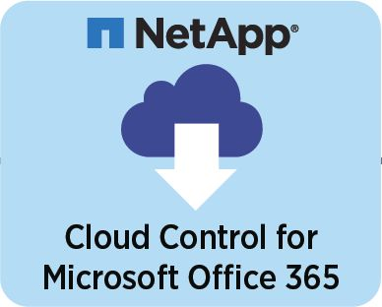



Backup
Restore
SaaS Backup for
SalesForce
Users

Slide 2

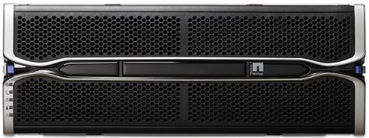
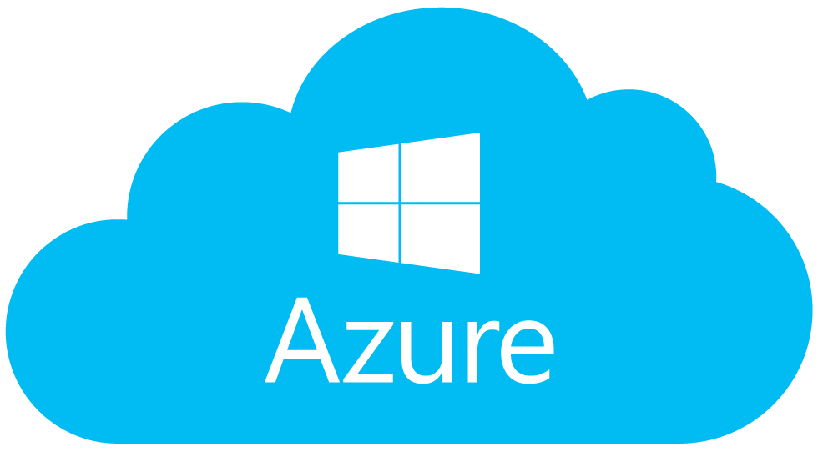
Backup
Restore
Office 365
Users

