Slide 1


DukeScript?
What’s new in

Slide 2


Anton Epple
Trainer and Consultant
Eppleton IT Consulting
Twitter: @monacotoni
www.dukescript.com

Slide 3
DukeScript
http://www.dukescript.com

Slide 4


Problem

Slide 5




Solution

Slide 6

“DukeScript is the Lightweight JavaFX I always dreamed of!”
Stephen Chin, JavaOne M.C.

Slide 7
How does it work?

Slide 8
How does it work?
Insert HTML5 Renderer here
DukeScript glues them together
Insert JVM here

Slide 9
How does it work?
HTML5 Component renders the result
DukeScript and it’s Java APIs control the Renderer
JVM executes Java Business Logic, written with DukeScript Java APIs

Slide 10
Desktop
javafx.scene.web.WebView
DukeScript glues them together
Hotspot

Slide 11
Android
android.webkit.WebView
DukeScript glues them together
Dalvik

Slide 12
iOS
NSObject.UIResponder.UiView
.UIWebView
DukeScript glues them together
RoboVM

Slide 13
Browser
Chrome…
DukeScript glues them together
bck2brwsr

Slide 14
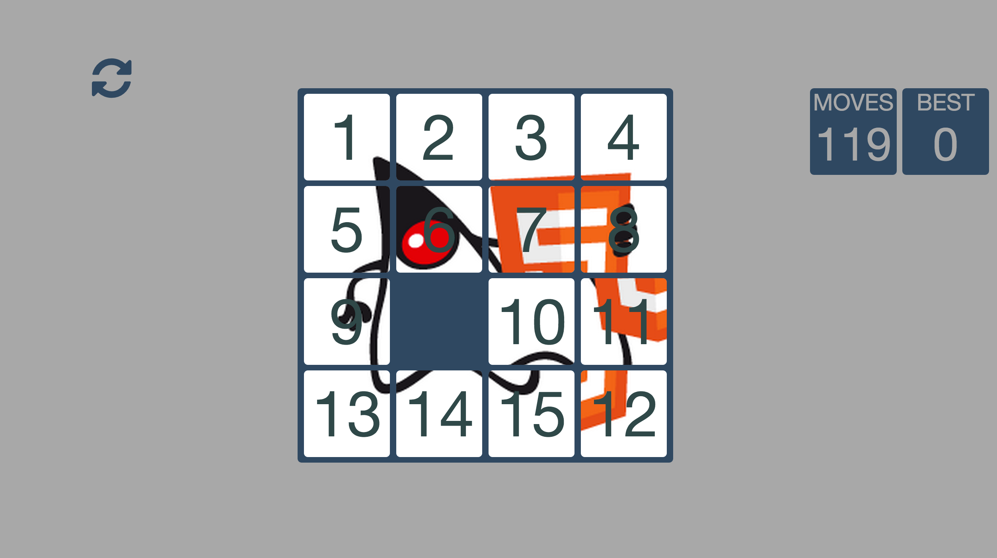
New Demos

Slide 15
What’s new?
Version 0.12 of Bck2Brwsr
https://dukescript.com/update/2014/12/31/New-Version-Of-bck2brwsr-released.html

Slide 16
What’s new?
New version of DukeScript for iOS and Android
now fully Open Sourced!
https://dukescript.com/update/2015/02/05/New-Version-of-Dukescript.html
https://github.com/dukescript/dukescript-presenters

Slide 17

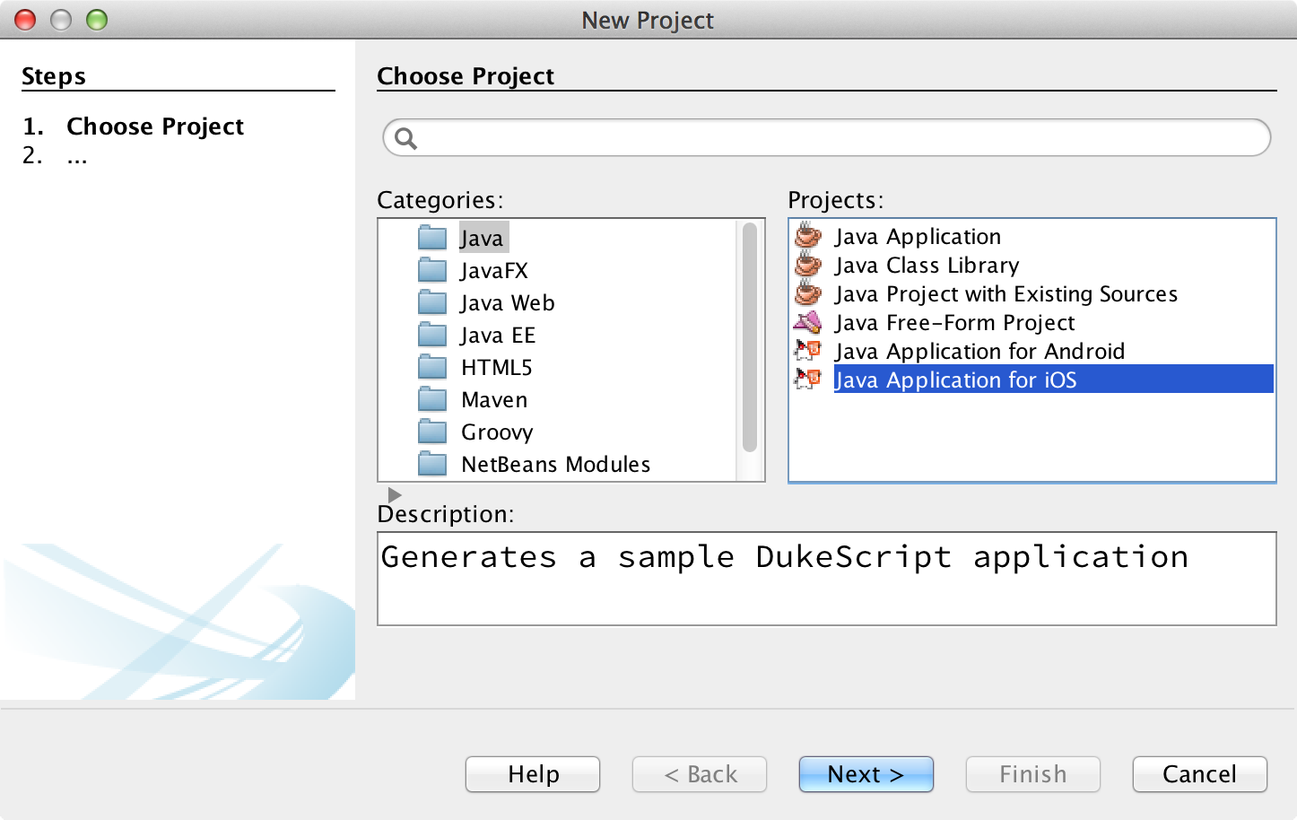
What’s new?
New version of DukeScript NetBeans Plugin
Demo
http://plugins.netbeans.org/plugin/57392/dukescript-project-wizard

Slide 18
What’s new?
Blog series on MVVM and TDD
https://dukescript.com/best/practices/2015/02/16/tdd-with-dukescript.html
https://dukescript.com/best/practices/2015/02/18/testing-http-with-dukescript.html
Model
ViewModel
View

Slide 19
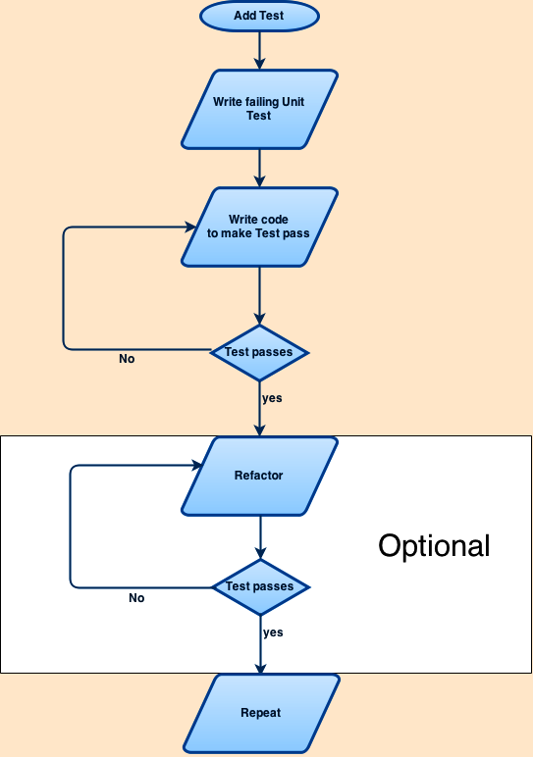
TDD

Slide 20

What’s new?
Version 1.1 of HTML APIS
Java
HTML
Models.applyBindings(p, „person“);
<div id=„person“
data-bind=„…“></div>
<div id=„address“
data-bind=„…“></div>
Models.applyBindings(a, „address“);
https://dukescript.com/update/2014/12/29/New-Version-Of-HTML-APIs-released.html

Slide 21
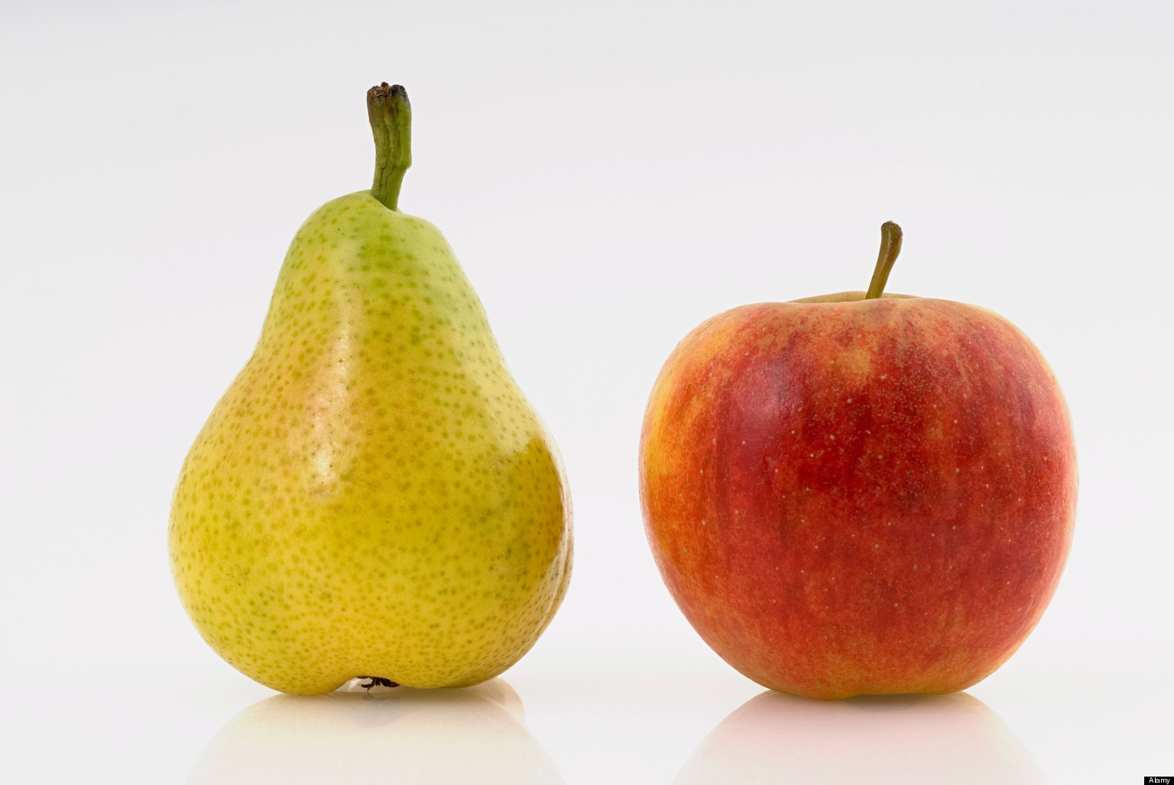
What’s new?
Performance Comparison
https://github.com/konsoletyper/teavm/tree/master/teavm-samples/teavm-samples-benchmark

Slide 22
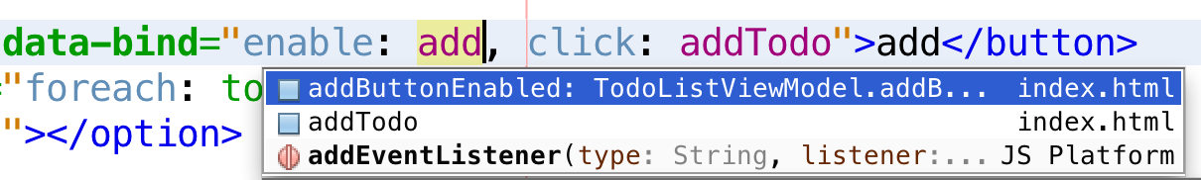
What’s Under Development?
Better Code Completion

Slide 23

What’s Under Development?
Hot Swapping

Slide 24
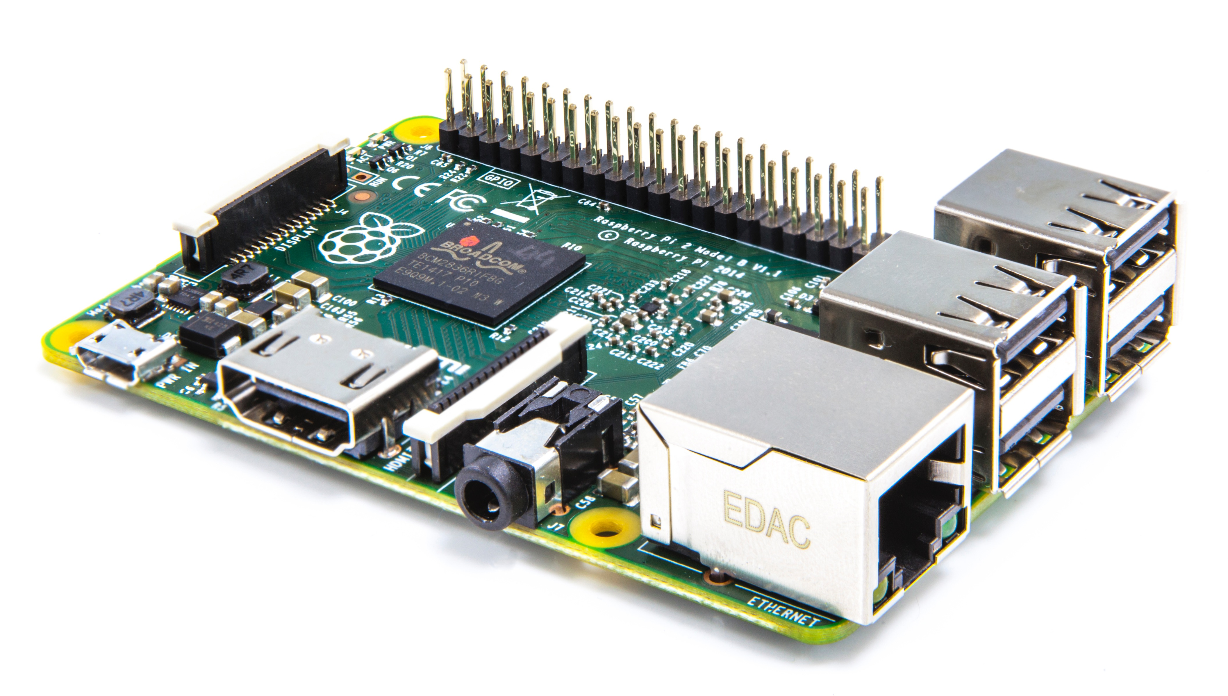
What’s Under Development?

Slide 25
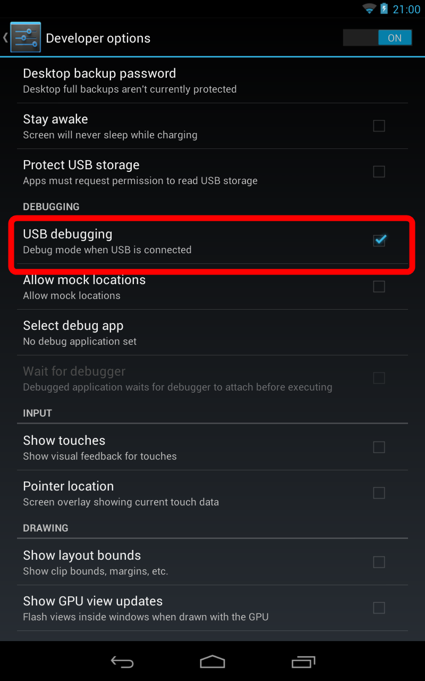
What’s Under Development?
On Device Debugging
(iOS, Android)

Slide 26
What’s Under Development?
Camera API
Leaflet4j
Controls.js
http://xelfi.cz/camera/
https://github.com/sperlchris/leaflet4j

Slide 27
Thank you for your attention!

