Slide 1
Developing Java EE applications with NetBeans and Payara

Slide 2

Agenda
Java EE is not last millennium’s J2EE
What is Payara ?
Code Demo
Wrap Up

Slide 3
Java EE 7 is not J2EE
For the old Guys
Java EE is NOT XML Driven
Java EE IS POJOs and Annotations
EJBs do NOT need complex Development
Java EE provides Dependency Injection
Java EE is lightweight
NetBeans has full Java EE 7 support out of the box

Slide 4
What is Payara
Payara is 24/7 software support for GlassFish Server Open Source Edition.
Payara Server is a drop in replacement for GlassFish Server with guaranteed quarterly releases. We provide enhancements, bug fixes and patches to upstream GlassFish Server and dependent libraries including Tyrus, Eclipse Link, Jersey and others.
Payara Server Developed on GitHub
https://github.com/payara/Payara.

Slide 5
Contact Database (Code Demo)
HTTP (HTML)
HTTP (JSON)
Payara
WAR file
Servlet
REST
Service
Session Bean
Entity Bean
Database

Slide 6
Java EE 7 is not J2EE
For the old Guys
Java EE is NOT XML Driven
Java EE IS POJOs and Annotations
EJBs do NOT need complex Development
Java EE provides Dependency Injection
Java EE is lightweight
NetBeans has full Java EE 7 support out of the box

Slide 7


Slide 8
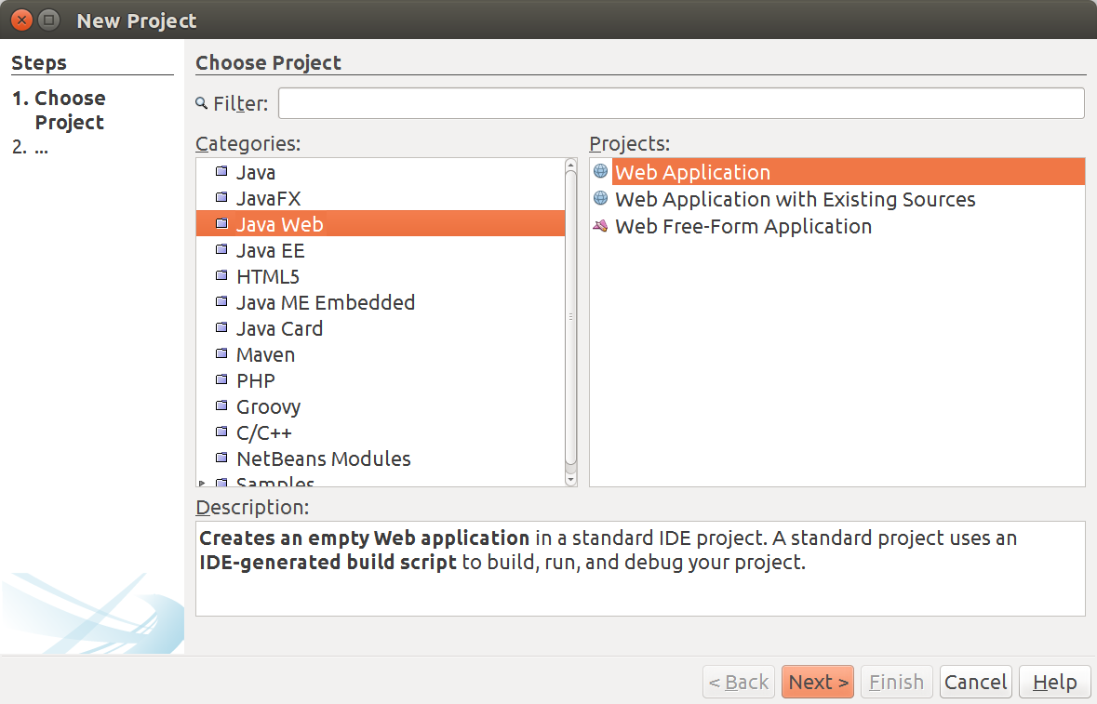

Slide 9
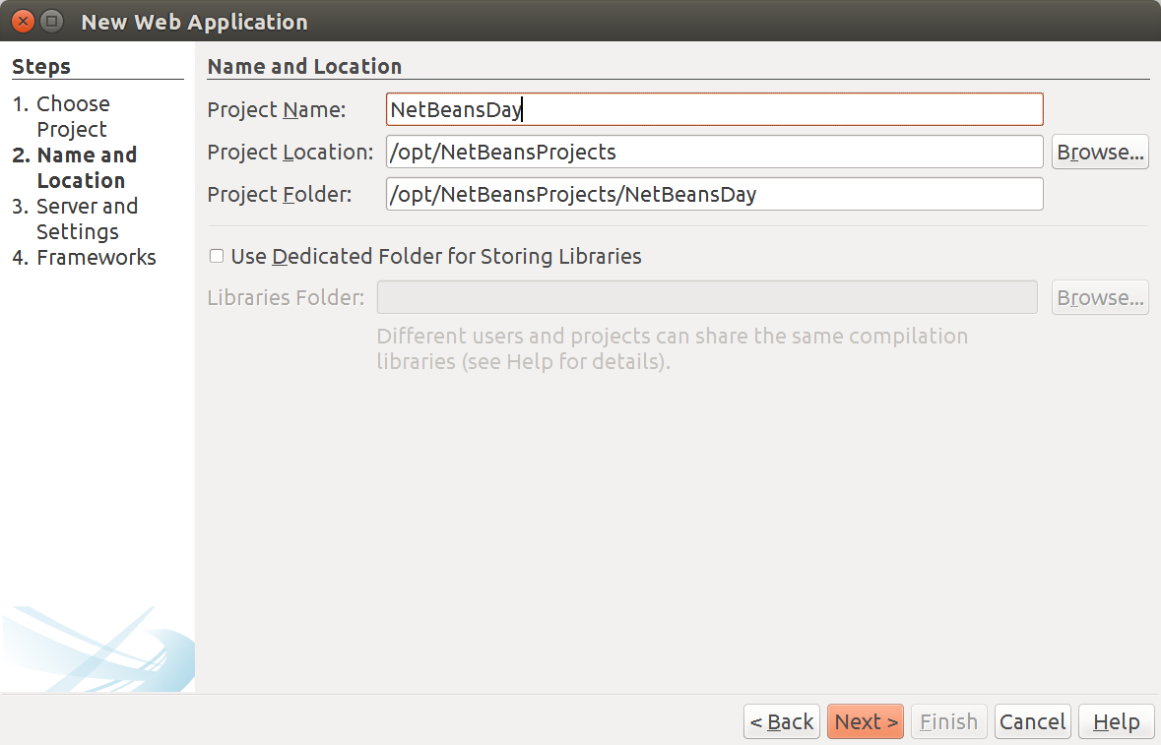

Slide 10
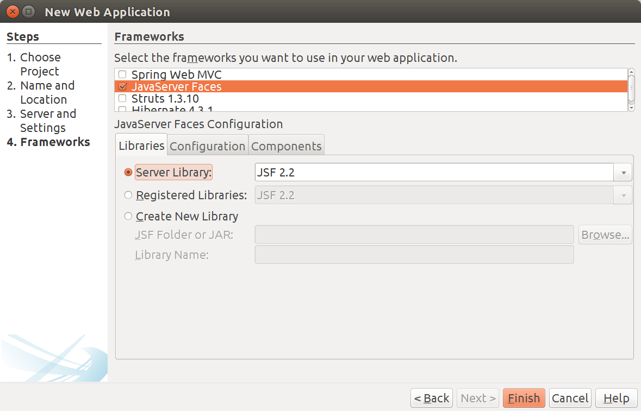

Slide 11
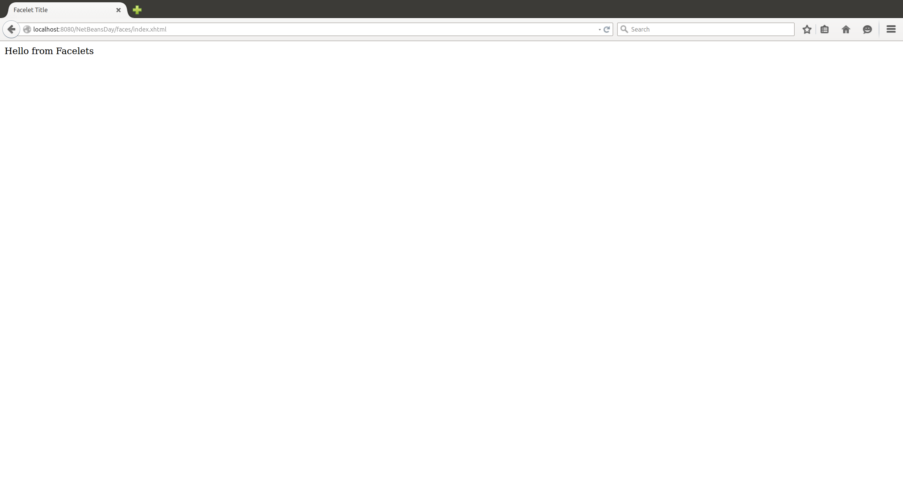

Slide 12
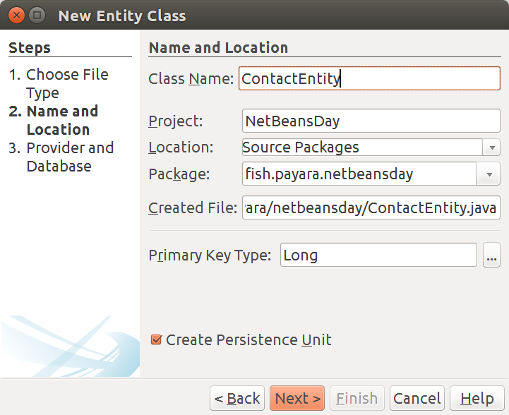

Slide 13
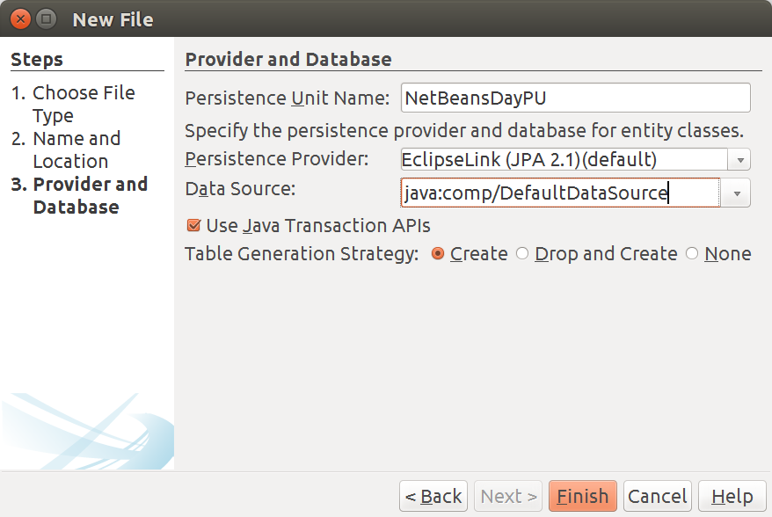

Slide 14
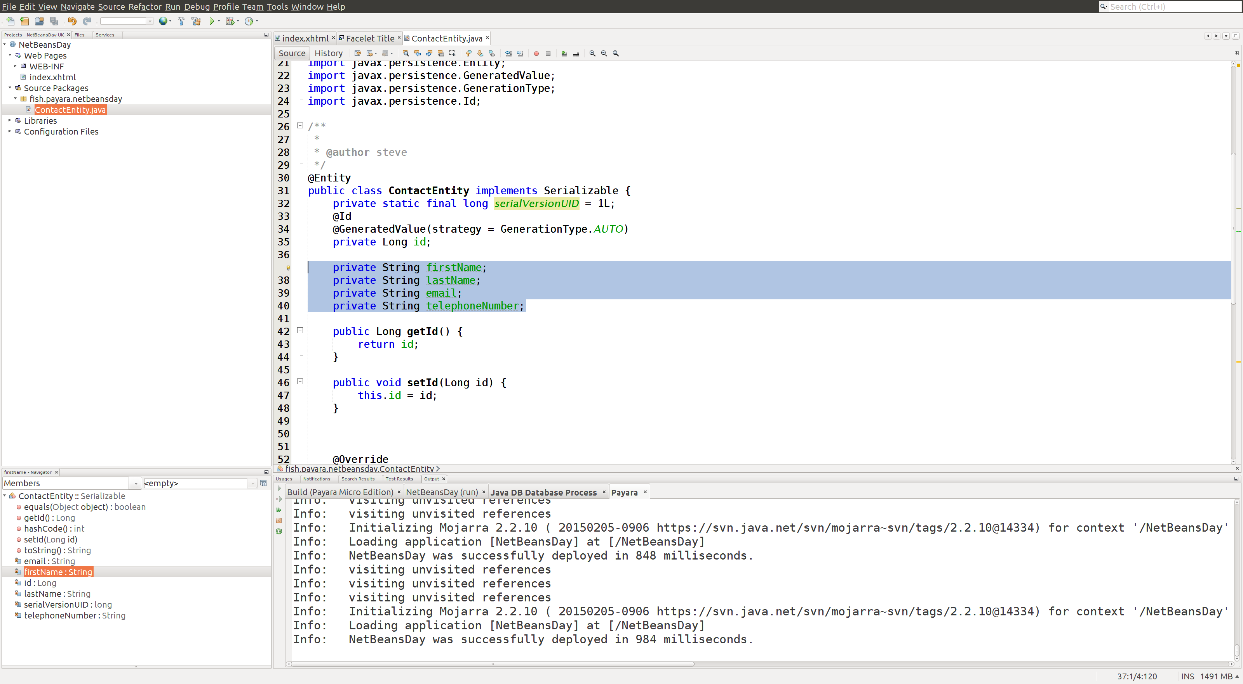

Slide 15
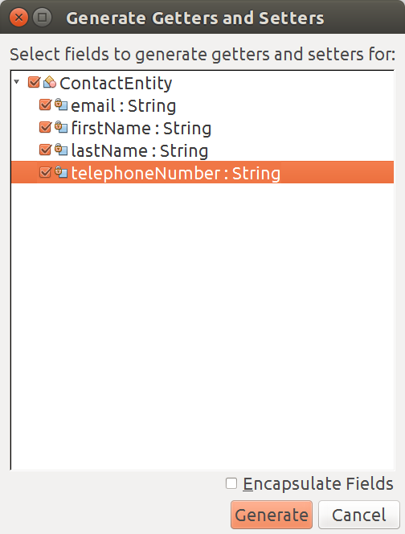

Slide 16
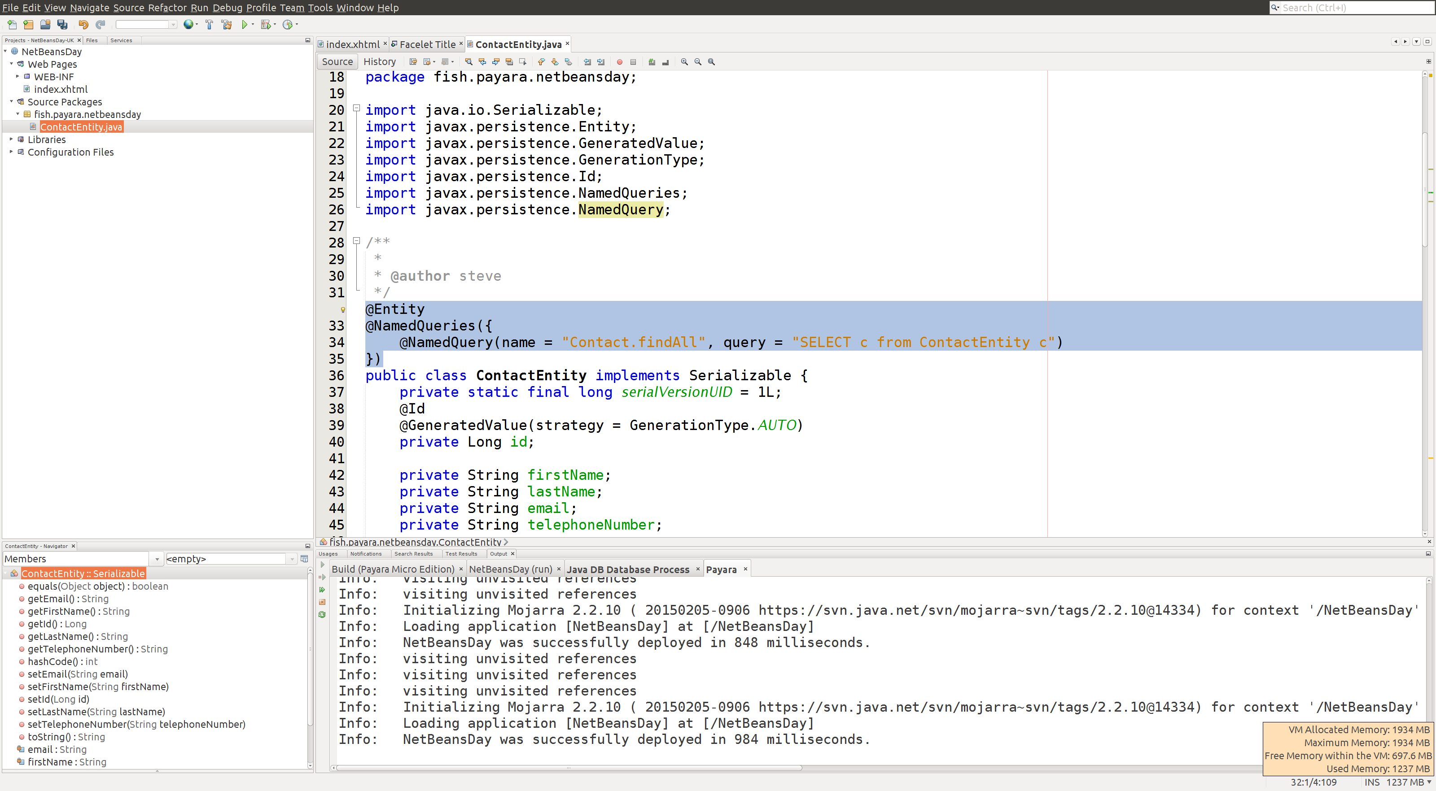

Slide 17
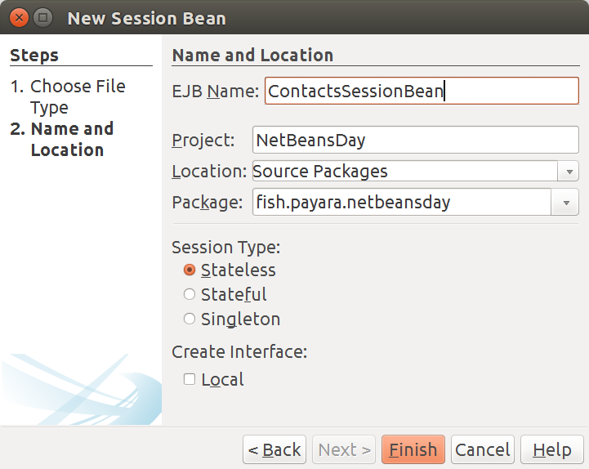

Slide 18
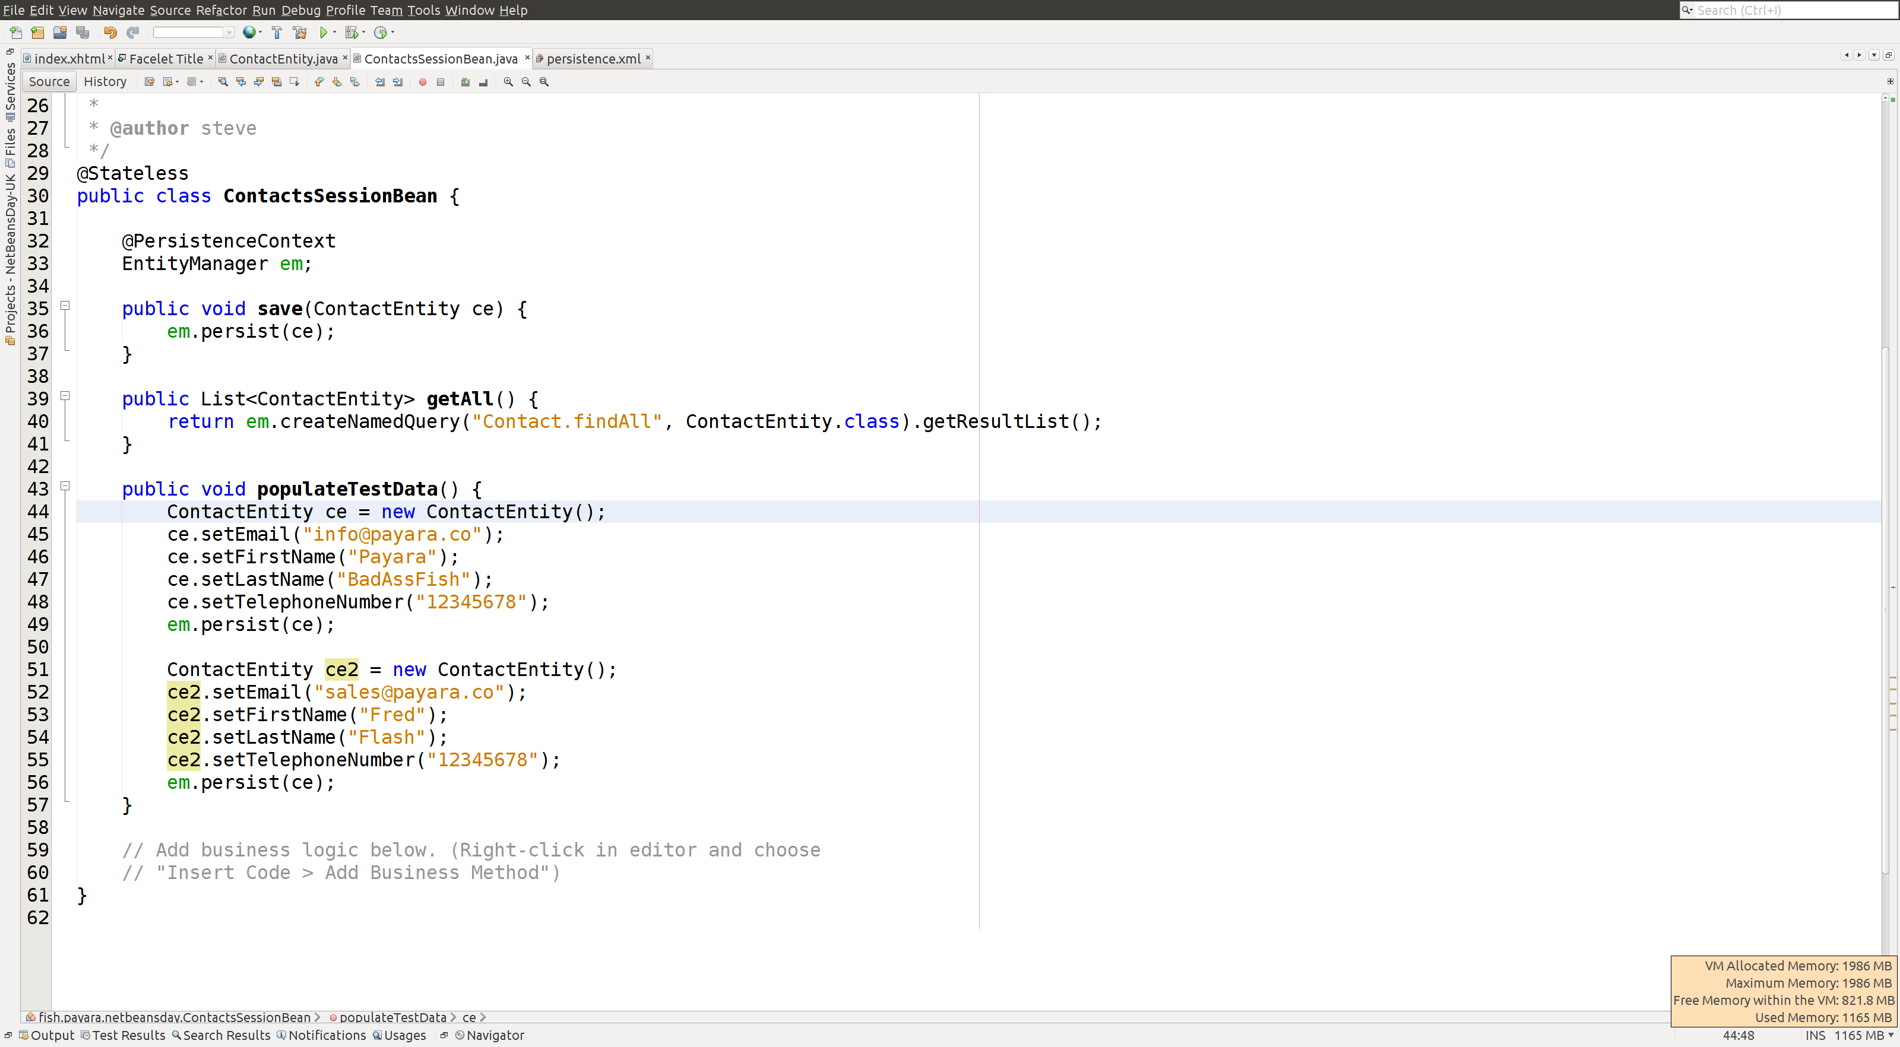

Slide 19
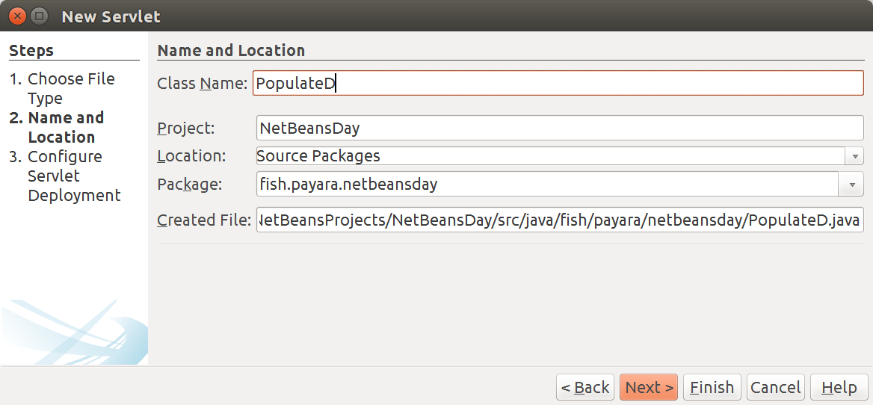

Slide 20
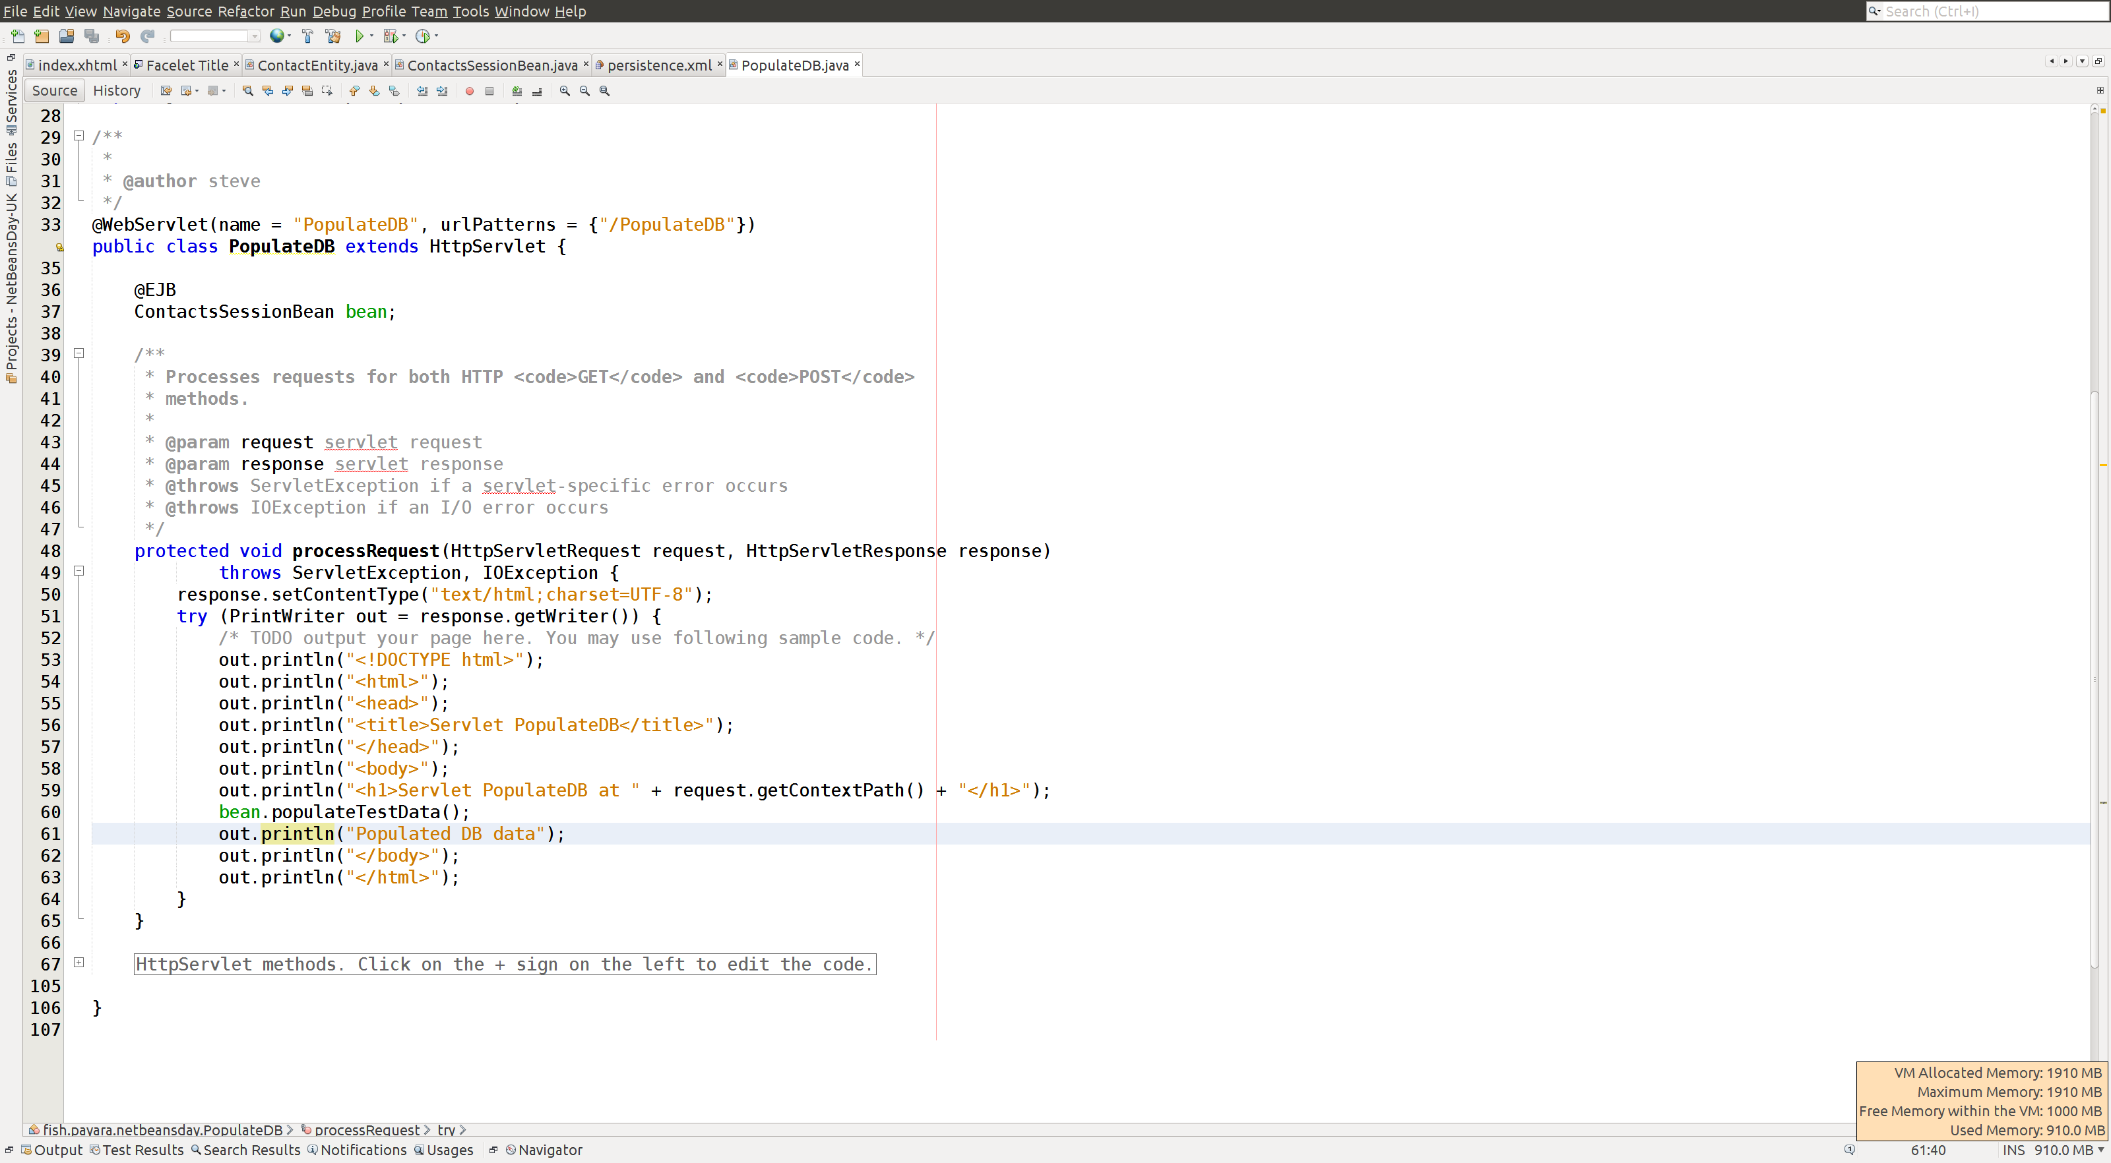

Slide 21
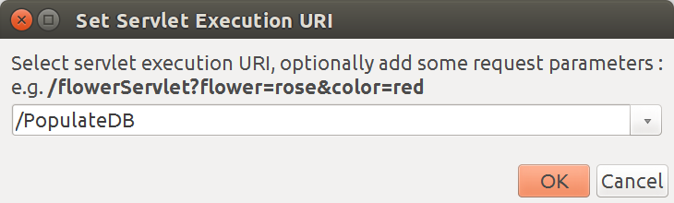

Slide 22
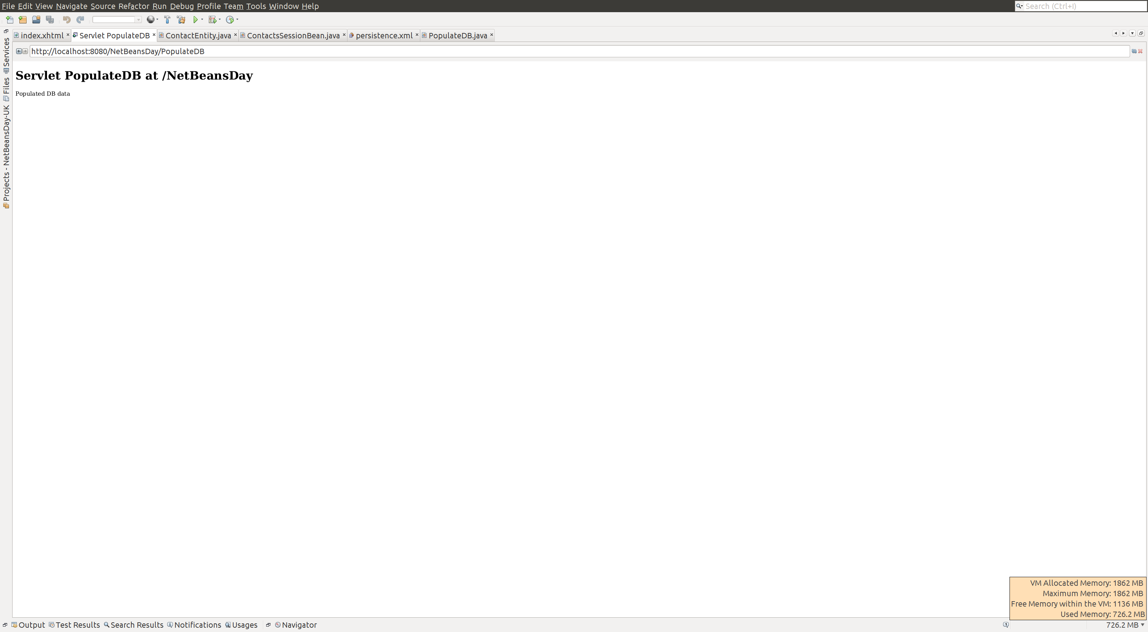

Slide 23
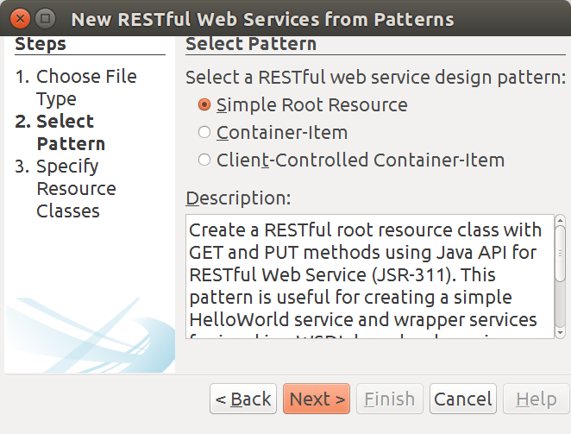

Slide 24
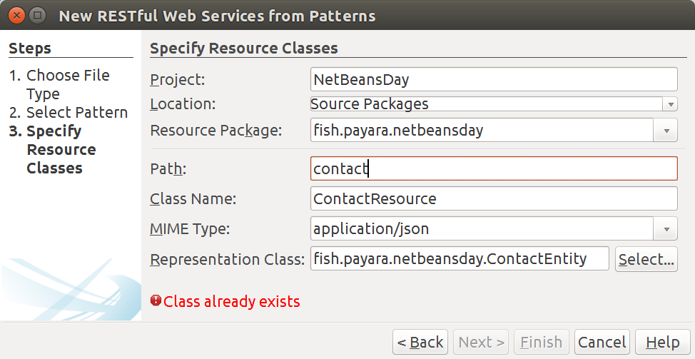

Slide 25
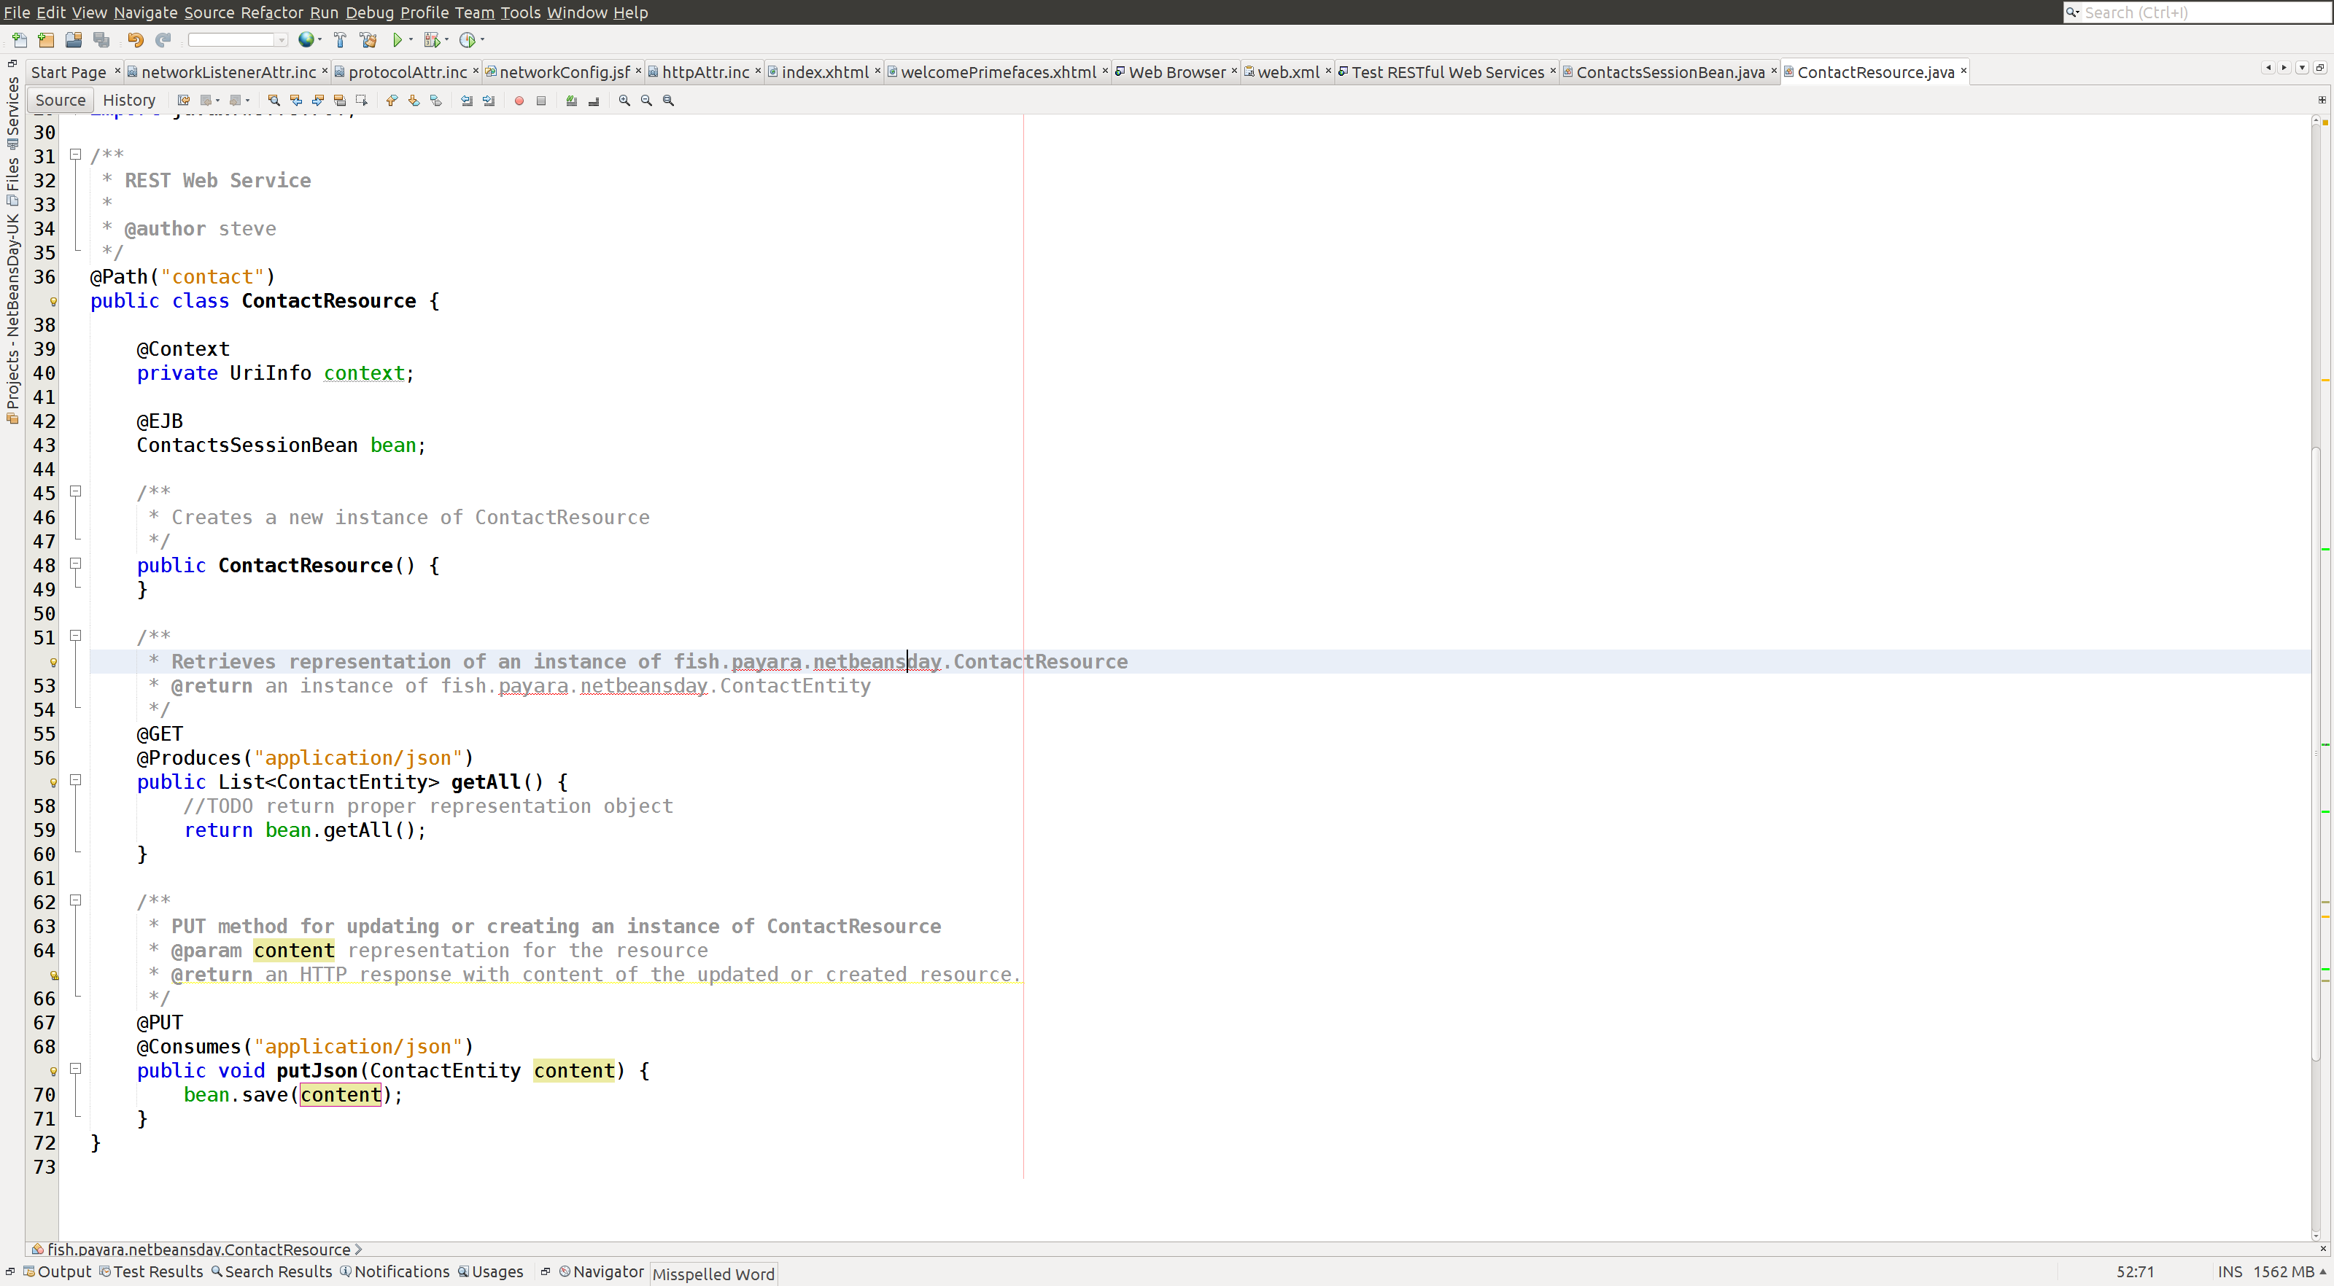

Slide 26
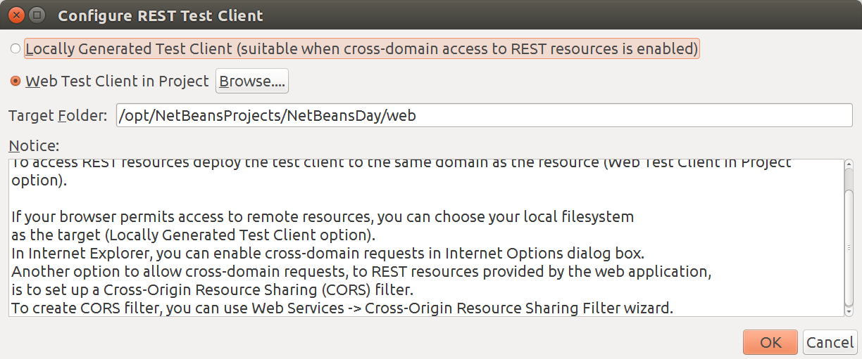

Slide 27
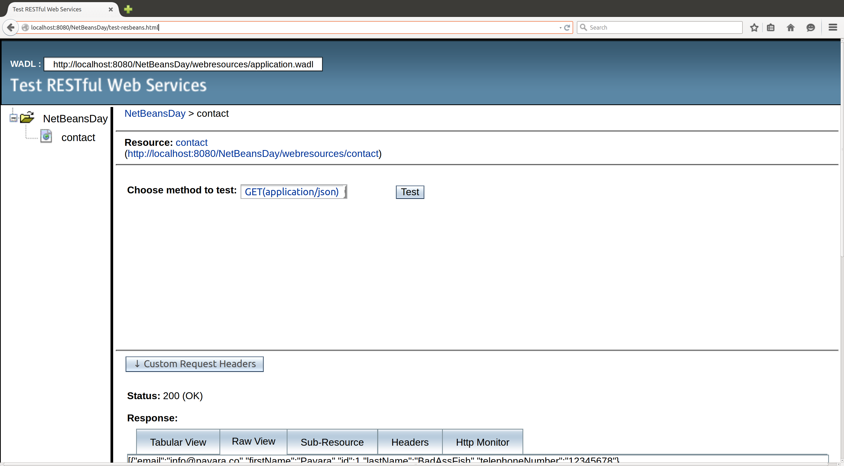

Slide 28
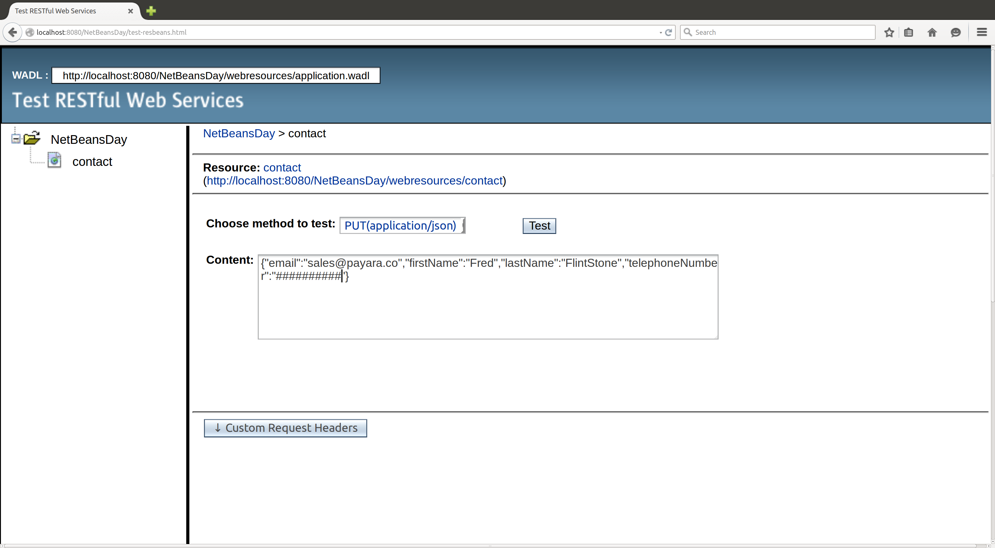

Slide 29
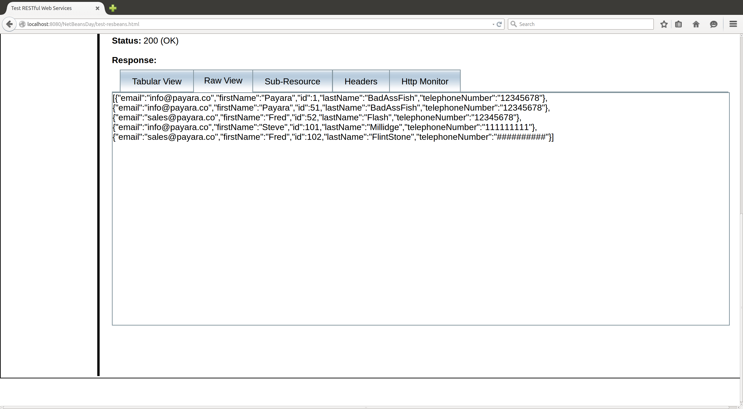

Slide 30
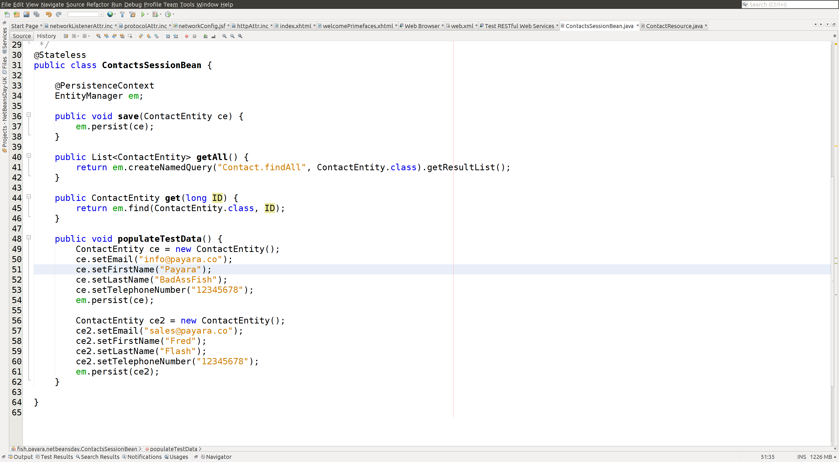

Slide 31
