Slide 1

NetFPGA Summer Camp
Project Presentation Template
Presented by:
Your Names Here
Stanford, CA
August 8, 2008
http://netfpga.org/netfpgawiki/index.php/SummerCamp2008
http://NetFPGA.org

Slide 2
Enhancing Modular Reference Designs
Usage #2
CPU
PW-OSPF
Verilog
EDA Tools
(Xilinx,
Mentor, etc.)
Memory
Java GUI
Front Panel
(Extensible)
PCI
NetFPGA Driver
1GE
1GE
FPGA
L3
Parse
L2
Parse
In Q
Mgmt
1GE
1GE
1GE
My
Block
1GE
Memory
IP
Lookup
Out Q
Mgmt
1GE
1GE
Verilog modules interconnected by FIFO interfaces

Slide 3
Running the Router Kit
User-space development, 4x1GE line-rate forwarding
Usage #1
OSPF
BGP
My Protocol
user
kernel
Routing
Table
“Mirror”
Fwding
Table
Packet
Buffer
1GE
1GE
IPv4
Router
1GE
1GE

Slide 4
What does a router do?
R3
R1
A
R4
D
1
4
16
32
Ver
HLen
T.Service
Total Packet Length
B
Fragment ID
Flags
Fragment Offset
E
TTL
D
20 bytes
Protocol
Header Checksum
R2
C
Source Address
Destination
Next Hop
R5
Destination Address
F
D
R3
Options (if any)
E
R3
Data
F
R5

Slide 5
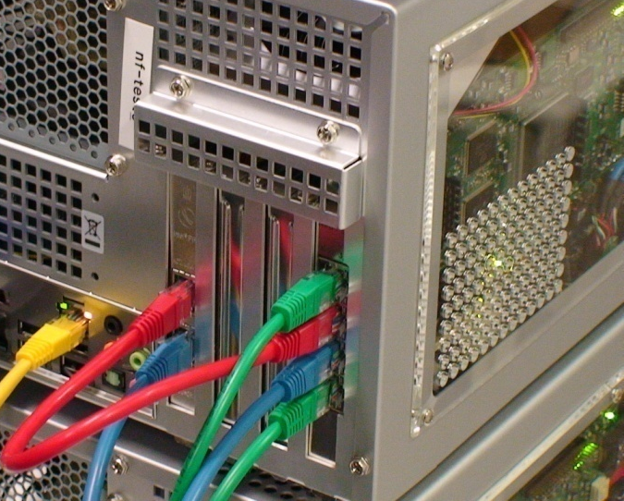
Cable Configuration in the Lab
NetFPGA Gigabit Ethernet Interfaces
  nf2c3 : Left neighbor in network (green)
  nf2c2 : Local host interface (red)
  nf2c1 : Routes for adjacent server (blue)
  nf2c0 : Right neighbor in network (green)
Host Ethernet Interfaces
  eth1 : Local host interface (red)
  eth2 : Server for neighbor (blue)
nf2c
3
3
3
3
3
3
3
3
3
3
1
2
1
2
1
2
1
2
1
2
1
2
1
2
1
2
1
2
1
2
2
1
2
1
2
1
2
1
2
1
2
1
2
1
2
1
2
1
2
1
eth
0
0
0
0
0
0
0
0
0
0

Slide 6

Subnet Configuration of the Ring
Demo 1
.1.1
.4.1
.7.1
.10.1
.13.1
.16.1
.1.2
.4.2
.7.2
.10.2
.13.2
.16.2
.3.1
.6.2
.9.2
.12.2
.15.2
.2.1
.3.2
.6.1
.9.1
.12.1
.15.1
.17.1
.30.2
.5.1
.8.1
.11.1
.14.1
.18.1
.30.1
.26.1
.23.1
.18.2
.29.1
.27.2
.24.2
.21.2
.20.1
.28.2
.27.1
.25.2
.24.1
.22.2
.21.1
.19.2
.28.1
.25.1
.22.1
.19.1
Video Server
Video Client
Shortest Path
Notes:
Explain the reason why we chose this toplogy
Explain how we will run the video. Will it be projected on the screen or will we ask users to do it themselves?

Slide 7
Neighbor Interfaces and Subnets
Demo 2
eth1 connects your host to your NetFPGA Router
nf2c2 routes to nf2c1 (your adjacent server)
eth2 serves web and video traffic to your neighbor
.2.1
.5.1
.8.1
.11.1
.4.1
.7.1
.10.1
.13.1
.1.1
.1.2
.4.2
.7.2
.10.2
.13.2
.2.2
.5.2
.8.2
.11.2
.29.1
.14.2
.29.2
.26.2
.14.1
.23.2
.20.2
.17.2
.28.2
.25.2
.22.2
.19.2
.16.2
.28.1
.25.1
.22.1
.19.1
.16.1
.26.1
.23.1
.20.1
.17.1
This configuration allows you to modify and test your router without affecting others

Slide 8
NetFPGA Block Diagram
NetFPGA platform
V2-Pro50 FPGA w/ infrastructure
18Mb
SRAM
PHY
1GE
MAC
1GE
Your hardware specified
in Verilog source code
connected to components
of the Reference Router
circuits and cores.
PHY
1GE
MAC
1GE
64MB
DDR2
SDRAM
Four Gigabit Ethernet Interfaces
-
PHY
1GE
MAC
1GE
Board
18Mb
SRAM
-
PHY
1GE
MAC
1GE
FIFO
3
Control, PCI
SATA
packet
Gb
Board Interconnect
buffers
Interface
Host
Linux OS
-
NetFPGA Kernel driver
computer
User
-
defined software networking applications

Slide 9
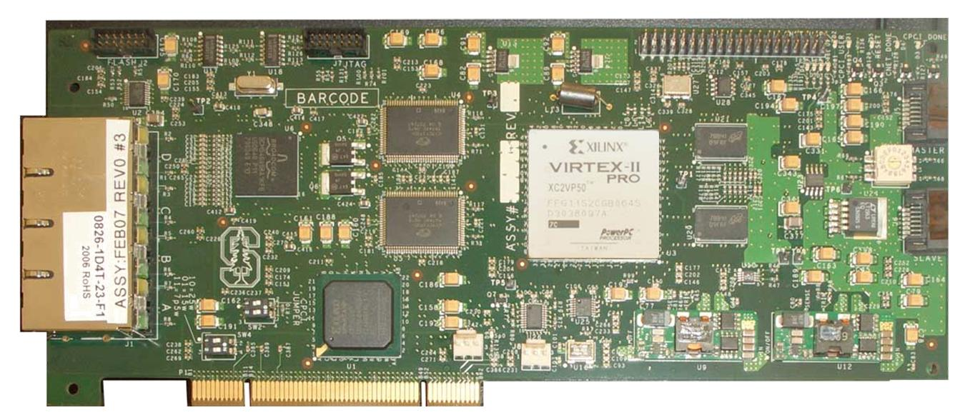
Details of the NetFPGA
Fits into standard PCI slot
  Standard Bus: 32 bits, 33 MHz
Provides interfaces for processing network packets
  4 Gigabit Ethernet Ports
Allows hardware-accelerated processing
  Implemented with Field Programmable Gate Array (FPGA) Logic

Slide 10
Reference Router Pipeline
Exercise 1
MAC
RxQ
CPU
RxQ
MAC
RxQ
CPU
RxQ
MAC
RxQ
CPU
RxQ
MAC
RxQ
CPU
RxQ
Five stages
  Input
  Input arbitration
  Routing decision and packet modification
  Output queuing
  Output
Packet-based
module interface
Pluggable design
Input Arbiter
Output Port Lookup
Output Queues
MAC
TxQ
CPU
TxQ
MAC
TxQ
CPU
TxQ
MAC
TxQ
CPU
TxQ
MAC
TxQ
CPU
TxQ

Slide 11
Enhanced Router Pipeline
Demo 2
MAC
RxQ
CPU
RxQ
MAC
RxQ
CPU
RxQ
MAC
RxQ
CPU
RxQ
MAC
RxQ
CPU
RxQ
Two modules added
  Event Capture to capture output queue events (writes, reads, drops)
  Rate Limiter to create a bottleneck
Input Arbiter
Output Port Lookup
Event Capture
Output Queues
MAC
TxQ
CPU
TxQ
Rate
Limiter
CPU
TxQ
MAC
TxQ
CPU
TxQ
MAC
TxQ
CPU
TxQ
MAC
TxQ

Slide 12
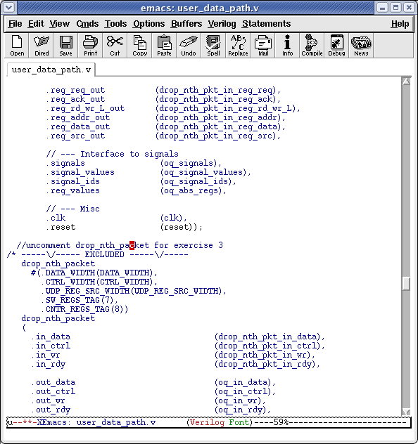
Step 5 - Add the Drop Nth Module
Exercise 2
  Search for drop_nth_packet (ctrl+s drop_nth_packet), then press Enter
  Uncomment the block (ctrl+c+u)

Slide 13
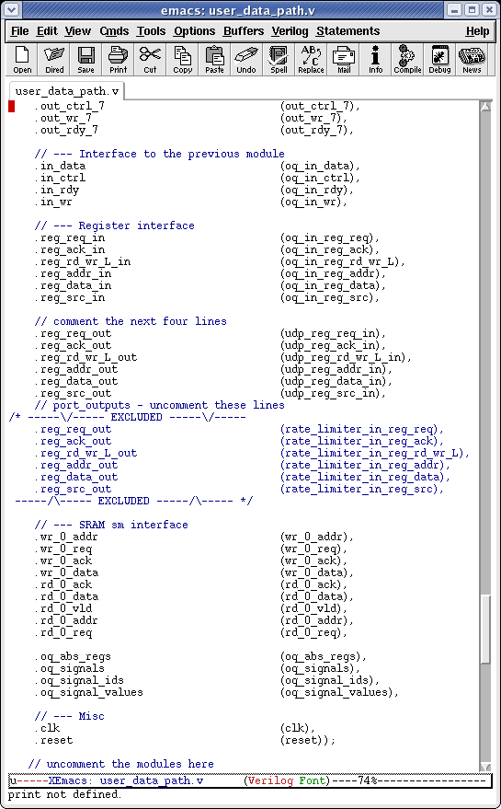
Step 7 - Connect the Registers
Exercise 2
  Search for port_outputs (ctrl+s port_outputs), then press (Enter)
  Comment the 6 lines
  (select the six lines by using shift+arrow keys), then type (ctrl+c+c)
  Uncomment the commented block by scrolling down into the block and typing (ctrl+c+u)
six

Slide 14
Inter-Module Communication
Using “Module Headers”:
Ctrl Word
(8 bits)
Data Word
(64 bits)
x
Module Hdr
Contain information such as packet length, input port, output port, …
…
…
y
Last Module Hdr
0
Eth Hdr
0
IP Hdr
0
…
0x10
Last word of packet

Slide 15

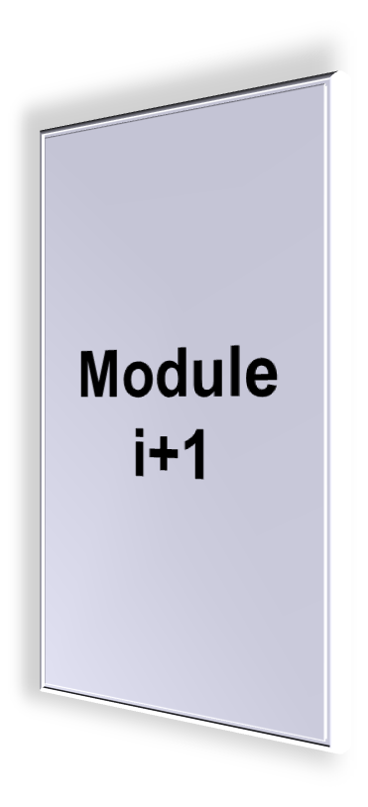
Inter-Module Communication
data
ctrl
wr
rdy

Slide 16
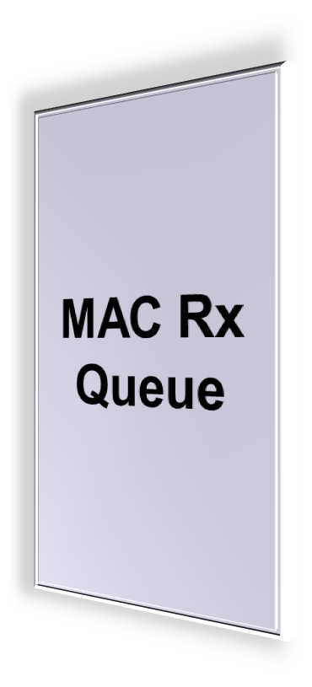
MAC Rx Queue
Eth Hdr:
Dst MAC = port 0, Ethertype = IP
IP Hdr:
IP Dst: 192.168.2.3, TTL: 64, Csum:0x3ab4
Data

Slide 17
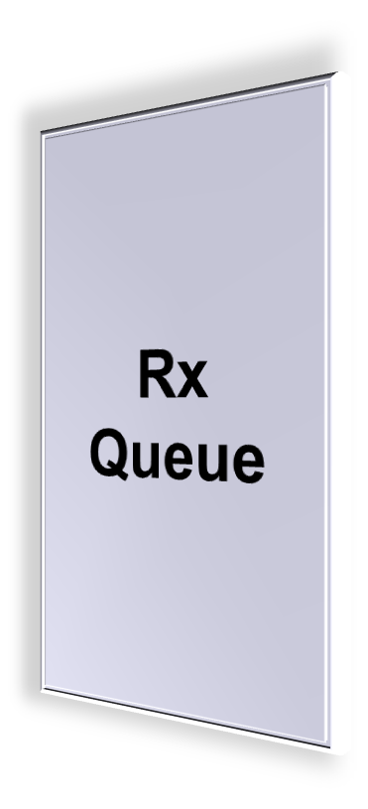
Rx Queue
0xff
Pkt length,
input port = 0
0
Eth Hdr:
Dst MAC = port 0, Ethertype = IP
0
IP Hdr:
IP Dst: 192.168.2.3, TTL: 64, Csum:0x3ab4
0
Data

Slide 18

Output Port Lookup
1- Check input port matches Dst MAC
5- Add output port header
0xff
Pkt length,
input port = 0
Pkt length,
input port = 0
output port = 4
2- Check TTL, checksum
6- Modify MAC Dst and Src addresses
0
EthHdr: Dst MAC = 0
Src MAC = x,
Ethertype = IP
3- Lookup next hop IP & output port (LPM)
EthHdr: Dst MAC = nextHop Src MAC = port 4,
Ethertype = IP
0
IP Hdr:
IP Dst: 192.168.2.3, TTL: 64, Csum:0x3ab4
7-Decrement TTL and update checksum
IP Hdr:
IP Dst: 192.168.2.3, TTL: 63, Csum:0x3ac2
4- Lookup next hop MAC address (ARP)
0
Data

Slide 19


Output Queues
OQ0
OQ4
Pkt
OQ7

Slide 20

MAC Tx Queue
0xff
Pkt length,
input port = 0
output port = 4
0
EthHdr: Dst MAC = nextHop Src MAC = port 4,
Ethertype = IP
0
IP Hdr:
IP Dst: 192.168.2.3, TTL: 64, Csum:0x3ab4
IP Hdr:
IP Dst: 192.168.2.3, TTL: 63, Csum:0x3ac2
0
Data

Slide 21
MAC Tx Queue
0xff
Pkt length,
input port = 0
output port = 4
0
EthHdr: Dst MAC = nextHop Src MAC = port 4,
Ethertype = IP
0
IP Hdr:
IP Dst: 192.168.2.3, TTL: 64, Csum:0x3ab4
IP Hdr:
IP Dst: 192.168.2.3, TTL: 63, Csum:0x3ac2
0
Data

Slide 22
NetFPGA-Host Interaction
Linux driver interfaces with hardware
  Packet interface via standard Linux network stack
  Register reads/writes via ioctl system call
  with wrapper functions:
    readReg(nf2device *dev, int address, unsigned *rd_data);
    writeReg(nf2device *dev, int address, unsigned *wr_data);
    eg:
    readReg(&nf2, OQ_NUM_PKTS_STORED_0, &val);

Slide 23



NetFPGA-Host Interaction
Register access
2. Driver performs PCI memory read/write
PCI Bus
1. Software makes ioctl
call on network socket
ioctl passed to driver

Slide 24
Long-term plans for the NetFPGA
Your plans for using the NetFPGA
  Teaching
  Research
  Other
Resources needed for your class
  Source code
  Courseware
  Examples
Your plans to contribute
  Expertise
  Capabilities
  Collaboration Opportunities

Slide 25
To Contribute your Project
Create a compressed tar file with your files
  Run the following one-line command from /root
    tar cvzf MyProjectName.tgz NF2/project/MyProjectName
  If you have created library modules, include the additional files by running a command like:
    tar cvzf MyProjectName.tgz NF2/project/MyProjectName NF2/lib/verilog/MyModuleName
Upload your files to the Wiki
  Edit the Wiki and add a line like:
    Project files: [[Summer08_MyProjectName. tgz]]
  Click on the file from your local directory

Slide 26
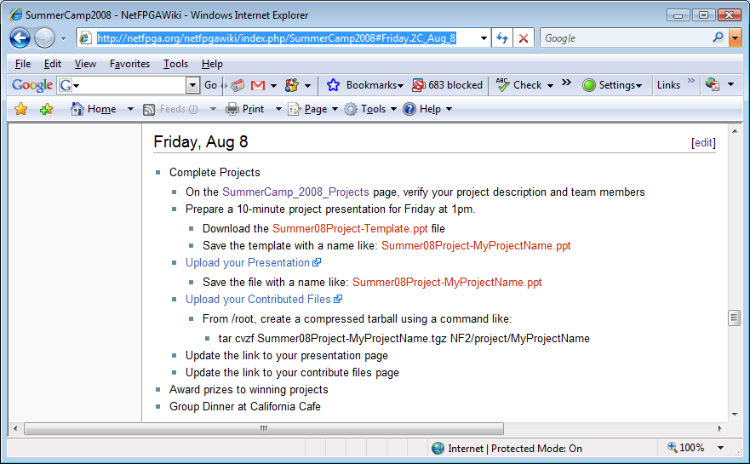
Prepare for Project Presentation
  http://netfpga.org/netfpgawiki/index.php/SummerCamp2008#Friday.2C_Aug_8

Slide 27
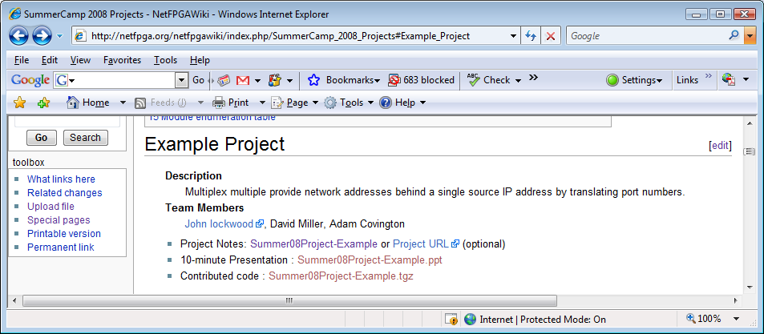
Contribute to the Project
Update your project on:
  http://netfpga.org/netfpgawiki/index.php/SummerCamp_2008_Projects

