Slide 1

NetFPGA Summer Camp
Project Presentation Template
Presented by:
Songkrant Muneenaem
The Computer Center, Prince of Songkla University, Hat Yai, Thailand
Stanford, CA
August 8, 2008
http://netfpga.org/netfpgawiki/index.php/SummerCamp2008
http://NetFPGA.org

Slide 2
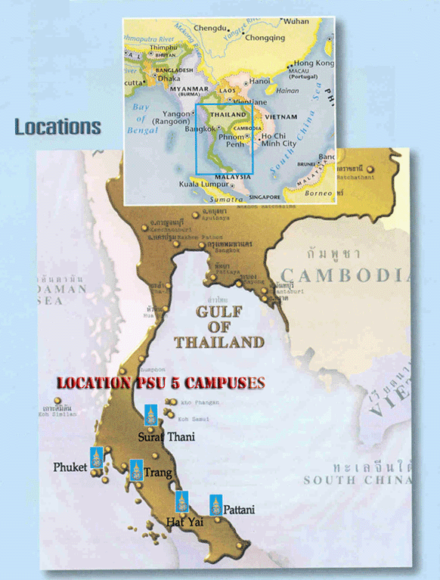
Hat Yai, Thailand

Slide 3
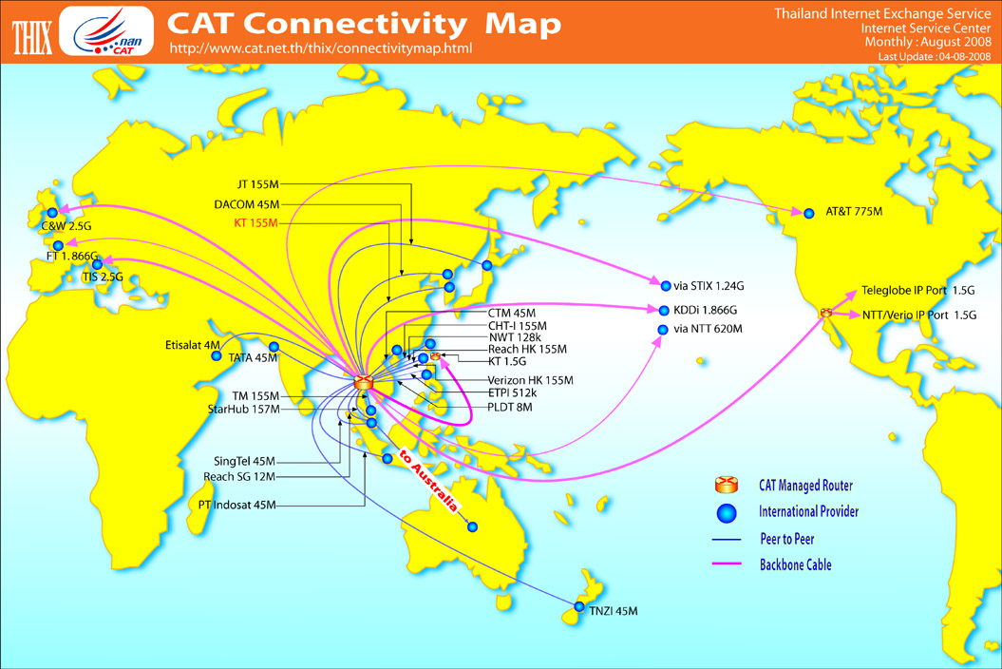

Slide 4
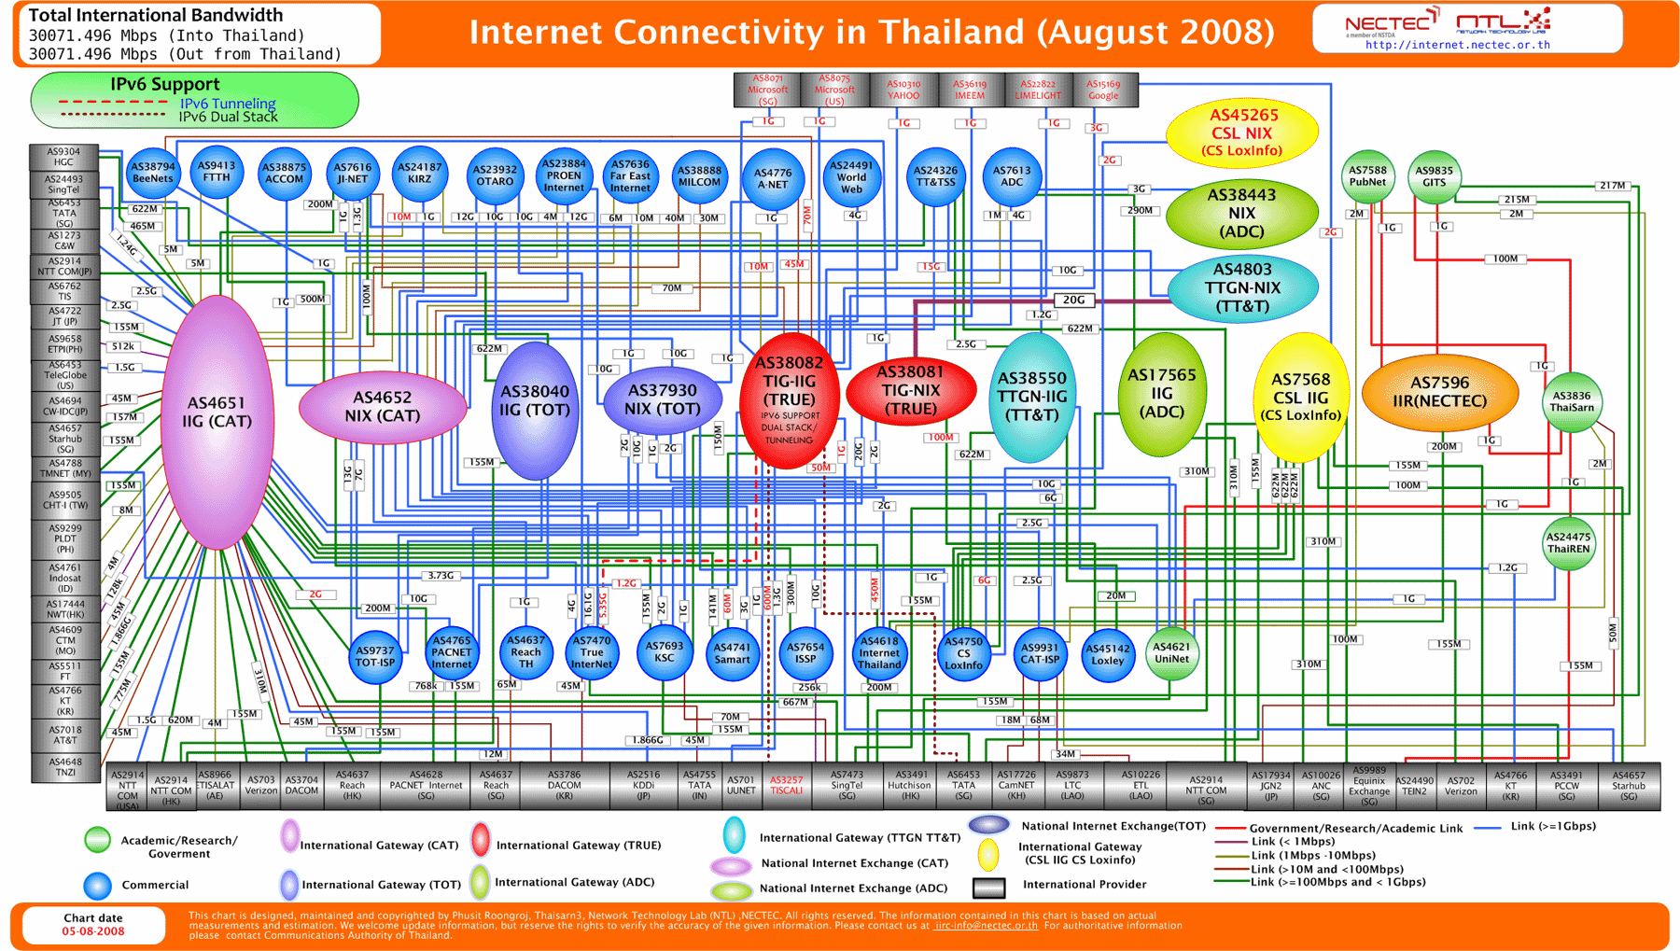

Slide 5
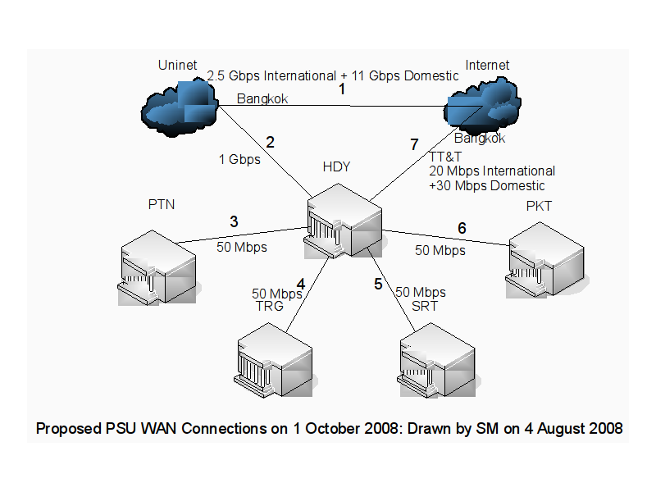
Inter-campus Link

Slide 6
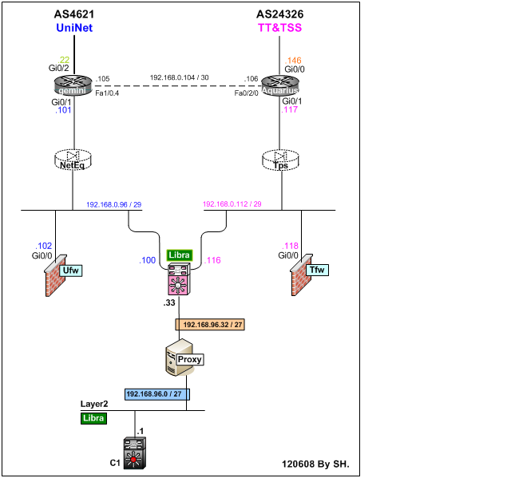

Slide 7
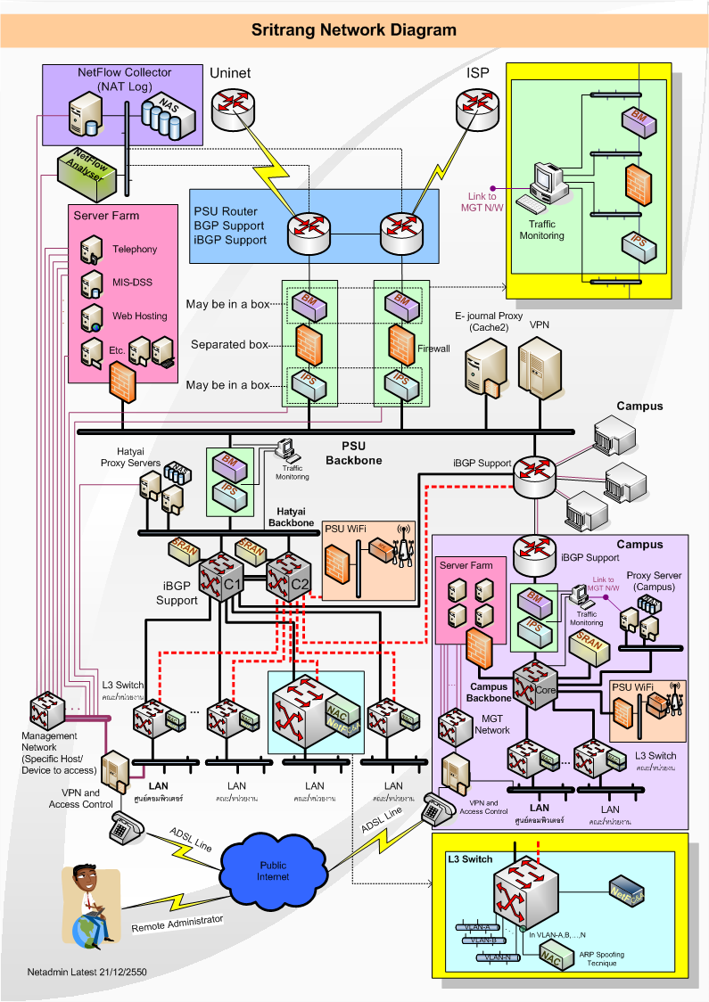

Slide 8
Report Example
Report Example

Slide 9

About n-top
libpcap-based applications.
Designed to handle couple of hundred Mbit traffic
CAN NOT operate at Gbit speeds.
the time spent analyzing each captured packet is too long, hence the CPU is overloaded (both due to packet capture and anaysis) and packet loss occurs.

Slide 10
More on ntop
Current version 3.3.6, 3.3.7rc1
64-bit PCI bus, bandwidth of 4 Gbit, capable to capture traffic at Gbit speed
32-bit Gbit PCI adapters cannot usually operate above 400 Mbit
possible to capture traffic up to ~900 Mbit with a standard Linux distribution (Debian Linux 3.0 with no kernel tuning) on a PC dual AthlonXP 1.6 GHz + 64-bit PCI GbitEtht

Slide 11
Ntop at last
The upper limit is ~250,000 packet/sec where CPU is used at about 85%
Libpcap performance is not an issue but network cards and drivers
Reference:http://luca.ntop.org/PAM2003.pdf
Passively Monitoring Networks at Gigabit Speeds Using Commodity Hardware and Open Source Software by Luca Deri, NETikos S.p.A.

Slide 12
Will NPU help? (from former reference)‏
Paper on 2003, mentioned Intel IPX family
Compute traffic statistics directly on the card without having to move all the traffic to the computer
The dark side of NPU cards is that they:
are quite expensive and relatively difficult to purchase <not anymore, get a NetFPGA>
are available only for a few media types, usually Ethernet and a few others <OK4me>
have little memory on board limiting dramatically the size of programs that can run on the card itself <need to investigate?>
• can be programmed using very primitive tools and
languages.

Slide 13
Ntop on NetFPGA Ready PC
ntop-3.3-1.el5.rf.i386.rpm, required libpcap-0.9.4 but had 0.8.3-12.el4_6.1
ntop-3.2-2.el5.rf.i386.rpm, required libpcap-0.9.4 but had 0.8.3-12.el4_6.1
ntop-3.2-2.el4.rf.i386.rpm installed!
run ntop, set ntop-admin password
ntop then become ready on eth0
Access via http://localhost:3000/

Slide 14
Profiling of ntop on NetFPGA Ready PC
2008-07-17 OProfile 0.9.4 released
OProfile consists of a loadable kernel module and a system daemon process that collects sample data from a running system
has several post-profiling tools
takes advantage of the hardware performance counters available in today's microprocessors
capable of profiling all code including the kernel, kernel modules, kernel interrupt handlers, system shared libraries, and the applications

Slide 15
Oprofile issues on test PC
Could not simply run Oprofile on PC with NetFPGA ready system, due to module dependency issues
Package modutils is not installed
Required modutils 2.4.6 or above
modutils 2.4.6 depends on module-init-tools
file /sbin/xxxmodxxx from install of modutils-2.4.7-1 conflicts with file from package module-init-tools-3.1-0.pre5.3.4.el4_6.1

Slide 16
Oprofile of ntop on a laptop PC
Required to have the matching kernel image of target system
linux-image-debug-2.6.24-20-generic
samples| %|
8196 3.6483 nvidia
193 0.0859 libntopreport-3.2.so
79 0.0352 ntop
2 2.5316 ntop
6894 3.0688 libntop-3.2.so

Slide 17
What is in libntop-3.2.so?
Aug.8th 2008 ntop-3.3.6 (posted 2008-06-11)
Dependency: cairo, expat, fontconfig, gdbm freetype, glib, libpcab, libpng, libxml2, pango, pixman, zlib, rrdtool
ntop Database file in /usr/local/var/ntop/
1. addressQueue.db 16 KB
2. dnsCache.db 97 KB
3. fingerprint.db 12 KB
4. LsWatch.db 12 KB
5. macPrefix.db 1,201 KB
6. ntop_pw.db 13 KB
7. prefsCache.db 13 KB
8. rrd directory also here

Slide 18
Ntop's RRD directory
/usr/local/var/ntop/rrd/
1. flows --> empty
2. graphics --> empty
3. interfaces --> has eth0 which contains:
.rrd 46 files has the same 58 KB in size except throughput.rrd which is 153 KB within 4 hours running 120 kbps vdo streaming overnight
IP_HTTPBytes.rrd, IP_HTTPFlows.rrd, IP_KazaaBytes.rrd, IP_KazaaFlows.rrd, more

Slide 19
Running ntop on NetFPGA ?
NetFPGA platform
V2-Pro50 FPGA w/ infrastructure
18Mb
SRAM
PHY
1GE
MAC
1GE
Packet processing
with 50 filters for ntop
and update to 50 counters
for packet count and
flow count
PHY
1GE
MAC
1GE
64MB
DDR2
SDRAM
Four Gigabit Ethernet Interfaces
-
PHY
1GE
MAC
1GE
Board
18Mb
SRAM
-
PHY
1GE
MAC
1GE
FIFO
3
Control, PCI
SATA
packet
Gb
Board Interconnect
buffers
Interface
Host
Linux OS
-
NetFPGA Kernel driver
computer
User
-
defined software networking applications

Slide 20
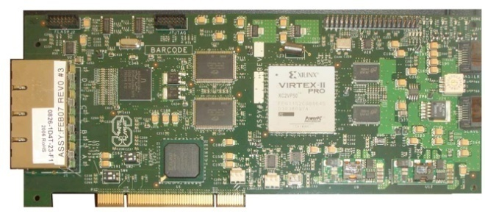


NetFPGA-Host Interaction
Register access
2. Driver performs PCI memory read/write
PCI Bus
1. Software makes ioctl
call on network socket
ioctl passed to driver

Slide 21
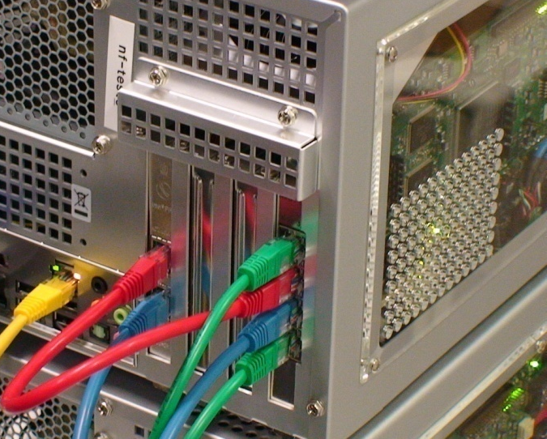
NetFPGA as the network splitter
NetFPGA Gigabit Ethernet Interfaces
  nf2c3 : Mirror port from Ethernet Switch
  nf2c2 : Duplicated out to IDP, IDS
  Nf2c1 : Duplicated out to traffic logger
  nf2c0 : Duplicated out to other analyzer
Host Ethernet Interfaces
  eth1 : Local admin interface (red)‏
  eth2 : Other access for ntop display (blue)‏

Slide 22
Long-term plans for the NetFPGA
Your plans for using the NetFPGA
  Teaching
  Research
  Other
Resources needed for your class
  Source code
  Courseware
  Examples
Your plans to contribute
  Expertise
  Capabilities
  Collaboration Opportunities

Slide 23
Thank you very much
(^_^)‏
__/\__

