Slide 1

NetFPGA Summer Camp
Universal Hash Funtion
Presented by:
Thomas Zink (University of Konstanz)
Stanford, CA
August 8, 2008
http://netfpga.org/netfpgawiki/index.php/SummerCamp2008
http://NetFPGA.org

Slide 2
Motivation
provide a set of hash functions
widely used in different applications
(bloom filters, hash tables)
hash calculation in software too expensive

Slide 3
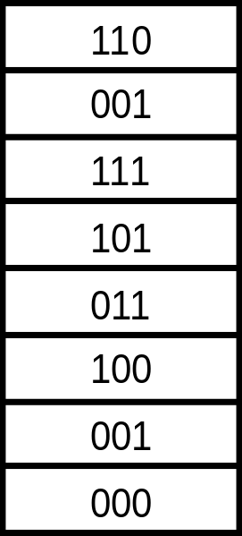
Universal Hash Function
random table
h(00110101) = q(3) XOR q(4) XOR q(6) XOR q(8)
= 111 ^ 101 ^ 100 ^ 000
= 110
q =
h(01100100) = q(2) XOR q(3) XOR q(6)
= 001 ^ 111 ^ 100
= 010
(1) L. Carter, M. Wegman, “Universal Classes of hashing functions”, Journal of Computer and System Sciences, vol. 18, no. 2, pp. 143-154, 1979.
(2) M. Ramakrishna, E. Fu, E. Bahcekapili, “A performance Study of Hashing Functions for Hardware Applications”, Proc. ICCI 94, pp. 1621-1636, 1994.

Slide 4
Implementation Overview
Module Headers
Eth Header
IP Header
Payload
extract key
calc hashes
buffer FIFO
Module Headers
Hash
Eth Header
IP Header
Payload

Slide 5
Details and Challenges
arbitrary number of hash functions and address space
random table in an array of registers
random values generated by software
hash values computed in parallel, kept in registers
Status
simulation working
does not synthesize

