Slide 1

Mini-Network Intrusion Detection and Prevention Module
Presented by:
Young H. Cho and Nathan W. Schrenk
Stanford, CA
August 8, 2008
http://netfpga.org/netfpgawiki/index.php/SummerCamp2008
http://NetFPGA.org

Slide 2
Overall System
MAC
RxQ
CPU
RxQ
MAC
RxQ
CPU
RxQ
MAC
RxQ
CPU
RxQ
MAC
RxQ
CPU
RxQ
Input Arbiter
Mini-NIDS/NIPS
Output Queues
MAC
TxQ
CPU
TxQ
MAC
TxQ
CPU
TxQ
MAC
TxQ
CPU
TxQ
MAC
TxQ
CPU
TxQ

Slide 3
Features
On-line User Defined Payload Patterns
  Single entry of 7 bytes and mask
  Match pattern(s) at every byte alignment
  Matching at 64Gbps
Pattern Match Counter
  Counts by 1 when the pattern is detected
  Detection per packet basis
Packet Filtering Mechanism
  Drop packets with the pattern(s)

Slide 4
Mini-I.D.S. Module Design
SW
Interface
M
6
5
4
Pattern
Matcher
3
2
1
0
Command
Counter

Slide 5
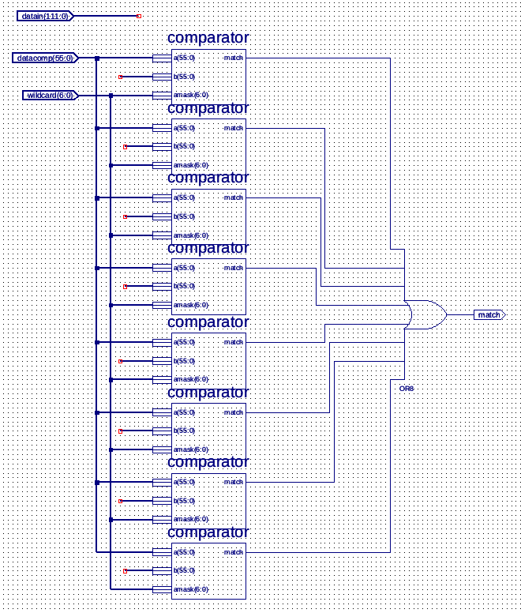
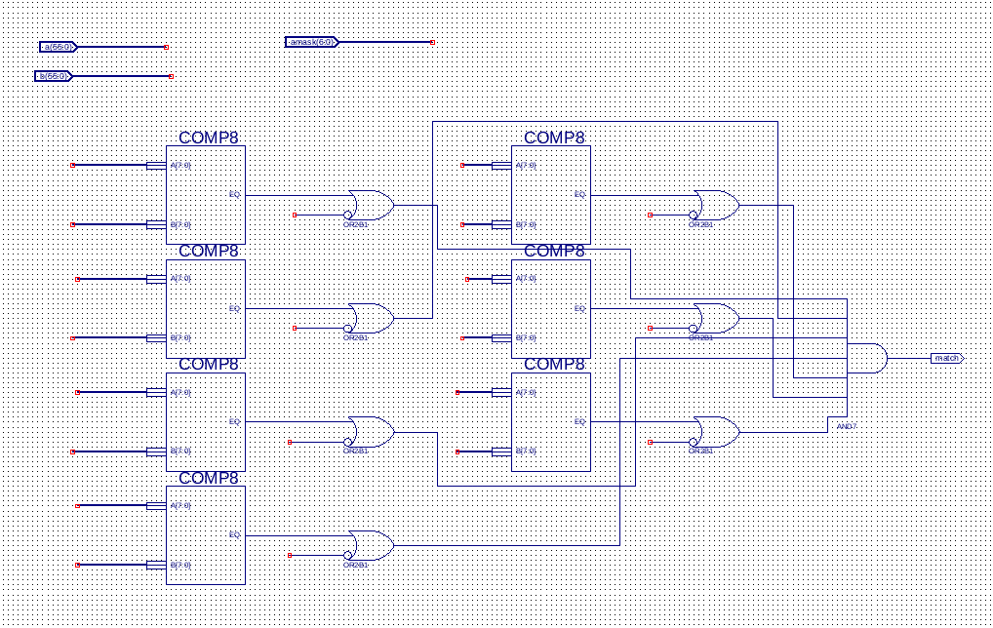
Masked Pattern Matchers

Slide 6
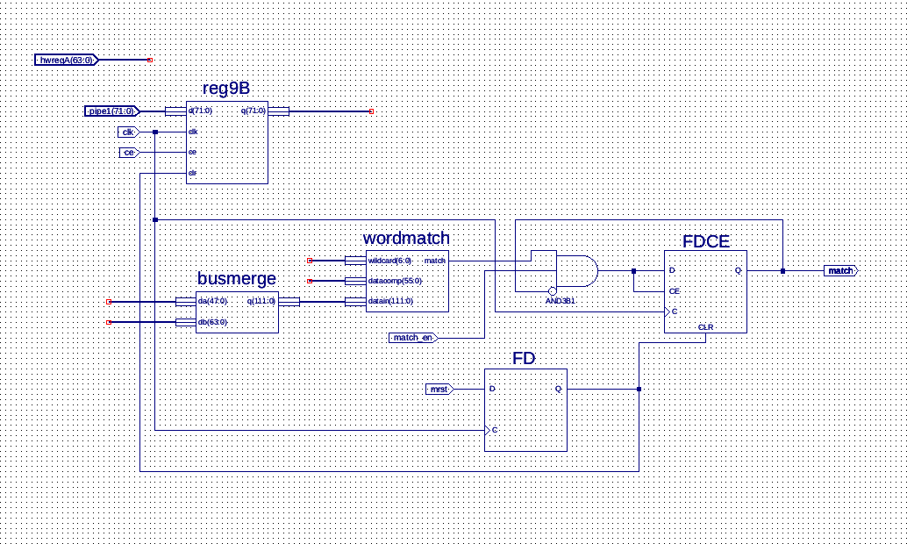
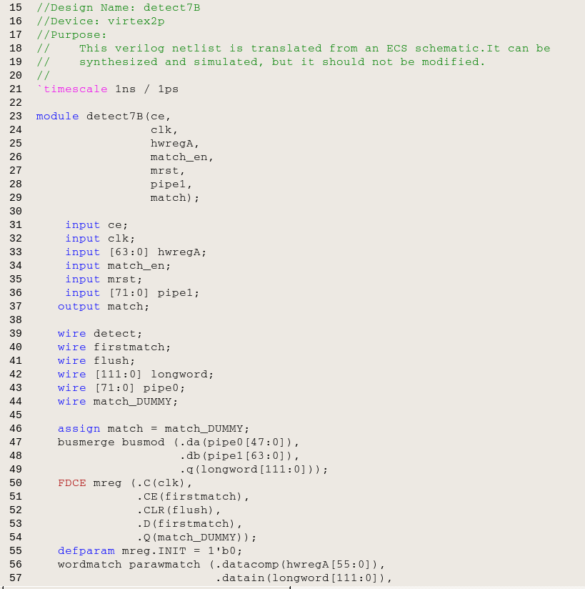
Pattern Matcher at All Alignment

Slide 7
Mini-I.-Prevention-S. Module Design
SW
Interface
M
6
5
4
Pattern
Matcher
3
2
1
0
Command
Counter
Drop FIFO

Slide 8
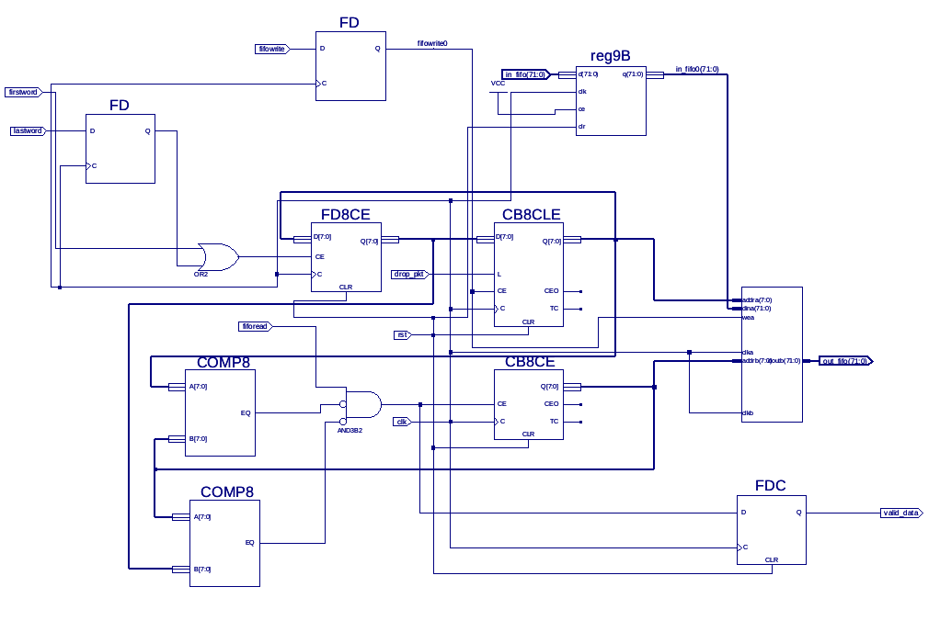
Drop Enabled FIFO

Slide 9
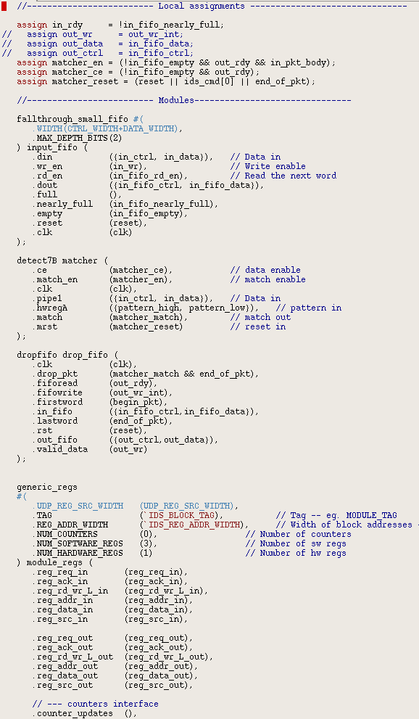
Top IDS/IPS Module
Reference NIC MOD
  Counter
  Access to SW/HW Registers
Schematic Translation
  Pattern Matcher
  Packet drop FIFO
Coregen Components
  Dual port Memory
  2 Block Memory

Slide 10
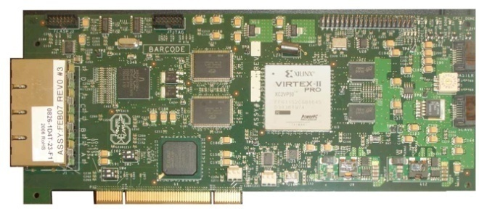
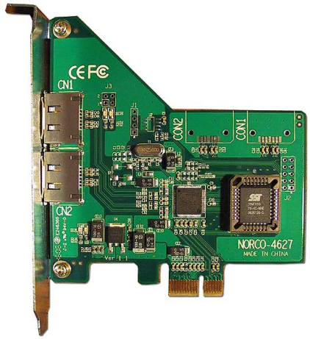


Demo Setup
Software Interface
  Set pattern
  Send command
  Read count
Traffic
  Custom generate packets
  Send using TCPREPLAY
  Receive using TCPDUMP
PCI Bus

Slide 11
DEMO

Slide 12
Future Enhancements?
SW
Interface
Smarter Pattern Matcher
M
6
5
4
Pattern
Matcher
3
2
1
0
Command
Counter
Drop FIFO

Slide 13
Conclusion
Functional Design
  Initial verilog template for IDS/IPS
  Available schematics
  Relatively easily enhancements
Enhancement Suggestions
  Memory based deep content inspection
  High density content inspection logic
  Header field inspection
  Other filtering mechanisms (i.e. forwarding)
  http://www.oasysresearch.com/pub

