Slide 1
Assessment of Prototyping an AFDX Policy Switch Leveraging NetFPGA and OpenFlow Switch
A Systems Engineering View
Thomas Gaska
thomas.gaska@lmco.com
Lockheed Martin Systems Integration - Owego

Slide 2
Task Description
Assess feasibility of NetFPGA and IP research components to prototype AFDX
Outputs
  Top level protocol behavior comparison
    OpenFlow vs AFDX
    Major differences and design scope
  Notional architecture
Allocation of reuse proposed

Slide 3
Task Approach
Reviewed AFDX and OpenFlow Reference Specifications
Configured NetFPGA System with both Reference Router and OpenFlow Prerelease
Open Flow IP
  Controller
    NOX Network Operating System Primitives
  Kernel Device Driver
    Based on derivative of NetFPGA IP4 driver
  OpenFlow NetFPGA
    Verilog source with high NetFPGA router/switch reuse

Slide 4
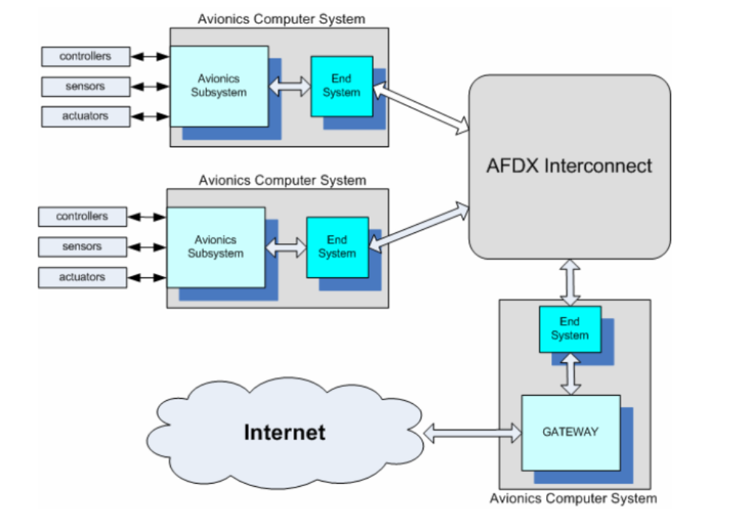
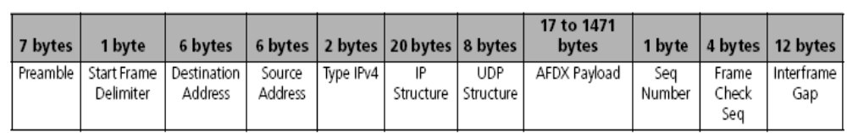
AFDX Network Must support Layer 2 and 3
Notional Switch Product:
16 AFDX Ports
8 TCP/IP Ports
1 SNMP Port
100BT/GigE
Reprogrammable networking
support for routing and
security

Slide 5
AFDX Protocol Highlights
AFDX=Avionics Full DupleX
  AFDX is based on IEEE 802.3 Ethernet and TCP/IP general principles
  Provides secure data transfer with real time constraints
  Guarantee of services and determinism required for civil aerospace requirements
  Components (End Station, Switch) – Leverage COTS MACs and custom Switch
BANDWIDTH GUARANTEE
  Bandwidth control is achieved with advanced queue management and multiple bandwidth use strategy
  BAGs (Bandwidth Allocation Gap) and of maximum frame size to allocate bandwidth – Constant Packet Frequency x Max Length
REAL TIME CONTROL
  Real-time performance is achieved with latency control in the form of the maximum network transit delay control (end-to-end latency)
  Includes an accurate time-stamping logic –Jitter and QoS in Protocol
SERVICE GUARANTEE
  Guarantee of services is made and policed by the AFDX Switch
  User can select a variety of services and constantly monitor the payload for each of the services, which are concurrently executed

Slide 6
AFDX vs Open Flow Specification Comparison
Capability | Open Flow | AFDX Protocol
End-Station Interop | Unmodified End Stations | Scheduled, Layer 2 Enhanced End Stations
Lookup Infrastructure | Flow Table and Interface to Modify Flow Table Entries | Multiple Flow Tables and Interface to Modify Flow Table Entries
Table Content per Entry | Lookup on Header for PKT: HDRs – IN Port, E SA, EDA, ETP, VLAN ID, IP SA, IP DA, TCP SA, TCP DA; PKT Counters – PKT, DUR, DROP; ACTIONS | Lookup on VL static values for PKT: IN Port, OUT Port, Next Hop Port, BAG Rate, Max Jitter, ACcount, Size, Prioritization
Table Content per Port |  | Max Delay, Port State, Speed, Queue Buffer Size
Frame Filtering & Monitoring | Exposes 10-tuple HDR for matching fields explicitly or to wildcards
Forwarding | Normal, Flood, All, Controller, Local (Lvl 0) | Lookup VL for DA: if match VL static entry FWD PKT, else LOG event and DROP PKT
Validity | IF Valid IP Checksum, IP Option, TTL, and Match FWD PKT | if Valid DA & Valid FCS & Valid Size & Valid Jitter then FWD PKT, else LOG event and DROP PKT
Calculation Primitives | IP Checksum, Wildcard and Exact Lookup | Compute FCS, Valid Size, & Jitter
ACTION Primitives | Normal, Flood, All, Control, Local (Lvl 0) | Normal, Multicast, Controller, Local
Kernel Driver SW Functions | Maintain flow tables, participates in flow establishment, processing packets, and update statistics | Add, Remove, and Update Flow Table; Exception Handling; Logging
Controller SW Functions | Handles new flow establishment a and implements complex user Policy enforcement decisions | Handle Table reconfiguration, exception processing, and logging

Slide 7
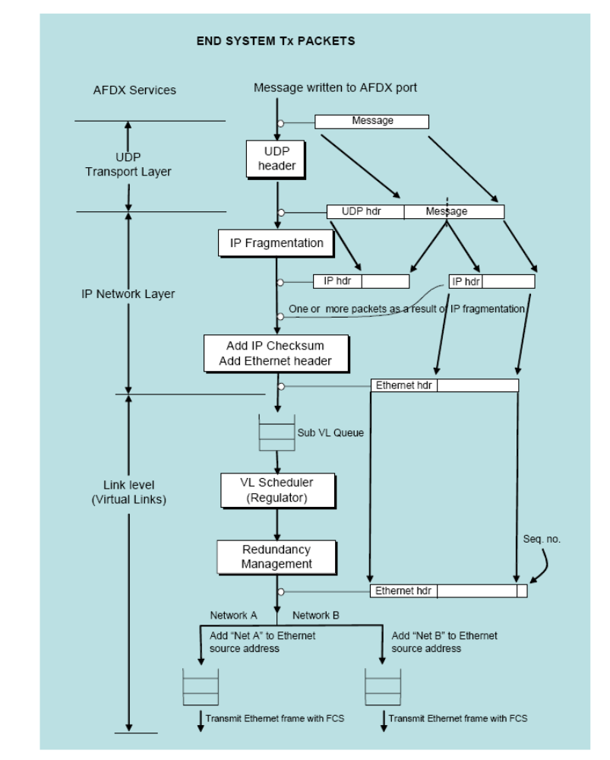
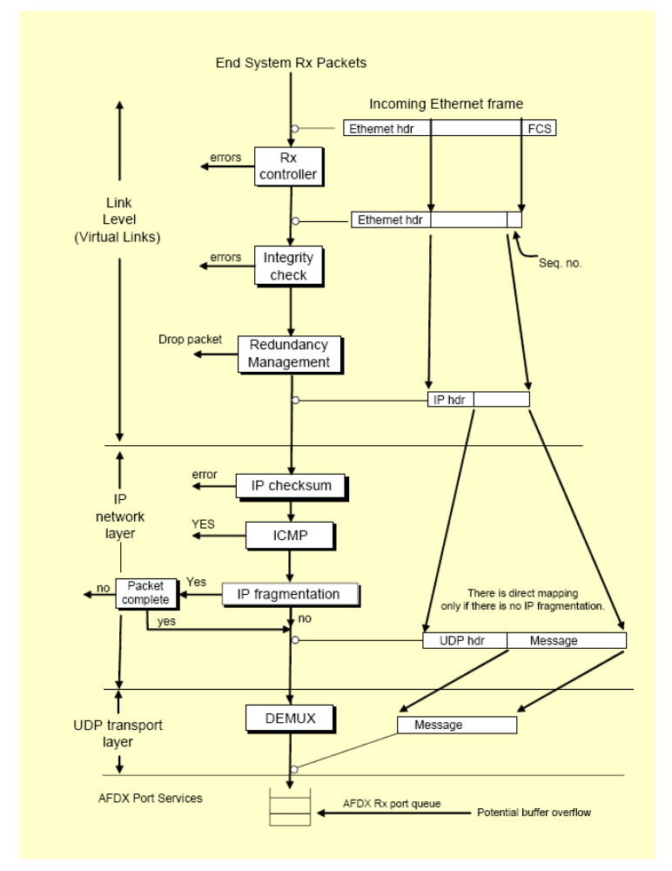
AFDX End Station Flows – Uses Std MAC
Future Candidates for NetFGPA NIC Customization – VL Scheduler, Redundancy Mgmt, SoC MP

Slide 8
Reference Router to OpenFlow NetFPGA Layering
NetFPGA Reference Router Verilog
NetFPGA OpenFlow Switch Verilog
Reuse from Reference Router –
Ref: /root/new_tree/projects/openflow_switch/include/lib_modules.txt
Path:
/root/NF2/lib/verilog
  nf2/generic_top
  nf2/reference_core
  io/mdio
  utils/generic
  cpci_bus
  dma
  input_arbiter/rr_input_arbiter
  io_queues/cpu_dma_queue
  io_queues/ethernet_mac
  io_queues/add_rm_hdr
  user_data_path/reference_user_data_path
  user_data_path/udp_reg_master
  output_queues/bram_output_queues
New Design for OpenFlow –
Ref: /root/new_tree/projects/openflow_switch/src
  user_data_path.v
  output_port_lookup.v
  match_arbiter.v
  opl_processor.v
  vlan_adder.v
  Vlan_remover.v

Slide 9
Normal Packet Processing OpenFlow Pipeline
10 Tupple HDR | Lookup by (MAC, IP, Port, VLAN) - PKT | Forwarding Action
Ingress Port | All Packets | Normal – Process packet using L2, VLAN and L3 Flood – Via Minimum spanning tree All – Send packet on all interfaces except incoming interface Controller – Via Controller Secure Channel Local – Local networking stack
Ethernet SA, DA | All Packets on enabled ports
Ethernet Type | Standard Ethernet
VLAN | Packets 8100 – Add, modify, remove (opt)
IP SA, DA, IP Type | All IP Packets – Mod HDR (opt)
TCP SA, DA | All TCP/IP Packets – Mod HDR port (opt)
 | Table: PKT Cnt, Flow: PKT Cnt, BYTE Cnt, Duration, Port: RX Cnt, TX Cnt, Dropped Cnt
Kernel
Driver
Write
I/F
Kernel
Driver
Read
I/F
Ctrl
Regs
Exact
Match
Lookup
CPU
DMA
WR
IF
Input
Queues
Input
Arbiter
Header
Parser
Arbiter
Output
Queues
CPU
DMA
WR
IF
Wildcard
Lookup
RX
MACs
0-3
Payload
Queue
Packet
Editor
TX
MACs
0-3

Slide 10
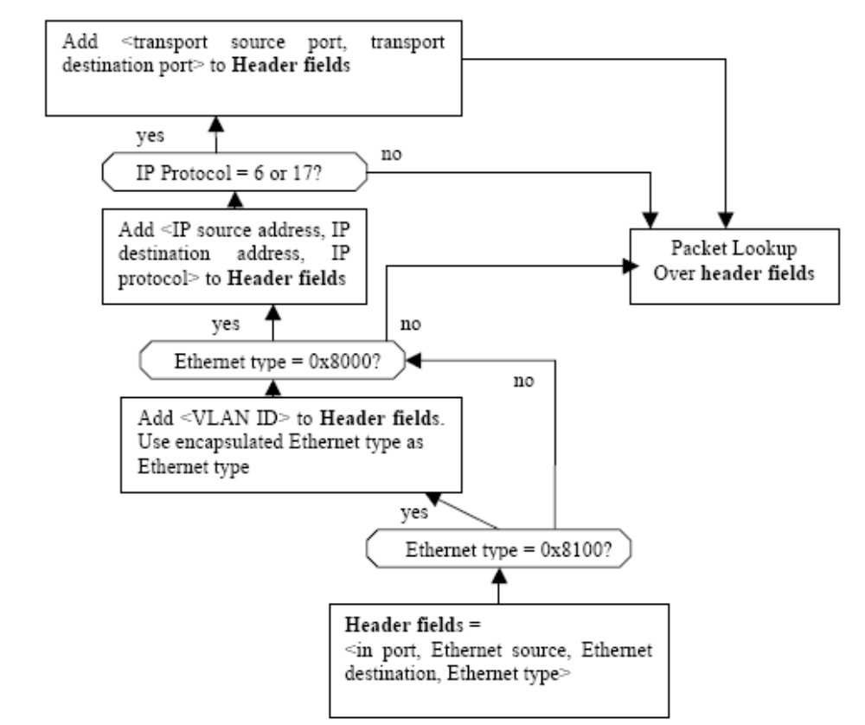
OpenFlow Switch Flow Matching Details

Slide 11
Normal Packet Processing AFDX Pipeline
Kernel
Driver
Write
I/F
10 Tupple Trigger | Table Processing (By VL) | Forwarding Action
Ingress Port | All Packets | Lookup on VL static values for PKT: IN Port, OUT Port, BAG Rate, Max Jitter, ACcount, Size, Prioritization Lookup VL for DA: if match VL static entry FWD PKT & OK, else LOG event and DROP PKT OK = if Valid DA & Valid FCS & Valid Size & Valid Jitter then FWD PKT, else LOG event and DROP PKT
Ethernet SA, DA | DA
Ethernet Type | AFDX
VLAN | Opt
IP SA, DA, IP Type | Opt
TCP SA, DA | Opt
 | Table: PKT Cnt, VL: PKT Cnt, BYTE Cnt, Last PKT TS, Port: RX Cnt, TX Cnt, Dropped Cnt Log: Events
Kernel
Driver
Read
I/F
Ctrl
Regs
Exact
Match
Lookup
Arbiter
Output
Queues
CPU
DMA
WR
IF
Input
Queues
Input
Arbiter
Header
Parser
CPU
DMA
WR
IF
Wildcard
Lookup
RX
MACs
0-3
Payload
Queue
Packet
Editor
TX
MACs
0-3

Slide 12
OpenFlow Switch NetFPGA Allocation Analysis (1) – Base Reuse
Verilog Component In OpenFlow | Functional Allocation | Changes Required for AFDX
cpi_bus : cpci_bus.v | CPCI register bus & FIFO synchronization main module | Minimal
dma : nf2_dma.v nf2_dma_sync.v nf2_dma_queue_infc.v nf2_dma_bus_fsm.v | DMA main module Signal synchronization CPCI & system clk Packet Data path & Control DMA Queues DMA State Machine to cPCI Chip | Minimal
input_arbiter: input_arbiter.v in_arb_regs.v | Round Robin arbiter main module Demultiplexes, stores, and serves requests | Minimal – Understand Jitter behavior
io_queues: cpu_dma_queue cpu_dma_queue_main.v cpu_dma_queue_regs.v cpu_dma_queue.v | CPU dma queue main module Registers for CPU dma queue CPU dma queues | Minimal
io_queues: ethernet_mac nf2_mac_grp.v rx_queue.v, tx_queue.v mac_grp_reg.v | MAC FIFO main module MAC FIFOs rx, tx Demultiplexes, stores and serves MAC register requests | Minimal
io_queues: add_rm_hdr add_rm_hdr.v add_hdr.v, rm_hdr.v | Add/remove length header main module Adds/removes length header to/from packets | Minimal

Slide 13
OpenFlow Switch NetFPGA Allocation Analysis (2)
- Base Reuse
Verilog Component In OpenFlow | Functional Allocation | Changes Required for AFDX
user_data_path/reference_user_data_path user_data_path.v udp_reg_grp.v | Contains all user instantiated modules Predecodes registers for the user datapath and multiplexes between them | Overloaded by OpenFlow user_data_path
user_data_path/udp_reg_master udp_reg_master.v | User datapath register master main module | Overloaded by OpenFlow user_data_path
output_queues: bram_output_queues output_queues.v output_header_parser.v | Store PKT to SRAM & rr arbiter out queue main module Finds the Destination port in the module headers & puts it in FIFO | Need to access coupling with OpenFlow unique components

Slide 14
OpenFlow NetFPGA Allocation Analysis (3) – OpenFlow Unique
Verilog Component In Open Flow | Functional Allocation | Changes Required for AFDX
user_data_path.v | Contains all the user instantiated modules | Need to allocate
output_port_lookup.v | When a packet comes in, the header parser gets the packet size & assembles the flow header to match against. The flow header is sent to the wildcard & the exact match modules which compare it against their entries. The result is then sent to the match_arbiter which decides which entry should be used & writes the actions into the result_fifo. The opl_processor reads the result_fifo, and writes the actions into the module headers. If the packet has no forwarding actionor doesn't match any entries, it is dropped. | Need to allocate
match_arbiter.v | Arbitrates between different sources of matches and selects a winner. Currently exact always wins over wildcard. | Need to allocate
opl_processor.v | Appends the actions to take on a packet to the beginning of a packet then pushes the packet out to the next module. | Need to allocate
vlan_adder.v | Adds the VLAN tag if it finds it in a module header. If thereare multiple ones, it only uses the first one it finds. | Not Required
vlan_remover.v | Removes the VLAN info if existing and puts it in a module header. | Not Required

Slide 15
Kernel Driver Software Allocation Analysis
Functional Component In Open Flow SW – C | Functional Allocation | Changes Required for AFDX
C Files…… | Maintain SW Copy of Flow Control Table | Need to allocate
Register IO Service | Read and Write Registers
DMA IO Service | Manage DMA Transfers
SSL Communication Service | Provide Message interface to Controller
Flow Exception Notification Service | Support Exception Processing
New Flow Notification Service | Notify Controller on New Flow
GUI Interface Service – Debug and Maintenance | GUI interface to Net-FPGA statistics and monitoring
FPGA Load Service | Loads the NetFPGA
POC and Location of src: Need access to src for component mapping from src 0.8.1

Slide 16
Controller Software Allocation Analysis
Functional Component In Open Flow SW – C | Functional Allocation | Changes Required for AFDX
User Flow Policy Manager | Establish Flow Path Based on High Level User Policy | Need to allocate
NOX Operating System | Networking Service System Utilities
Invalid Flow Assignment Manager | Determines how to handle packets without valid flow entries
Valid Flow Assignment Manager | Manages the switch flow table by adding and removing flow entries
Flow Expiration Handler | Manages behavior when Flow expires
SSL Communication Services Controller Initiated: Configuration Modify-State Read-State Send-Packet Asynchronous: Packet-In Flow Expiration Port-Status Error | Secure channel communication – Dedicated IP Address and Port
POC and Location of src: Need access to src for component mapping from src 0.8.1
POC and Location of src: Need access to src for component mapping,

Slide 17
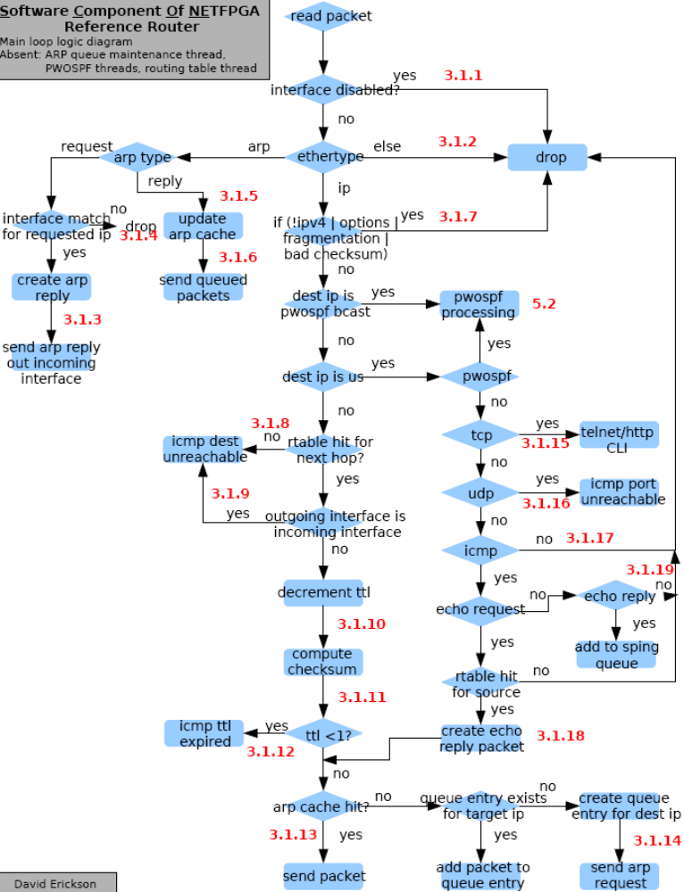
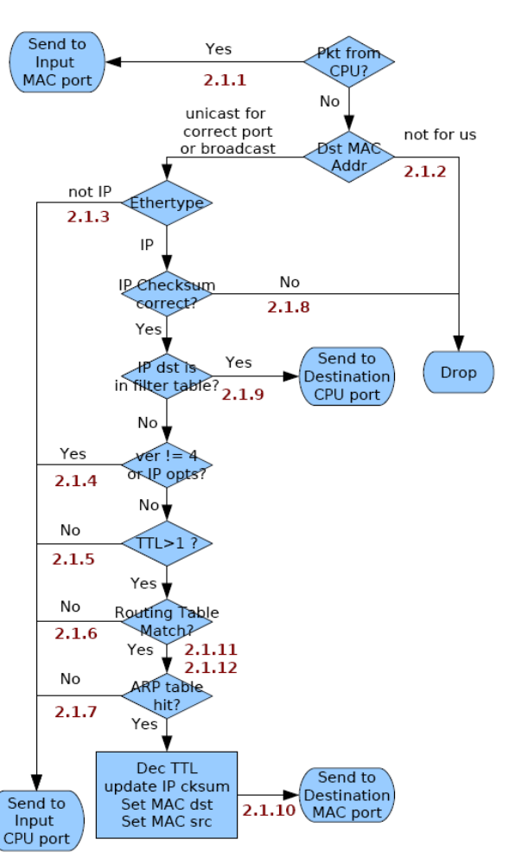
Current Net-FPGA Router Behavior

Slide 18
Conclusions
NetFPGA OpenFlow Switch and NetFPGA Network Interface Controller (NIC) FPGA Verilog offers significant reuse potential for implementing AFDX prototype
  Thanks for the excellent support of the community
For Final HW Product
  Need custom board layout to provide minimum of 16 port AFDX and 8 port standard TCP/IP
  Migration to Xilinx V5 family to support SoC design
OpenFlow Device Driver and Controller C based software needs further analysis to assess reuse potential
  Need access to Device Driver Descriptions/SRC and Controller C/src
  OpenFlow for SW router does exist on OpenFlow Switch Web Site
Next step is to refine mapping of AFDX requirements into HW and SW components and complete reuse assessment and prototype selected four port configuration
  Some high level Sequence Diagrams would really help HW/SW Allocation process

