Slide 1

NetFPGA Summer Camp
Load balancer
Presented by:
Danai Chasaki
Fernando Hämmerli
Paul Germano
Stanford, CA
August 8, 2008

Slide 2
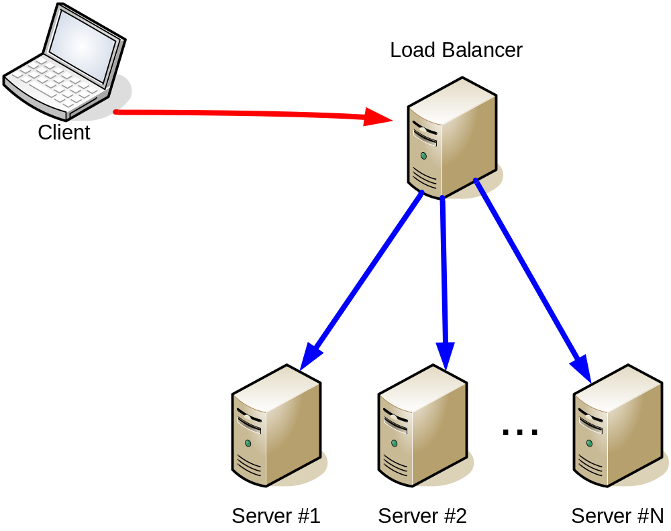
Load balancer overview

Slide 3
Load balancer overview
Client send pkts to a virtual IP address
  LB replyes ARP queries for the Virtual IP
LB receive the pkt
  First pkt from SrcIP ?
    Choose a destination server and create an entry on a table, matching SrcIP to that server
  Entry already exists?
    Pick the server info
  Replace DestMAC on the pkt with the server MAC

Slide 4
Load balancer overview
Servers on the pool
  Must accept pkts to the Virtual IP
  Cannot answer ARP requests for the Virtual IP

Slide 5
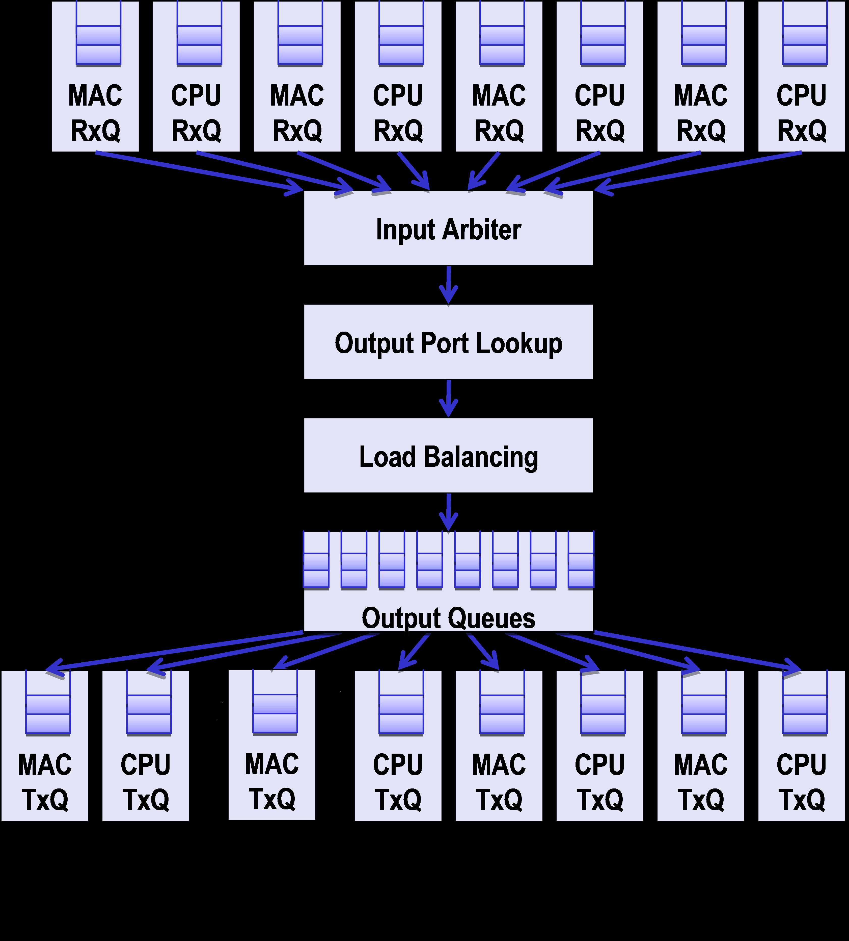
Load Balancer Pipeline
One module added
Load Balancing: module that sends requests to different servers on the same interface

Slide 6
State Machine
FSM for Load Balancing:
    Skip module headers:
      Also acts as idle state
    Read Ethernet/IP headers
      Store Ethernet and IP headers for future manipulation
    Send Data
      Choose the real destination (server)
      Send headers changing the destination MAC
      Send the remaining words

Slide 7
Problems/results
Load_balancer
  Coding - Done
    Simple version, using 1 input and 1 output port
    Working when simulated alone
  Problems unsolved (until now)
    Errors simulating the full user_data_path

Slide 8
Problems/results
Thank You

