Slide 1

NetFPGA Summer Camp
Project Presentation
Presented by:
Faisal Khan, Atif Nazir, Guanyao Huang
Stanford, CA
August 8, 2008
http://netfpga.org/netfpgawiki/index.php/SummerCamp2008
http://NetFPGA.org

Slide 2
Project Description
Identify elephant flows/heavy hitters by hashing the incoming flows using multistage filters in the SRAM.
The flow whose corresponding filters exceed a threshold are identified as heavy hitter. These heavy hitters are stored in another register.

Slide 3
Multistage Filters
Array of counters
flow memory
Hash(Pink)
Notes:
As with sample and hold, we start with an empty stream memory. But besides this we also have an array of counters initialized to all 0s.
When a packet comes in, it is hashed to one of the counters based on the stream identifier and the counter is incremented.

Slide 4
Multistage Filters
Array of counters
flow memory
Hash(Green)
Notes:
Packets from different streams usually hash to different counters.

Slide 5
Multistage Filters
Array of counters
flow memory
Hash(Green)
Notes:
But packets from the same stream always hash to the same counter. This gives us a nice invariant. The value of the counter a stream hashes to will always be at least as large as the stream itself. So if we set a threshold which is three in this example, we are sure that by then time a stream reaches the threshold, the counter iit hashes to does too.

Slide 6
Multistage Filters
flow memory
Notes:
Now a yellow packet.

Slide 7
Multistage Filters
flow memory
Collisions are OK
Notes:
We see here that the violet packet hashed to the same counter as the pink one. We do nothing about these collisions. This makes it very easy to implement the counters efficiently in hardware or software.

Slide 8
Multistage Filters
Reached threshold
flow memory
stream1 1
Insert
Notes:
Now green sends its third packet. We see that the counter reaches the threshold and create an entry for the green stream which will count all of its packets from here on.

Slide 9
Multistage Filters
flow memory
stream1 1
Notes:
Brown packet.

Slide 10
Multistage Filters
flow memory
stream1 1
stream2 1
Notes:
Now, pink got an entry, but it shouldn’t have, because it’s only at its second packet. The collision with violet is what caused the trouble. We could reduce the number of collisions by increasing the number of counters, but this isn’t a very scalable solution since we would have to increase the number of counters linearly with the number of streams.

Slide 11
Multistage Filters
flow memory
Stage 1
stream1 1
Stage 2
Notes:
What we can do is add another stage of counters that uses an independent hash function and operates in parallel with the first one. We change the rule for adding an entry to the stream memory so that we only add an entry if the counters at both stages reach the threshold. Green will have no problem achieving this because it will push both counters high. Pink is not so lucky though, because its counter at the second stage doesn’t let it get an entry. Our analysis shows that the number of small streams passing the filter decreases exponentially with the number of stages.

Slide 12
Implementation
Hardware:
  Read packet, extract 2 tuples.
  Hash (src_ip[:], dst_ip[:]) to BRAM Register File
    one register with two hash function
Verification:
  Realize hash function in software, compare the multistage read from hardware with software generated multistage.

Slide 13
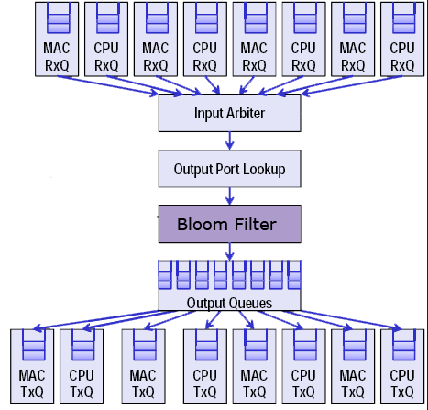
Datapath

Slide 14
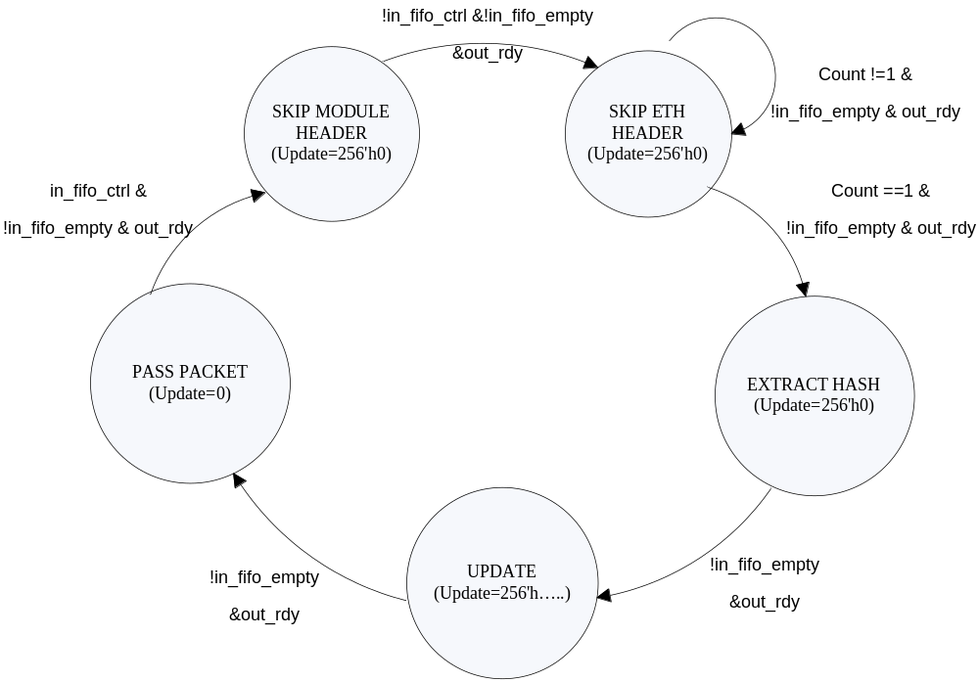
Bloom Filter - State Machine (Hashing)

Slide 15
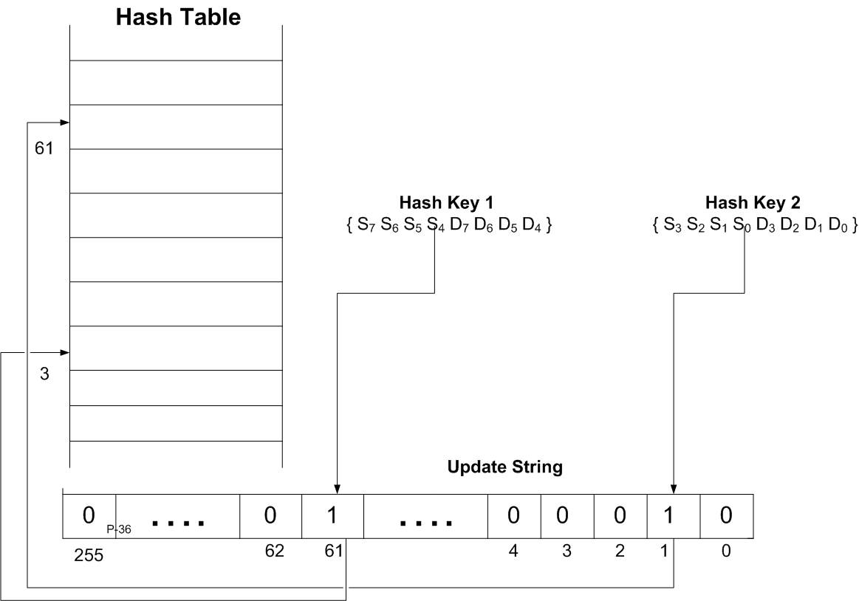
Hash Table 2-way Update

Slide 16
Software Testing
Generate random number of packets
Compare hardware register with software maintained bloom-filter

Slide 17
Future Work
  Maintain Flow memory for flows whose hash exceed the threshold – require more support from register file
  Realize more complicated hash function

