Slide 1

NetFPGA Summer Camp
MAC in MAC implementation
Presented by:
Jim Chen, Hao Chen, Tatsuya Yabe
Stanford, CA
August 8, 2008
http://netfpga.org/netfpgawiki/index.php/SummerCamp2008
http://NetFPGA.org

Slide 2
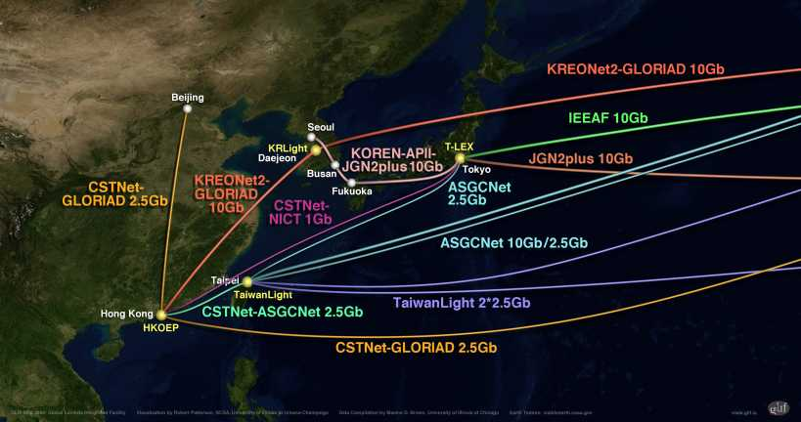
Motivation
NetFPGA on Campus / Lab
  Experiments with various sites
  Networks for research / experiment
  Desire of interactive connection / collaboration
  Encapsulation is one way(outgoing traffic)
    -> Utilize NetFPGA as a tunnel device

Slide 3
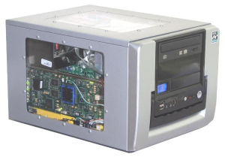
The way MAC in MAC works
Encap’ed frame
frame
NetFPGA
Ethernet network
NetFPGA
frame
frame
Site A
Site B

Slide 4
Implementation Idea
Encap / Decap frames(MAC) in Ether frames(MAC)
  See a previous slide
IEEE 802.1ah – like encap/decap
  2-day target
  Easier to do connectivity test
    IEEE 802.1ah
      Used in wide-area Ethernet network
      Don’t have to disclose customers’ MAC addresses in WAN
      WAN switches don’t have to store too many MAC addresses

Slide 5
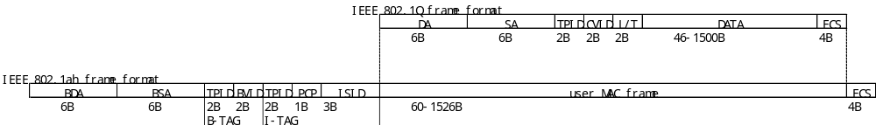
Basic idea of MAC-in-MAC
Data format
BDA: Relay destination address inside provider
BSA: Relay source address
B-TAG: VLAN tag for relay
I-TAG: Service instance tag
ISID: Service instance identifier (to differentiate each user

Slide 6
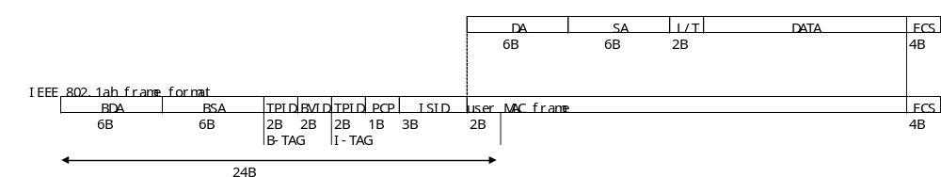
Our specs / assumptions Current implementation
Original frames don’t have VLAN tags
We don’t touch VLAN IDs (BVIP, PCP, ISID) for MAC-in-MAC frames.
No intermediate switches between the two NetFPGAs
Insert two more bytes in an additional header.
(Then we will totally have 24B (3Words).)
Reason:
  Tentative goal is to connect between NetFPGAs
No VLAN tags
zero
zero
zero
Notes:
Explain the reason why we chose this toplogy
Explain how we will run the video. Will it be projected on the screen or will we ask users to do it themselves?

Slide 7
Where and how to implement it
Base source code :
Reference NIC
Output Port Lookup
  Check the Module Header
  Connect MAC port 0
  to/from MAC port 1
  Update data length
MAC-in-MAC Enc/Dec
  Check ETH header
    Normal Ether frame
    -> Encap.
    Encapsulated frame
    -> Decap.
  Add a register to define additional
  src/dst MAC address
MAC
RxQ
CPU
RxQ
MAC
RxQ
CPU
RxQ
MAC
RxQ
CPU
RxQ
MAC
RxQ
CPU
RxQ
Input Arbiter
Output Port Lookup
MODIFY
MAC-in-MAC
Encap/Decap
ADD
Output Queues
MAC
TxQ
CPU
TxQ
MAC
TxQ
CPU
TxQ
MAC
TxQ
CPU
TxQ
MAC
TxQ
CPU
TxQ

Slide 8
Project Progress
Simulation
  Encap finish
  Decap underway
Trial
  Plan to make a test between Tokyo & Chicago
  Welcome others to join(contact us)

Slide 9
What’s next ?
Finish MACinMAC implementation in NetFPGA when standard finalized as resource available
Trial in Research Network partners around the world
Similar capabilities in L3 network

Slide 10
Thank you

