Slide 1

Tutorial
Stephen Ibanez

Slide 2
Outline
P4 Motivation
P4 for NetFPGA Overview
P4->NetFPGA Workflow Overview
Tutorial Assignments

Slide 3
What is P4?
Programming language to describe packet processing logic
Used to implement forwarding-plane of network elements (i.e. switches, routers, NICs, etc.)
Notes:
P4 is an open source language that allows the specification of packet processing logic, as well as the automatic generation of an API to allow control-plane software to interact with the forwarding-plane
It first appeared in a paper published in ACM CCR in 2014 and was largely motivated by limitations of the OpenFlow protocol. For those of you who are familiar with OpenFlow and SDN, these things really tried to give network owners and operators control over the control-plane. They could add and remove entries from tables that already exist in the hardware but could not add any new tables. I like to think of P4 as a logical extension to this, it tries to provide network owners and operators with an even deeper level of control, control over the forwarding plane.
The current version of P4 is being called P4_14, but a fairly major revision to the language is coming out in May called P4_16.
If you’d like to explore P4 more on your own after this talk, I’d highly encourage you to go check out P4.org. It is an open language consortium with about 60 member organizations.
They have hosted multiple events at Stanford. Events such as Developers Days which are dedicated to teaching P4 to new developers, as well as P4 Workshops which are more conference style, where researchers give talks about the latest and greatest in programmable forwarding.

Slide 4
Benefits of Programmable Forwarding
New Features – Add new protocols
Reduce complexity – Remove unused protocols
Efficient use of resources – flexible use of tables
Greater visibility – New diagnostic techniques, telemetry, etc.
SW style development – rapid design cycle, fast innovation, fix data-plane bugs in the field
You keep your own ideas
Think programming rather than protocols…
Notes:
So now you have a general sense of what P4 is and what is aims to accomplish. I’ll try to motivate why I think it’s so great.
Of course, an obvious benefit is that new features can now be added very easily, simply change the P4 program and recompile. Or you may actually want to remove features that you are not using (or don’t think you are using) in order to reduce complexity in your network. Many network failures are caused by unanticipated interactions of features that network operators didn’t even know they were using!
With P4, it becomes very easy to reallocate resources between different tables after deployment. For fixed function switches, features and table sizes are baked in at design time.
With programmable forwarding also comes much greater visibility into the network, as well as a software style development process
You keep your own P4 programs.
Could also use P4 programs to explicitly define the functionality of fixed function switch chips as a way to potentially replace datasheets.

Slide 5
P4 for NetFPGA Overview

Slide 6
General Process for Programming a P4 Target
P4->NetFPGA tools
SimpleSumeSwitch
Architecture
NetFPGA SUME
Notes:
So here is the general process for programming a P4 target.
The manufacturer of the target provides the P4 programmer with 3 things
The target itself
A compiler that takes in the P4 program and generates the data-plane runtime implementation for the target, as well as an API to allow the control plane to interact with the tables and other stateful elements in the data-plane
The manufacturer also provides a P4 architecture model for their target that the user then instantiates with their P4 program.
Target = NetFPGA
P4 compiler = P4->NetFPGA Workflow

Slide 7
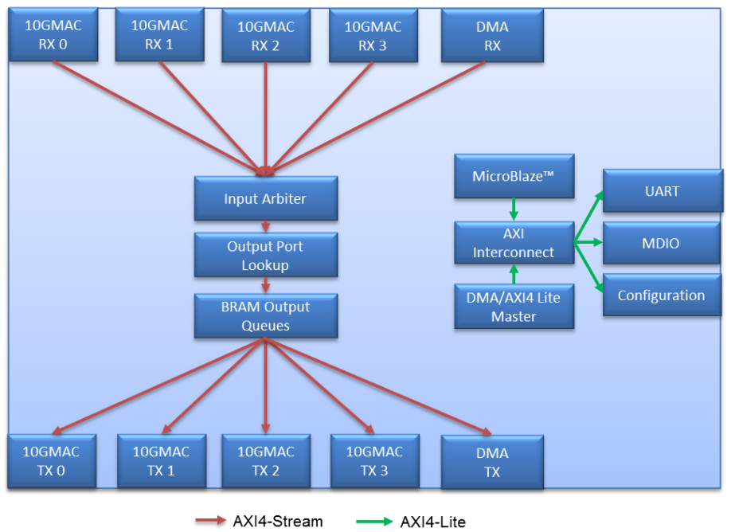
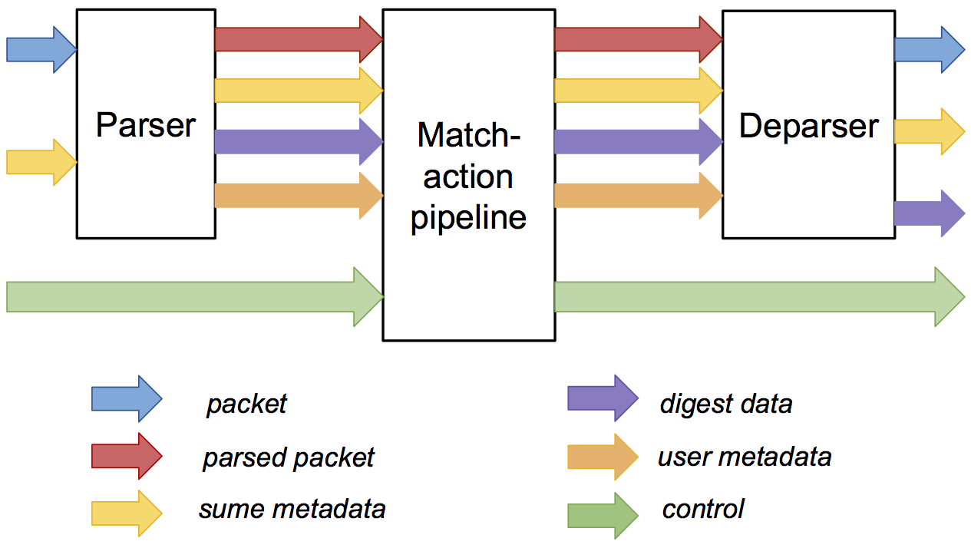
P4->NetFPGA Compilation Overview
P4 Program
NetFPGA Reference Switch
Xilinx P4₁₆ Compiler
Xilinx SDNet Tools
SSS
SimpleSumeSwitch Architecture

Slide 8
SimpleSumeSwitch Architecture Model for SUME Target
tdata
tdata
tuser
tuser
AXI
Lite
AXI
Lite
P4 used to describe parser, match-action pipeline, and deparser
Notes:
Here is the particular P4 architecture model that we are currently using for the SUME target, which we are calling the SimpleSumeSwitch architecture because it is pretty much the most basic thing that we could do.
As you can see, it consists of …
The P4 programmer is responsible for filling in the implementation of the parser, match-action pipeline, and deparser with their P4 program
Name buses – axi_stream, axi_lite

Slide 9
Metadata in SimpleSumeSwitch Architecture
/* standard sume switch metadata */
struct sume_metadata_t {
bit<16> dma_q_size;
bit<16> nf3_q_size;
bit<16> nf2_q_size;
bit<16> nf1_q_size;
bit<16> nf0_q_size;
bit<8> send_dig_to_cpu; // send digest_data to CPU
bit<8> drop;
bit<8> dst_port; // one-hot encoded
bit<8> src_port; // one-hot encoded
bit<16> pkt_len; // unsigned int
}
*_q_size – size of each output queue, measured in terms of 32-byte words, when packet starts being processed by the P4 program
src_port/dst_port – one-hot encoded, easy to do multicast
user_metadata/digest_data – structs defined by the user
Notes:
Here is the current definition of the standard SUME metadata bus
This bus consists of the fields that are set or used by other parts of the switch architecture outside of the parser, match-action pipeline, and deparser
It consists of things like …
We’ve currently chosen the digest metadata to be convenient for a learning switch application, but ideally the P4 programmer should decide what fields they want here for their application
In the future, we plan to add more standard SUME metadata fields that will provide the P4 programmer more information about the current state of the switch. For example, queue sizes, link utilizations, ingress time stamp.

Slide 10
P4->NetFPGA Compilation Overview
User P4 code is compiled with respect to SimpleSumeSwitch Architecture Model:
Code for Parser, Match-Action Pipeline, and Deparser
Compiler outputs Verilog module for whole P4-described system
Standard AXI-S packet input/output interfaces
Standard AXI Lite control interface
Supports P4 extern feature for user defined logic
Notes:
Within the P4-NetFPGA workflow, the user’s P4 code that implements the parser, match-action pipeline, and deparser is compiled with respect to the SimpleSumeSwitch Architecture Model
The compiler outputs a Verilog module for the whole P4-described system
This module has standard AXI-S packet input/output interfaces, which is directly compatible with the rest of the SUME design.
The only interface that is not directly compatible is the metadata interface, which uses big-endian while the SUME uses little-endian
The SDNet output is engineered for 100G rates so is able to easily handle the aggregate 40G rate in the SUME
The workflow also supports the P4 extern feature allowing users to use their own custom logic in their P4 programs

Slide 11
P4 Language Components
Parser Program
State-machine;
Field extraction
Match + Action Tables
Table lookup and update;
Field manipulation;
Control Flow
Control Flow
Deparser Program
Field assembly

Slide 12
Overall P4 Program Structure
#include <core.p4>
#include <sume_switch.p4>
/******** CONSTANTS ********/
#define IPV4_TYPE 0x0800
/******** TYPES ********/
typedef bit<48> EthAddr_t;
header Ethernet_h {...}
struct Parsed_packet {...}
struct user_metadata_t {...}
struct digest_data_t {...}
/******** EXTERN FUNCTIONS ********/
extern void const_reg_rw(...);
/******** PARSERS and CONTROLS ********/
parser TopParser(...) {...}
control TopPipe(...) {...}
control TopDeparser(...) {...}
/******** FULL PACKAGE ********/
SimpleSumeSwitch(TopParser(), TopPipe(), TopDeparser()) main;

Slide 13
Learning by example – L2 Learning Switch
Parses Ethernet frames
Forwards based on Ethernet destination address
Frame broadcasted (with ingress port filtering) if address not in forwarding database
Learns based on Ethernet source address
If source address is unknown, the address and the source port are sent to the control-plane (which will add an entry to the forwarding database)

Slide 14
Learning Switch – Header/Metadata definitions
typedef bit<48> EthernetAddress;
// standard Ethernet header
header Ethernet_h {
EthernetAddress dstAddr;
EthernetAddress srcAddr;
bit<16> etherType;
}
// List of all recognized headers
struct Parsed_packet {
Ethernet_h ethernet;
}
// data to send to cpu if desired
// MUST be 80 bits
struct digest_data_t {
port_t src_port;
EthernetAddress eth_src_addr;
bit<24> unused;
}
typedef – alternative name for a type
header – ordered collection of members
Can be valid or invalid
Byte-aligned
struct – collection of members
May contain any derived types
Header stacks - array of headers
Parsed_packet
The headers that can be parsed, manipulated, or created by the switch
digest_data_t
Data that may be sent to the control-plane if desired.

Slide 15
Learning Switch – Parser
@Xilinx_MaxPacketRegion(16384)
parser TopParser(packet_in b,
out Parsed_packet p,
out user_metadata_t user_metadata,
out digest_data_t digest_data,
inout sume_metadata_t sume_metadata) {
state start {
b.extract(p.ethernet);
digest_data.src_port = 0;
digest_data.eth_src_addr = 0;
digest_data.unused = 0;
transition accept;
}
}
State machine
3 predefined states:
start
accept
reject
User defined states
Extracts headers from incoming packets
Produces parsed representation of packet for use in match-action pipeline
@Xilinx_MaxPacketRegion – for parser/deparser; declares the largest packet size (in bits) to support

Slide 16
Ethernet + IPv4 – Parser
parser TopParser(packet_in b,
out Parsed_packet p,
out user_metadata_t user_metadata,
out digest_data_t digest_data,
inout sume_metadata_t sume_metadata) {
state start {
b.extract(p.ethernet);
digest_data.src_port = 0;
digest_data.eth_src_addr = 0;
digest_data.unused = 0;
transition select(p.ethernet.etherType) {
IPV4_TYPE : parse_ipv4;
default : accept;
}
}
state parse_ipv4 {
b.extract(p.ip);
transition accept;
}
}
State machine
3 predefined states:
start
accept
reject
User defined states
Extracts headers from incoming packets
Produces parsed representation of packet for use in match-action pipeline
@Xilinx_MaxPacketRegion – for parser/deparser; declares the largest packet size (in bits) to support

Slide 17
Control Blocks
control TopPipe(inout Parsed_packet p,
inout user_metadata_t user_metadata,
inout digest_data_t digest_data,
inout sume_metadata_t sume_metadata) {
// Define tables
// Define actions
// Define global metadata
apply {
// Apply tables
// Call actions
// Define local metadata
}
}
Similar to C functions without loops
Algorithms should be representable as Directed Acyclic Graphs (DAG)
Standard arithmetic and logical operations:
+, -, *
~, &, |, ^, >>, <<
==, !=, >, >=, <, <=
No division/modulo
Additional operations:
Bit-slicing: [m:l]
Bit Concatenation: ++

Slide 18
Match-Action Tables
Which fields (header and/or metadata) to match on
Match type: exact, ternary, LPM
List of valid actions that can be applied
Resources to allocate to table
Single entry includes:
Specific key to match on
A single action
To be executed when a packet matches the entry
(Optional) action data
apply() method returns:
hit (boolean) – hit in table
action_run (enum) – the action invoked by the table

Slide 19
Actions
Modify header/metadata
Used in tables or invoked directly
May contain if/else statements
Action Parameters
Directional – from data-plane
Directionless – from control-plane
Header validity bit manipulation
header.setValid()
header.setInvalid()
header.isValid()

Slide 20
Learning Switch – Control Flow
apply {
// try to forward based on
// destination Ethernet address
if (!forward.apply().hit) {
// miss in forwarding table
broadcast.apply();
}
// check if src Ethernet address
// is in the forwarding database
if (!smac.apply().hit) {
// unknown source MAC address
send_to_control();
}
}
Try to forward based on dst MAC
Broadcast packet if dst MAC is not known
Check if src MAC is known
Send src port and src MAC to control-plane if src MAC is unknown

Slide 21
Learning Switch – Control Flow
apply {
// try to forward based on
// destination Ethernet address
if (!forward.apply().hit) {
// miss in forwarding table
broadcast.apply();
}
// check if src Ethernet address
// is in the forwarding database
if (!smac.apply().hit) {
// unknown source MAC address
send_to_control();
}
}
action set_output_port(port_t port) {
sume_metadata.dst_port = port;
}
table forward {
key = {
p.ethernet.dstAddr: exact;
}
actions = {
set_output_port;
NoAction;
}
size = 64;
default_action = NoAction;
}

Slide 22
Learning Switch – Control Flow
apply {
// try to forward based on
// destination Ethernet address
if (!forward.apply().hit) {
// miss in forwarding table
broadcast.apply();
}
// check if src Ethernet address
// is in the forwarding database
if (!smac.apply().hit) {
// unknown source MAC address
send_to_control();
}
}
action set_broadcast(port_t port) {
sume_metadata.dst_port = port;
}
table broadcast {
key = {
sume_metadata.src_port: exact;
}
actions = {
set_broadcast;
NoAction;
}
size = 64;
default_action = NoAction;
}

Slide 23
Learning Switch – Control Flow
apply {
// try to forward based on
// destination Ethernet address
if (!forward.apply().hit) {
// miss in forwarding table
broadcast.apply();
}
// check if src Ethernet address
// is in the forwarding database
if (!smac.apply().hit) {
// unknown source MAC address
send_to_control();
}
}
table smac {
key = {
p.ethernet.srcAddr: exact;
}
actions = {
NoAction;
}
size = 64;
default_action = NoAction;
}

Slide 24
Learning Switch – Control Flow
apply {
// try to forward based on
// destination Ethernet address
if (!forward.apply().hit) {
// miss in forwarding table
broadcast.apply();
}
// check if src Ethernet address
// is in the forwarding database
if (!smac.apply().hit) {
// unknown source MAC address
send_to_control();
}
}
action send_to_control() {
digest_data.src_port = sume_metadata.src_port;
digest_data.eth_src_addr = headers.ethernet.srcAddr;
sume_metadata.send_dig_to_cpu = 1;
}

Slide 25
Learning Switch – Deparser
// Deparser Implementation
@Xilinx_MaxPacketRegion(16384)
control TopDeparser(packet_out b,
in Parsed_packet p,
in user_metadata_t user_metadata,
inout digest_data_t digest_data,
inout sume_metadata_t sume_metadata) {
apply {
b.emit(p.ethernet);
}
}
Reconstruct the packet
emit(header) – serialize the header if it is valid
@Xilinx_MaxPacketRegion – for parser/deparser; declares the largest packet size (in bits) to support

Slide 26
Learning Switch – Control-Plane
DMA_IFACE = 'nf0'
def main():
sniff(iface=DMA_IFACE, prn=learn_digest, count=0)
def learn_digest(pkt):
dig_pkt = Digest_data(str(pkt))
add_to_tables(dig_pkt)
def add_to_tables(dig_pkt):
src_port = dig_pkt.src_port
eth_src_addr = dig_pkt.eth_src_addr
(found, val) = table_cam_read_entry('forward', ...
[eth_src_addr])
if (found == 'False'):
table_cam_add_entry('forward', ...
[eth_src_addr], ...
'set_output_port', ...
[src_port])
table_cam_add_entry('smac', ...
[eth_src_addr], ...
'NoAction_3', [])
Monitor DMA interface
Convert DMA data to appropriate format
Check if entry already exists in the forwarding table
Add entry to forwarding table
Add entry to smac table

Slide 27
API
Auto generated Python API
Exact match table API functions:
table_cam_add_entry()
table_cam_delete_entry()
table_cam_get_size()
table_cam_read_entry()
Ternary match table API functions:
table_tcam_add_entry()
table_tcam_clean()
table_tcam_erase_entry()
table_tcam_verify_entry()
LPM table API functions:
table_lpm_load_dataset()
table_lpm_set_active_lookup_bank()
table_lpm_verify_dataset()
Register API functions:
reg_read()
reg_write()
C API also available

Slide 28
Externs
Implement platform specific functions
Can’t be expressed in the core P4 language
Stateless – reinitialized for each packet
Stateful – keep state between packets
Xilinx Annotations
@Xilinx_MaxLatency() – maximum number of clock cycles an extern function needs to complete
@Xilinx_ControlWidth() – size in bits of the address space to allocate to an extern function

Slide 29
P4->NetFPGA Extern Function Library
Verilog modules invoked from within P4 programs
Stateful Atoms
Stateless Externs
Atom | Description
R/W | Read or write state
RAW | Read, add to, or overwrite state
PRAW | Predicated version of RAW
ifElseRAW | Two RAWs, one each for when predicate is true or false
Sub | IfElseRAW with stateful subtraction capability
Atom | Description
IP Checksum | Given an IP header, compute IP checksum
LRC | Longitudinal redundancy check, simple hash function
timestamp | Generate timestamp (granularity of 5 ns)

Slide 30
Using Atom Externs in P4 – Resetting Counter
Packet processing pseudo code:
count[NUM_ENTRIES];
if (pkt.hdr.reset == 1):
count[pkt.hdr.index] = 0
else:
count[pkt.hdr.index]++

Slide 31
Using Atom Externs in P4 – Resetting Counter
#define REG_READ 0
#define REG_WRITE 1
#define REG_ADD 2
// count register
@Xilinx_MaxLatency(1)
@Xilinx_ControlWidth(3)
extern void count(in bit<3> index,
in bit<32> newVal,
in bit<32> incVal,
in bit<8> opCode,
out bit<32> result);
bit<16> index = pkt.hdr.index;
bit<32> newVal;
bit<32> incVal;
bit<8> opCode;
if(pkt.hdr.reset == 1) {
newVal = 0;
incVal = 0; // not used
opCode = REG_WRITE;
} else {
newVal = 0; // not used
incVal = 1;
opCode = REG_ADD;
}
bit<32> result; // the new value stored in count
count_reg_raw(index, newVal, incVal, opCode, result);
State can be accessed exactly 1 time
Using RAW atom here
Instantiate atom
Set metadata for state access
Single state access!

Slide 32
P4->NetFPGA Workflow Overview

Slide 33
P4-NetFPGA Workflow
All of your effort will go here
Write P4 program
Write python gen_testdata.py script
Compile to verilog / generate API & CLI tools
$ make
Run initial SDNet simulation
$ ./vivado_sim.bash
Install SDNet output as SUME library core
$ make install_sdnet
Run NetFPGA simulation
$ ./nf_test sim –major switch –minor default
Build bitstream
$ make
Check Timing
Test the hardware
Notes:
Tools to help write testdata
sss_sdnet_tuples
scapy
Tools to help debug failing simulations
Parsing simulation output into header / metadata fields

Slide 34
Directory Structure of $SUME_FOLDER
P4-NetFPGA-live/
|
|- contrib-projects/
| |- sume-sdnet-switch/ → the main directory for P4 dev
|
|- lib/ → contains all of the SUME IP cores
|
|- tools/ → various NetFPGA scripts for test infra.
|
|- Makefile → builds all of the SUME IP cores

Slide 35
Directory Structure of $SUME_SDNET
sume-sdnet-switch/
|
|- bin/ → scripts used to automate workflow
|
|- templates/ → templates for externs, wrapper module,
| CLI tools, new projects
|
|- projects/ → all of the P4 project directories
| |- switch_calc/

Slide 36
Directory Structure of $P4_PROJECT_DIR
$P4_PROJECT_DIR/
|
|- src/ → P4 source files and commands.txt
|
|- testdata/ → scripts to generate testdata used for
| verifying functionality of P4 program
|
|- simple_sume_switch/ → main SUME project directory,
| top level HDL files and SUME sim scripts
|
|- sw/ → populated with API files and CLI tools and any
| user software for the project
|
|- nf_sume_sdnet_ip/ → SDNet output directory

Slide 37
API & Interactive CLI Tool Generation
Both Python API and C API
Manipulate tables and stateful elements in P4 switch
Used by control-plane program
CLI tool
Useful debugging feature
Query various compile-time information
Interact directly with tables and stateful elements in real time

Slide 38
Tutorial Assignments

Slide 39
Tutorial Assignments
Assignments described at this link:
https://github.com/NetFPGA/P4-NetFPGA-public/wiki/Tutorial-Assignments
Short version:
https://tinyurl.com/P4-NetFPGA-Camp

Slide 40
Assignment 1: Switch as a Calculator

Slide 41
Switch as Calculator
Supported Operations:
ADD – add two operands
SUBTRACT – subtract two operands
ADD_REG – add operand to current value in register
SET_REG – overwrite the current value of the register
LOOKUP – Lookup the given key in the table
header Calc_h {
bit<32> op1;
bit<8> opCode;
bit<32> op2;
bit<32> result;
}

Slide 42
Switch as Calculator
User PC
NetFPGA SUME
Ethernet
DST: MAC1
SRC: MAC2
Type: CALC_TYPE
Calc
op1: 1
opCode: ADD
op2: 2
result: 0
Payload…

Slide 43
Switch as Calculator
User PC
NetFPGA SUME
Ethernet
DST: MAC1
SRC: MAC2
Type: CALC_TYPE
Calc
op1: 1
opCode: ADD
op2: 2
result: 0 3
X
Payload…

Slide 44
Switch as Calculator
User PC
NetFPGA SUME
Ethernet
DST: MAC2
SRC: MAC1
Type: CALC_TYPE
Calc
op1: 1
opCode: ADD
op2: 2
result: 3
Payload…

Slide 45
Switch Calc Operations
ADD
SUB
ADD_REG
op1 op2
op1 op2
op2 const[op1]
+
-
+
result
result: op1-op2
result
SET_REG
LOOKUP
op2
key | val
0 | 1
1 | 16
2 | 16²
3 | 16³
key:
op1
result:
val
const[op1]

Slide 46
Assignment 2: TCP Monitor

Slide 47
TCP Monitor
Practice writing stateful P4 programs for NetFPGA SUME
Compute TCP flow size distribution in the data-plane
Flow is determined by 5-tuple and delimited by SYN/FIN
Fine grained flow monitoring capabilities with P4
Flow Size Distribution
# Flows
Flow Size (bytes)

Slide 48
byte_cnt
distribution
0
0-16K
0
0
16-32K
0
32-48K
Ethernet
48-64K
0
IP_src
IP_dst
Proto: TCP
0
64-80K
0
80-96K
0
96-112K
sport
dport
flags: SYN
hash
0
>112K

Slide 49
byte_cnt
distribution
0
1K
0-16K
0
0
16-32K
0
32-48K
Ethernet
0
48-64K
IP_src
IP_dst
Proto: TCP
0
64-80K
0
80-96K
0
96-112K
sport
dport
flags: ACK
0
>112K
hash
len(payload) = 1K

Slide 50
byte_cnt
distribution
1K
2K
0-16K
0
1
0
16-32K
0
32-48K
Ethernet
0
48-64K
IP_src
IP_dst
Proto: TCP
0
64-80K
0
80-96K
0
96-112K
sport
dport
flags: FIN
0
>112K
hash
len(payload) = 1K

Slide 51
Assignment 3: In-band Network Telemetry (INT)

Slide 52
In-band Network Telemetry (INT)
One of the most popular applications for programmable data-planes
All about gaining more visibility into network
Basic idea:
Source requests each switch along path to insert some desired metadata into packet (using a bitmask)
Example metadata:
Switch ID
Ingress Port
Egress Port
Timestamp
Queue Occupancy

Slide 53
In-band Network Telemetry (INT)
Bitmask format (5 bits):
<SWITCH_ID><INGRESS_PORT><Q_SIZE><TSTAMP><EGRESS_PORT>
Payload
INT
bm: 11001
Ethernet
Egress port
timestamp
Queue size
Ingress port
SwitchID

Slide 54
In-band Network Telemetry (INT)
Bitmask format (5 bits):
<SWITCH_ID><INGRESS_PORT><Q_SIZE><TSTAMP><EGRESS_PORT>
Payload
Egress port
bos: 1
Ingress port
bos: 0
SwitchID
bos: 0
INT
bm: 11001
Ethernet
Egress port
timestamp
Queue size
Ingress port
SwitchID

Slide 55
Additional Details
Notes:
Now I’ll briefly describe the process of compiling P4 programs using the Xilinx P4-SDNet toolchain
But before I do, I want to clarify that P4-SDNet is an official Xilinx product, so I haven’t had much to do with it’s development other than helping to debug a few features here and there
I was just fortunate enough to get the opportunity to put it to use for NetFPGA

Slide 56
Implementing Extern Functions
Implement verilog extern module in $SUME_SDNET/templates/externs/
Add entry to $SUME_SDNET/bin/extern_data.py
No Need to modify any existing code
If the extern has a control interface a cpu_regs module will be generated automatically to easily expose control_registers using the AXI Lite interface

Slide 57
Debugging SDNet Simulation
HDLSimulation
Xsim or Questa sim
Error:
expected < tuple_out_sume_metadata > = < 00000000000000000000000100040041 >
actual < tuple_out_sume_metadata > = < 00000000000000000000000100040040 >
$ $P4_PROJECT_DIR/testdata/sss_sdnet_tuples.py --parse 00000000000000000000000100040041 sume
Parsed Tuple:
-----------------------
dma_q_size = 0
nf3_q_size = 0
nf2_q_size = 0
nf1_q_size = 0
nf0_q_size = 0
send_dig_to_cpu = 0
drop = 1
dst_port = 00000000
src_port = 00000100
pkt_len = 65

Slide 58
Debugging SDNet Simulation
C++ model
Prints debug info
Hit or miss in tables
Header/Metadata field modification along the way
Generates Packet_expect.pcap to compare to dst.pcap
-skipEval option
Compare C++ model output to HDL simulation – make sure SDNet compiler is working properly
Future Improvements:
SDNet C++ model implementation of extern functions

Slide 59
Debugging SUME Simulation
What to do if SDNet simulation passes but SUME simulation fails?
Make sure you’ve:
$ cd $P4_PROJECT_DIR && make config_writes
$ cd $NF_DESIGN_DIR/test/sim_major_minor && make
$ cd $P4_PROJECT_DIR && make install_sdnet
Run SUME simulation longer?
Make sure SDNet module has finished reset before applying configuration writes
Check nf_*_expected.axi and nf_*_logged.axi
Add signals to simulation waveform
Perhaps issue with wrapper module?

Slide 60
SDNet Module HDL Wrapper
Located in: $SUME_SDNET/templates/sss_wrapper/
Tasks:
Generate tuple_in_VALID signal for s_axis_tuser
Reverse reset polarity
Reverses endianness of digest_data and inserts into last 80 bits of m_axis_tuser

