Slide 1
HINDI LEARNING CLASSES

Slide 2
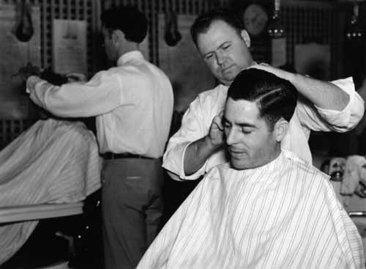
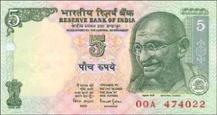
TWO STORIES
NAAI
PAANGH(PADHA-NANGHU)

Slide 3
WORDS COMMON TO BOTH HINDI AND TAMIL LANGUAGE
Anubhava
Pra-yo-janam
Poosai
Homam
Kattam
Nattam
Isttam
Rubai

Slide 4
TAMIL, ENGLISH AND HINDI
My mom is coming home.
Enoda amma vitu ku varange.
Meri ma ghar aa rahi hain.
My dad is coming home.
Enoda appa vitu ku varange.
Mere papa ghar aa rahe hain.
Give milk.
Paal kuduinga
Dudh dijiye.
Give money.
Kaas kuduinga.
Paisa dijiye.
I am going to the market.
Na market ku pooren.
Mai market ja raha hu.

Slide 5
PRONOUNS
 | First person | Second person | Third person
Singular | I: mai my: mera/meri Me: mujhe | You:tum Your: tumhara/tera Aapka | This: yah That: vah His: uska/iska Her: uski/iski He/she: vah
Plural | We: hum | You: aap Your: aapke | They: ve These:ye

Slide 6
GENDER
GENDER
MASCULINE
FEMININE
RIVERS
DAYS OF A WEEK
MONTHS
TREES
FOODGRAINS
LANGUAGES
SPICES

Slide 7
VERBS
Come: aa
Go: jaa
Talk:bol
Stop:ruk
See: dekh
Take: lo
Give:do
Open: khol
Hear: sun
Walk: chal
Do : kar
Study: padh
Sleep:so
Drink: pe
Keep: rakh
Buy: kharid

Slide 8
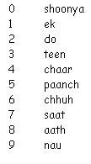
FAMILY:1
mother: ma
Father: pita
Son: beta
Daughter: beti
INSIDE A BUILDING:1
Door: darvaja
Window: khidhki
Room: kamra
GREETINGS
Thank you: dhanyavad
Hello: namaste
Good morning : suprabhat
Good evening: shubhsandhya
Good night: subhratri
NUMBERS
FOOD:
Rice: chaval
Chappati: roti
Pulses: dal
Milk:dudh
DIRECTION
Uttar – north
Dakshin – south
Paschim – west
Poorav – east

Slide 9
BIRDS 1:
Crow: kauva
Hen: murgi
FRUITS 1:
Banana: kela
Mango: aam
MEASUREMENTS:
Big: bada
Small: chota
DAYS:
Today: aaj
Tomorrow: kal
Yesterday: kal
Day after tomorrow: parso

Slide 10
Basic sentences
1. Come here
yahaan aao
2. Go there
vahaan jaao
3. Come to play
Khelne aao
4. Don’t laugh
Hanso mat
5. Don’t cry
Roo mat
Don’t ……….
…….. mat
6. Keep it there
Use udhar rakho
7. Stand up
Khade ho
8. Sit down
Baith jao
9. Come fast
Jaldi aao
10. Walk fast
Jaldi chalo
11. Walk slowly
Dheere chalo

Slide 11
SENTENCE FORMATION
I am going to the market.
Na market ka poore.
Mai market ja raha hu.
Give me food
Mujhe khana dijiye.
Give me ……..
Mujhe ……….. Dijiye.
I am going to ………….
Mai ………… ja raha hu
I have ………..
Mere paas ………. Hai
I don’t have ……..
He/She is ………
Ye ………. hain
This is a ………..
Yeh ek …………. Hai (this/that – yeh/vah)

Slide 12
PART II
INTRODUCTION

Slide 13
VOCABULARY:
Naam - name
Saal - year
Ka – of
Vishay – subject
Chaatra – student
Kitaben – books
Pasand – like
Aur – and
Unhe – them
Parna – study / read
Ruchi – hobby
Apne – my
Mitron – friends
Pariwaar – family
Saath – with
Samay – time
Bitana – spending (time)
Bhi – also
Achha – good
Lagta – feel
Bhavishya – future
Me – in
Ek – one / a
Safal – successful
Vyakti – person
Banna – want to be
Parichay - introduction

Slide 14
PASSAGE:
Good afternoon.
Namaste.
My name is Aadarsh.
Mera naam Aadarsh hai.
I am 21 years old.
Mei 21 saal ka hoon.
I study engineering in NIT Trichy.
Mei NIT Trichy me engineering padhta hoon.
I like books and my hobby is reading.
Mujhe kitaben pasand hai aur unhe parna meri ruchi hai.
I also enjoy spending time with my friends and family.
Mujhe apne mitron aur pariwaar ke saath samay bitana bhi achha lagta hai.
I aspire to be a successful person in the future. What about you?
Mujhe bhavishya me ek safal vyakti banna hai. Aapka kya parichay hai?

Slide 15
GOOD EVENING
Namaste Shubsandhya
My name is …………….
Mera naam ……………. Hai
My hometown is ……………………..
Mai ……….. Ka rehne vala hu.
I have completed my studies from ………………………. University
Maine apni padhai ………………. University se ki hai
I am an assistant professor in ………… department
Mai ………….. Vibhag me assistant professor hu.
I have a teacing experience of ……… years .
Mere paas ……… saal padhane ka anubhav hai
I live in Nit Quarters.
Mai Nit Quarters me rahta hu

Slide 16
My mother’s name is ………
Meri maa ka naam ……….. Hai
I like watching …………...
Mujhe ……….. dekhna accha lagta hai.
I sleep at ….. Pm
Mai ……… baje sota hu
I read ………… newspaper
Main ………….. Samacchar patra padta hu

