Slide 1
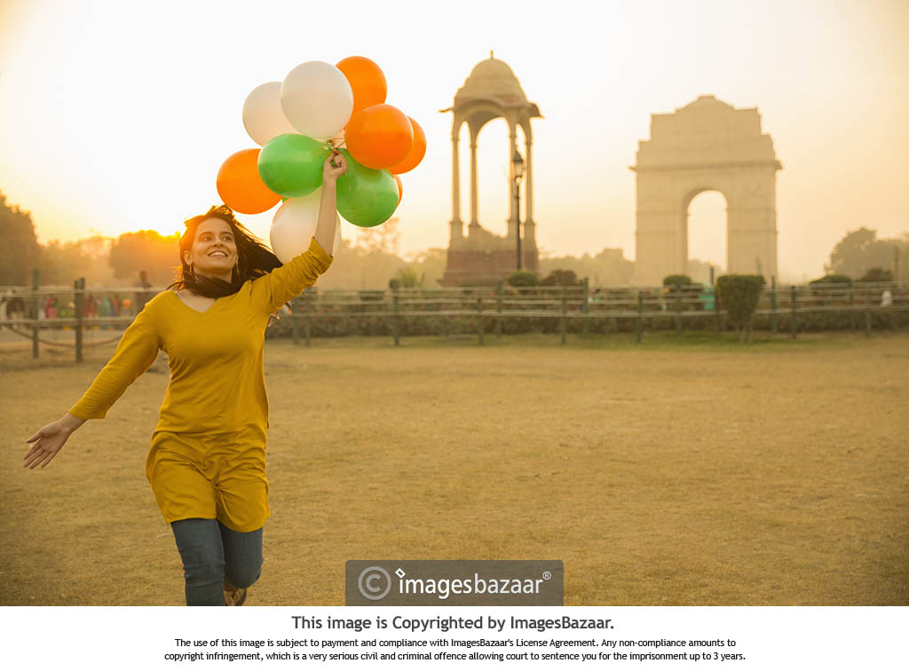
INCREDIBLE INDIA
NSS Web Development Mayank Singh Chauhan
Udit Jain
Nishtha Gupta

Slide 2
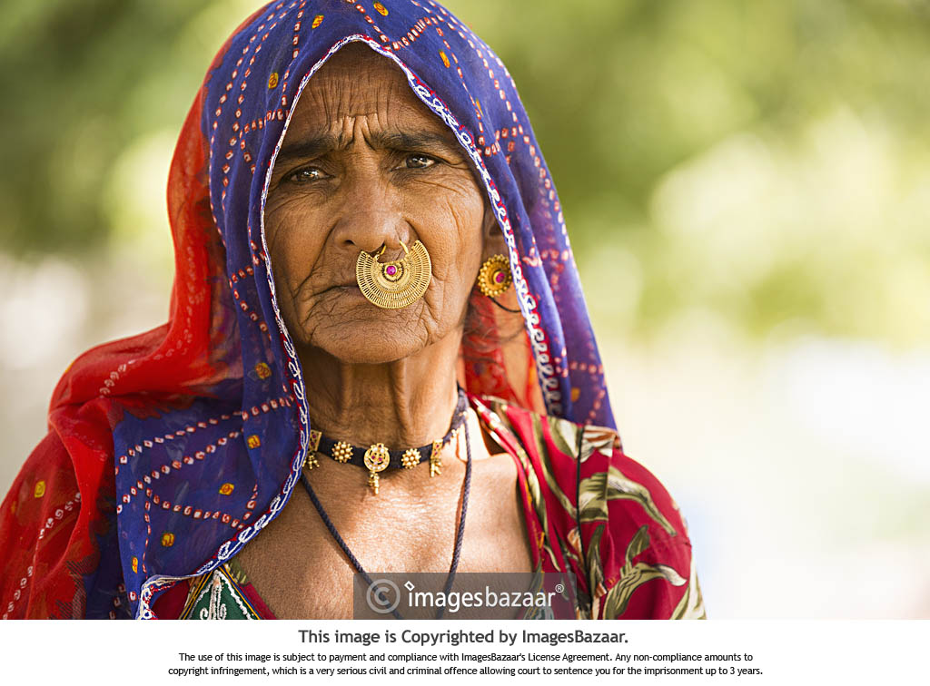
The Social Cause:
‘Incredible India’ is not the social cause but the solution to the social problem- ‘Unemployment in rural areas’.
Due to lack of opportunities, people from the villages are migrating to cities in search of jobs.
This leads to congestion and overcrowding in urban areas.
Hence, it is necessary to generate new employment opportunities for the rural people.

Slide 3
Targeting the tourism sector
India’s tourism sector has huge potential that can be utilised to generate income.
Every nook and corner in the country has a story to be told, a raw culture to be experienced.
Ironically, we don’t realise the value of our rich culture and heritage while people from other nations can be found exploring our tourist spots.

Slide 4
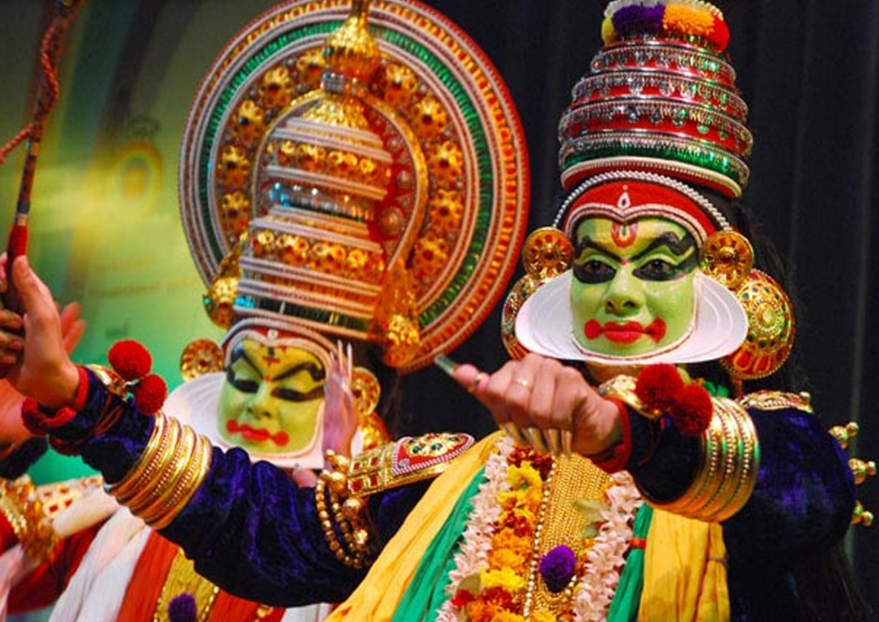
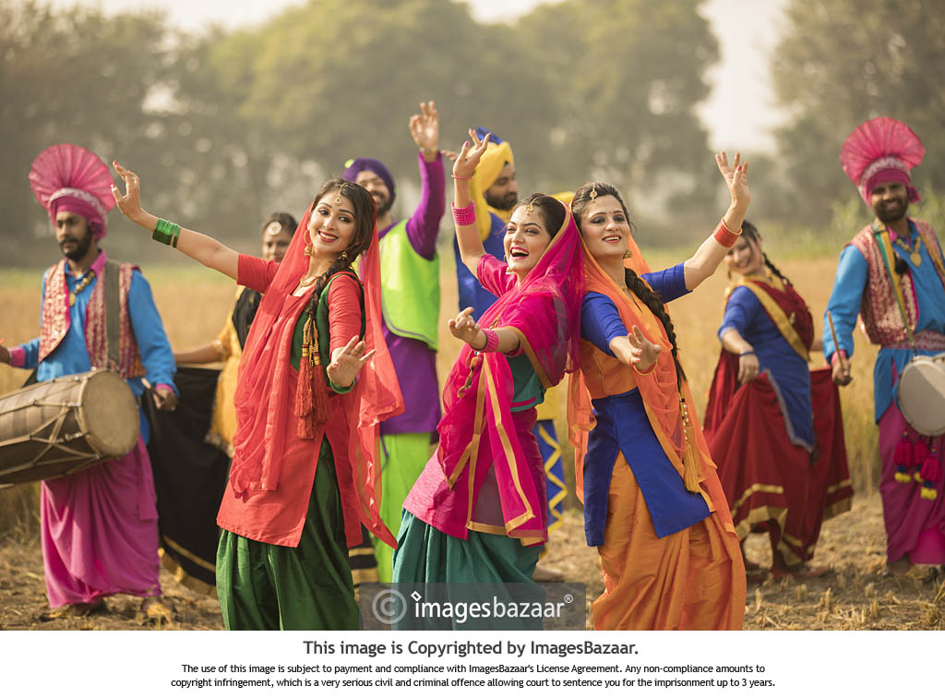
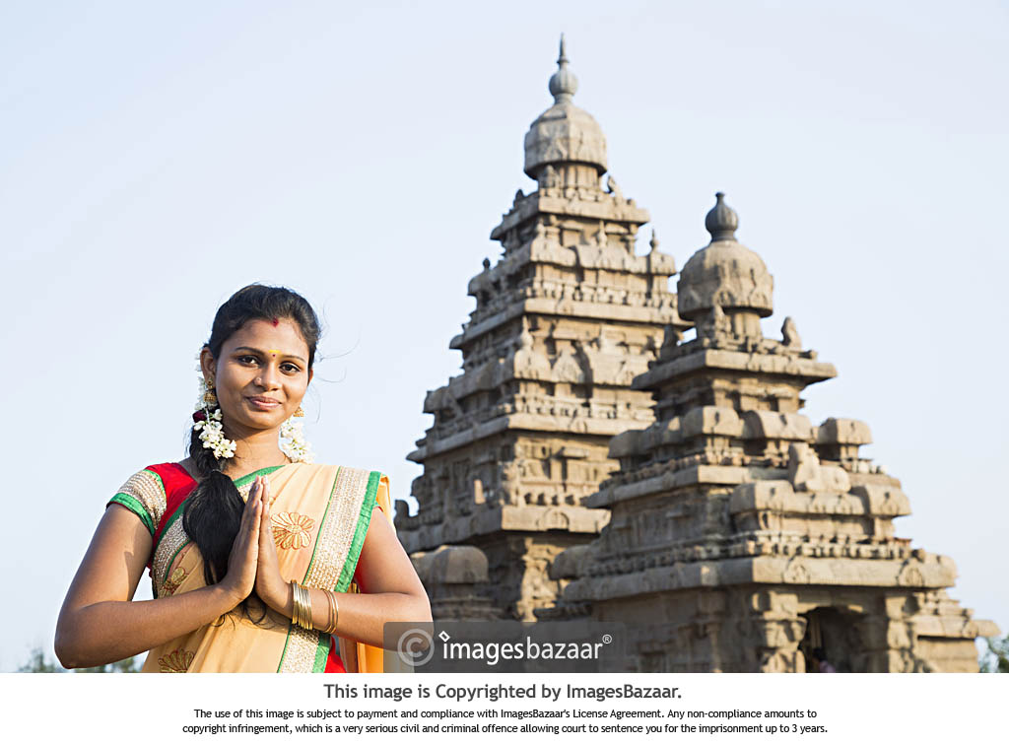
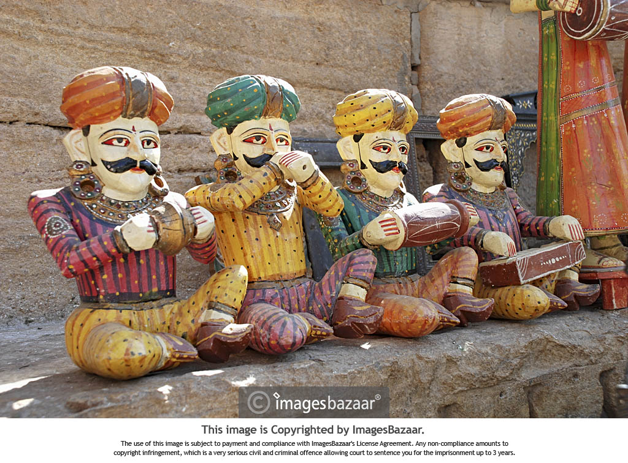
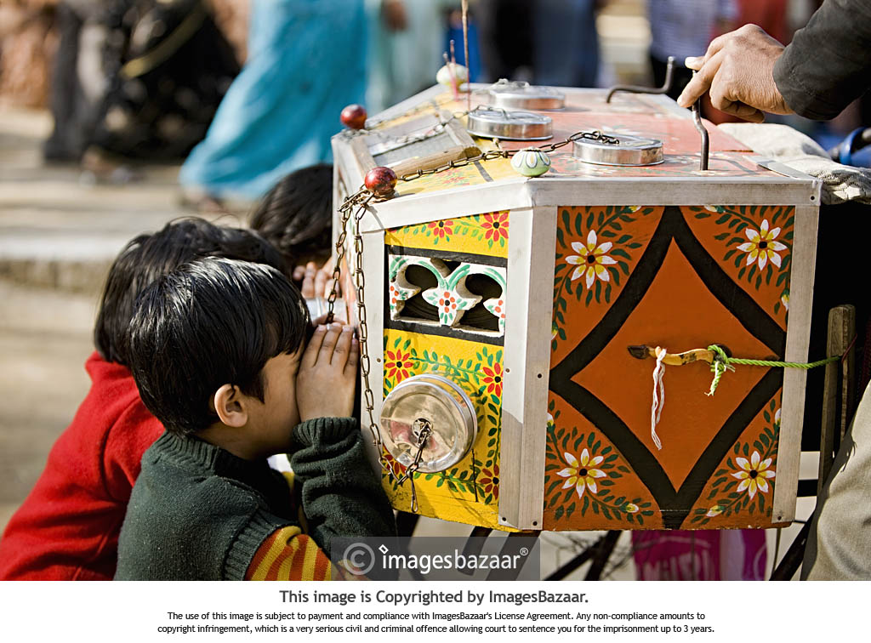
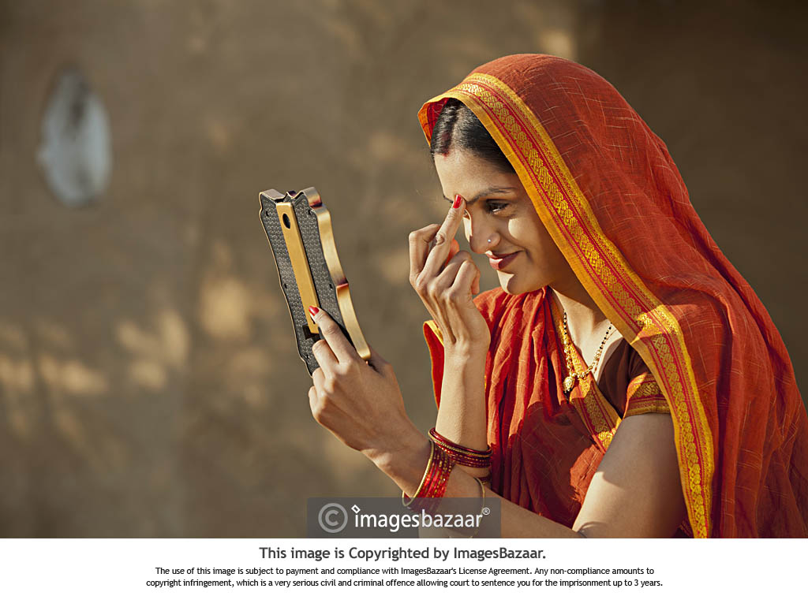
THE VIBRANT COLOURS OF INDIA

Slide 5
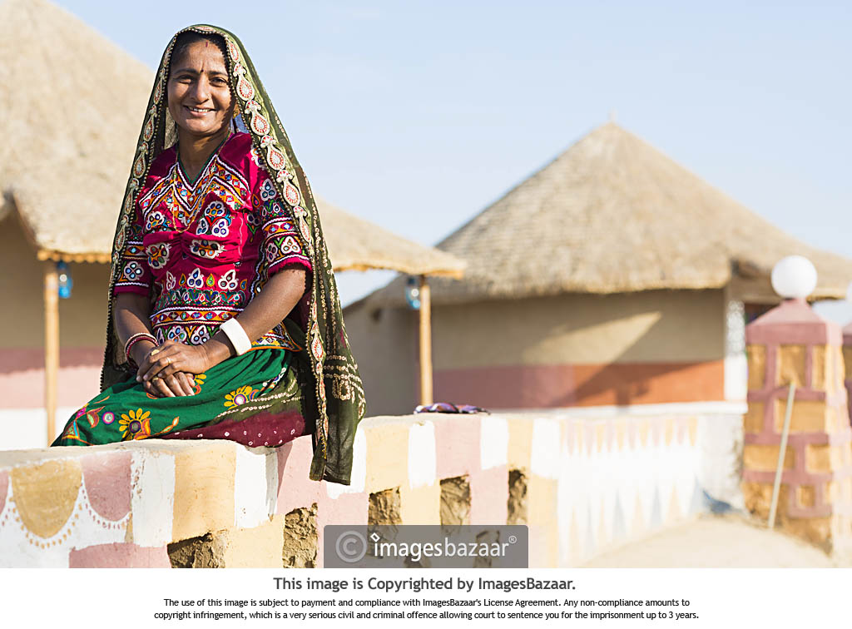
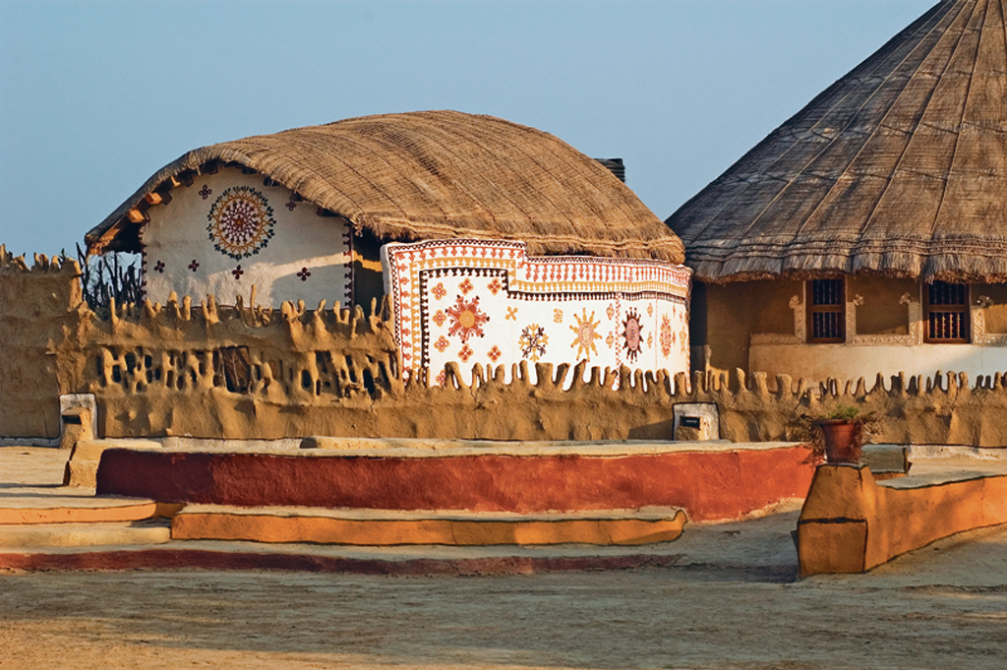
Our Idea
Promoting ‘Rural tourism’ is a great way to generate employment in rural areas.
The basic idea is to link the rural people with the tourists.
The concept of rural home stays is an emerging trend in Rajasthan.
We can provide the contact numbers and details of the people willing to rent their homes for rural home stays, giving tourists chance to experience the true essence of Rajasthan.

Slide 6
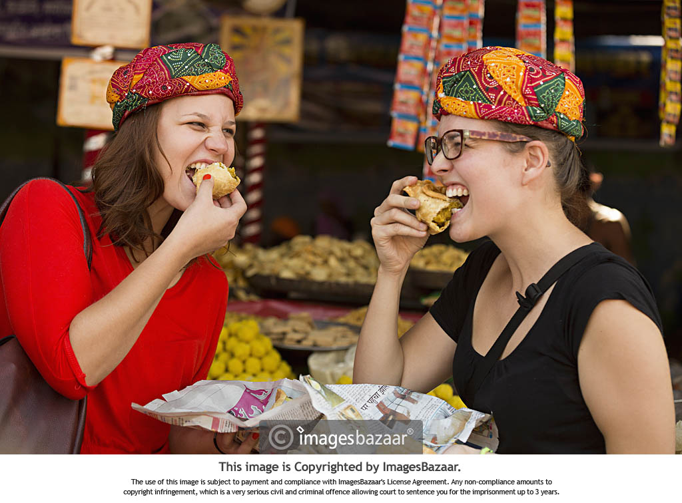
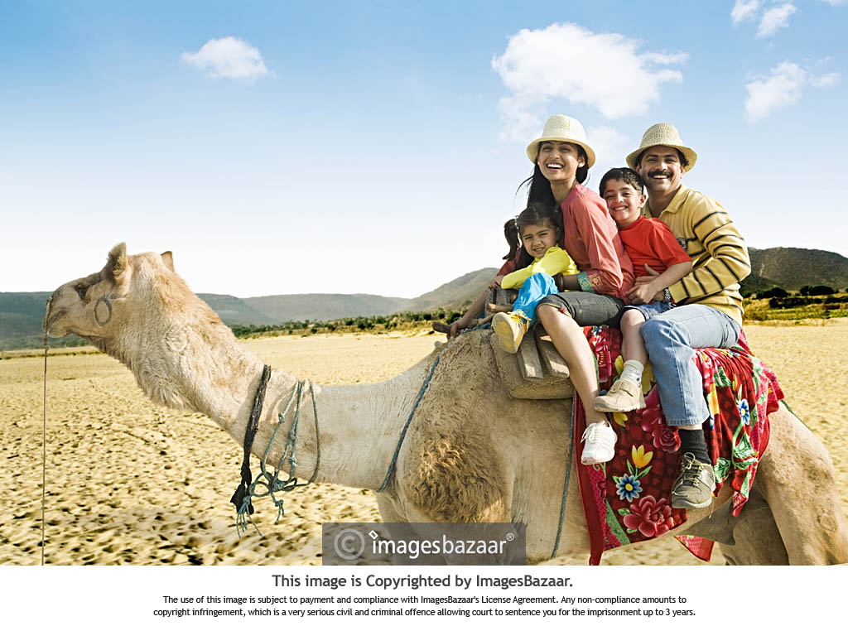
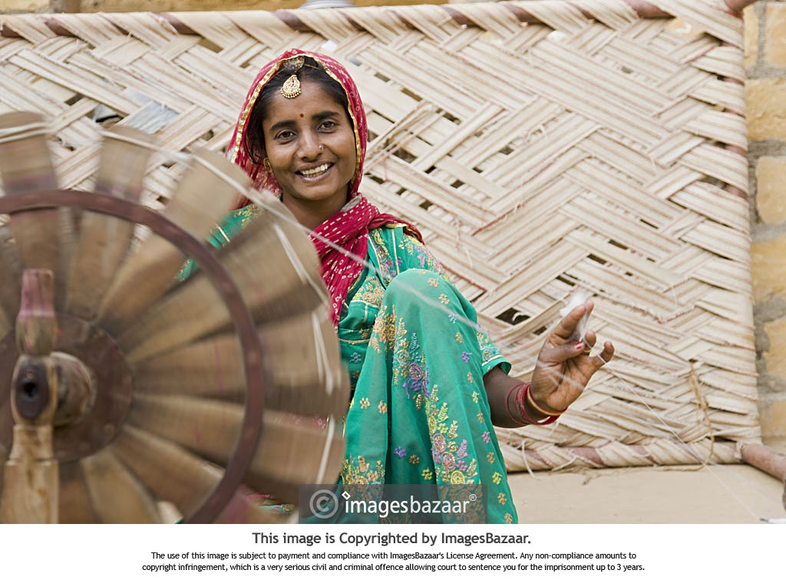
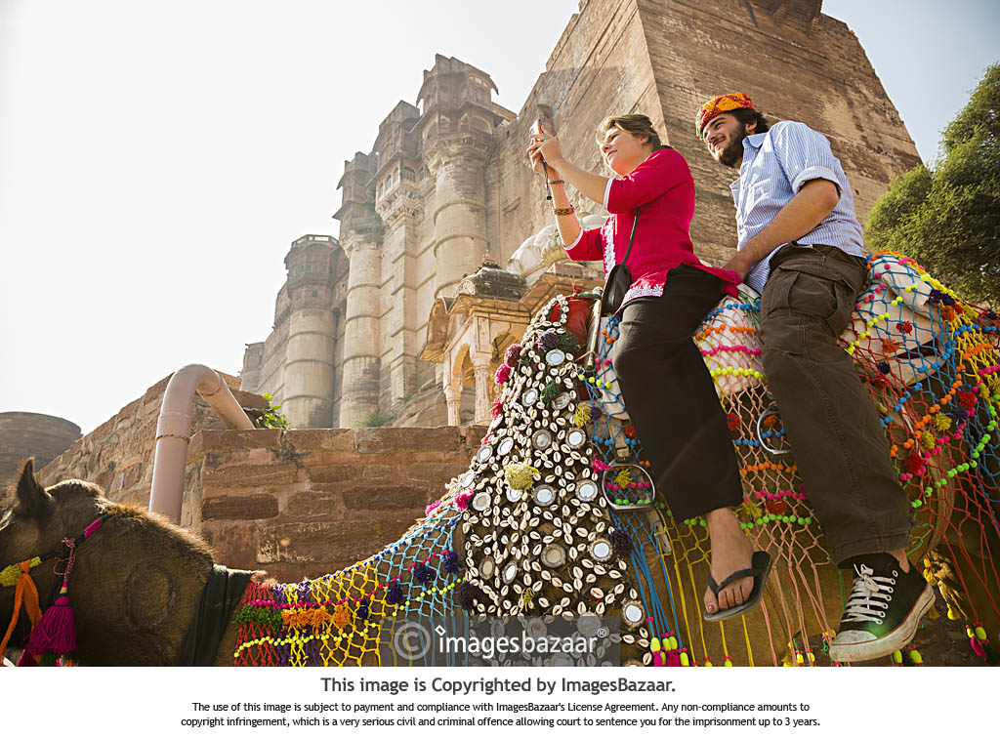

Slide 7

Our Website
We have provided a portal in our website that will allow the interested people to register themselves and their homes for rent, giving their address, contact details, pictures of their homes etc.

Slide 8
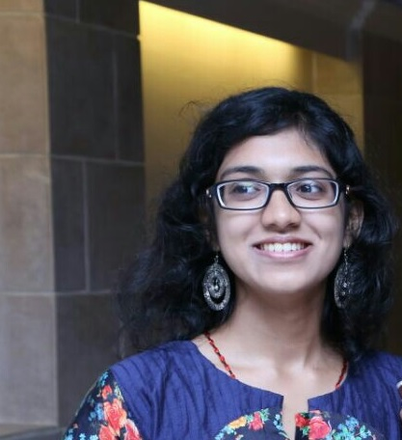
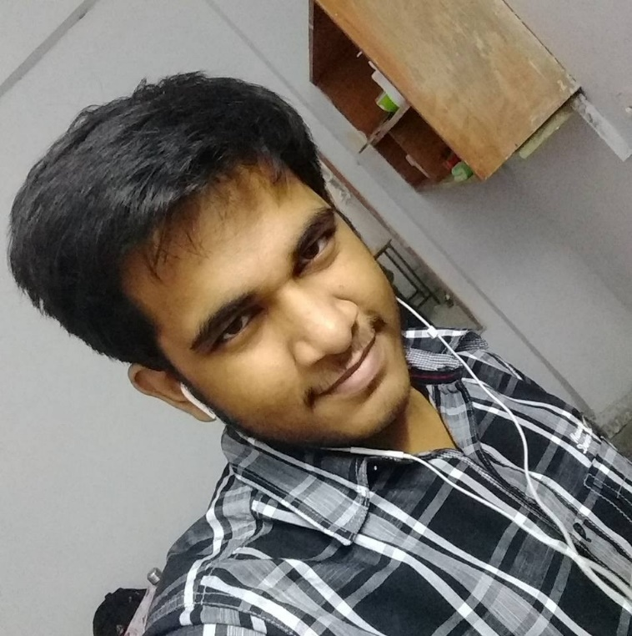

About Us:
Nishtha Gupta
2016CH10088
Mayank Singh Chauhan
2016CS50394
Udit Jain
2016CS10327

