Slide 1
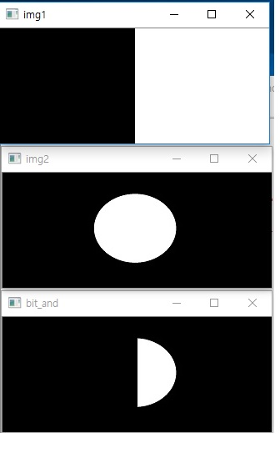
bitwise_and()
import cv2
import numpy as np
img1 = cv2.imread(‘bitand_img1.jpg’)
img2 = cv2.imread(‘bitand_img2.jpg’)
bit_and = cv2.bitwise_and(img1,img2)
#computes bitwise conjunction of the two arrays (dst = src1 & src2)
#Calculates the per-element bit-wise conjunction of two arrays
#or an array and a scalar.
#https://docs.opencv.org/3.4/d2/de8/group__core__array.html#ga60b4d04b251ba5eb1392c34425497e14
cv2.imshow(‘img1’,img1)
cv2.imshow(‘img2’,img2)
cv2.imshow(‘bit_and’,bit_and)
cv2.waitKey(0)
cv2.destroyAllWindows()

Slide 2
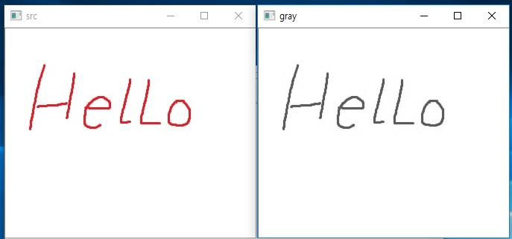
cvtColor()
import cv2
src=cv2.imread('cvtColor.jpg')
gray = cv2.cvtColor(src,cv2.COLOR_BGR2GRAY)
#Converts an image from one color space to another
#https://docs.opencv.org/3.4/d8/d01/group__imgproc__color__conversions.html #ga397ae87e1288a81d2363b61574eb8cab
cv2.imshow('src',src)
cv2.imshow('gray',gray)
cv2.waitKey()
cv2.destroyAllWindows()

Slide 3
absdiff()
수치연산함수
Calculates the per-element absolute difference between two arrays or between an array and a scalar.
https://docs.opencv.org/3.4/d2/de8/group__core__array.html#ga6fef31bc8c4071cbc114a758a2b79c14ray and a scalar.
참고영상
https://pysource.com/2018/05/17/background-subtraction-opencv-3-4-with-python-3-tutorial-32/

Slide 4
read()
프레임 획득 cv2.VideoCapture.read([image])
Grabs, decodes and returns the next video frame.
https://docs.opencv.org/3.4/d8/dfe/classcv_1_1VideoCapture.html#a473055e77dd7faa4d26d686226b292c1
참고영상
https://www.youtube.com/watch?v=1XTqE7LFQjI

Slide 5
참고자료
https://pysource.com/2018/01/29/bitwise-operators-opencv-3-4-with-python-3-tutorial-7/

